Slide 1
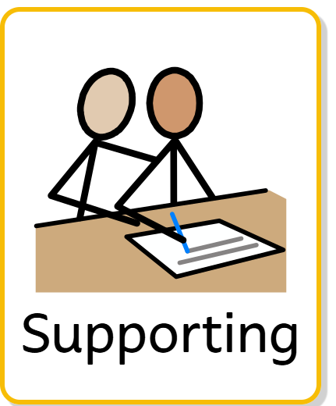
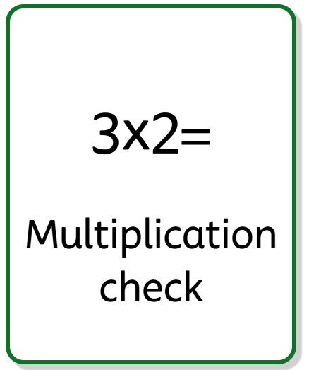
Year 4 Multiplication Tables Check (MTC) Workshop
Supporting your child at home

Slide 2
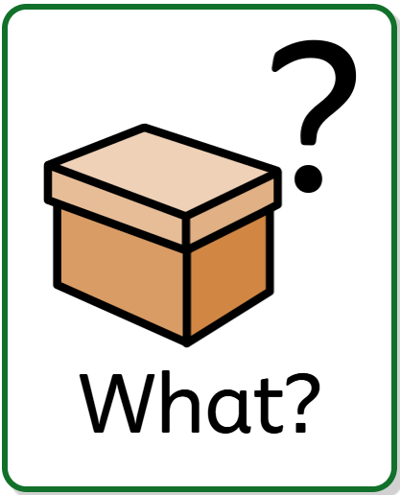
What is the MTC?
A statutory check for all Year 4 pupils
Assesses multiplication fact recall up to 12 x 12
Completed online in school
Designed to support mathematical fluency

Slide 3
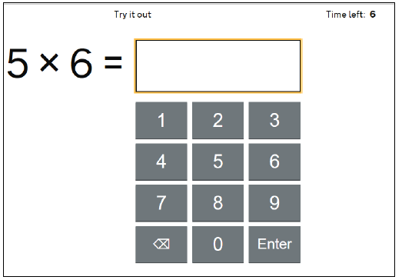
What does the check look like?
25 questions
6 seconds per question
3-second pause between questions
Children answer using a tablet

Slide 4
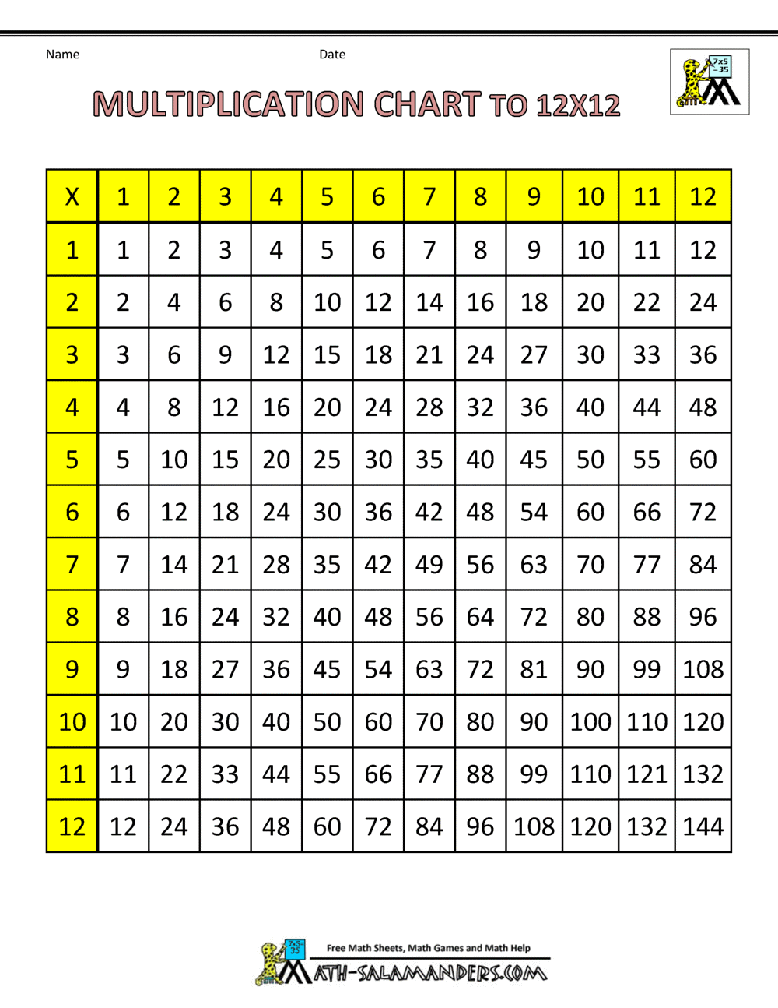
Key Tables to Know
Children should be fluent in all multiplication facts up to 12 × 12.

Slide 5

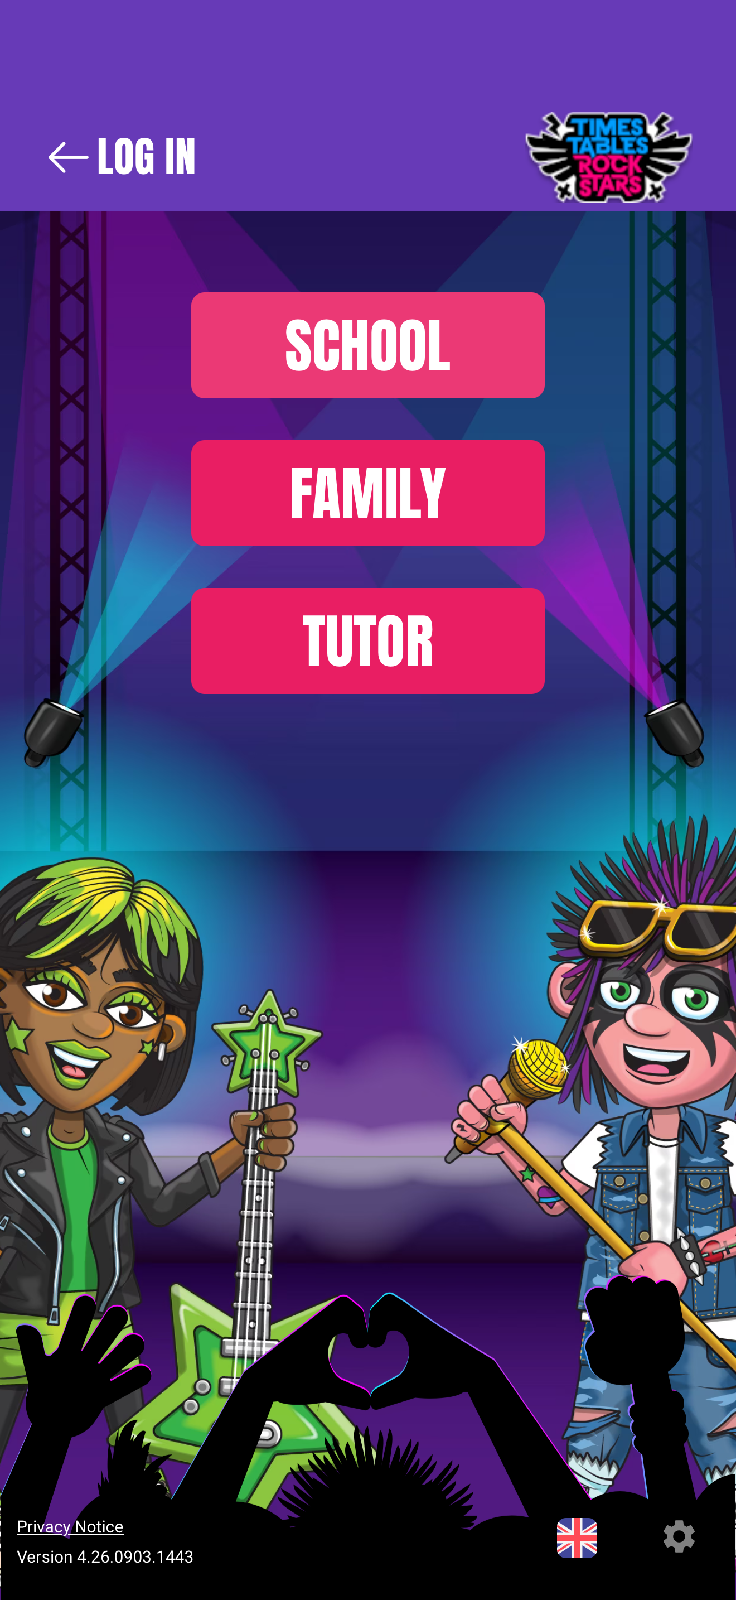


Slide 6
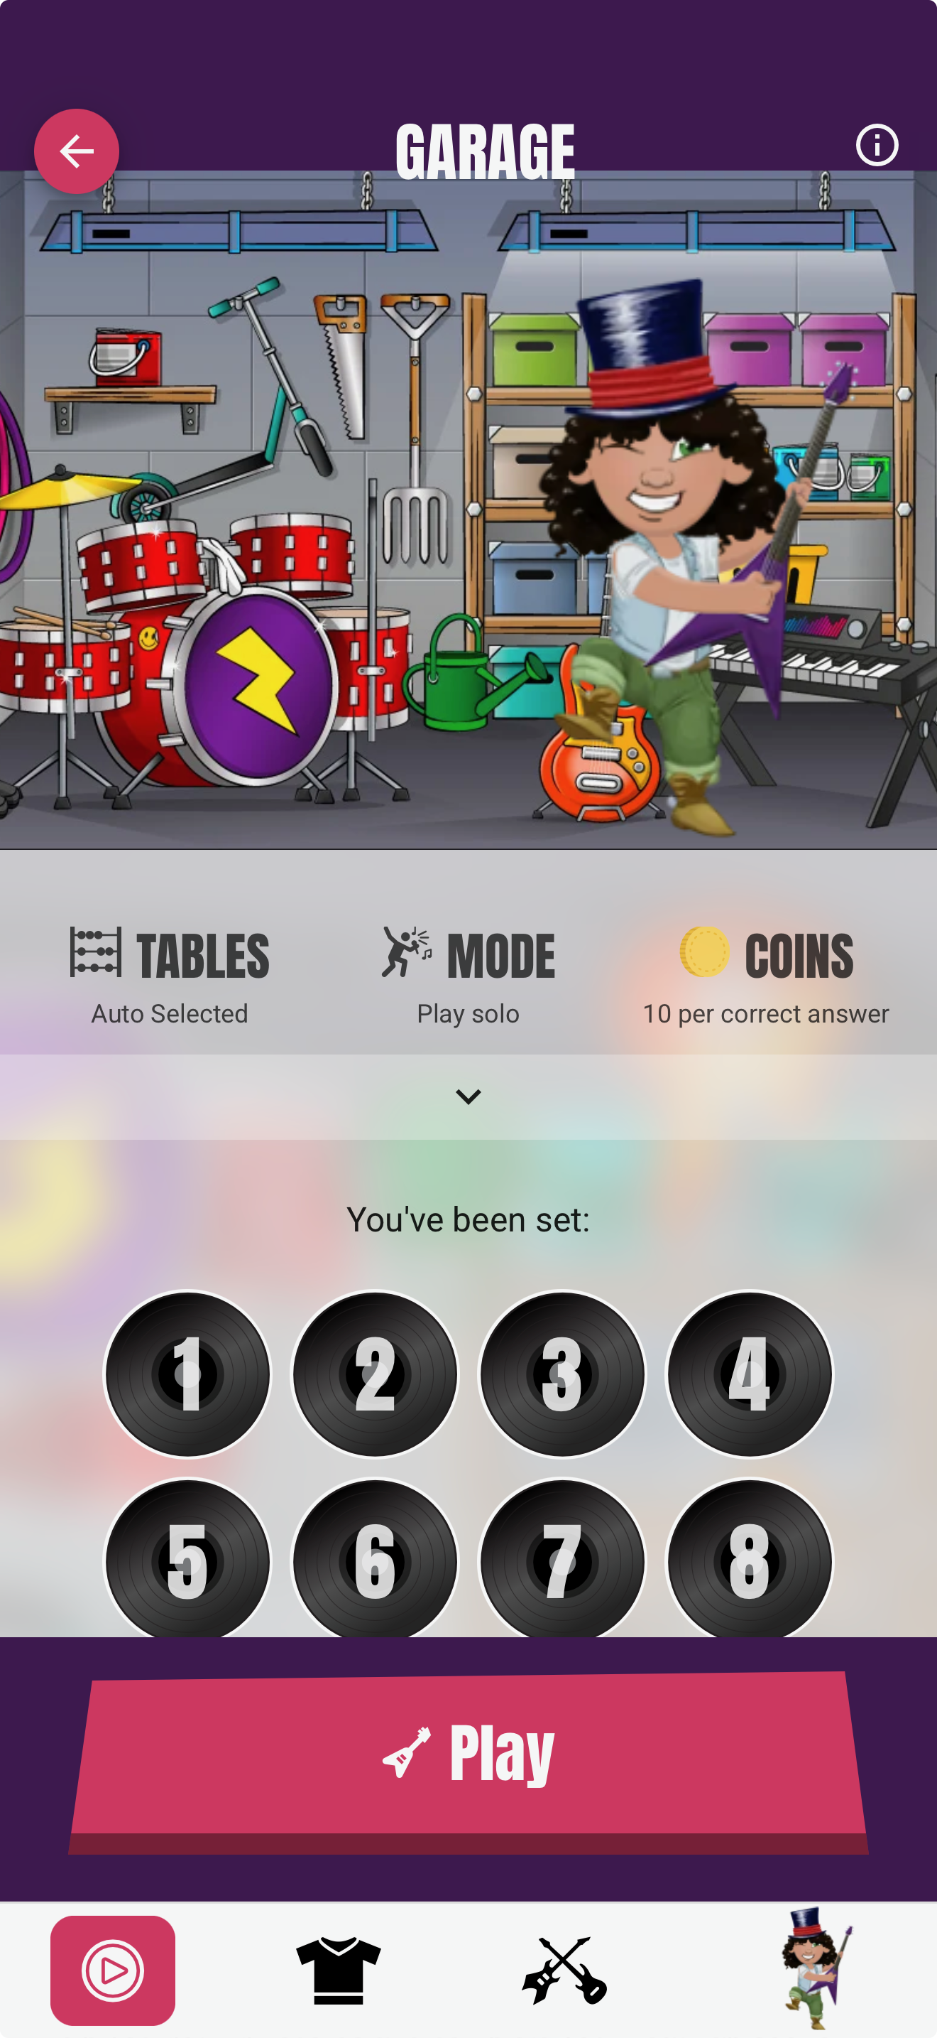
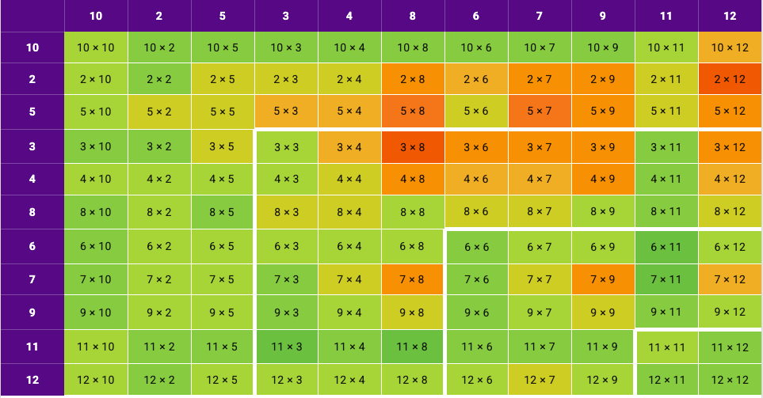
Heat maps

Slide 7
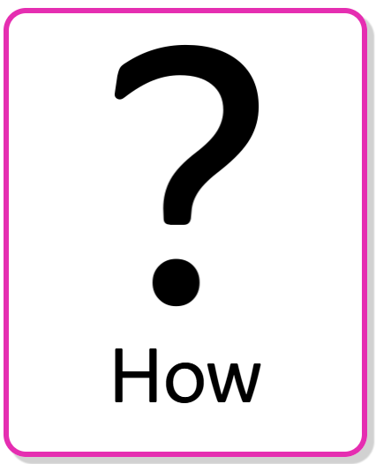
How can you help at home?
Practise little and often
Focus on rapid recall rather than counting
Use Times Tables Rock Stars regularly
Quiz multiplication facts during everyday activities
Celebrate effort and progress

Slide 8
How can you help at home?
Mathsframe.co.uk
Topmarks.co.uk
Counting stick

Slide 9
Making Triangles using Matchsticks on a 10s frame
3
6
9
12
15
18
21
24
27
30
Let’s whisper count saying each multiple of 3 louder

Slide 10


