Slide 1

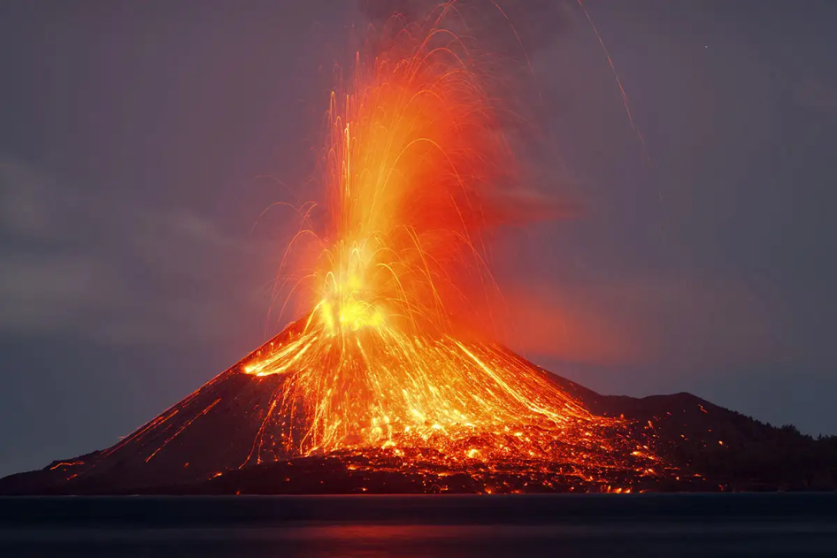
Year 3 Curriculum Plan
Summer 2 2025/2026
Key Curriculum Areas
As Readers we will continue to read as a whole class throughout the week and improve our confidence to read unfamiliar words including those with prefixes and suffixes. We will focus on a specific skill weekly and work towards understanding what we have read in a variety of ways. Our class texts this term are Escape from Pompeii by Christina Balit.
​As Writers we will be linking our lessons to our topic as much as possible. We will write setting descriptions for before and after the eruption of Mount Vesuvius. These pieces of writing will be linked to our class text ‘Escape From Pompeii’ by Christina Balit. We will continue to correctly use conjunctions, adverbs and figurative language in our writing. It is important that we continue to use the punctuation we have learned so far (full stops, exclamation marks and commas) in our writing. We will focus on writing to persuade by creating a persuasive leaflet of Pompeii. We will revisit persuasive language and practice writing in 2nd person.
As Mathematicians we will continue to work on our 3, 4 and 8 times tables and so it is crucial that the children are practicing these at home. Some children will be working towards their 6s, 7s and 9s ready for next year’s statutory multiplication test. We are starting with another measuring unit in which we will learn to tell the time to the minute. In geometry, we will look at the properties of shape and statistics. We would encourage you to help your child to practise reading the time from both 12 and 24 hour clocks at home to support their learning in class.
Our spelling practice will continue with weekly cumulative testing using the lists available on the school website. The children will learn a new spelling rule each week and carry out activities to consolidate these. ​
In handwriting, the children will continue to develop their cursive writing which will allow them to both work towards earning their pen licence and maintain their skills. Practising handwriting and spellings at home will be a very big help towards this.
As Religiously Literate students we will be exploring the big questions ‘Who is Jesus?’ in which we learn about the meaning behind the ‘I am statements’ and we will describe what a Christian might learn from these. Through this unit we will focus on the core concepts Incarnation and Gospel as we consider how the statements may be relevant to our own lives.
Active Planet
Overview of Topic
The tectonic plates that form the earth’s crust are always moving. The children will learn how even the smallest movement can cause huge earthquakes, volcanoes and tsunamis that devastate communities across wide areas. We will learn which parts of the world suffer the most with these natural disasters and how and why they occur.
Value of the half term: Responsibility

Slide 2
Other Curriculum Areas
Reminders
P.E Days: We will be having PE twice a week on Mondays and Thursdays. Children will be expected to come to school in their PE kits on those days.
Homework
Reading: Children are expected to read everyday at home and use home reading journals on a daily basis. The children will be given their journals and new books on Fridays and will need to return them the following Thursday morning for a new book.
Spellings: These could be accessed on the school’s website,and will be tested weekly on a Friday.
Maths Homework: this will be set each week on Purple Mash each Friday and should be completed by the following Friday.
Fruit: If you wish, you may provide your child with a piece of fruit to eat at morning break.
Learning Experiences
W/C 15th June – Mental Health & Well-being week​
Wednesday 17th June – World Cup Fundraising, Non School Uniform Day​
Friday 19th June – Sports Day​
W/C 29th June – Maths focus week – Milo’s Money​
Friday 3rd July – School Fayre time tbc​
Friday 17th July – End of term service @ 12.30pm
Year 3 Oxfam Fundraising Penalty shoot out Date and time tbc
As Scientists we will learn about the topic of light. The children will recognise that they need light in order to see things and that dark is the absence of light. They will notice that light is reflected from surfaces; recognise that light from the sun can be dangerous and that there are ways to protect their eyes; recognise that shadows are formed when the light from a light source is blocked by an opaque object and find patterns in the way that the size of shadows change.
As Geographers, we’ll be finding out how the Earth is formed and the layers beneath its crust. We will also look at what a volcano island is and where they are in the world, as well as what causes an earthquake and how they can be measured.
As Athletes we will be developing our understanding of Rounders. Each week we will focus on key skills needed such as throwing, batting, fielding in order to make sense of the complex rules of rounders. We will practice in teams each week to consolidate our understanding of working in a team. Coach will also practice and teach Netball this term.
As Musicians we will focus on musical structure, specifically In the past and Communication units working on rhythmic patterns.
As Emotionally Literate students we will be starting with a focus of our value of this term ‘responsibility’. We will also focus on Money and budgeting as well as continuing to work towards our Global neighbours event to fundraise for Oxfam.
As Designers we will be researching, designing and creating our own seismographs in relation to our Active Planet topic.
As Linguists we will continue to have regular French lessons. We will revisit our previous learning and move on to learning about birthdays and classroom.
Computer Literate students we will learn about simulations and presenting as well as exploring Micro:bit.

