Slide 1


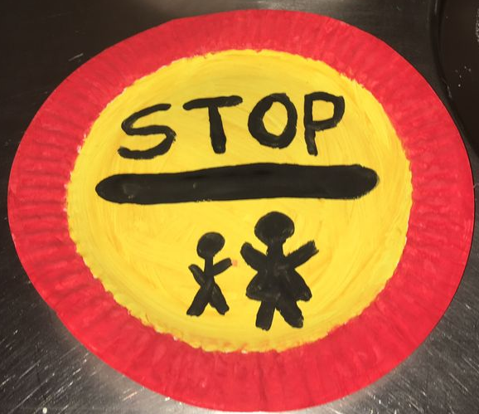

Nursery Curriculum Plan
Autumn 2 2017
Nursery Curriculum Plan
Spring 2 2026
The Prime Areas:
Personal, Social and Emotional
We will continue to use our Zones of Regulation to communicate how we are feeling during different activities and at different stages of the day and begin to understand how others may be feeling. This will help us to navigate our friendships and play experiences as we develop assertiveness in an appropriate way and as responsible learners. We will also continue to remember rules without needing an adult to remind us and develop a sense of responsibility and membership of community.
Physical
Through our indoor and outdoor provision, we will continue to work on both gross and fine motor control. We will choose appropriate resources to carry out independent plans and directed tasks. In our PE sessions we will begin to introduce more equipment and we will learn how to navigate that safely. We will continue to use one-handed tools and equipment, for example, making snips in paper with scissors, and using a comfortable grip for good control when holding pens and pencils. With support we will develop ways to work together and collaborate with one another We will increase our independence with regards to getting dressed.
Communication and Language
We will listen to longer stories and, as we begin to remember more, will join in with retelling them. We will continue to demonstrate our ability to maintain concentration by paying attention to more than one thing and understanding a question or instruction that has two parts. We will be using a wider range of vocabulary, and start to understand ‘why’ questions, like: “Why do ambulances have sirens?” We will use talk to organise ourselves, our ideas and play and develop using the correct tense (ran not runned!). We will continue to develop our pronunciation – focussing more on the tricky sounds: r, j, th, ch, and sh as well as multi-syllabic words such as ‘pterodactyl’, ‘planetarium’ or ‘hippopotamus’. We will express our point of view and debate when we disagree with an adult or a friend, using words as well as actions.
Overview
Our theme for this half term is People Who Help Us. As part of our new topic, we will learn about different occupations, and how these people help us. We will also be constructing our very own emergency vehicles and road signs. Although we are moving onto a new topic, we will continue to plant seeds, care for them and watch them grow.
Key vocabulary
job, vehicle, mechanic, police, firefighter, emergency, paramedic, doctor, nurse, vet, dentist, lorry,
profession, occupation, hygiene, siren,
Half Term Value – resilience

Slide 2
The Specific Areas
Literacy
In phonics, we will continually revisit our initial sound recognition of s. a. t. p, i, n, m, d, g, o, c, k, e, u, r, h, b, f, l, j before moving on to v w y z qu. We will also concentrate on Aspect 4 (Rhythm and rhyme) and 5 (Alliteration) of Phase 1. Through our texts A Superhero Like You and You Can’t Call An Elephant In An Emergency we will continue to understand the key concepts of print and engage in more extended conversations about stories to support our learning and understanding of new vocabulary.
Mathematics
We will continue to show finger numbers to 5 as well as begin to solve real world mathematical problems involving numbers to 5. We will start to recite numbers beyond that and experiment with our own symbols and marks. We will link numerals with amounts and be able to match them with objects. We will continue to use positional language, but without pointing, and begin to describe familiar routes. We will talk about and explore 2D and 3D shapes by thinking about suitability for building. We will talk about and identify patterns in our environment and use informal language to describe them such as spotty, pointy, blobs. We will also continue to compare quantities using ’more than’ and ‘fewer than’. We will also make comparisons between objects relating to size, length, weight and capacity.
Expressive Arts and Design
We will continue to explore different materials freely and to develop ideas about how to use them and what to make. We will create closed shapes with continuous lines, begin to use these shapes to represent objects, and start to draw with increasing complexity and detail, such as representing a face with a circle and further facial details. As we remember and sing entire songs we will begin to notice where the melody goes up and down and as we become more confident, we may even create or improvise our own! We will play instruments with increasing control to express their feelings and ideas.
Understanding the World
We will enjoy hands-on exploration of the natural world, tuning in to all of our senses.
We will continue to develop a sense of responsibility when respecting and caring for the natural environment and all living things. We will begin to make sense of our life-story, family’s history and show an interest in different occupations. In RE, we will explore what makes places like homes, parks, churches, and hospitals special. They will learn how people like police officers, firefighters, and doctors help the community. Through stories, discussions, and activities, children will reflect on the feelings and experiences connected with special places and begin to understand why they matter. Children will talk about the feelings linked to special places and learn simple ways to show respect and care for shared spaces.
Reminders
Home / School links:
Your child will be tired after a busy morning at nursery, but please sit with them every day and read for pleasure! We encourage you to discuss the story with them, discussing the characters and what they think may happen next.
Tapestry - We will continue to share evidence of your child’s experiences across the curriculum on Tapestry. Please interact with these and also feel free to share your child’s developments and achievements outside of school with us.
Weather – Whilst we celebrate the sun shining more regularly, it can still feel chilly, and with the unpredictable rainfall, so as we are outside every day, please remember to bring a coat if rain is forecasted! Please put sunscreen on your child every morning before school, as we will be outside most of the day, and the sun is shining more. We will get messy, but the stains show we have worked and played hard.
Reading:
Please read for pleasure with your child daily. The children will be bringing home a book from our reading garden every week, so please fill in their reading record with a comment on how you both got on. This could include what you liked or disliked about the story.
Dates to note:
Thursday 5th March – World Book Day
Friday 20th March – Comic Relief
Monday 23rd-25th March – Scholastic Book Fair after School
Tuesday 24th March – Parent Consultations (2pm early finish)
Wednesday 25th March - Parent Consultations (normal finish)
Friday 27th March - Easter Service @ Jesus Church 12.30pm
Friday 27th March - Early Finish at 1:30pm
.

