Slide 1

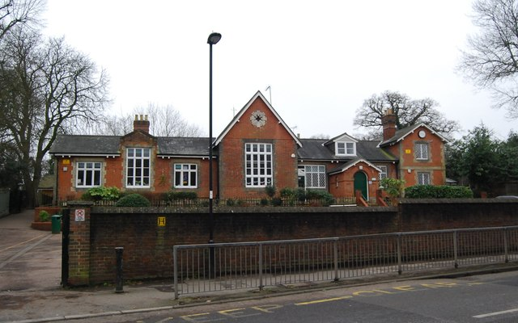
Forty Hill
Our strong, supportive community
is essential to our school’s wellbeing
We will not be taking any questions or comments in the whole meeting, though you are welcome to have a quiet chat with us afterwards.

Slide 2

We will always put the wellbeing of all children at the heart of what we do.
The school has a number of challenges at the moment and it is meeting these challenges very well. The leadership team is extremely strong, the school has access to robust advice from both local authority services and the Diocese, and there is steady work behind the scenes.
The timing of the Ofsted inspection was not ideal but the findings have been useful and in keeping with the experience of other schools across the UK. Forty Hill is a great school at its core and we are addressing each area which needs attention very rapidly. We aim for re-evaluation on all areas as soon as possible.
It is not appropriate for the school to share information which is private or could be harmful to any child.
A strong, supportive community is essential.

Slide 3

A strong, supportive community
Please do continue to show the kindness, support and positive relationships amongst each other and with the school that we have enjoyed for many many years
Please encourage your children to do the same
Please do raise any ongoing concerns privately and through the proper channels
Please remember to put the wellbeing of all children at the heart of your actions
Please act kindly online and call on others to do the same

Slide 4
Ongoing concerns? This is what to do:
Please remain respectful and clear in all your communications
Raise the concern privately with the class teacher
Raise the concern with a senior leader/the headteacher
If issues persist, lodge a formal complaint with the Chair of Governors
Follow the formal complaints process through
If still dissatisfied, raise the concern with Ofsted using their ‘complain about a school’ process.

