Slide 1

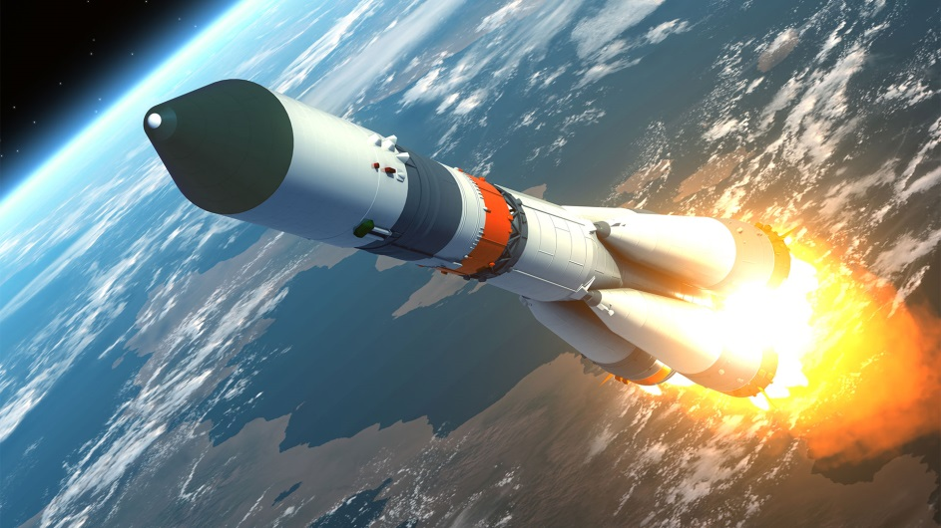
Year 2 Curriculum Plan
Spring 1 2026
Key Curriculum Areas
As Readers children are expected to read everyday at home and use “Boom Reader” to communicate what’s going well, any queries you have and anything specific we’d like you to work on. This is also the best way to let us know what your child is reading for pleasure and if they have completed any of the Reading Challenge books. One text is for your child to read to you, it is a text they have used in their adult led reading sessions. As a result we expect them to read this to you almost fluently and with an awareness of how punctuation affects tone and expression. Your child should be able to read ‘tricky words’ by sight and discuss key vocabulary with you. The second text is for you to read and share with your child for pleasure.
During class time we will be exploring a few key texts which link with our focus topic: Man on the Moon – by Simon Bartram & the biography of Neil Armstrong, Trail Blazers.
As Writers we will be will be writing our own simple narrative stories with setting descriptions in Space. This will allow the children to practice and embed literacy techniques such as use of adjectives and expanded noun phrases. This half term the children will be exposed to a new type of genre, through biographies. We will consider the features of biographies, and even begin to write some simple ones of our own. Throughout these weeks, we will also embed our use of time connectives as well as applying the correct tenses (past, present and future) within writing.
As Mathematicians we are continuing to build upon our knowledge of multiplication through representing number in groups and arrays. Subsequently we will progress to explore simple division The children will also be exploring money. They will begin to consider how to add values, why change needs to be given and compare different ways in which the same value can be made using altered coins and notes.
As Religiously Literate students we will be learning about the Jewish faith while focussing on the question How are Jewish festivals remembered and celebrated? The children will be learning about a variety of Jewish festivals thinking about why certain festivals are important to Jewish people, and which festivals are personally important to them.
New Frontiers
Overview of Topic
Discovering new things is always exciting – whether hundreds of years ago or even today! Within this topic the lives and discoveries of famous explores, Amelia Earhart and Neil Armstrong will be considered. We will think about how these peoples discoveries are different, yet similar in some ways; even though years came between them.
Key Vocabulary:
Explorer, Navigator, Voyage, Pilot, Apollo, Space Race, Transatlantic.
Value of the half term: Reflective

Slide 2
Other Curriculum Areas
Reminders
P.E Days: are on Wednesdays and Fridays – children should come to school in full PE kits on those days. Please keep an eye on the weather as it changes.
Homework
Reading: Children are expected to read everyday at home and use Reading Records to record their progress.
Spellings: Weekly spellings are available on Emile (our school Spelling App) and children should engage with their tasks and interactive games.
.
Fruit: If you wish, you may provide your child with a piece of fruit to eat at morning break.
Learning Experiences
Arts trophy launch - 15th Jan
MHWB week 9th - 13th Feb
Online safety day - 10th Feb
As Historians we will be looking at the topic “New Frontiers”. We will be exploring the lives of Amelia Earhart and Neil Armstrong. We will learn about both explorer’s expeditions and the reasons surrounding them. We will also see the parallels in both of their lives as well as the differences.
As Scientists this half term we will be exploring and experimenting with different materials – considering their properties and how they can be best utilised.
In Art we will be using the work of Joan Miro as inspiration for our own consolation pieces (linked with our topic and literacy). We will learn and use the skill of printing and patterns to create our masterpieces!
As Athletes the children will carry on building on their gymnastic skills, practising balance and high and low parts.
We will also begin to learn and explore “ball skills”, thinking about dribbling and passing.
As Musicians this half term we will be exploring a topic called “Our Bodies”. We will think of ways in which we can use our bodies to produce procession/ music.
As Emotionally Literate students as always, we will continue to explore and apply our school vision and values where we can within different school experiences. In addition, we will consider why we need to have healthy diets, as well as what a balanced diet is. The children will reflect on why they think exercise is an important factor in remaining healthy.
This half term is our Mental Health and Wellbeing focus week. The children will have many opportunities throughout this week to consider our wellbeing and ways in which we can manage it.
As Computer Literate students we will be considering effective and safe ways in which we can research using search tools and the internet, through computers and iPads.

