Slide 1

Maths at Forty Hill
EYFS – Year 2

Slide 2
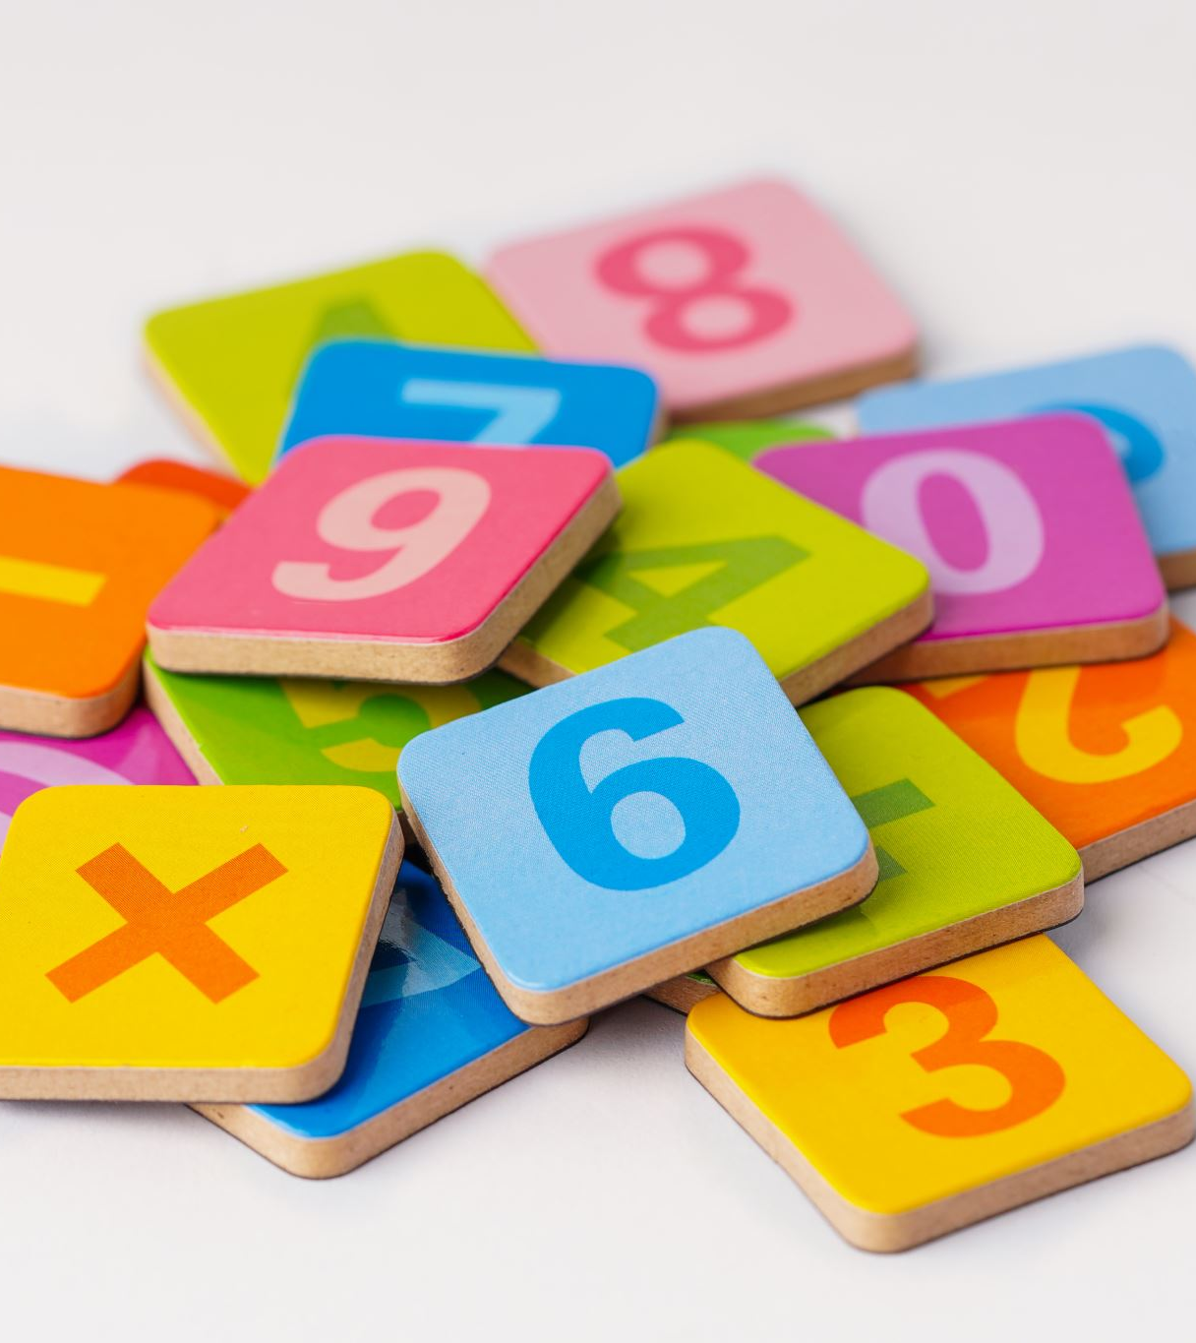
Agenda
Maths at Forty Hill
Curriculum Overviews
Understanding Number
The importance of Manipulatives
At home
PLEASE ASK QUESTIONS AS WE GO!

Slide 3
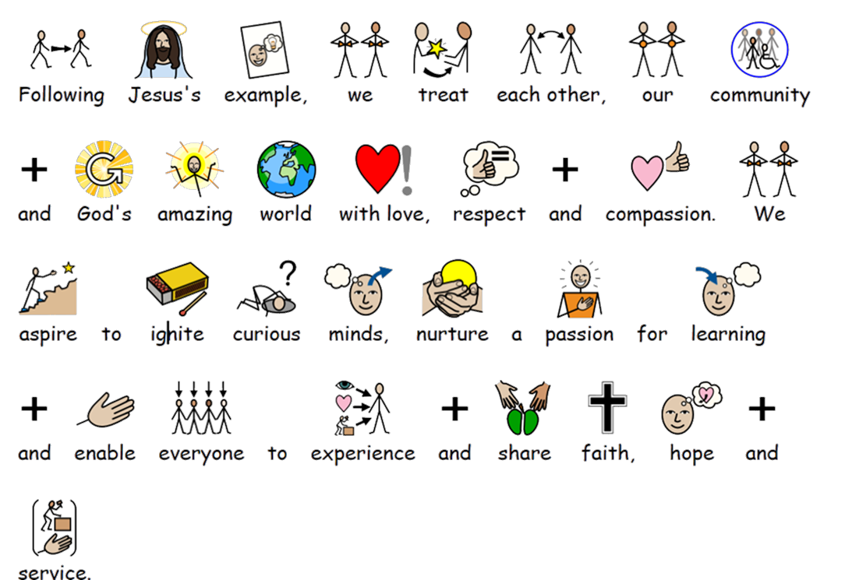
Our Vision

Slide 4

Our Journey Begins in Nursery
Nursery does not follow the White Rose scheme. Instead, they learn according to the ‘Development Matters’ statements which set out the necessary skills they will need. These skills underpin the rest of their Maths journey through the school
Maths is incorporated in all areas of learning through play and within the classroom context
Assessed and recorded on Tapestry

Slide 5
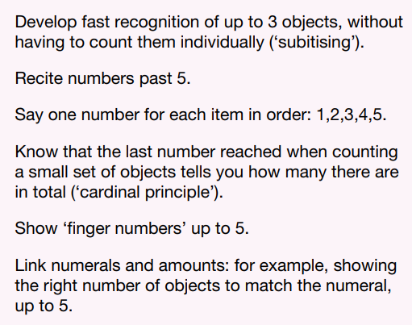
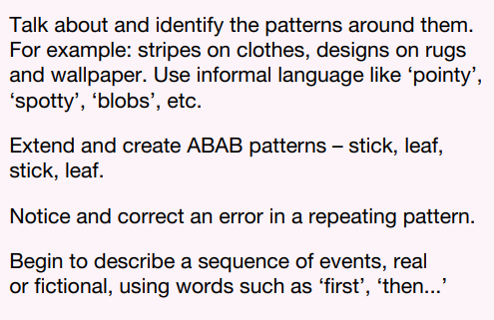
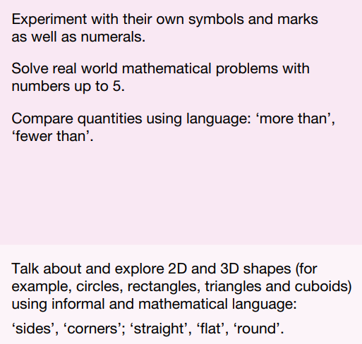

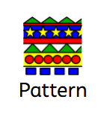
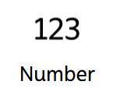
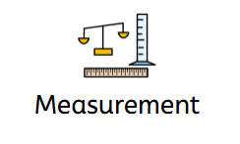
Development Matters - Nursery

Slide 6

Reception
Follow White Rose scheme completing between 3 and 5 maths lessons a week.
Usually the class may focus on one concept, exploring this in different ways and in both small group and individual tasks.
Practical first, then moving to pictorial.
Children’s work is recorded in their Maths books however this is mainly through photographic evidence of hands-on maths.

Slide 7
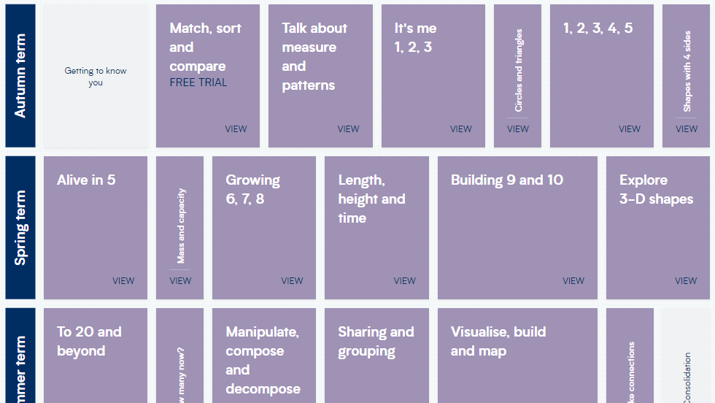

Slide 8
KS1
4 Maths lessons a week.
Children follow the White Rose scheme and record their work in their own maths books.
Children begin to understand presentation expectations and use a mixture of work sheets and writing out number sentences on the squared paper.
Manipulatives are still used throughout, and children are encouraged to use whatever helps them.

Slide 9
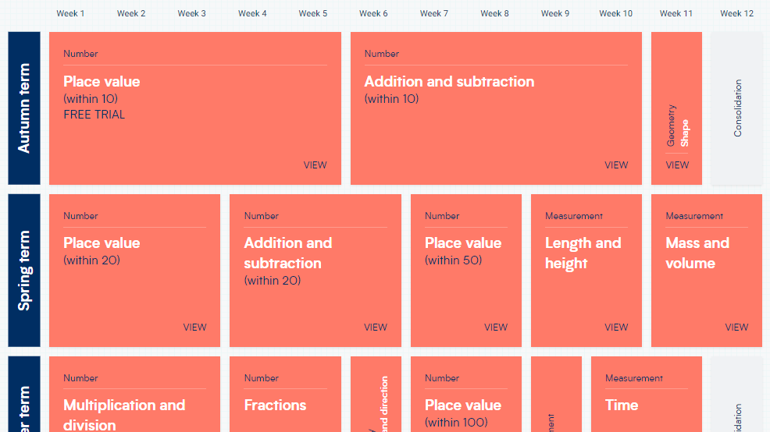
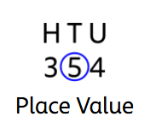

Slide 10
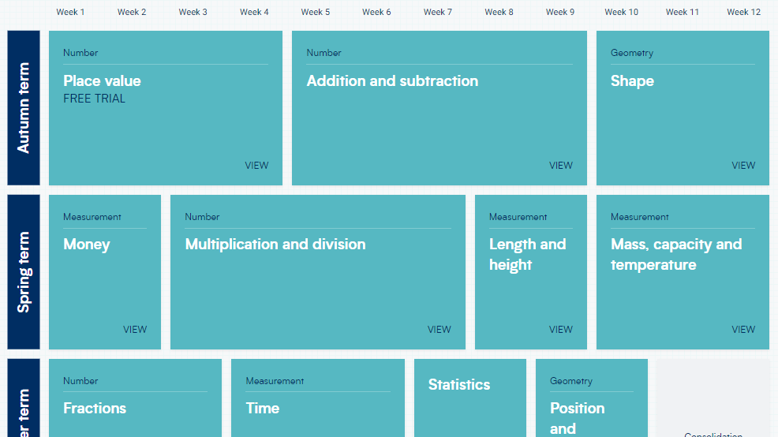
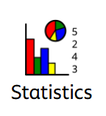

Slide 11

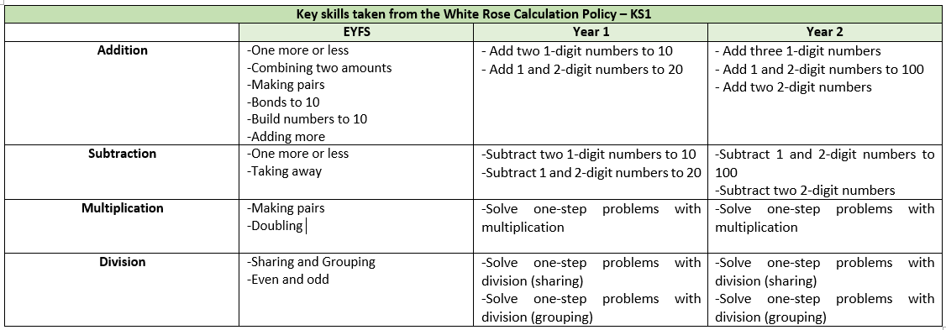
Progression

Slide 12



Concreate, Pictorial, Abstract

Slide 13
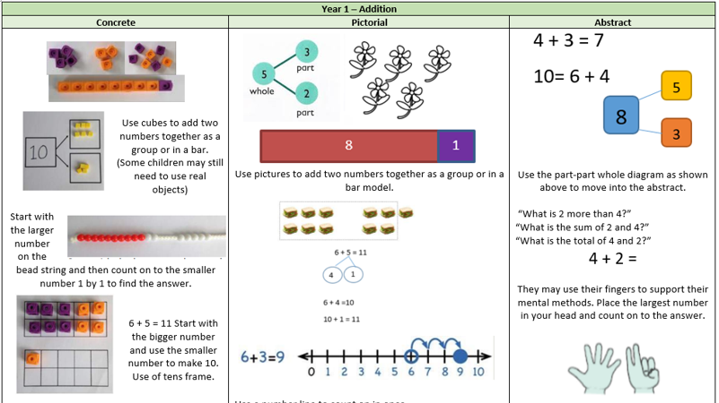

Slide 14
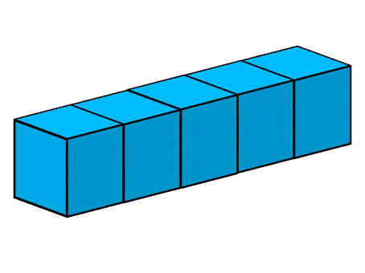

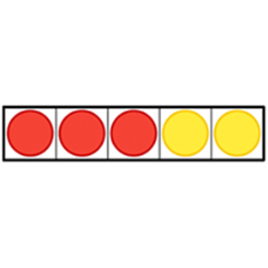


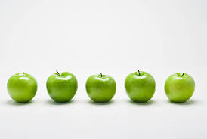

The 5-ness of 5
Cardinality & Subitising

Slide 15
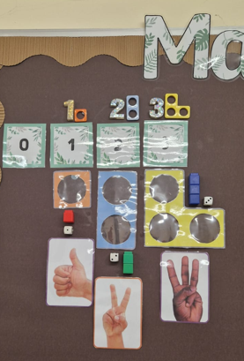
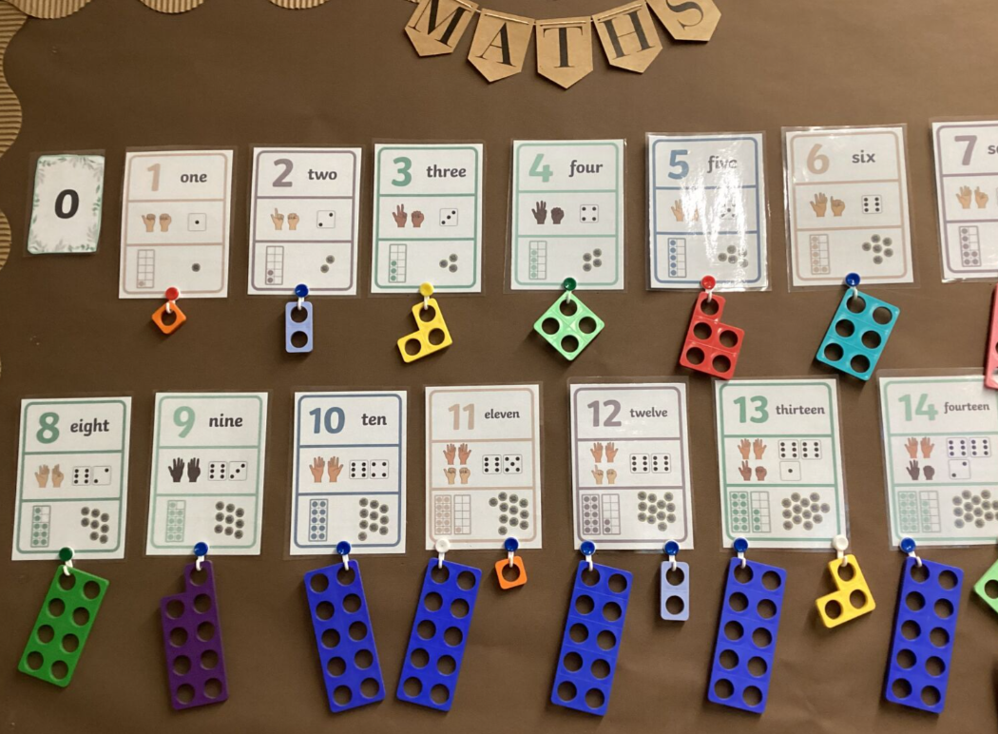

Slide 16
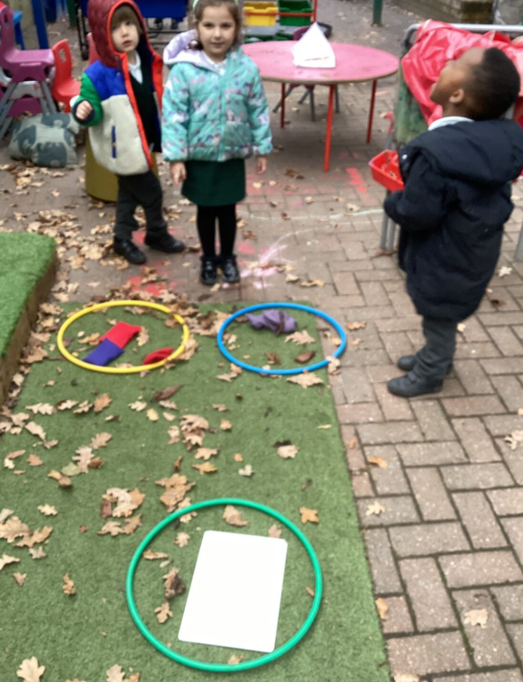
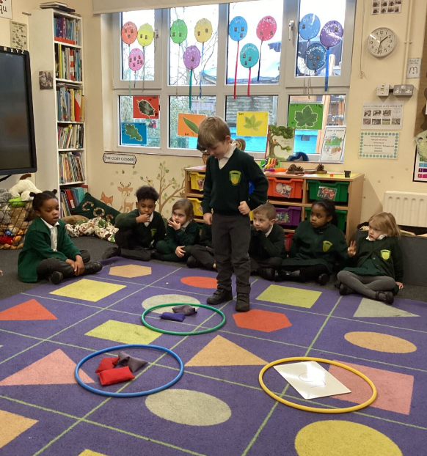
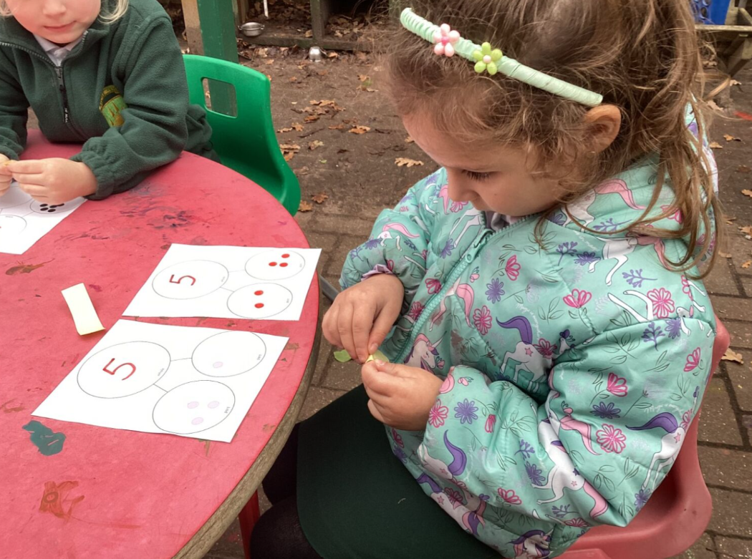
Reception – Part, Part, Whole

Slide 17
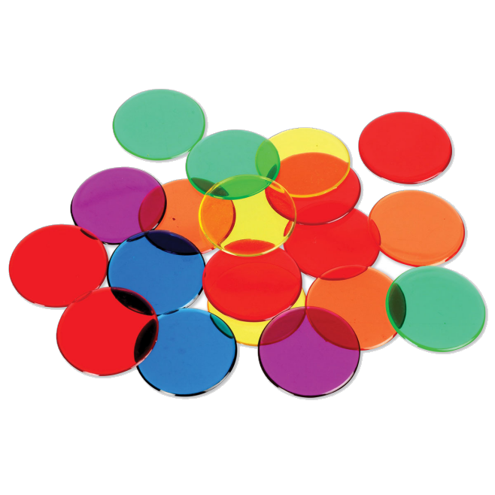
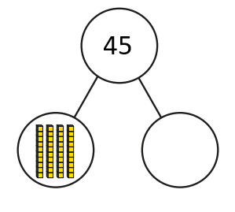
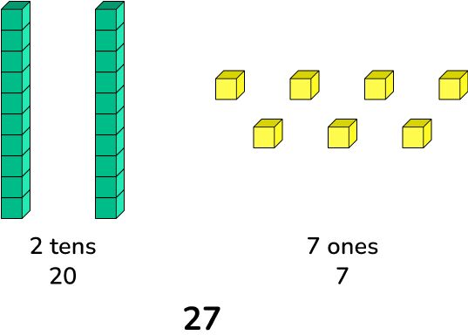

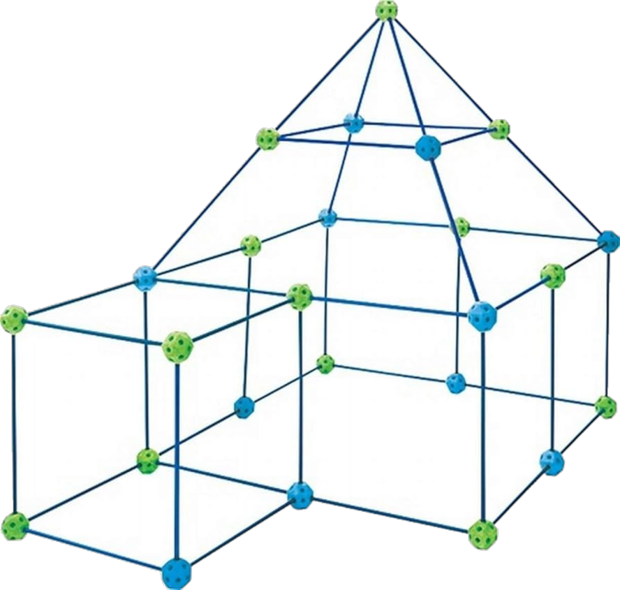
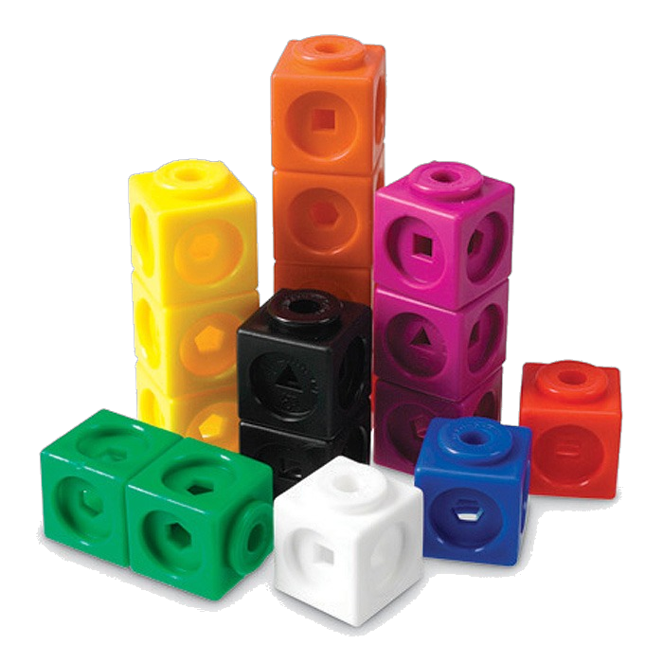
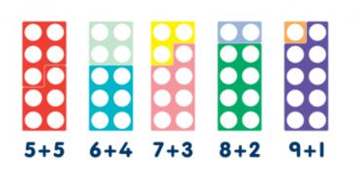
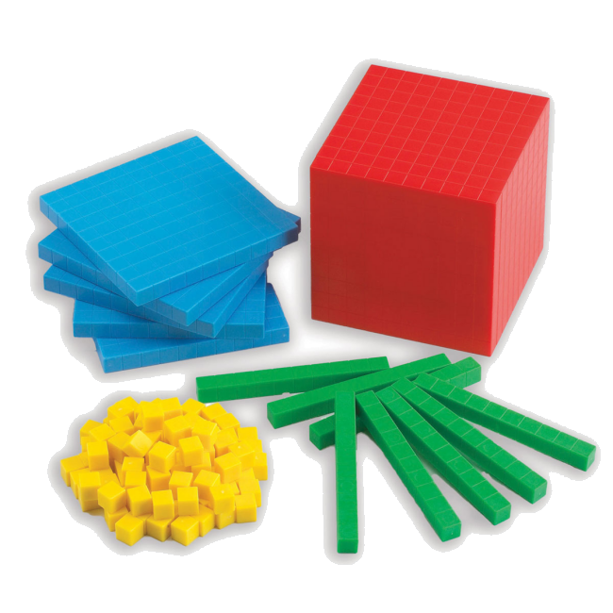
The Importance of Manipulatives
Please Explore…

Slide 18
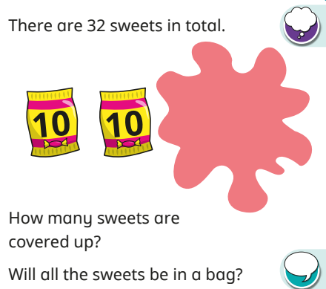

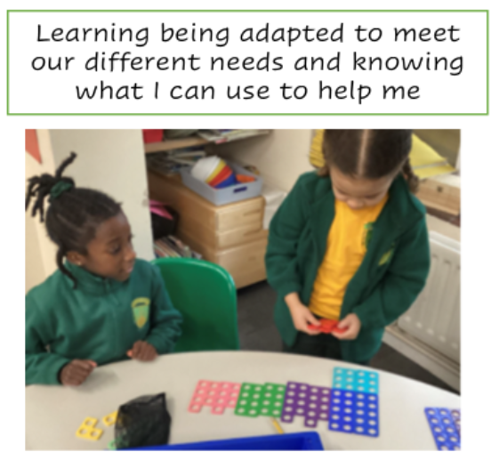
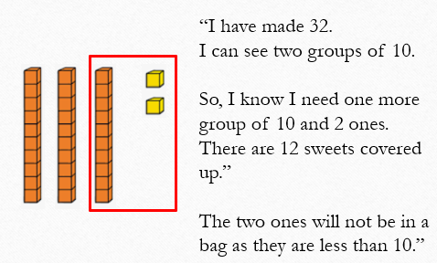
Our Key Priorities…
…Manipulatives to aid deeper thinking

Slide 19

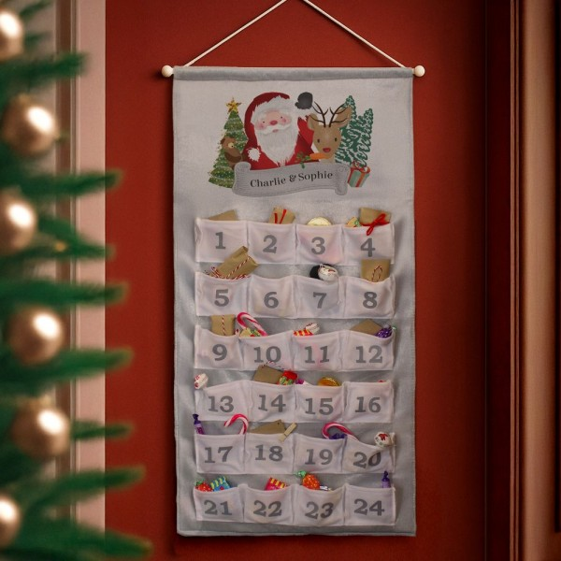
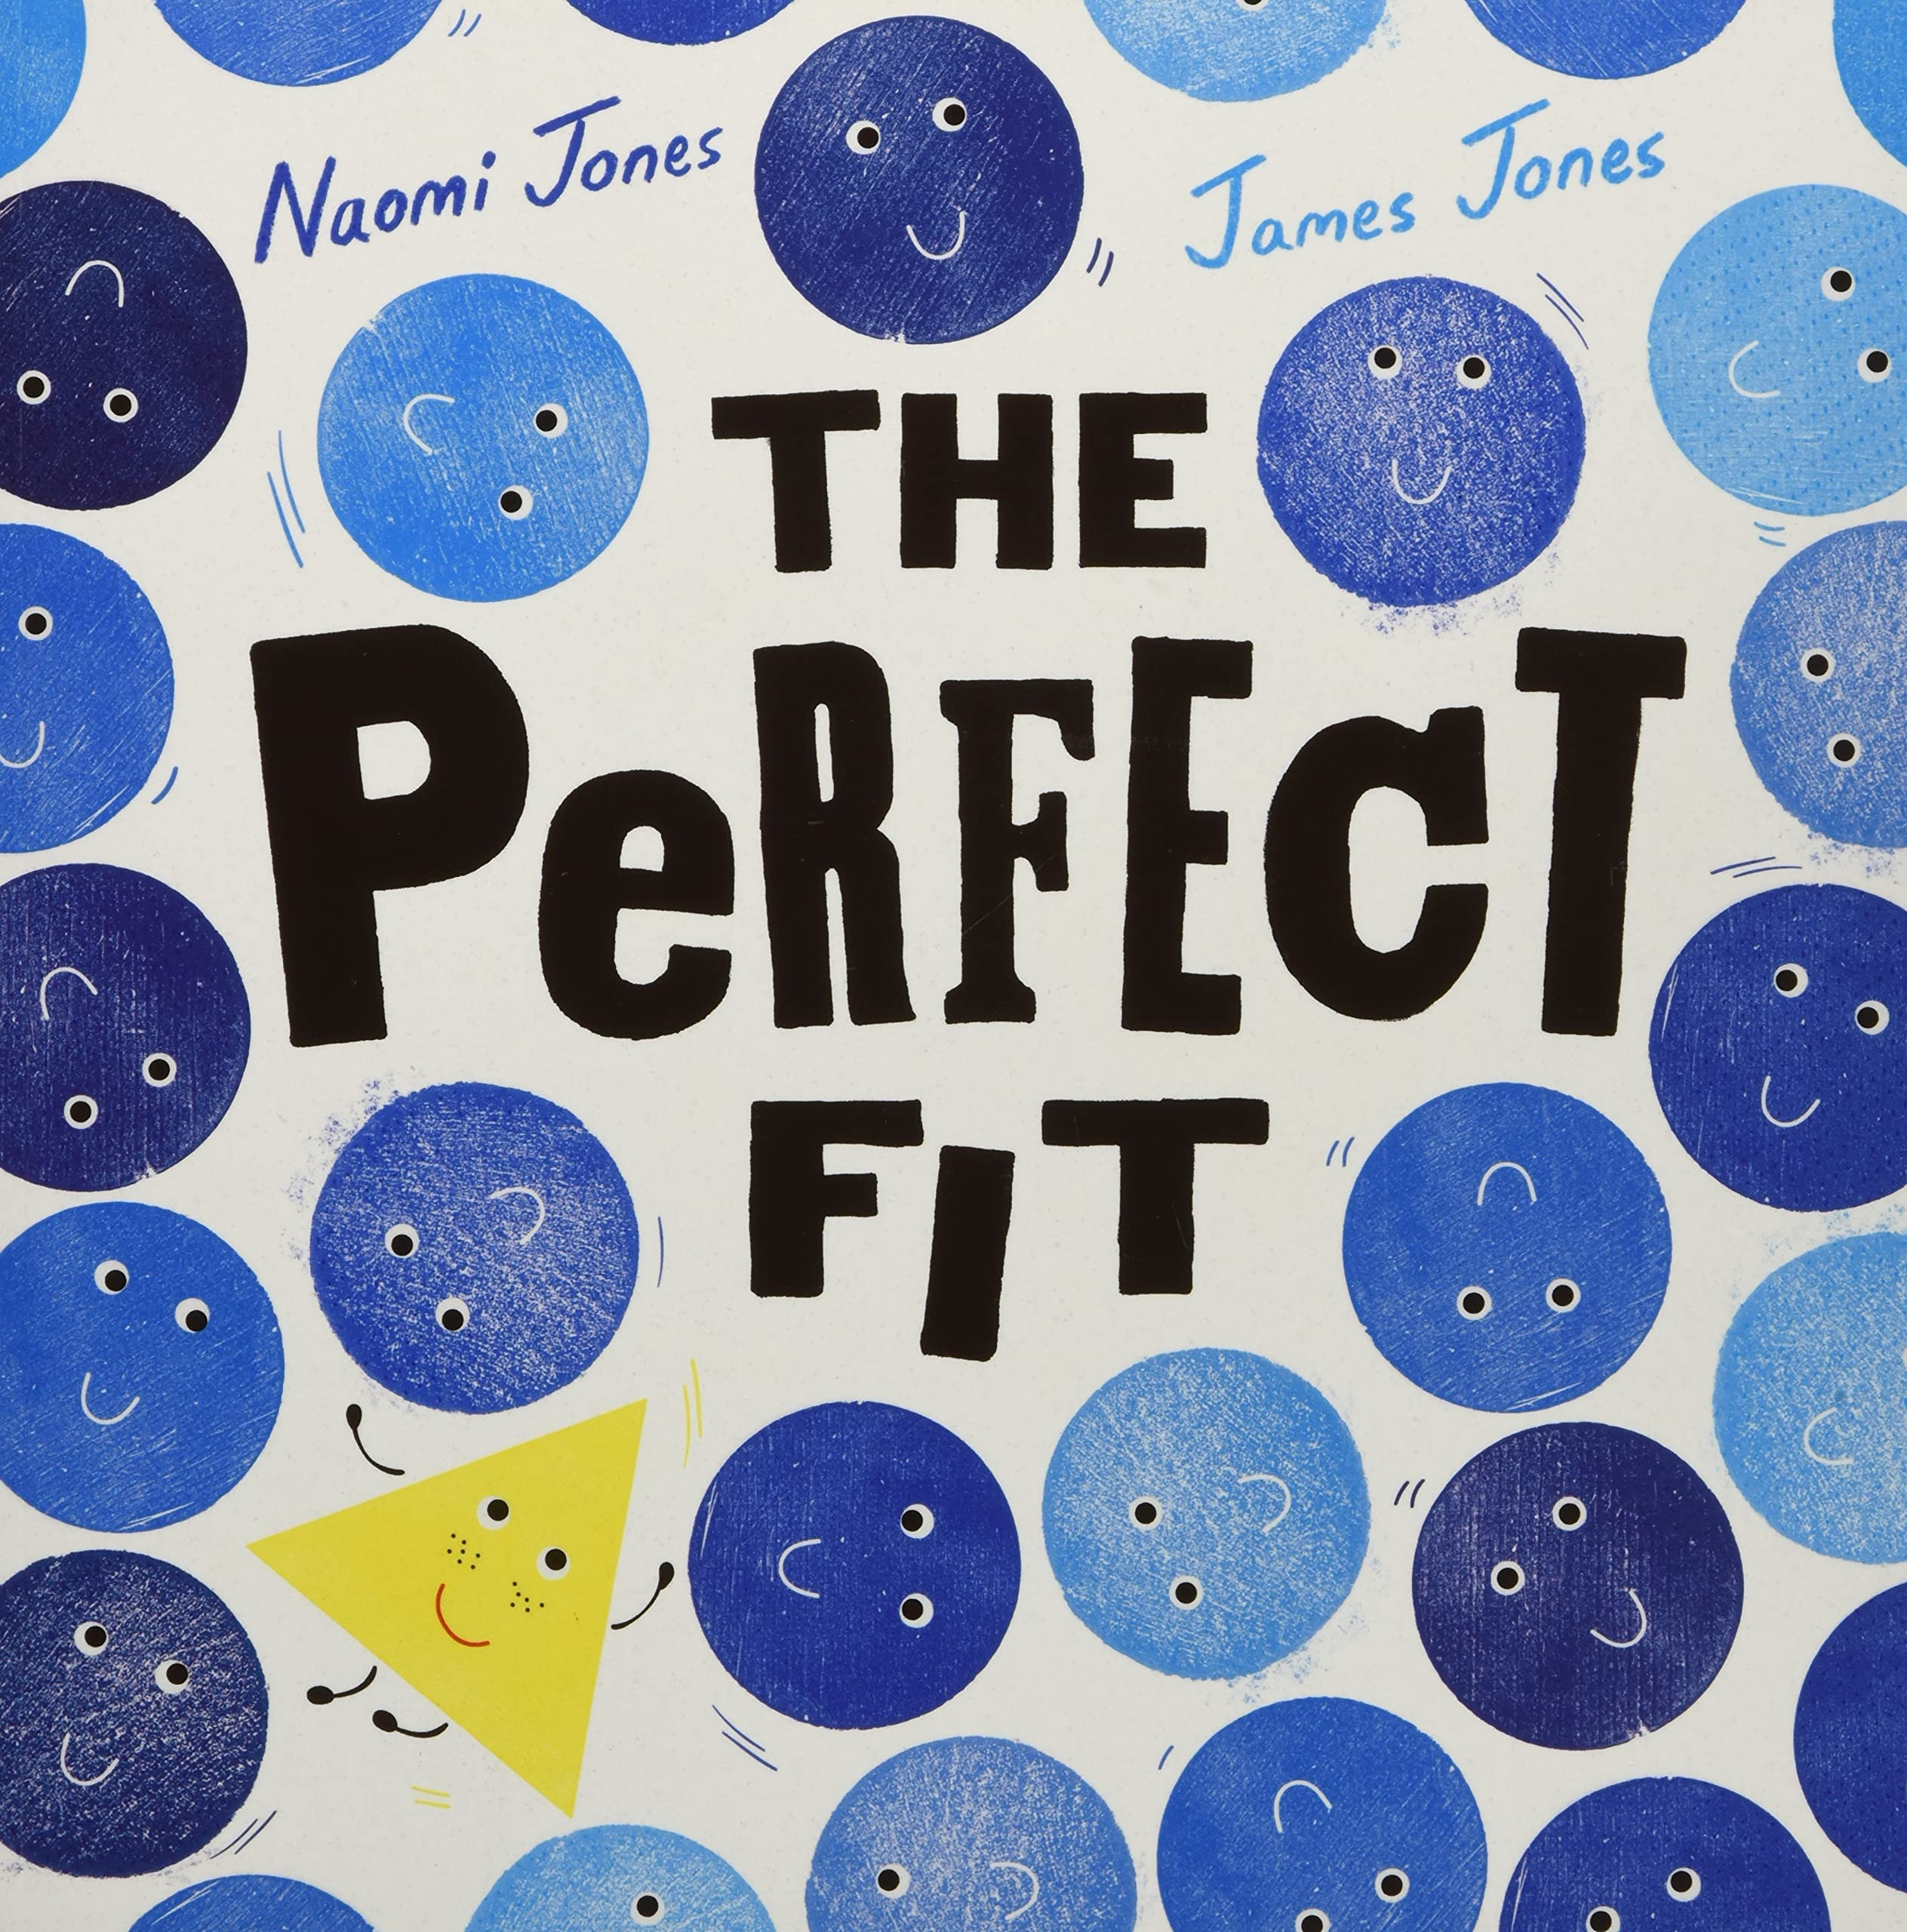
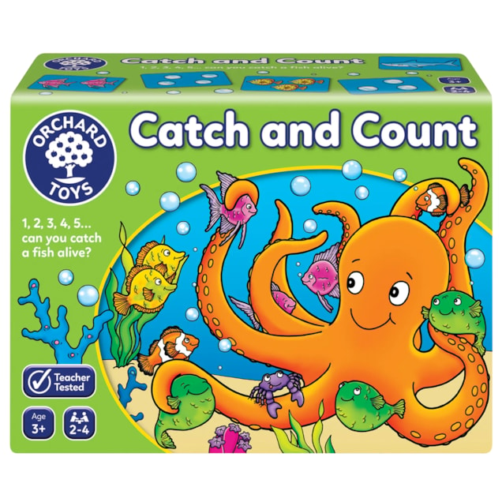
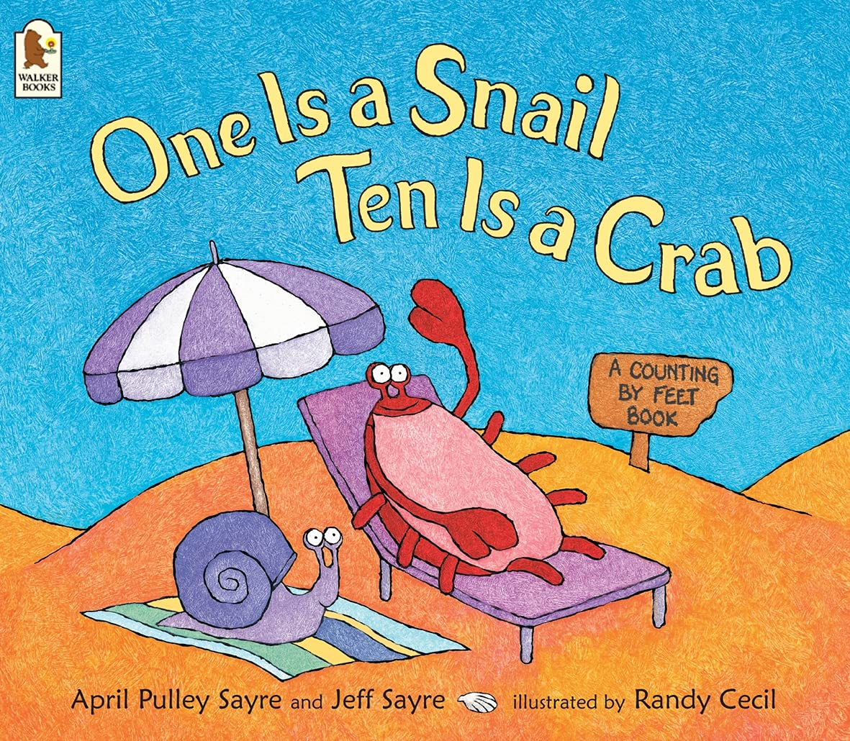
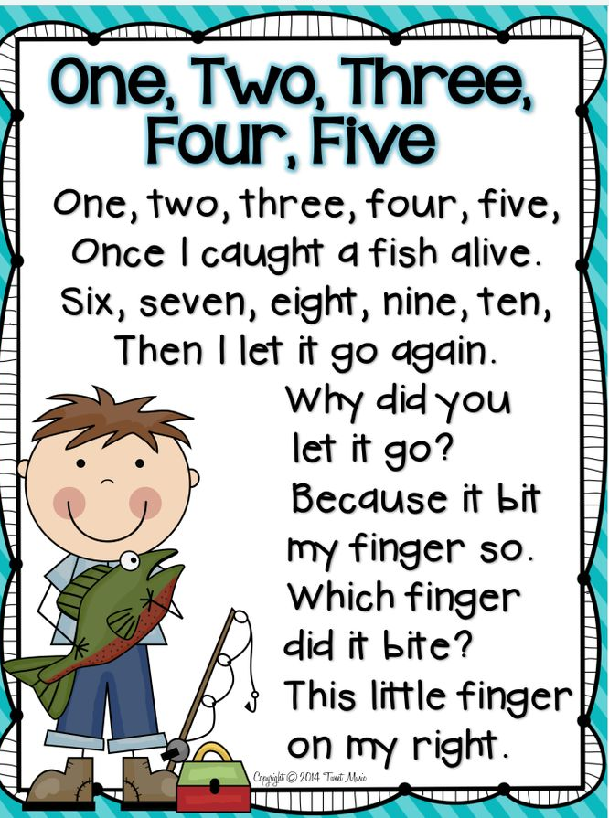
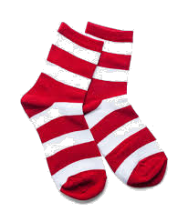
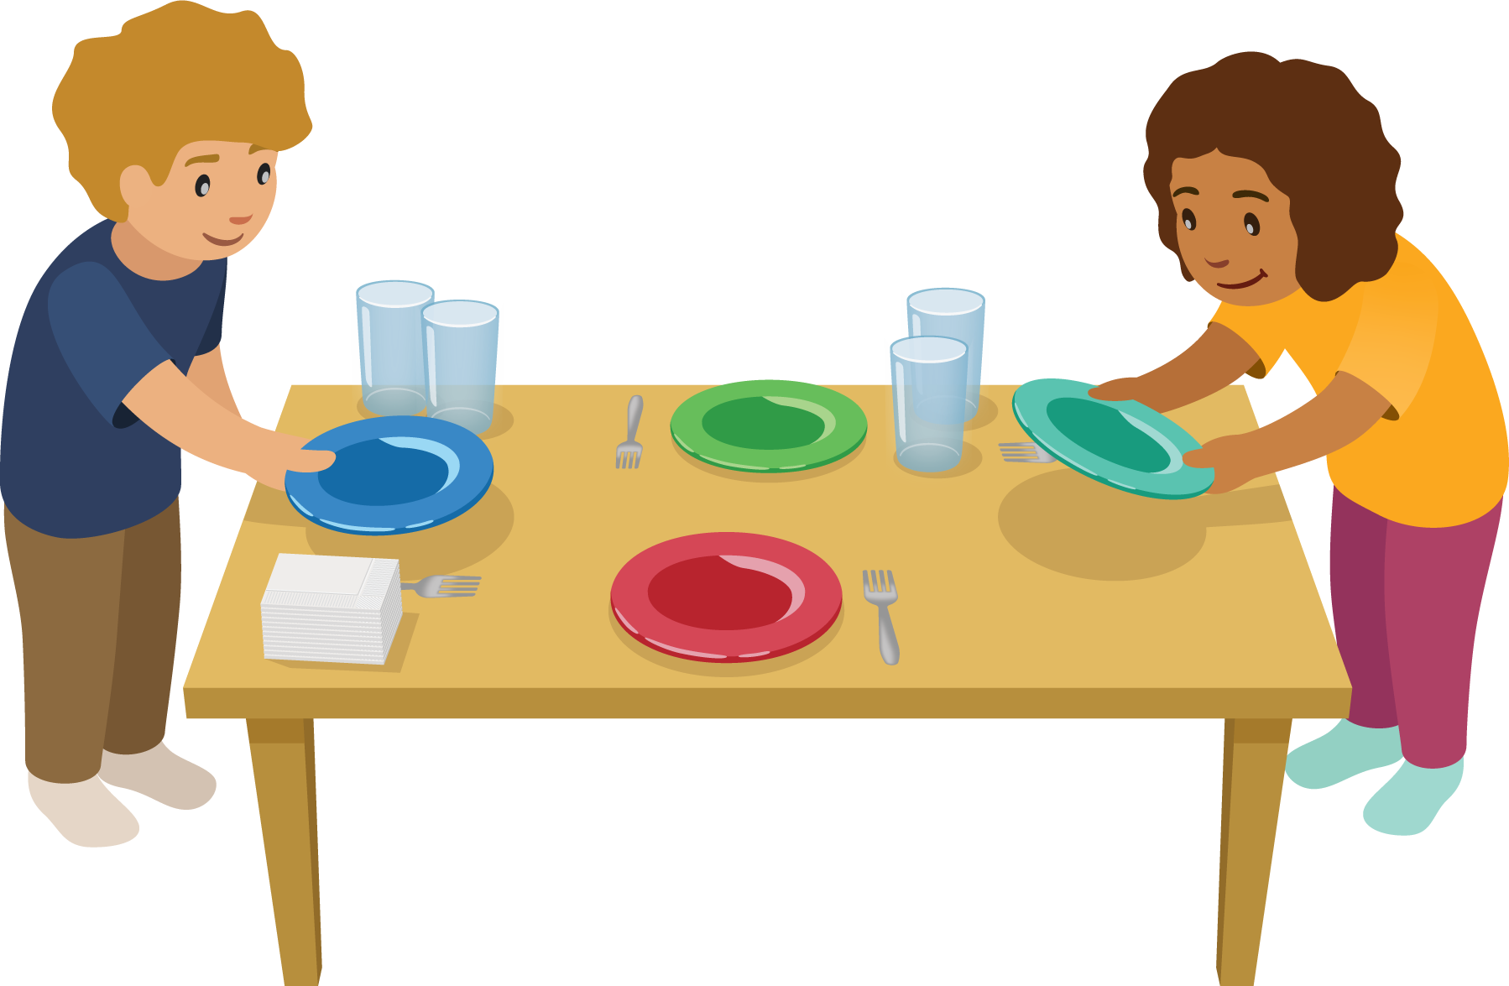
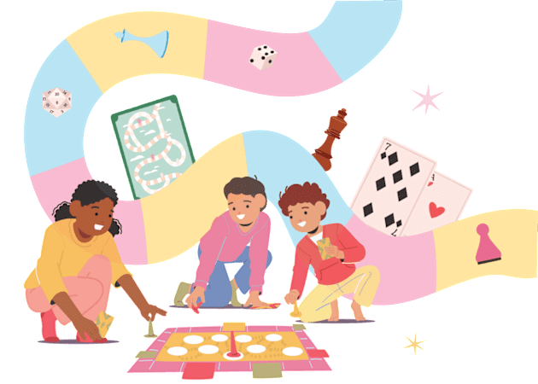
Maths at Home
Keep it practical

Slide 20
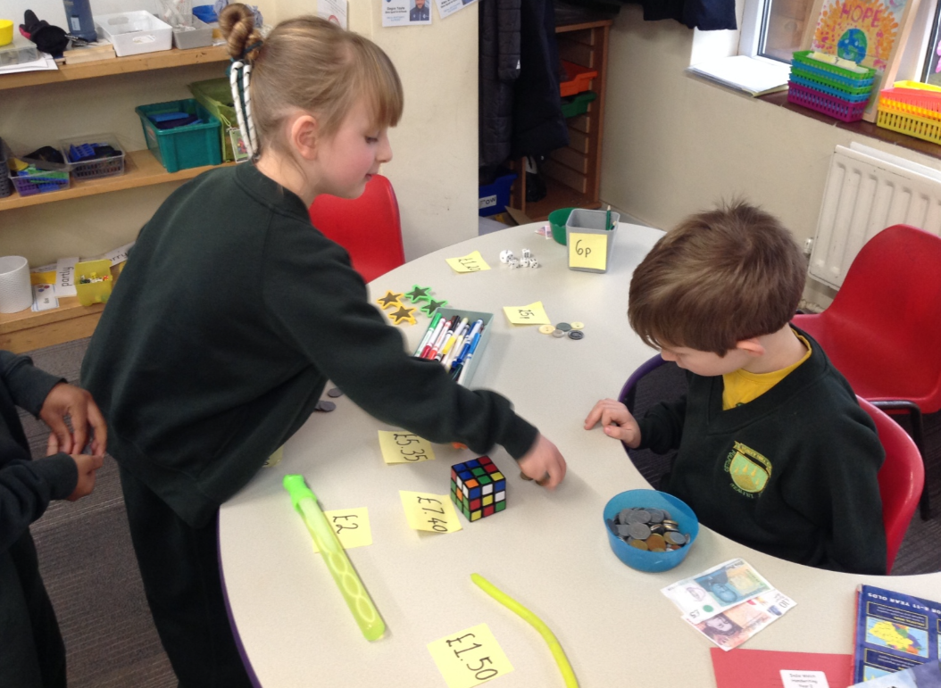
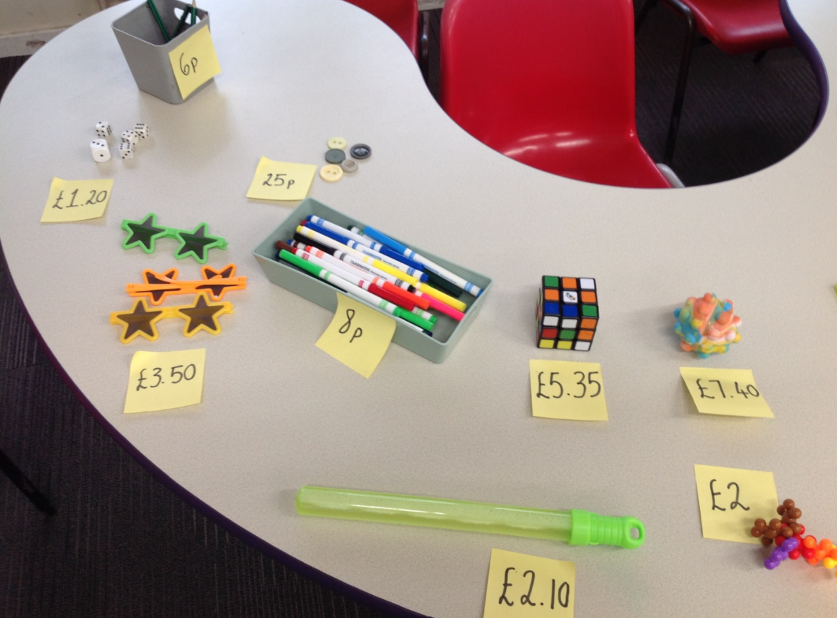
Practical Maths - Money
Keep it practical

Slide 21
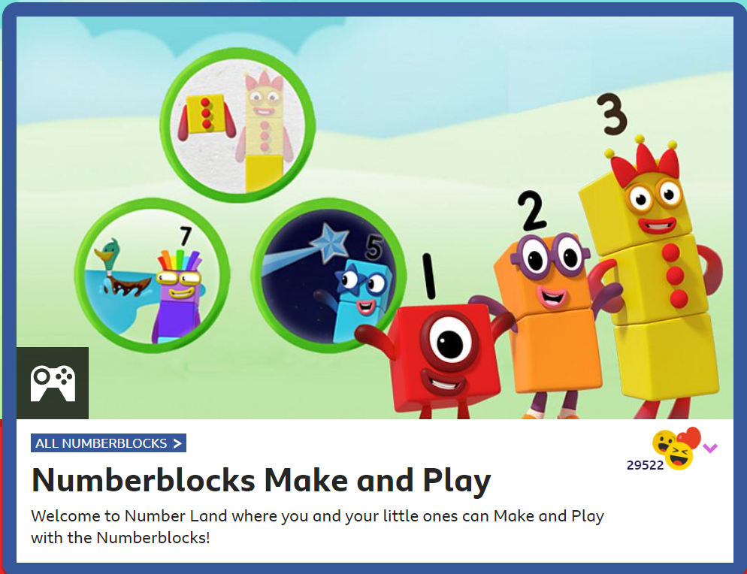
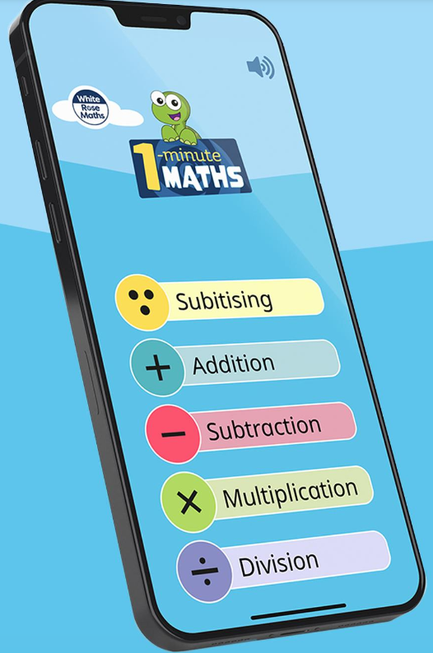

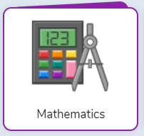
Helpful Resources and Websites
BBC: Numberblocks
Purple Mash
White Rose – 1 Minute Maths App

Slide 22

Thank you so much for your time
Any questions, please ask!

