Slide 1

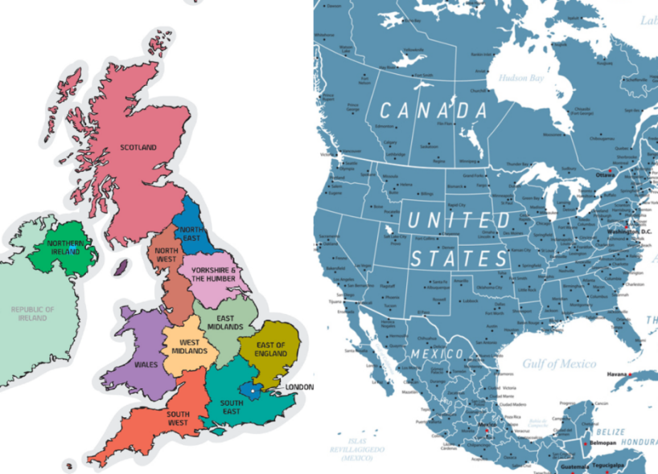
Year 5 Curriculum Plan
Autumn 2 2025/6
Key Curriculum Areas
As Readers we will be enjoying our new class text ‘Wonder’ by R.J. Palacio. We will be using this book to support our fluency skills, as well as completing different comprehension activities, When reading aloud at home, please continue to focus on the key skills of pace, punctuation, fluency and expression.
As Writers we will be also be using ‘Wonder’ by R. J. Palacio. We will be creating formal balanced arguments using themes in the book, before creating sections of narrative that involve dialogue. Within these pieces of writing we will be consolidating rules for punctuating direct and indirect speech, as well as ensuring we use consistent and correct tenses throughout a piece of writing Our non-fiction balanced argument will give an opportunity to learn how to use modal verbs and adverbs (such as can/could, may/might, must, will/would, and shall/should) to explain how something might be possible.
We will continue to use the plan, draft, edit publish process and will be adding our new final pieces to our writing folders.
As Mathematicians we will be continuing to use many of the core skills learnt so far, with particular focus on multiplication and division skills. Multiplication and division are especially important for the children’s understanding of fractions, which is the another one of the units we will be focusing on later on this term.
Please continue to use TTRS to support times tables knowledge, as well as completing the tasks set on Purple Mash each week to support learning in the classroom.
As Religiously Literate students we will be considering how art and music can convey the Christmas narrative. We will think deeply about the theology behind the Nativity story and what this teaches Christians, particularly in relation to the concept of Incarnation. We will analyse different artworks and Christmas carols to understand how these can represent this theology, before creating our own written ad artistic reflections.
The Americas and Us
Overview of Topic
This half term, through our Geography unit we will be learning about the continents of North and South America and Europe. We will be locating main countries, including principle cities and environmental regions as well as identifying both differences and similarities between their urban and rural areas.
Key Vocabulary
county, rural, state, urban, environmental region, Greenwich Meridian, latitude longitude, principle city
Value of the half term: Respect

Slide 2
Other Curriculum Areas
Reminders
P.E Days: We will be having PE a week on Tuesdays and Wednesdays (College). Children will be expected to come to school in their PE kits on Tuesdays and on Wednesdays.
Homework
Reading: This year logging reading at home and school will be done through their Reading Records, which should be brought home daily. Please continue to log all the reading that your child does at home and any comments that you would like to make.
Spelling: Children will be learning and practicing a new spelling rule each week in our Thursday lessons. They can then log on to Emile and use the ‘Task Code’ to access the ‘Learn Game’ for that week’s word list. They have until the following Thursday to complete this.
Maths – Weekly Maths homework will be set on ‘Purple Mash’. This is set on a Friday and is due in the following Friday.
Fruit: If you wish, you may provide your child with a piece of fruit to eat at morning break.
Learning Experiences
Tuesday 11th November- Remembrance Day Service 10:45 outside Jesus Church- all welcome
Thursday 20th November- Year 5 Class Act of Worship for school and Y5 parent/carers 9am
Friday 28th November- Spurs Festival Y5/6 Friday
Friday 12th December- Arts Trophy Final -Performance pm
Wednesday 17th December- Community Carols by Candlelight 3:30 all welcome
Thursday 18th December- Rocksteady Concert to school and parents 9:30 am
Friday 19th December- Christmas Service 12:30 all welcome, all children dismissed at 1:30 pm
As Scientists we will be developing our understanding of different forces, such as gravity, friction and air resistance. We will be planning and carrying out comparative tests designed to answer our scientific questions and will continue to use the vocabulary that we have learnt in previous related units.
As Geographers we will be exploring the UK and North America, including Central America and the Caribbean. We will understand some of the human geography of both locations, with a particular focus on environmental regions and the differences between rural and urban areas. Finally, we will understand how lines of latitude and longitude are connected with time zones and the significance of the Greenwich Meridian.
As Athletes, we will focus on Health and Related Exercise. We will ensure that all pupils understand the meaning of strength, flexibility and the cardiovascular elements of fitness. Pupils will perform cardio, flexibility and strength focused circuits developing their own fitness. We will also be learning about tag rugby. The unit of work will challenge pupils to apply their prior learning of passing and moving, learning how to execute different passes and understanding where, when they are used in a game. Pupils will be able to develop tactics for both attacking and defending and apply these successfully within their team
As Musicians we will explore music about the solar system and analyse how it uses melody, rhythm and facts to create a song. We will also be practising our Christmas Carols in preparation for the Christmas Service and our Reaching Out program.
As Emotionally Literate students we will begin by exploring the value of the half term: Respect. In particular, we will consider how this links with our new school Vision. Our main PSHE unit will include learning how to deal with difficult situations. The children will be given the opportunities to understand why forgiveness is important to a friendship; to understand embarrassment and to develop strategies for anger management.
As Designers we will we be researching, designing and making electrically powered/ pulley system cable cars to support tourism in Yosemite (a key landmark in North America, The children will use the familiar process of researching existing products before designing, making and evaluating their own creations.
As Linguists we will be revising numbers 1-100, speaking about our families,, describing people and our home. We will learn key colours, animals as well as how to speak about celebrations including Christmas.
As Computer Literate students we will be continuously revisiting online safety as well as starting our new unit on concept mapping using the Purple Mash programme.

