Slide 1

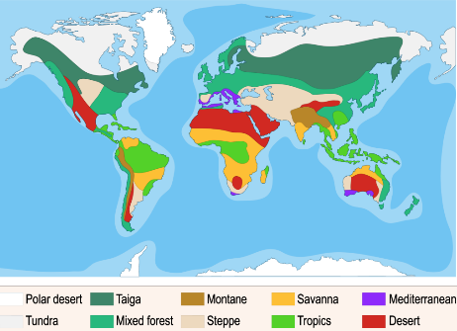
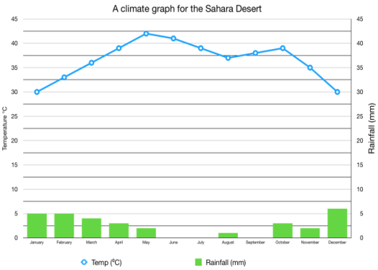
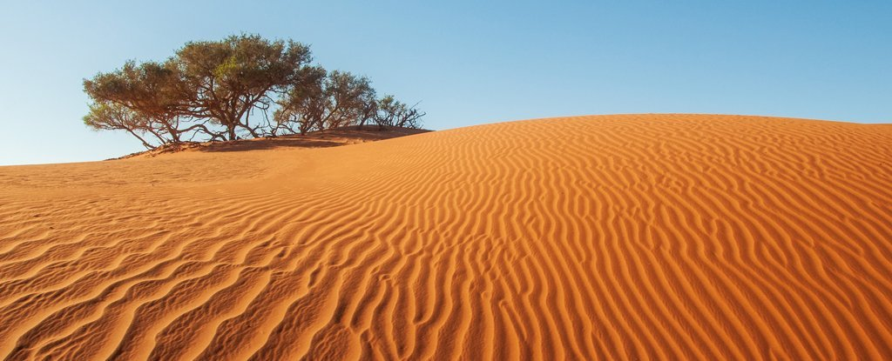
Year 4 Curriculum Plan
Autumn 2 2025-2026
National Curriculum
As Readers this term we will be completing guided reading as a whole class. We will be reading a variety of fiction and non-fiction texts and focusing on the skills of prediction, inference, summarising, and explaining. We will be using these texts to really try and improve our fluency in reading by making sure to read with expression whilst using all the punctuation to help us understand our tone and delivery. We will begin a new class text, ‘The Boy Who Biked the World’ by Alistair Humphreys, which we will enjoy listening to throughout our half term and which is also linked to our Geography unit.
As Writers our writing this half term will be linked to our class book ‘The Boy Who Biked The World – Part One: On the Road to Africa’ by Alistair Humphreys. We will be planning and writing a non-fiction explanation text which will also draw on our learning in our Topic Geography lessons. We will be revising the features of non-fiction writing, using the Internet to find key information and using elements of Talk For Writing to help us construct our own text.
Spellings this half term will include abverbs of manner, time and place. In addition, we will have a recap on some of the 3 & 4 word list.
As Mathematicians we will start with a Measurement unit, focussing on area. We will then begin our first unit on Multiplication and Division, including some focus on the 3, 6, 9, 7, 11 and 12 times tables and their related division facts. We will also look at multiplying numbers by 10 and 0 and dividing numbers by 1 and itself. Please ensure that your child is using Time Table Rock Stars to practice their times tables every day ahead of their statutory assessment in June. Please use the ‘Studio’ setting so that Mr Kansara can monitor their progress.
As Religiously Literate students, we will explore the significance of the Beatitudes, before learning about the idea of ‘Peace’ and how Christians refer to this around Christmas time. We will consider whether the Christmas message of peace is still relevant in today’s world.
All Dried Up: Deserts
Overview of Topic
This Geography and Art unit will be identifying the largest deserts in the world, as well as key geographical points such as the Equator and Tropics of Cancer and Capricorn.
Key Vocabulary
Climate desert, fertile, inhabit, biome, equator, irrigation, latitude, nomad.
Value of the half term: Respect

Slide 2
Reminders
P.E Days
Our P.E days are Thursday and Friday. Children are to come to school in full PE kit on these days.
Reading: Children are expected to read every day at home. They will be recording their reading in their reading records. with them everyday.
Spellings: Children will be expected to go onto the Emile Spelling app and do the learn task that has been set for that week. The words will be based of the rule we had just learnt in the Friday's lesson.
Maths – Weekly Maths homework will be set on ‘Purple Mash’. This is set on a Friday and due in every Friday.
Learning Experiences
Thursday 6th November – Arts trophy launch
Tuesday 11th November – Remembrance Day Church Service
Thursday 20th November – Year 5 Class act of worship
Friday 21st November – Children in Need
WK Beginning 1st December – Assessment week.
Thursday 11th December – Year 6 class act of worship
Friday 12th December – Arts trophy Final – Performances
Tuesday 16th December – EYFS Nativity to the school
Thursday 18th December – Rocksteady concert
Thursday 18th December – Christmas dinner day
Friday 19th December – Christmas service – Jesus Church
Friday 19th December – End of term. Children collected at 1:30pm
Other Curriculum Areas
As Geographers, we will be focussing on developing our knowledge of geographical terms. We will use maps to identify and locate areas of similar environmental desert regions. We will also identify the largest deserts in the world and compare these. We will identify the position and significance of Equator, N. and S. Hemisphere, Tropics of Cancer and Capricorn and use the eight points of a compass and four figure grid references when working with maps.
As Artists, we will be looking at the work of Salvador Dali and learning all about his artistic process. We will then create our own art pieces experience and secondary sources they will learn about changes of state and how this happens. We will also develop our understanding of the water cycle and the changes in state that occur within this process.
As Athletes, we will be looking at Handball. This unit of work will develop pupils’ ability to apply the principles of attack vs. defence, with a particular focus on creating simple attacking tactics in order to move the ball up the court, creating an attack that results in a shooting opportunity. In addition, we will be looking at problem solving. This unit of work will develop pupil’s ability to apply effective teamwork through different problem-solving challenges. Throughout the unit, there will be a focus on pupils' ability to apply skills essential to working within a team as well as create effective tactics.
As Musicians, we will look at the way sounds are produced and classified. The children will use their voices to make beatbox sounds, learn to sing four-part songs and perform a jazzy round.
As Linguists, we will be looking into animals, about the children's likes and dislikes. In addition, different celebrations including Christmas.
As Emotionally Literate students, we will be examining our feelings and thinking about how to overcome barriers to learning. We will learn how to develop resilience and celebrate each others’ strengths, as well as thinking about and discussing the British value of mutual respect.
As Computer Literate students, we will be finishing our topic on coding. We will then be moving on to our topic of Logo. The children will learn about the structure of the coding language of Logo. They will then be able to progress to use and build procedures in Logo.

