Slide 1

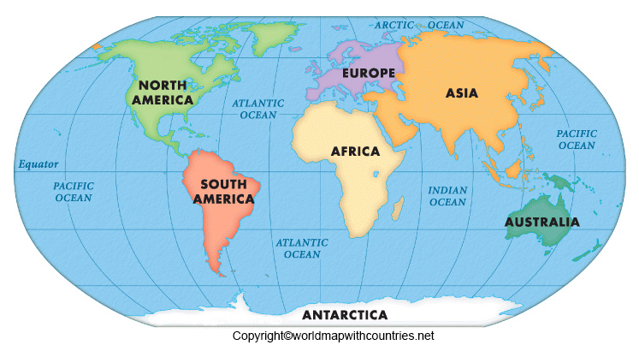
Year 2 Curriculum Plan
Autumn 2 2025
Key Curriculum Areas
As Readers children are expected to read everyday at home and use the Boom Reader journal to communicate what’s going well, any queries you have and anything specific we’d like you to work on. This is also the best way to let us know what your child is reading for pleasure and if they have completed any of the Reading Challenge books. One text is for your child to read to you, it is a text they have used in their adult led reading sessions. As a result we expect them to read this to you almost fluently and with an awareness of how punctuation affects tone and expression. Your child should be able to read ‘tricky words’ by sight and discuss key vocabulary with you.
During class time we will be exploring a key text based on our Topic for this half term, “Our World Continents and Oceans”. Toward the beginning of November we will start to introduce whole class guided reading sessions, which will help with reading skills and comprehension. Our first class text for this half term is “What’s the Commotion in the Ocean?” - A rhyming story about saving our oceans By Nyasha Williams.. The second is Gretta and the Giants; using this text we will explore Non-fiction writing and create some of our own information texts.
As Writers we will be writing our own simple poems this half term, based on our class What’s the Commotion in the Ocean. We will continue to look at expanded noun phrases, using commas for lists, joining our handwriting using the cursive font. We will also be exploring poetic vocabulary such as adjectives and adverbs and perfecting our use of capital letters, full stops, question marks and exclamation marks to define sentences. We will continue to recap and revise all phases of phonics, with emphasis on using all the sounds we know within our writing.
As Mathematicians We are continuing to learn about addition and subtraction, emphasising the use of column methods to help with larger two digit numbers. Towards the end of this half term the children will begin a geometry based topic looking at shape.
As Religiously Literate students As Christmas approaches we will consider the question “How does the symbol of light help us to understand the meaning of Christmas to Christians” We will be thinking about this big question – highlighting that Jesus is referred to in Christianly as the light of the world.
Our World – Continents and Oceans
Overview of Topic
Our world is where we live – our world is complexed, made up of 7 continents and 5 oceans. Each continent is unique in it’s own way. This topic will provide an insight to our world, through discovering each continent and the oceans that surround them. As well as this, we will continue to explore maps, globes and how to use a compass, to enhance our geographical skills and field work.
Key Vocabulary:
Shore, Tide, Continents, Oceans, Intertidal Zone, Sunlit Ocean Zone, Littoral Zone
Value of the half term: Respect

Slide 2
Other Curriculum Areas
Reminders
P.E Days: are on Wednesdays and Fridays – children should come to school in full PE kits on these days. Please keep an eye on the weather as it changes as some of our lessons will be outside and warmer kit may need to be worn. (see Forest School section for clarification on clothing for Wednesdays)
Forest School:
This half term it is Year 2's opportunity to take part in Forest School sessions every Tuesday. Children should come to school in old clothes, bring a waterproof coat and have wellies in a bag to change into after lunch.
Homework
Reading: Children are expected to read everyday at home and use home reading journals to record this.
Spellings: Spellings are available on the Emilie App and are linked to the spelling patterns and rules that they are learning at school during the week.
Fruit: If you wish, you may provide your child with a piece of fruit to eat at morning break.
Learning Experiences
Tuesday 11th November – Remembrance Service @ 10.45am
Friday 21st November - Non uniform fundraiser for Children in Need
Tuesday 25th November – Early Maths Workshop @9am
Monday 1st December – Phase Trip to Chickenshed Theatre 11am
Thursday 11th December – Christmas Jumper Day tbc
Friday 12th December - Arts Trophy Final (Solo Performance)
Wednesday 17th – EYFS Nativity
Wednesday 17th December – Community Carols in the playground @ 3.30pm
Thursday 18th December - Rocksteady Performance to Whole School
Friday 19th December - End of Term Service @ Church 12.30pm
Year 2's Forest School sessions are every Tuesday afternoon this half term!
As Geographers we will be looking at the topic “Our World”. We will be learning about the 7 Continents and the 5 Oceans that make our world the special place that it is. We will be learning how to locate them on a world map, as well as learning some fun and interesting facts! The children will also be exploring how we can direct each other using compasses and maps.
In DT we have the important job of designing Litter Pickers, in order to keep our community and environment clean! The children will be planning and making their litter pickers, thinking about the ways in which we can use them in order to have a positive impact for our planet, tackling littering and pollution.
As Athletes we will be learning about the different skills involved with using balls in different sports. The children will also be able to show off their amazing dancing talents as we have a dance unit called "water". The unit will cover how we can use our bodies to represent different movements.
As Musicians we are exploring a topic called “travel” which links lovely to the “Our World” topic. We will explore the sounds and tones of different instruments, linking them to similar sounds that come from familiar modes of transport.
As Emotionally Literate students as always we will continue to explore and apply our school vision and values where we can within different school experiences. Also the children will be learning about the ways in which we can handle and manage different emotions as and when we feel them on a daily basis or as one off experiences.
As Computer Literate students we will be learning about the varying ways in which we can present ideas and information using different online methods. This includes e-books, concept maps, quizzes and tables.

