Slide 1

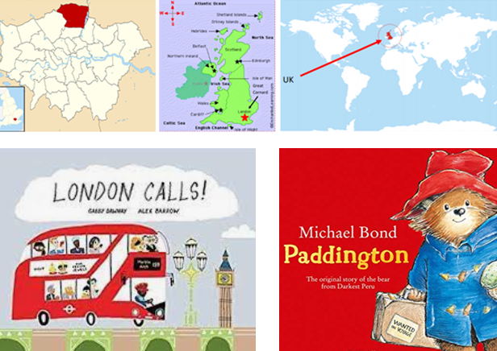
Year 1 Curriculum Plan
Autumn 2 2024-25
Key Curriculum Areas
As Readers we will continue with our three structured reading sessions which allow us to develop our phonic and word reading skills, grow our vocabulary and focus on our understanding of texts. We will continue to grow the code as we take on new Phase 5 graphemes, tricky words and develop our confidence in asking ‘the question’ for example: is it /i/ in light or /i/ in pie? Our tricky words this term are: their, people, oh, your, Mr, Mrs, Ms, ask, could, should, would, our, house, mouse, water, want.
As Writers we will explore two texts Paddington and London Calls. We will spend time becoming familiar with our texts by orally retelling, sequencing pictures, story mapping and role play. We will work towards writing a character description of Paddington. We will also explore the features of non-fiction writing to create a guide to London. We will continue to orally compose our sentences and write using the phonemes we have been taught. We will develop our use of punctuation as we think about when to use a full stop, question or exclamation mark. As we continue to develop our writing skills it is essential we can read our work back. When we are editing, we are developing the correct use of grammar, essential spelling skills and correct letter formation too.
As Mathematicians, we will continue to use a range of manipulatives and number lines to develop our place value and numeracy skills. We will continue to use part part whole models as we further explore the operations of addition and subtraction. We will read, interpret and solve numerical and pictorial number sentences. We will revisit and develop our understanding of 2D and 3D shapes.
As Religiously Literate students, we will explore one big questions. We will focus on Why is each person important in the Nativity story? We will be focusing on the key concept, Incarnation and understand what that means. We will revisit the Nativity and understand the message of the story and how each person holds special significant for Christians.
Where am I?
Overview of Topic
When Paddington Bear arrived in London he probably thought Where am I? We will be asking ourselves the same question as we discover where we are in Enfield, London and the UK. We will use maps, atlases and globes to locate the four countries of the UK and their capital cities, identify their key characteristics, and surrounding seas. We will consider our local area and discuss the pros and cons of different living environments.
Key vocabulary:
Atlas, aerial view, capital city, city, compass point, country, Enfield, island, London, Northern Ireland, Scotland, surrounded, Wales.
Value of the half term: Respect – Through Faith in God, Ourselves and Each Other

Slide 2
Other Curriculum Areas
Reminders
P.E Days
PE kit should be worn to school on a Tuesday and Thursday.
Reading: Children will bring home one decodable text which they have used in three adult led reading practice sessions. As a result, we expect them to read this to you fluently, with an awareness of punctuation and with expression. Your child should be able to read ‘tricky words’ by sight and discuss key vocabulary with you. Please also use the comprehension guide at the back of the book to check their understanding of the text and feel free to create your own questions too. The second text is for you to read and share with your child for pleasure! Children are expected to read every day at home and whilst we provide two books you should not feel limited by these, please read together for learning and for pleasure. You can use Boom Reader to communicate what’s going well, any queries you have and we will note down anything specific we’d like you to work on. This is also the best way to let us know if your child has completed any of the Reading Challenge books from the fifty recommended reads for Year 1.
Learning Experiences
Tuesday 11th November – Remembrance Service at 10;45am
Friday 21st November - Non-uniform Day fundraiser for Children in Need
Tuesday 25th November – Early Maths Workshop at 9am
Friday 28th November – Pathways Christmas Experience at Enfield Town Community Church at 9:30am
Monday 1st December – Phase Trip to Chickenshed Theatre 11am
Thursday 11th December – Christmas Jumper Day
Friday 12th December - Arts Trophy Final (Solo Performance)
Wednesday 17th December - EYFS Nativity to School
Wednesday 17th December – Community Carols in the playground at 3:30pm
Thursday 18th December - Rocksteady Performance to Whole School
Friday 19th December - End of Term Service at 12:30pm
This term you can help your child at home by:
Reading and sharing books with your child every day.
Reading the tricky words: their, people, oh, your, Mr, Mrs, Ms, ask
could, should, would, our, house, mouse, water want
Letter formation using Little Wandle formation phrases.
Reading, making and calculating addition and subtraction number sentences.
2D shape recognition and identifying and naming everyday 3D shapes.
As Scientists we will look at everyday materials and explore their properties. We will consider how materials are made and whether they are natural or man-made. As a result, we will recognise that the same object can be made from different materials and that very different objects can be made from the same material. We will sort and separate using physical grouping, overlapping rings and record this in tables, Venn and Carroll diagrams. Later on we will have the opportunity to apply our materials knowledge in our Design and Technology project.
As Athletes, we will develop pupils’ sending and receiving skills, applying and developing understanding of where we send a ball and why. Pupils will combine their sending and receiving skills to keep possession. Pupils will explore stopping the ball. We will also introduce teamwork. Pupils will explore and learn why it is important to include everyone when working as a team and what makes an effective team. Pupils will begin to explore simple strategies to solve problems
As Emotionally Literate students we will be learning about feelings and recognising that people can feel and respond differently to the same situation. We will identify how different emotions look and feel in our bodies, recognise that some emotions are stronger than others and learn different ways to manage these feelings. We will talk about how change and loss can also affect the way we feel and recognise what we can do for ourselves and others when we experience this.
As Design Technologists we will design and make a scarecrow. We will conduct product research before planning a design which will need to meet the specification of our ‘client’. We will use our materials knowledge to make sensible and practical decisions and of course evaluate our final product.
As musicians we will use the school to explore different sound sources and analyse the different dynamics and duration of sounds. We will think about how we can interpret these sounds on instruments and other materials to create and perform a soundscape.
As Computer Literate students we will continue to familiarise ourselves with the keyboard and logging into Purple Mash independently. We will begin to use the Grouping activities to sort objects by a range of criteria. We will also explore data being represented pictorially and interpret and create our own pictograms.

