Slide 1

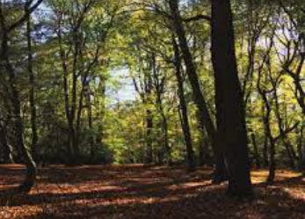
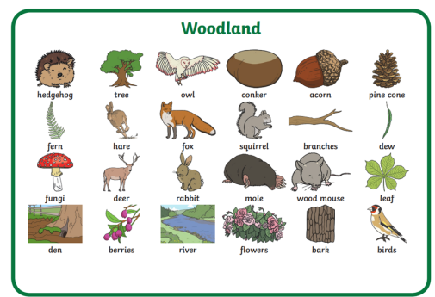
Reception Curriculum Plan
Autumn 2 2025
The Prime Areas:
These three areas are the most important for your child’s development. Their future ability to learn and develop will depend on their strengths in these areas.
Communication and Language – We will continue to engage in story time and share both fiction and non-fiction texts. We will learn and apply a wide range of vocabulary throughout the day and encourage good pronunciation. We will also be developing the ability to understand two-part instructions.
Physical Development – We will explore different ways of using our hands to move with a ball whilst keeping control. Pupils will explore rolling, pushing and bouncing a ball with a partner As always, our in-class provision will support our fine motor development.
Physical, Social and Emotional Development – We will continue to maintain behaviour expectations and develop negotiating with less adult support. We will begin to talk about how others may be feeling and developing appropriate ways to be assertive. We will discuss our Global Neighbours project ‘We’re Not So Different’. As we continue to understand what it is to be, and live as, a refugee we develop our understanding of empathy and a respect for diversity.
The Specific Areas
Literacy
As Readers we will have the opportunity to explore a range of stories based around our topic this term and our class texts: Owl Babies and The Nativity. We will continue to practice reading phonetically decodable words in our daily lessons and continue to recognise tricky words. We will learn : ff, ll, ss, j, v, w, x, y, z, zz, qu, words with s /s/ added at the end (hats sits) ch, sh, th, ng, nk, words ending s /z/ (his) and with s /z/ added at the end (bags). Our new tricky words will be: put, pull, full, as, and, has, his, her, go, no, to, into, she push, he, of, we, me, be
As Writers we will have lots of opportunities to mark-make using a range of different materials. As we learn each phoneme we will focus on forming its grapheme correctly. We will also begin to try and write our names independently and write some simple words.
Into the woods
Overview of Topic
Our focus for this half term is ‘Into the woods’. We will develop our knowledge of what being in the woods looks and feels like, as well as the animals it homes by exploring our own woodland area within the school. We will create our own individual art pieces and woodland creatures using natural resources.
Key Vocabulary
tree trunk, branches, swooped
nocturnal, hoot,
Owl, owlet, fledgling
Half Term Value – Respect

Slide 2

The Specific Areas
Maths
As Mathematicians we will continue to represent, compare and compose number with pictures and objects as we begin to recognise digits and count accurately. As our confidence and understand of numbers to 5 develop we will begin to explore one more or less than a given number. We will look at shape, beginning with circles and triangles and then shapes with four sides. We will recognise shapes within the environment and consider their orientation. We will also explore positional and directional language through different tasks, using vocabulary to describe where things are positioned and how to get to them. As we begin to look at time we will think about different activities we do during the day and at night.
Understanding the World
As explorers we will respond to the natural world around us and talk about how we feel when we are outdoors. We will observe and discuss the effects of the changing season. We will think about what we can see or hear and explore what lives in our woodland area and learn about the life cycle of an Owl.
Expressive Arts and Design
As Artists we will make nests and owls with natural materials. We will enjoy songs and music making as we prepare for the Nativity and use props to retell the story. We will be learning to sing in a group, increasingly matching pitch and following a melody. We will continue to develop our role play skills as we extend our storylines. Through both our into the wood topic and Nativity focus we will also begin to understand landscape paintings and explore marbling to create backgrounds.
As Religiously Literate students we will begin to explore the key concept Incarnation as we focus on our Big Question Why is Christmas special for Christians? We will become familiar with the events of the Nativity and discover how Mary knew she was going to have a baby through the visit of Archangel Gabriel. We will begin to understand how Christians prepare for Christmas and how the special gift of Christ makes Christmas so special for them.
Reminders:
PE Days: Our PE day continues to be Thursday. Please ensure that children come to school in their PE kit for the day.
Reading: Daily phonics sessions continue. We will send home the phoneme and grapheme correspondence that children have learnt for the week and ask parents to practice these at home.
Dates for your diary:
Tuesday 11th November – Remembrance Service @ 10.45am
Friday 21st November - Non uniform fundraiser for Children in Need
Tuesday 25th November – Early Maths Workshop @9am
Monday 1st December – Phase Trip to Chickenshed Theatre 11am
Thursday 11th December – Christmas Jumper Day tbc
Friday 12th December - Arts Trophy Final (Solo Performance)
Wednesday 17th – EYFS Nativity
Wednesday 17th December – Community Carols in the playground @ 3.30pm
Thursday 18th December - Rocksteady Performance to Whole School
Friday 19th December - End of Term Service @ Church 12.30pm
.

