Slide 1







Slide 2

What's all the fuss about?
Phonics
Reading
Writing
Vocabulary

Slide 3
A love of reading is the biggest indicator of future academic success.
OECD (The Organisation for Economic Co-operation and Development)
Notes:
Slide purpose:
To share the link that research has established between loving reading and being successful academically
Suggested script:
Let's start our session with a quote from the Organisation for Economic Co-operation and Development ...
Read the quote.
This quote reminds us of the importance not just of teaching children to read, but also of teaching them to love reading.
Today, we're going to talk about phonics, but we always see phonics as the route into reading and a love of reading as the ultimate goal of phonics teaching.

Slide 4




How many times have you already read today?
Notes:
Slide purpose:
To help parents see the value of reading by getting them to reflect on their own reading experiences
Suggested script:
Just think about how many times you have already read things today. More than ever, we are surrounded by text and reading is a vital skill.
We want all of our children to become confident readers who can navigate the world of reading around them.

Slide 5
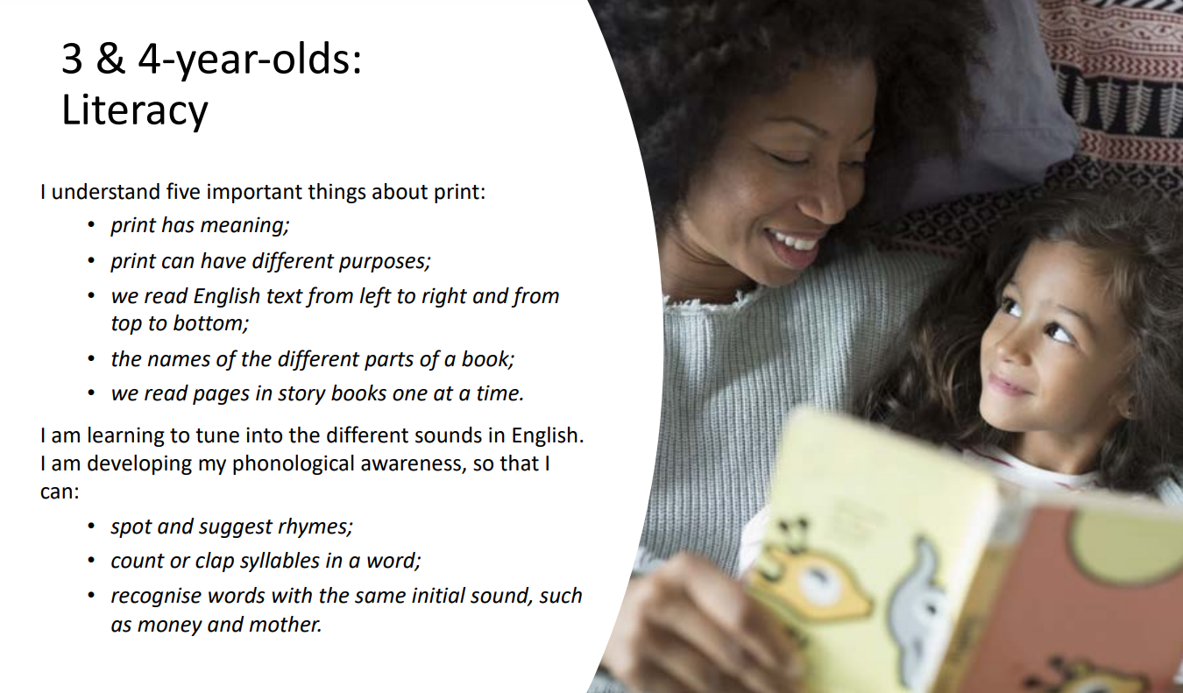

Slide 6
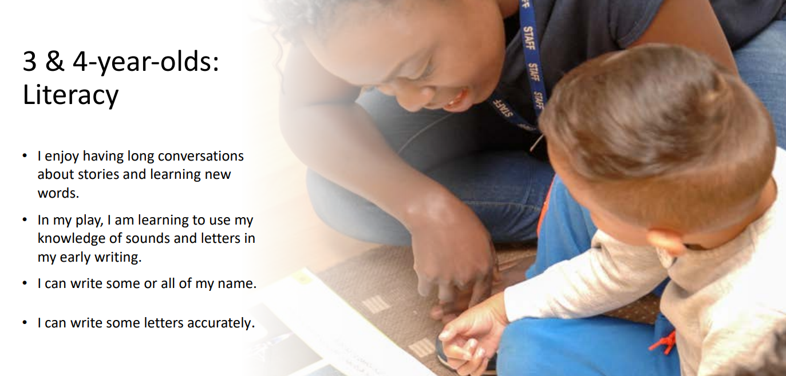

Slide 7
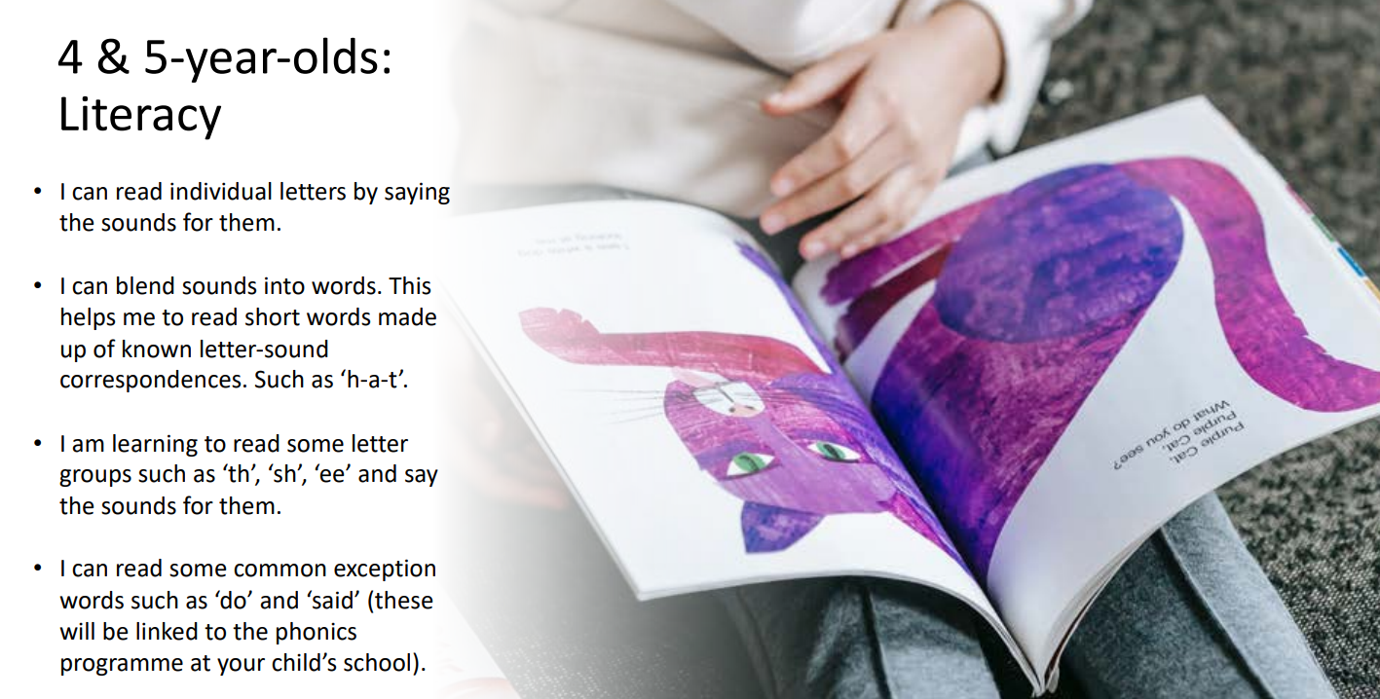

Slide 8
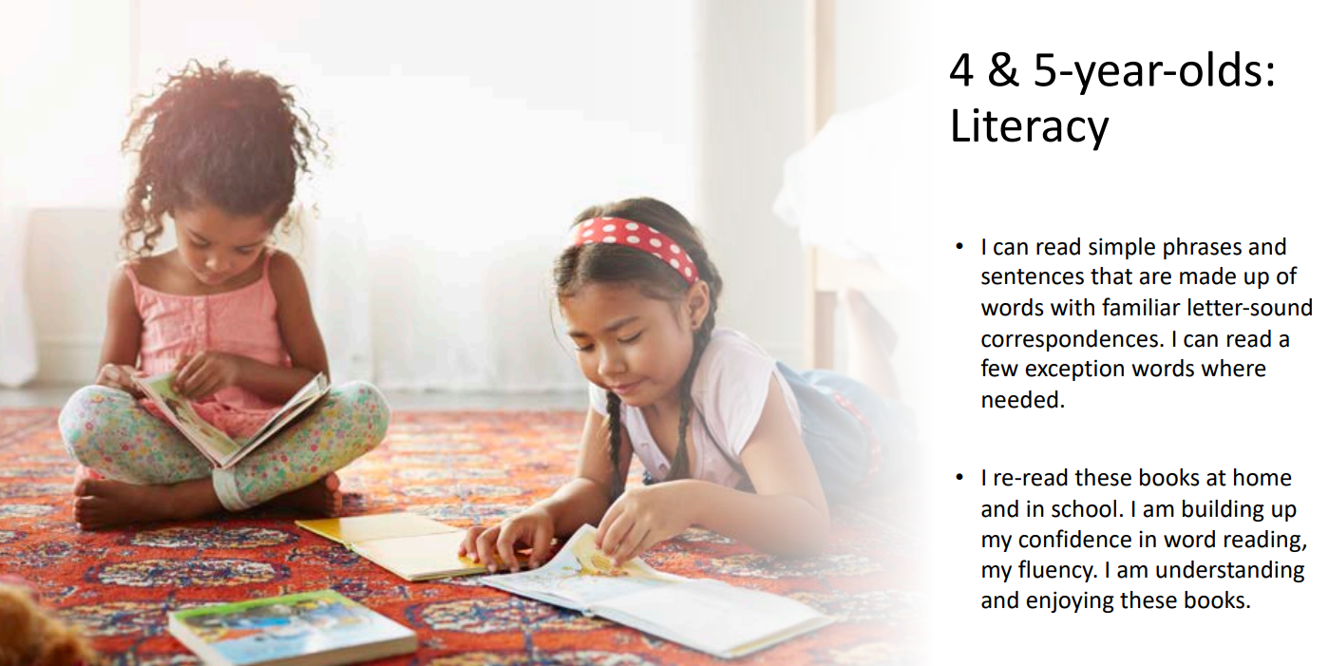

Slide 9
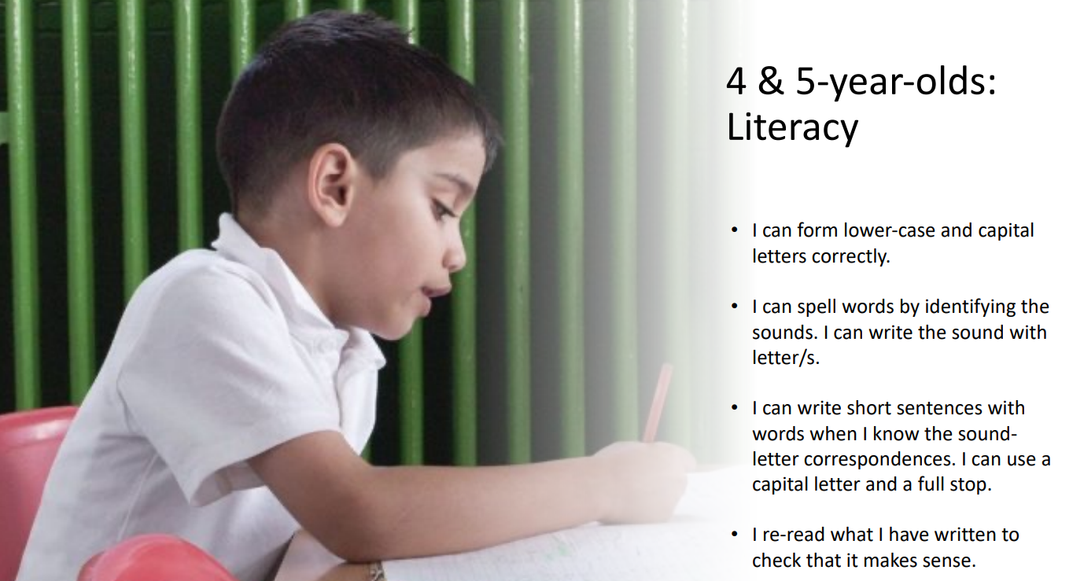

Slide 10
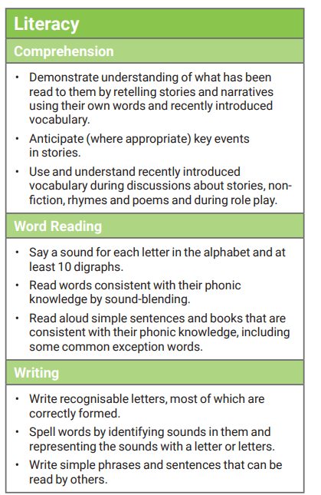
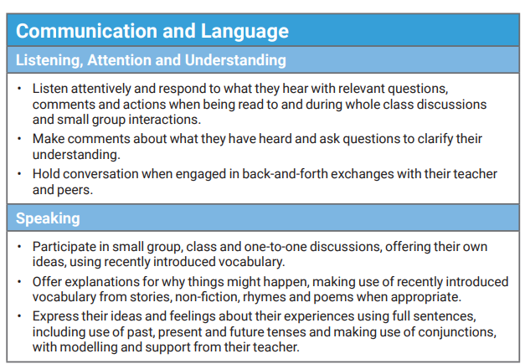
At the end of Reception children should be able to:

Slide 11


How, and why, do we teach Phonics at Forty Hill School?

Slide 12





Slide 13
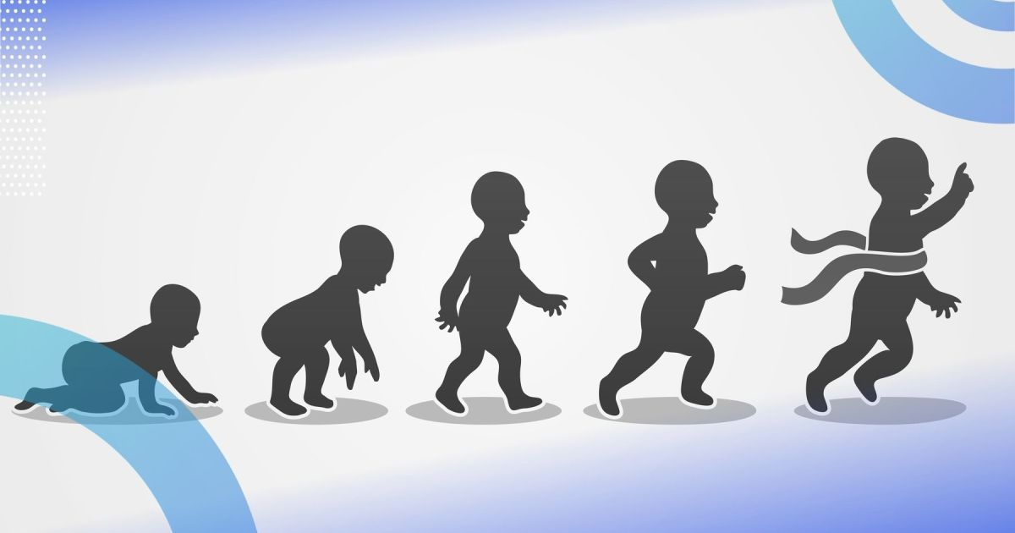

Slide 14






Systematic Synthetic Phonics ~ SSP

Slide 15

What makes a Phonics Scheme a scheme?

Slide 16
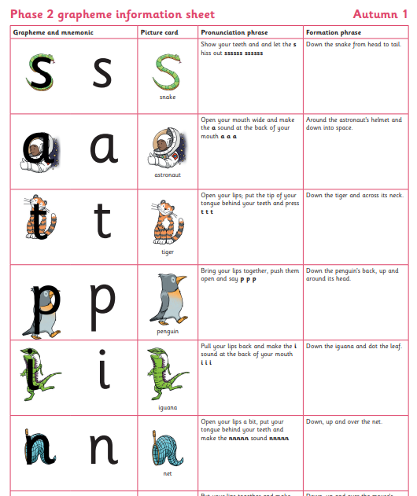
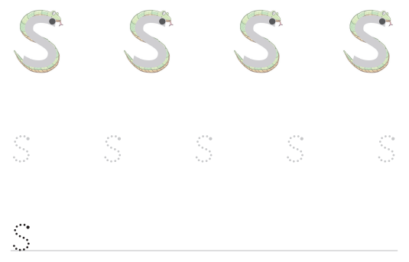
Consistency – with formation phrases. Grapheme to phone correspondence follows through into writing.

Slide 17
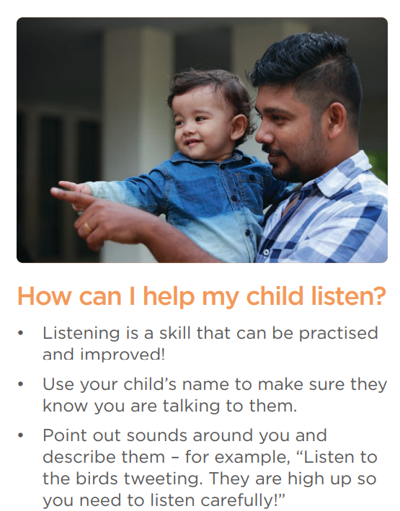
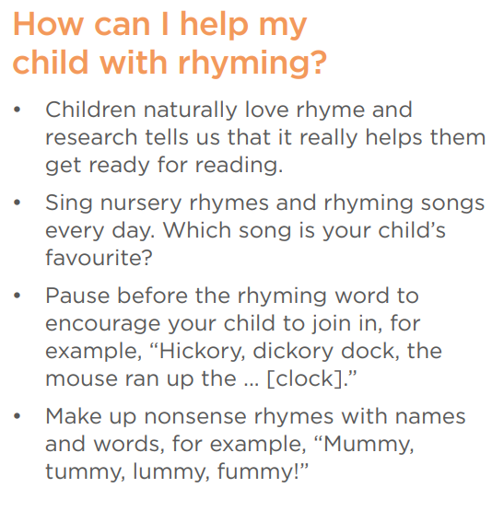

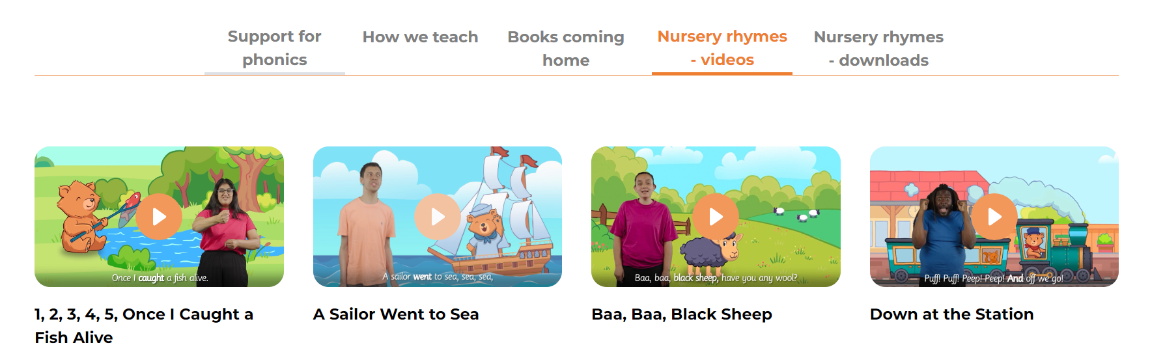

Slide 18

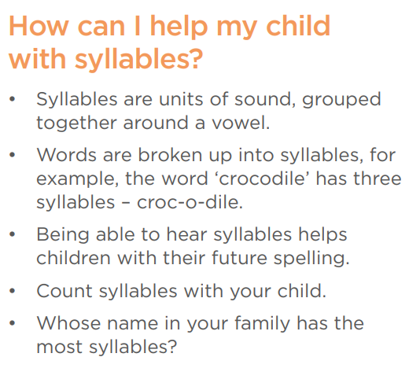
Mumm-y
Dadd-y
Tho-mas
Will-i-am
O-liv-er
Josh-u-a

Slide 19
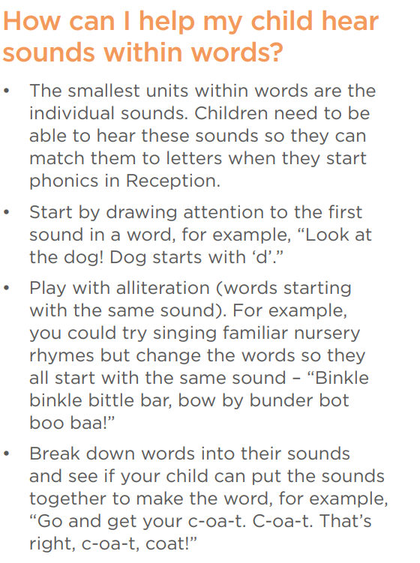
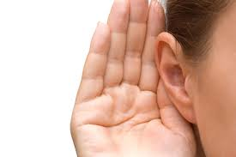

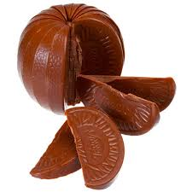

Slide 20
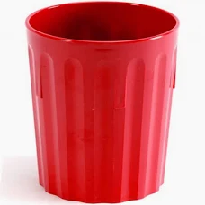

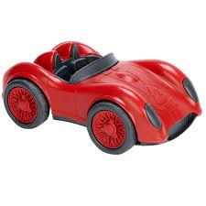
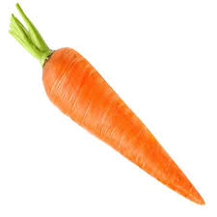

Slide 21
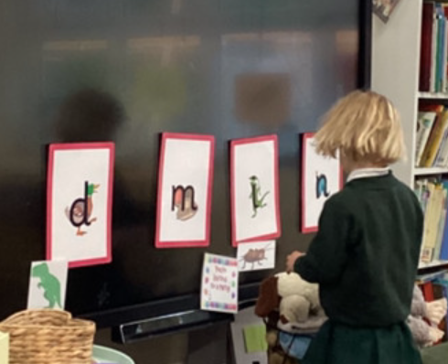
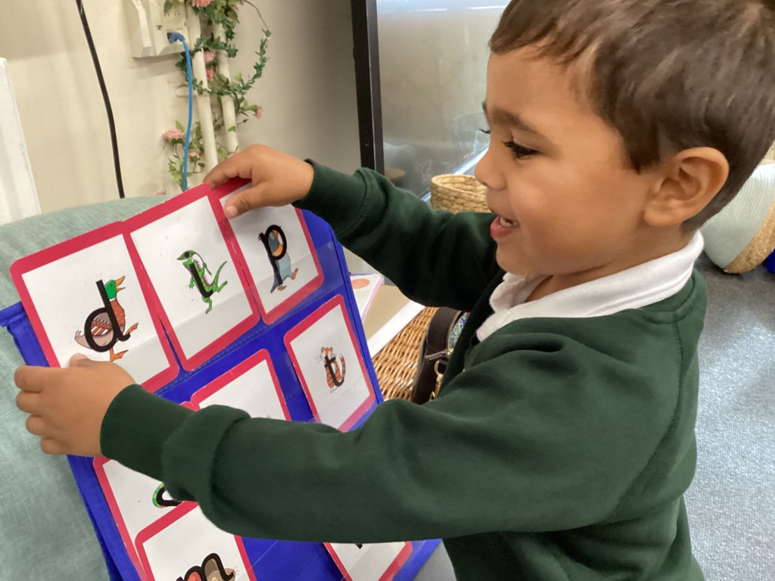
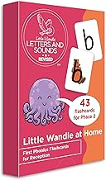
Initial sound matching games and building words!
https://www.amazon.co.uk/Little-Wandle-Phonics-Flashcards-Reception/dp/000856373X/ref=sr_1_1?crid=27CKECFV8CNFJ&dib=eyJ2IjoiMSJ9.k6o_tRv38ntYWocwsdxla1UC_Ic7JC8B1LTxjWZaNa6gOXEH-p6KBowIuEaAfawKlpXFK3bXCvJHlZILq_3KI_4Ijnl-lQ2XfFkFI6Prkwk0msPeeHAdRB2ypFCskLhPJoLQn-2XMOyll2SQJinJMSS5kNLfOmJj2PAYy4M8TIK_b4Odx0Nku1VHq8XqTaRwf8iwDJNb6RrHJm0AM_tGn0sABlddyDu9JCUee1azTKM.D7erjnCVcbAKaOlMbbOPFpvZBCTC25BFWwBLXKLK1Jg&dib_tag=se&keywords=little+wandle+at+home&qid=1759180019&sprefix=little+wandle+at+home%2Caps%2C156&sr=8-1

Slide 22
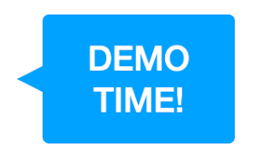




Slide 23
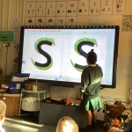
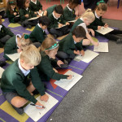
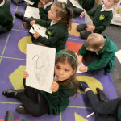
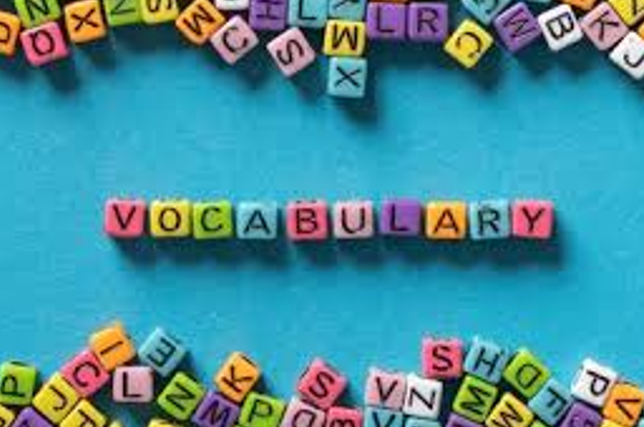
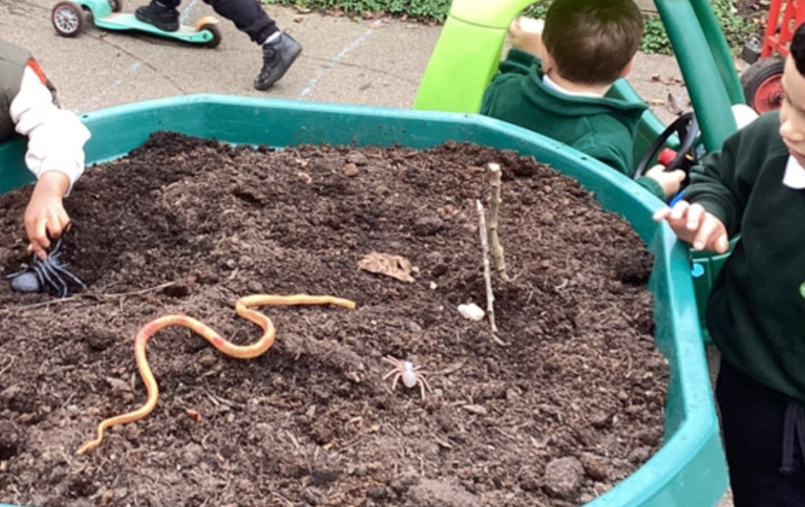

Slide 24
Terminology
Phoneme: The smallest unit of sound that can be identified in words. We also use the term ‘sound’ but your child may use the word ‘phoneme’. There are 44 phonemes or sounds in the English language.
Grapheme: A letter or group of letters used to represent a phoneme in writing. The way graphemes are used to represent phonemes in our written language is known as the alphabetic code.

Slide 25
Decode: To break down (‘sound out’) a written word into sounds then blend the sounds together to read the word.
Digraph: A grapheme made of two letters that represent one sound. An example is the ‘sh’ in ‘shop’.
Schwa: This is the name for the most common sound in English. It is the unstressed sound that we find in many words and can be spelled in many ways. It makes an ‘uh’ sound, which varies according to accent. Examples include: the, better, carrot, balloon.

Slide 26
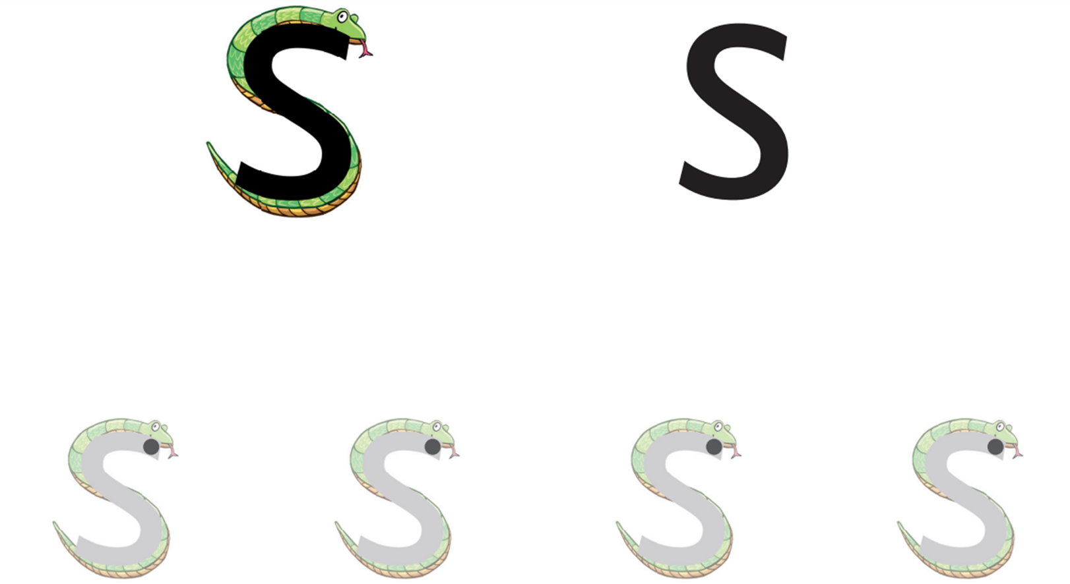
Phoneme and Grapheme
The first sound in snake is - sss

Slide 27



Digraph

Slide 28


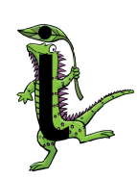
Decode

Slide 29
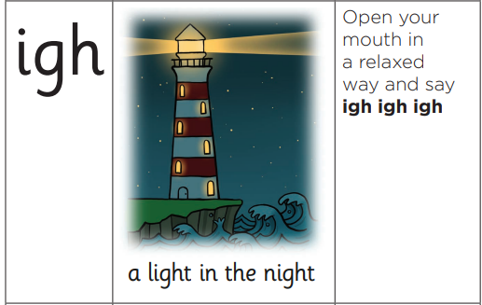
Trigraph - A grapheme made of three letters that represent one sound. An example is the ‘igh’ in ‘light’ and 'night'.

Slide 30
Can you see any graphemes/letters working together to make one sound?
Can you see a trigraph?
light

Slide 31
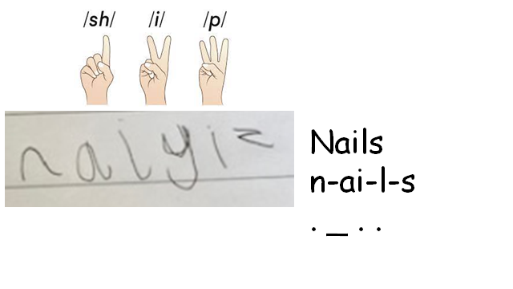
Pronunciation (pure sounds)

Slide 32

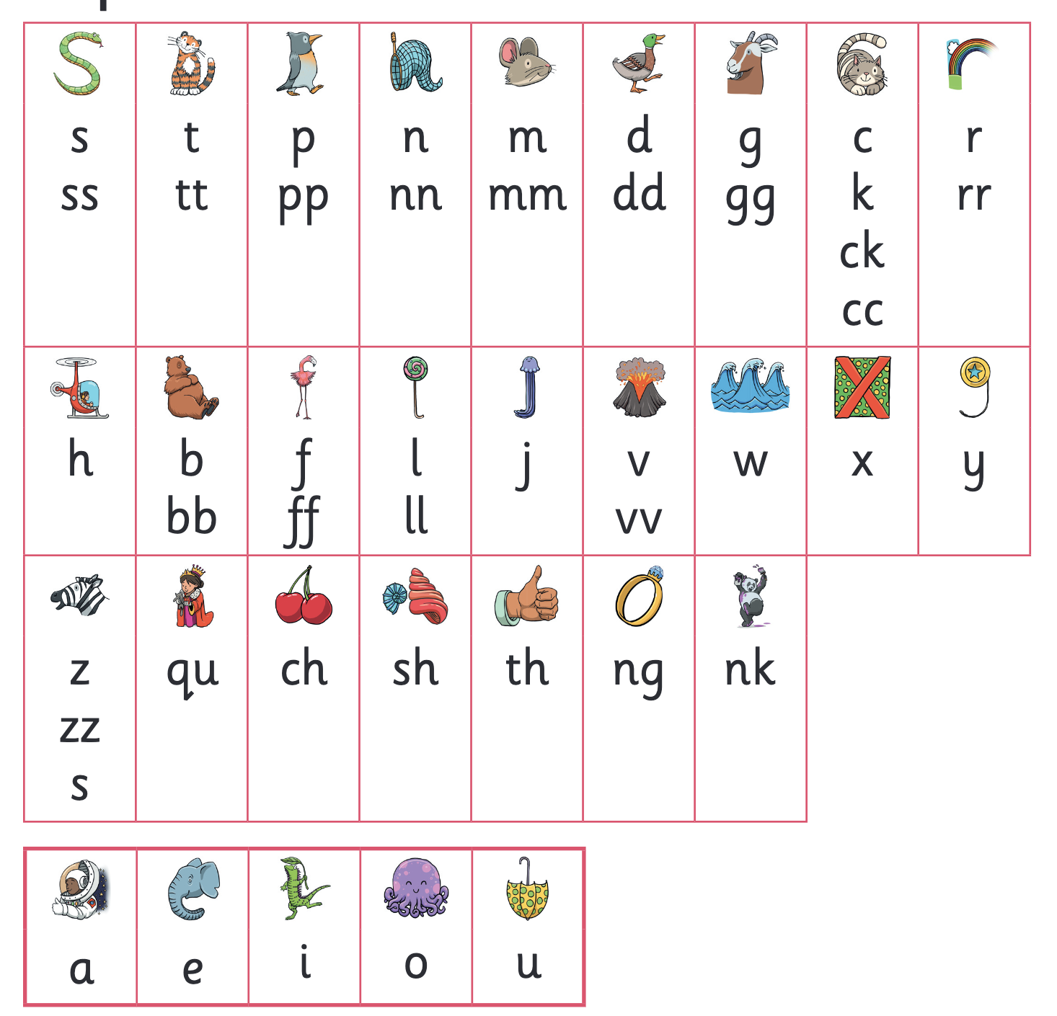
Let’s say the Phase 2 sounds
Notes:
Slide purpose:
To practise the Phase 2 sounds
Notes
Give out the parent handout and the Phase 2 and 3 grapheme mat.
Play the videos/teach the parents to say the Phase 2 sounds: https://www.littlewandlelettersandsounds.org.uk/resources/for-parents/
Show parents where to access these videos in the ‘For parents’ area of the Little Wandle website.

Slide 33
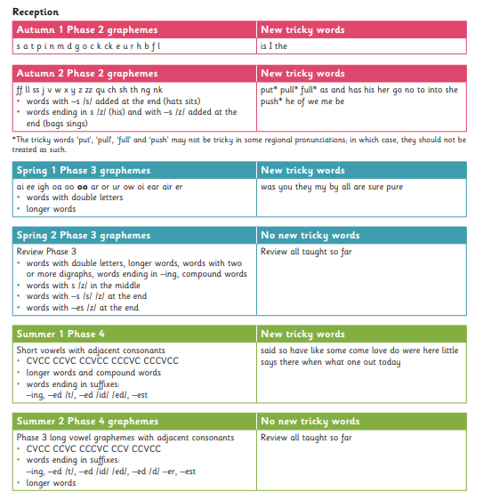
Progression

Slide 34
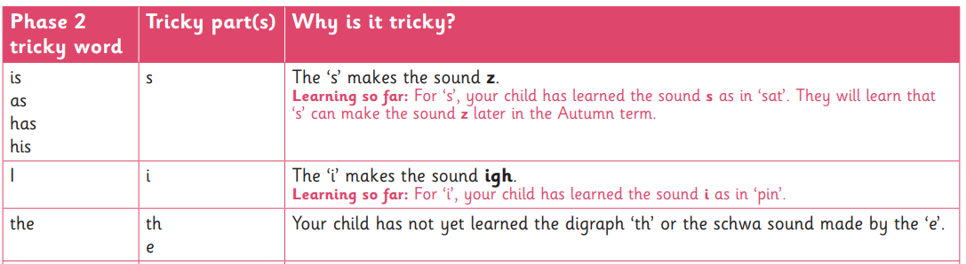
Tricky Words

Slide 35



The ‘s’ makes the sound z. Learning so far: For ‘s’, your child has learned the sound s as in ‘sat’. They will learn that ‘s’ can make the sound z later in the Autumn term
The ‘i’ makes the sound igh.
Learning so far: For ‘i’, your child has learned the sound i as in ‘pin’
Your child has not yet learned the digraph ‘th’ or the schwa sound made by the ‘e’.
Schwa: This is the name for the most common sound in English. It is the unstressed sound that we find in many words and can be spelled in many ways. It makes an ‘uh’ sound, which varies according to accent. Examples include: the, better, carrot, balloon

Slide 36
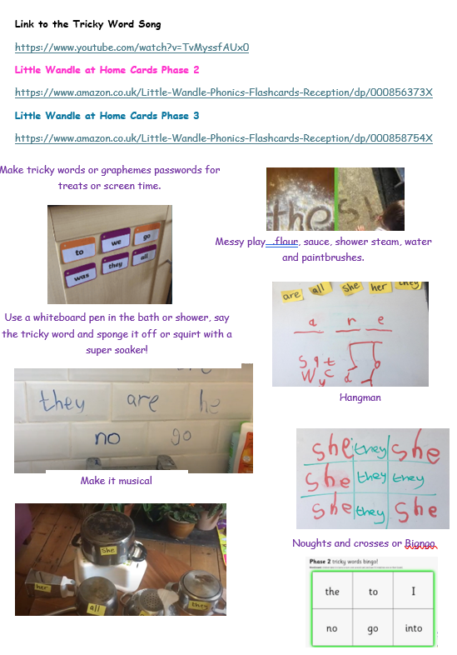
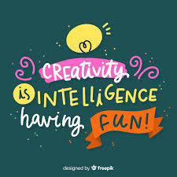

Slide 37

Reading @ Forty Hill
Love of reading
Daily Phonics
Phonic Assessments
Wordless picture books/
School reading sessions x3
GPC's

Slide 38
Assessment
Children are assessed individually after each half term and daily interventions are then provided, as necessary.
Reading books will be allocated in relation to this data.

Slide 39

How do we find the right book for your child?
Notes:
Slide purpose:
To introduce book matching
Suggested script:
We assess your child every six weeks to check progress.
Any child who needs extra support has Daily Keep-up sessions planned for them.

Slide 40
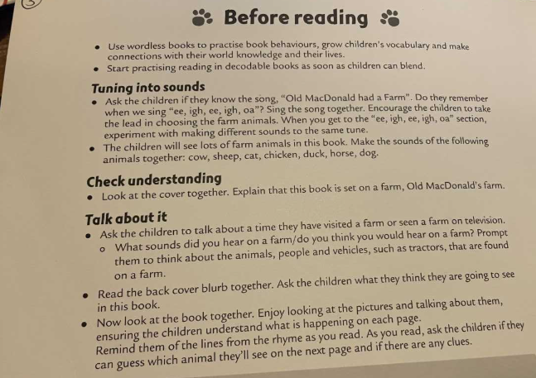
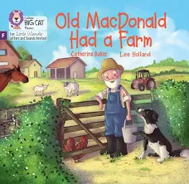
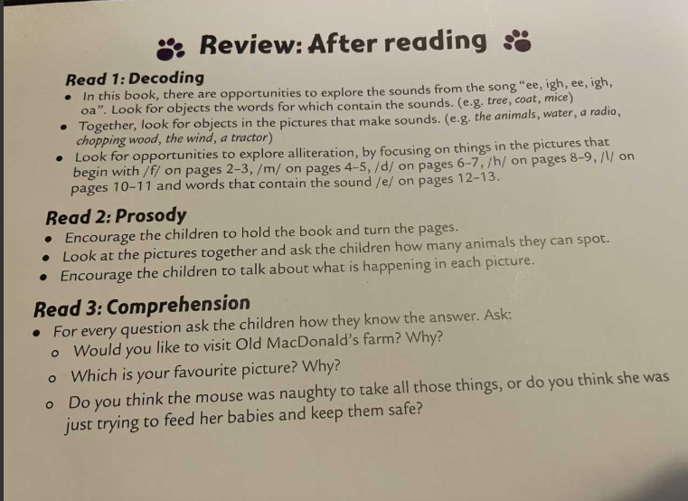
Use wordless books to practise book behaviours , grow vocabulary and make connections with the world and
lived experiences.
Use them to tune into sound and once your child can blend.

Slide 41
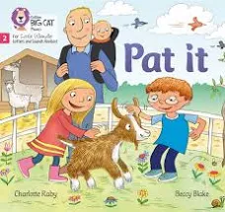
Three reading sessions a week, each with a specific focus
GPC’s and words – Inside the front cover your child should be able to read each sound and use them to read the decodable words.
At some point tricky words will also be included here and should be read by sight.
Prosody – reading with expression and taking note of punctuation.
Comprehension – Asking and answering questions to check understanding through specific recall.

Slide 42
Listening to your child read their phonics book
Your child should be able to read their book without your help.
They might sound out words and blend them before they read them fluently.
If they can’t read a word, read it to them.
Talk about the book and celebrate their success.
Notes:
Slide purpose:
To give guidance on reading the decodable book at home
Notes
Read the slide.

Slide 43
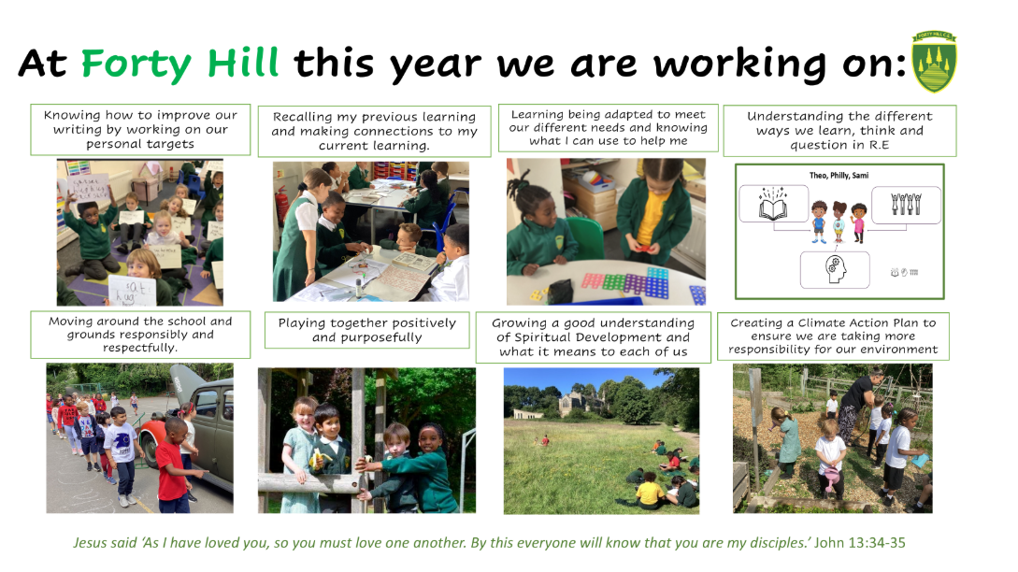

Slide 44
Knowing personal targets
This may be a particular sound or
formation aspect. It could be looking up and
maintaining focus. Segmenting and/or blending
Knowing what helps me
Mnemonics, sound mat.
Recall
This features in every Phonics lesson,
targeted questioning.

Slide 45
What can I do to support my child at home?
• Ask them what sounds they have learned each day and point out objects in the environment or in books that start with that sound.
• Read to your child daily – choose books that you can enjoy together.
• Listen to them practise reading their phonics book to develop their fluency.
• Ask us if you need extra help with supporting your child – that’s what we’re here for!

Slide 46
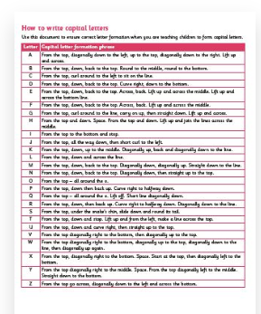
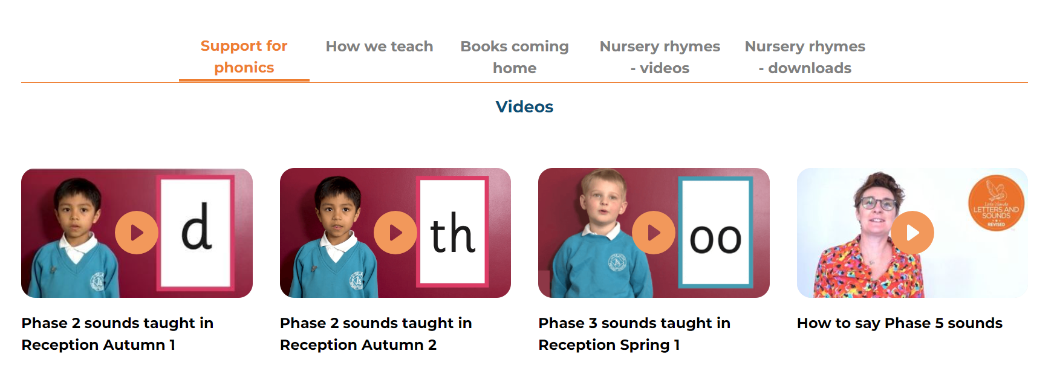
Little Wandle – For parents tab!
https://www.littlewandlelettersandsounds.org.uk/resources/for-parents/

Slide 47
Support/consistency at home.

Slide 48
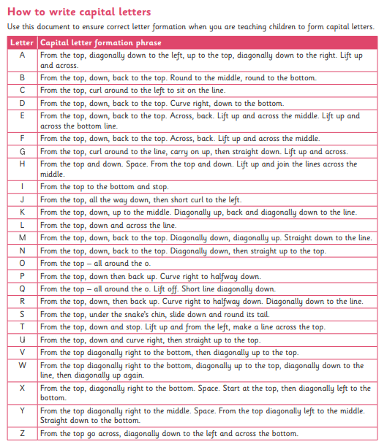
Captial letters

Slide 49

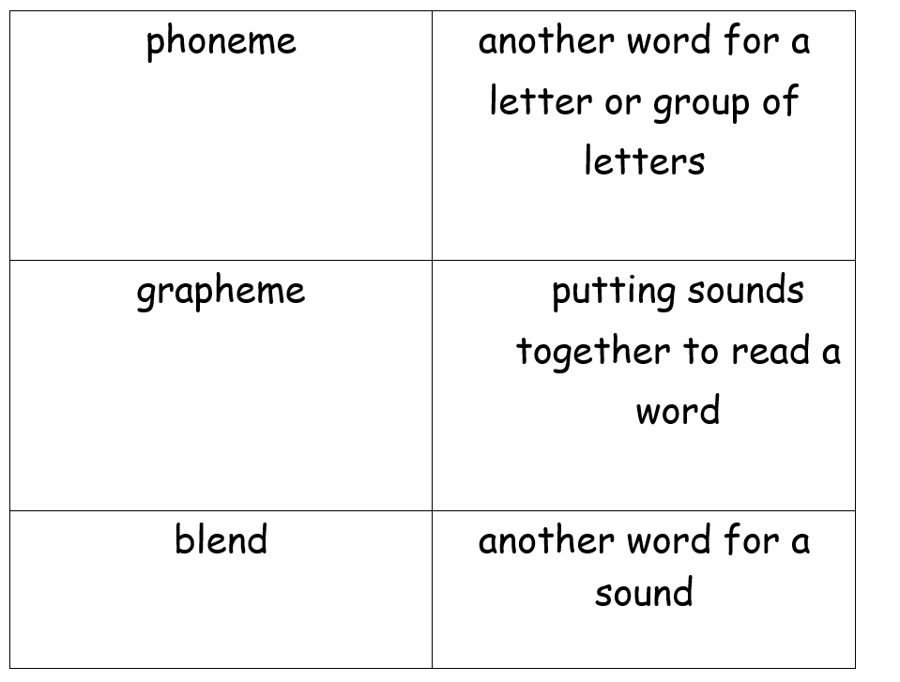
Match the words to the definitions

Slide 50

Any questions?

