Slide 1

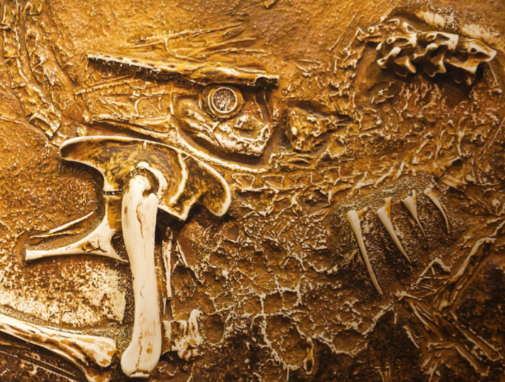
Year 1 Curriculum Plan
Autumn 1 2025-26
Key Curriculum Areas
As Readers we will have daily phonic sessions that will revisit, review and consolidate our prior knowledge (Phase 2, 3 and 4) before moving onto Phase 5 learning. In addition to this the children will have focused reading sessions using carefully matched phonetically decodable texts. These structured sessions will ensure that children are working not just on word reading, but increasing their fluency, reading with expression and building essential comprehension skills. We learn to read so that we can read to learn and great readers make great writers too.
As Writers we will use our text Gigantosaurus to explore how words combine to make sentences and focus on identifying nouns and adjectives. We will sequence events, retell and then have the chance to innovate the story. We will use Dear Dinosaur to write for purpose as we identify key features of letter writing. We will reflect our curiosity and developing subject knowledge about dinosaurs by writing letters which include questions and of course include a question mark. We will use the strategy, say it, write it and read it back to ensure our writing matches our oral composition. We will continue to focus on using capital letters, finger spaces, full stops and correct letter formation too!
As Mathematicians, we will use a number of resources to develop our numeracy skills. We will sort objects in different ways, ensure we are counting accurately and represent number pictorially alongside forming numbers correctly. We will focus on numbers within 10 initially and ensure that we can count forwards and backwards and state one more or one less than any given number. We will also use the language of fewer and greater and begin to recognise that symbols can be used for more than (>), less than (<) and equal to (=) to compare number. We will begin to read, interpret and solve addition sentences using part whole models and number bond facts.
As Religiously Literate students, we will be thinking about our Big Question ‘What Responsibility Has God Given People For Taking Care of Creation?’ We will focus on the story, and key concept, of creation and think about what it means to Christian’s to be made in God’s image. We will identify what Christian’s believe are their instructions for caring for creation and each other.
Footprints From The Past
Overview of Topic
Dinosaurs lived millions of years ago – long before people lived on Earth. No one has ever seen a dinosaur so how do we know anything about them? Fossil evidence and dinosaur bones provide our only clues.
Like detectives, we will try to discover what dinosaurs looked like, what they ate and what became of this remarkable species.
Key Vocabulary
Armoured Carnivore Extinct Fossil Herbivore Predator Prey Skeleton Excavate Paleontologist
Value of the half term: Learning and living in faith through building confidence.

Slide 2
Other Curriculum Areas
Reminders
P.E Days
PE days will be Wednesday and Friday and on those days children will come to school in their PE kits.
Reading: Children are expected to read everyday at home and use the home reading journals to communicate what’s going well, any queries you have and anything specific we’d like you to work on. This is also the best way to let us know what your child is reading for pleasure and if they have completed any of the Reading Challenge books. The matched decodable text is for your child to read to you, it is a text they have used in their adult led reading sessions. As a result we expect them to read this to you almost fluently and with an awareness of how punctuation affects tone and expression. Your child should be able to read ‘tricky words’ by sight and discuss key vocabulary with you. The second text is for you to read and share with your child for pleasure!
This term you can help your child at home by:
Reading and sharing books with your child every day.
Letter and number formation practice.
Reading and writing numbers to 10 in numerals and word.
Counting up to 20 forwards and backwards
Identifying pairs of numbers that total 5 and 10.
Learning Experiences
Tuesday 9th September – Afternoon Forest School Sessions begin (children attend school dressed in casual clothing that is suitable for being outdoors in the woodland area, labelled wellies to be sent in a separate carrier bag).
Sunday 14th September, 10:30am – School Blessing service at Jesus Church
Thursday 25th September – Individual and sibling photographs
Wednesday 1st October, 10am – School Harvest Festival at Jesus Church
Tuesday 7th October, 9am OR 2:30pm – Phonics Workshop
Week Commencing 13th October – Multicultural Week
Friday 17th October – World Polio Day Fundraiser
As Scientists we will be observing seasonal changes. We will begin with an Autumn scavenger hunt and begin to observe signs of autumn. We will observe changes to trees and continue to observe a ‘focus’ tree in each of the four seasons. We will observe and describe the different weather types across the seasons and use our knowledge to suggest answers to questions. We will record weather types over a period of time and focus on how day length varies by noting the time that it gets dark too.
As Athletes we will be focusing on running and will work to develop our ability to run using different parts of our body. We will begin to understand the basic principles of attack and defence as they develop our understanding of where we need to run and why. We will also be focusing on Health and Wellbeing where we will begin to understand agility, balance and co-ordination, understanding what they mean and why they are important. We will perform circuits to develop application and understanding.
As Emotionally Literate students we will think about what makes us special by reflecting on our similarities and differences. We will explore our roles and responsibilities at home, in school and towards the environment. We will think about co-operation, recognise what that looks like in practice and how to respond when things don’t go to plan. We will often use stories, and pictures as a stimulus to support being able to think widely and role play scenarios to assist in solving dilemmas Our Global Citizenships sessions are part of a cross curricula projects and our focus will be Raising Our Voices : the role of music in social change, , looking at human rights and equality issues and how music has been used to express people’s voices. Our vision and values serve as a frequent point of reference during our PSHE, P4C and Global Citizenship sessions.
As Artists we will explore fossil formation with printing and rubbing. We will shape and model clay to build our own 3D fossil sculptures.
As musicians we will explore sounds and consider how the weather can be represented through music We will explore and control dynamics (volume), duration and timbre with voices, actions, body percussion and instruments. We will also identify a sequence of sounds and respond to music with movement.
As Computer Literate students we will begin with online safety sessions and revisit what it means to be ‘safe online’. We will then develop this as we begin to explore Purple Mash and understand how to log in (and off) safely and with greater independence. We will learn how to find saved work in the Online Work area and find teacher comments. We will become familiar with the icons, types of resources and learn how to open, save and print.

