Slide 1
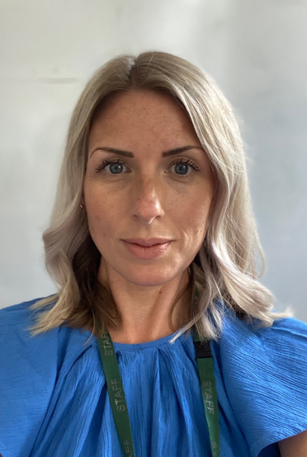
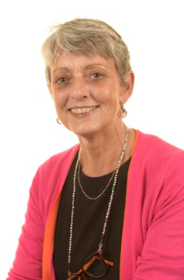
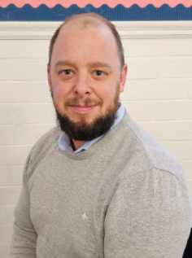
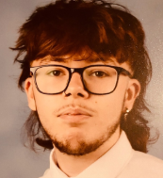
Welcome to Year 6
Miss Dale
Mrs Brewer
Mr Pennock Mr Theodosi

Slide 2

Our NEW Vision and Values at Forty Hill CE

Slide 3
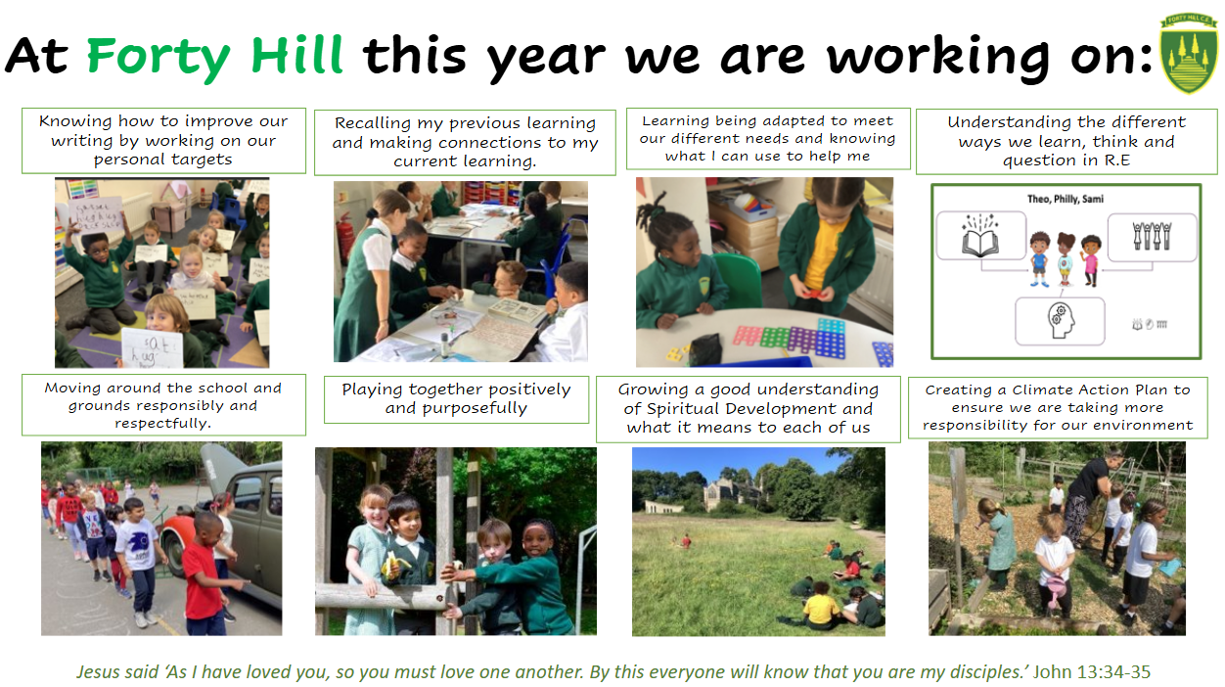
Our School Priorities 2025-2026

Slide 4
Whole Curriculum
History
English
Geography
Maths
Music
Art
DT
Science
PSHE
R.E
P.E
Please see your class overview in the class section of the school website for more information on what is being covered in each area throughout the year.
Please do remember we always publish a half termly curriculum booklet too which will be coming home soon. This will give you even more details about what your child is doing in school so that you know what we are learning each half term.

Slide 5
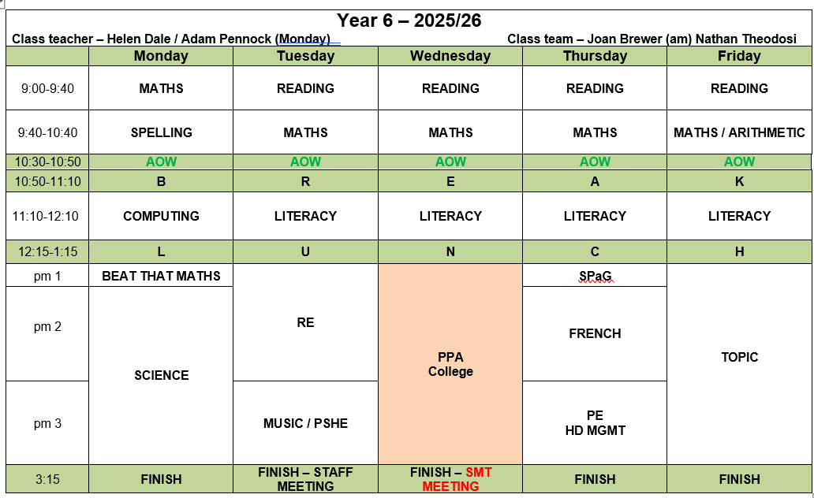
Our Timetable

Slide 6

Reading Expectations
Your child will develop their reading skills during their reading sessions at school. In year 5 and 6 your child may bring a book band book home if the school feels it would be helpful.
In Year 6, we still expect children to be reading at home. Reading continues to be hugely impactful on their outcomes and achievement. However, we also appreciate that they can read and fill in reading records independently and it should be their responsibility to do so.
Reading records should be bought into school each Friday.

Slide 7
Reading Challenge
We want children to enjoy reading and share books with you at home. We are re-launching our Reading Challenge this year. Each class will have a list of books that we feel children should be reading at their age and your child can tick these off throughout the year to complete the challenge.
These lists, along with more information, will be sent home to you.

Slide 8

Homework
MATHS – In Year 6, your children will take home paper homework each week, on a Friday. There will be one piece of work for each learning objective covered during the week’s lessons. This homework should take 30 – 45 minutes to complete and must be returned by the following Thursday. If your child finds this work difficult, they must see me before the deadline and I will offer support and guidance so that they can complete this.
SPELLING – Weekly spelling lists will be provided. Spelling lessons will take place on Mondays. Children must learn the spellings at home and practice them for a test the following Monday. They will learn statutory spelling rules provided by the National Curriculum and revise words from the Year 3 / 4 and Year 5 /6 statutory list.
Please note their will be additional homework and revision activities to complete at home as we get closer to SATs.

Slide 9
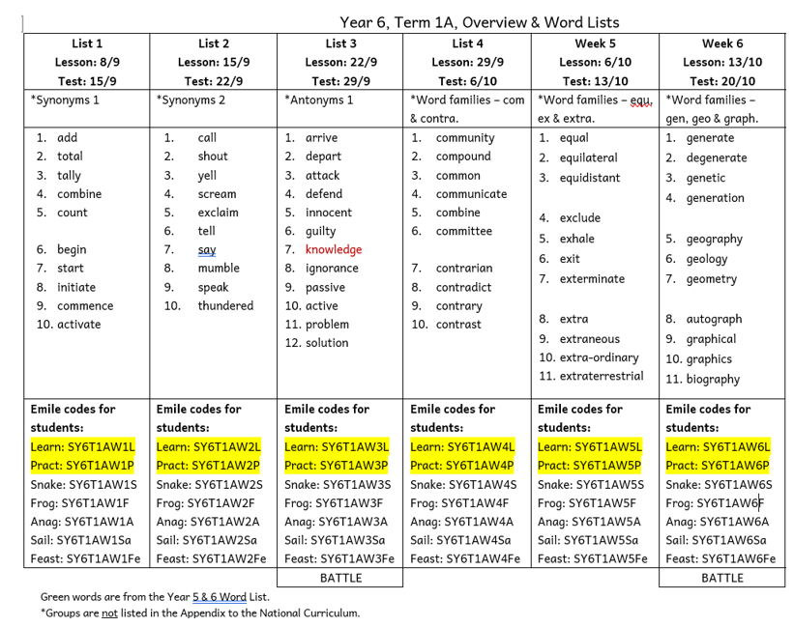
Homework- Spellings with Emile app to support learning

Slide 10
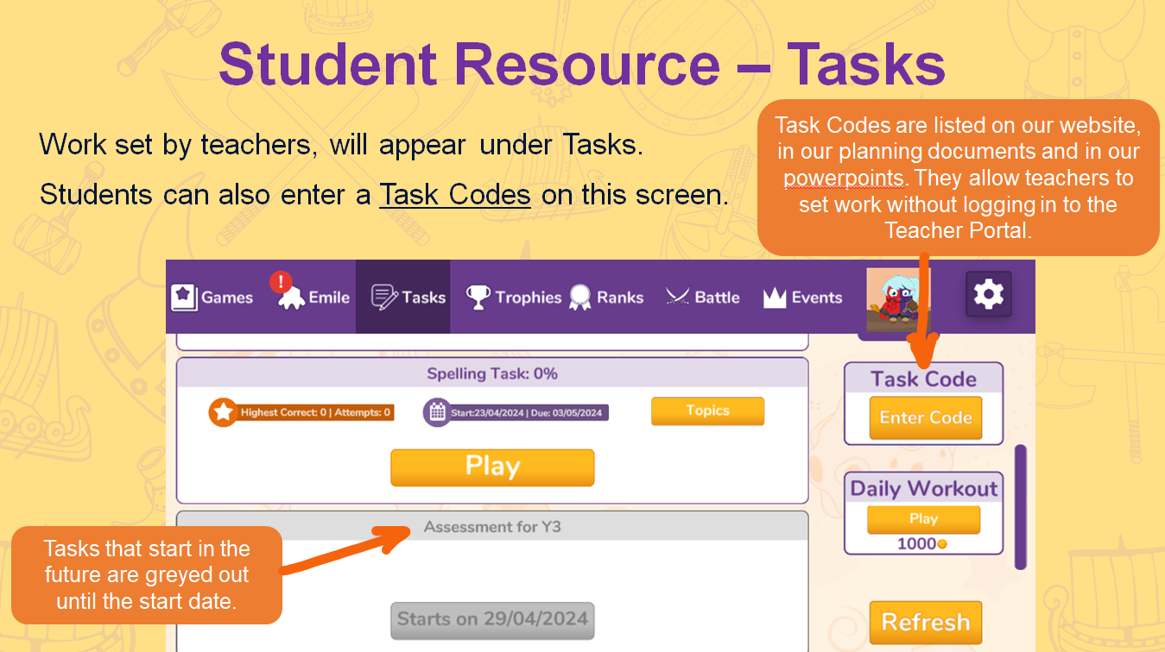

Slide 11
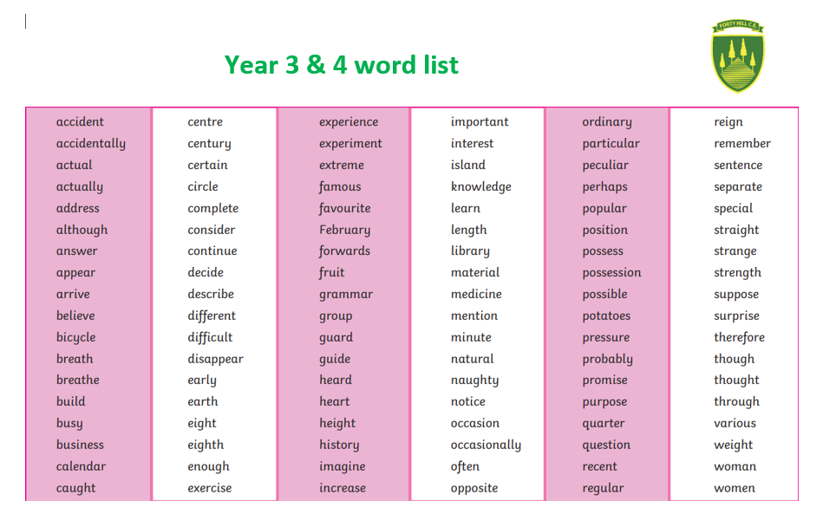
Additional spellings – Year 3 and 4, Year 5 and 6

Slide 12
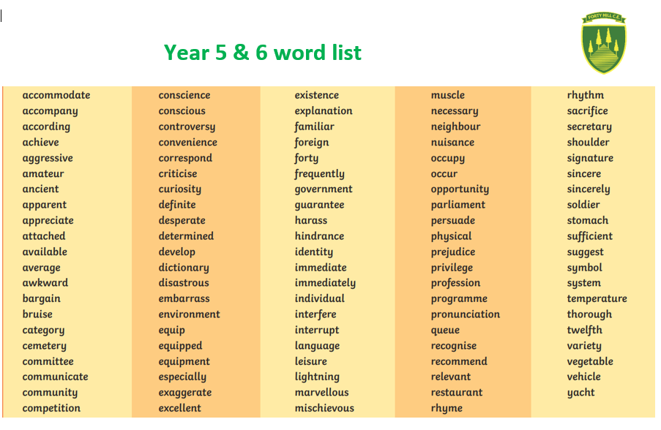

Slide 13

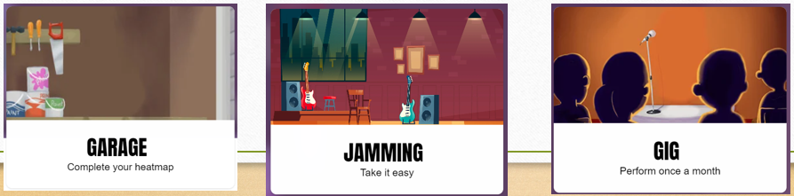
Times Tables Rockstars
Garage: Most children will spend most time here. Questions are tailored to individuals and children earn coins by answering them.
Jamming: No clock or timer. Children can tailor their own questions and choose between multiplication/ division or both.
Gig: Children have a monthly challenge to complete 100 multiplication questions in 5 minutes.

Slide 14
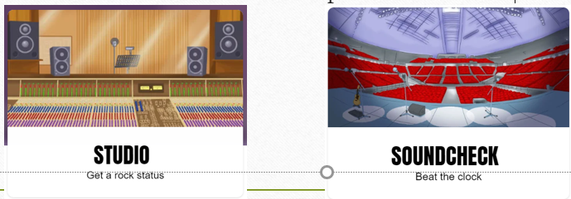
Times Tables Rockstars
Studio: More challenging. Includes multiplication and division. Results affect their rock status which is based on an average of their last 10 games.
Soundcheck: Simulates the MTC. Good practice for Year 4!

Slide 15

Times Tables Rockstars
Festival: Children play against people from around the world.
Arena: Similar to festival but they only play against classmates. Teachers can join as well!
Rockslam: Children can go head to head. Players don’t have to online at the same time.

Slide 16
Practise SATs papers.
Please avoid 2025, 2024, 2023 papers as we will be using these during assessment weeks at school.
There are plenty of other past papers and revision resources available online should you wish to use them!
SATs REVISION

Slide 17

Relationships and Conduct Policy
This policy, which was introduced last September is now fully established and used consistently across the school.
In the event of a poor choice being made, or conflict between peers, children will be guided in restorative conversations with each other to understand the impact their behaviour has had on another person and there may be opportunities, where relevant, to repair any damage done with an act of service in line with our new vision.
If your child receives a yellow card or we feel it appropriate to discuss their conduct, we will email or phone at our earliest convenience.

Slide 18
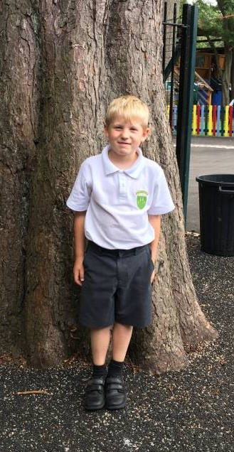
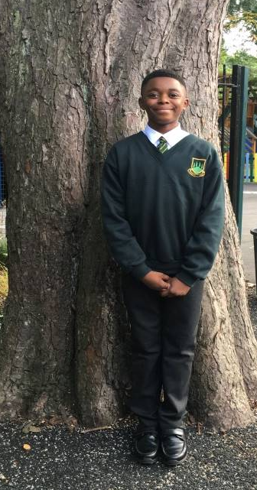
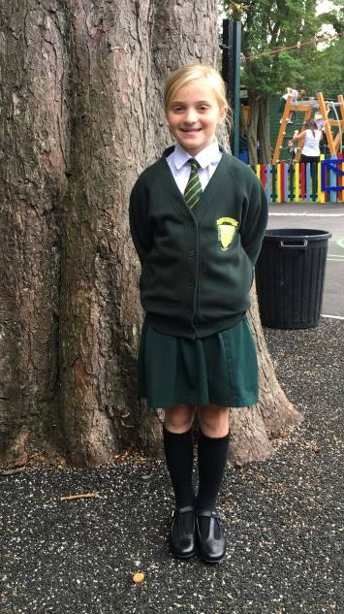
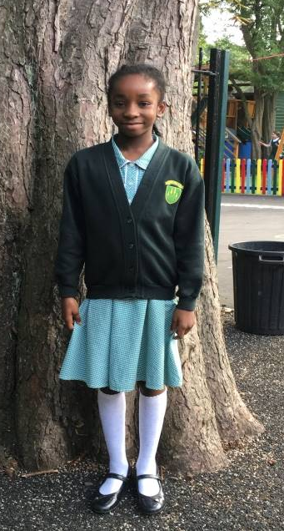
School Uniform
Full details can be found here:
https://www.fortyhill.com/page/?title=Uniform&pid=54
Children should always be smart and should now be using our new school backpack or book bag
Hair should be tied back if long
All black trainers can be worn to school
No nail varnish and stud earrings only – no other jewellery.
Ties to be worn if wearing a shirt
All shirts to be tucked in and appropriate black school shoes (NO boots please)
Full PE kit to be worn on PE days. Our PE days are XXXXX and XXXXXX
Forest school clothes should be worn for the whole day when our class have their Forest School sessions. Our sessions will be during XXXXXXXX. A reminder will be sent.

Slide 19

Attendance and Punctuality
Class | Drop Off | Collection
Nursery (when all in) | 8.45am | 11.45am
Reception (when all in full-time) | 8:45-8:55am | 3.15pm
Year 1 | 8.45-8.55am (Glass doors by hall) | Just before 3.15pm from gate by the office
Year 2 | 8.45-8.55am (Glass doors by hall) | Just after 3.15pm from gate by the office
Year 3 | 8.45-8.55am (Top of slope) | 3.15pm (Top of slope)
Year 4 | 8.45-8.55am (Year 4 Classroom steps) | 3.15pm (Year 4 Classroom steps)
Year 5 | 8.45-8.55am (Year 5 Classroom steps) | 3.15pm (Year 5 Classroom steps)
Year 6 | 8.45-8.55am (Bottom of slope) | 3.15pm (Bottom of slope)
It is really important to ensure that you are on time for drop off and collection. Attendance and punctuality are a big focus for the school this year and help children to have the best possible days. Holidays should NOT be taken during term time.

Slide 20

Staying Safe and Medicines
The most effective preventative measure is hand washing. Please make sure that this happens regularly for children AND yourselves.
Inhalers and epi-pens should be labelled and sent into school to be kept in our welfare room. These must be up to date.
Parents are asked to give clearly labelled medication to Mrs Vial in the school office in the morning.

Slide 21

Sickness
Parents need to ensure that children who have coronavirus symptoms do not attend the school.
If your child has sickness or diarrhoea they must not attend school for a full 48 hours after the last episode to help stop the spread of the bug. This is crucial to keep everyone well.
Please notify the office on the morning of the absence if your child will not be in school.
Please also notify the office of any appointments that your child needs to attend but, where possible, try to make these out of school hours. We know this can be tricky.

Slide 22
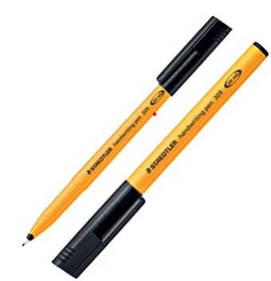
Year 6 specifics…
Beginning of the day
PE
SATs revision
Reading and books in school
Homework deadlines
Walking home and mobile phones
Responsibilities and transition
Trips inc PGL

Slide 23
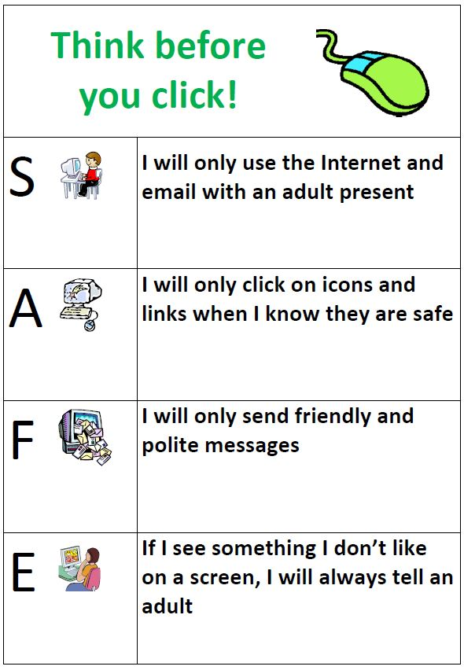

Online Safety KS2
https://www.youtube.com/watch?v=HAZU49hHMLE
For more information on Online Safety, click here:
https://www.fortyhill.com/page/?title=Online+Safety&pid=51
We will be showing these videos to the class. We will now watch this together…

Slide 24
Upcoming dates
House Captain elections
Trip

Slide 25
The Maintenance Payment
This is a contribution that we request each new school year. Currently we ask for a yearly contribution of £36.00 for each child that attends the school (discounts are made for siblings). We are asked by the LDBS as a school to contribute over £5000 each year towards a maintenance fund held at the diocese. Schools can then bid for a share of the money to pay for larger costly projects. At Forty Hill we have successfully bid several times over the last few years.
Works have included:
Extensive hot and cold water pipework
Refurbishment of the children’s toilets and disabled toilet
Replacing the school roof
Resurfacing the playground
Improvement to site security and a new gate and fob system
General upkeep e.g. repainting walls and windows, upgrading fire doors
If parents do not make this contribution, then the school has to make up the shortfall. Last year we had to make up a shortfall of 40% - this money therefore comes out of the budget for resources for the children. As a Church of England school, the Local Authority does not contribute at all to the upkeep or repairs of our building, so being part of this fund is a necessity.
For ease, it will be listed on your oldest child’s Parent Pay account as ‘School Maintenance Fund’. If you are a brand new family to our school, this will be set up once your child officially starts.

Slide 26

http://www.fortyhill.com
Our website…
Please make sure you have given your up to date email addresses to the office as well as any changes of address and phone numbers.

Slide 27


