Slide 1

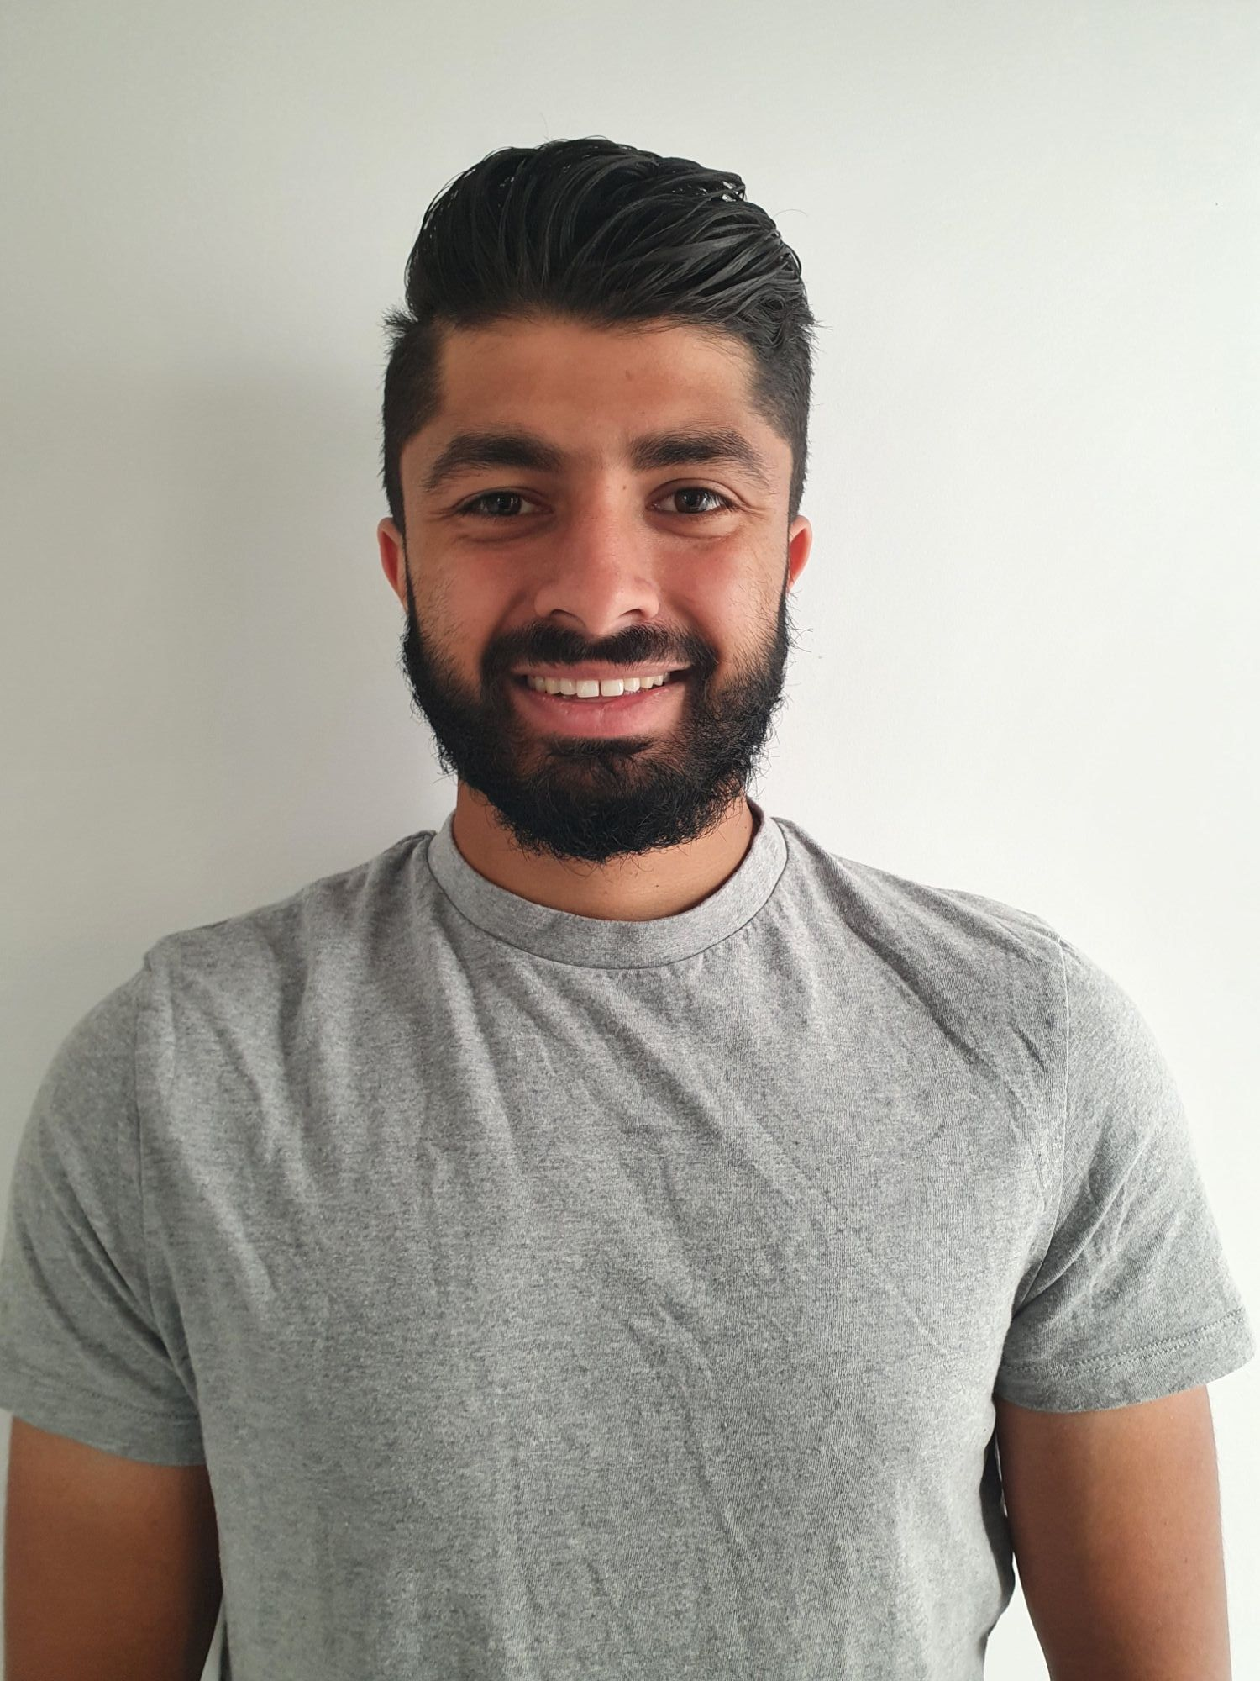
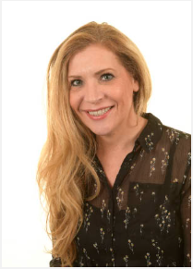
Welcome to Year 4!
Mr Kansara
Ms Bishop

Slide 2

Our Vision and Values at Forty Hill CE

Slide 3
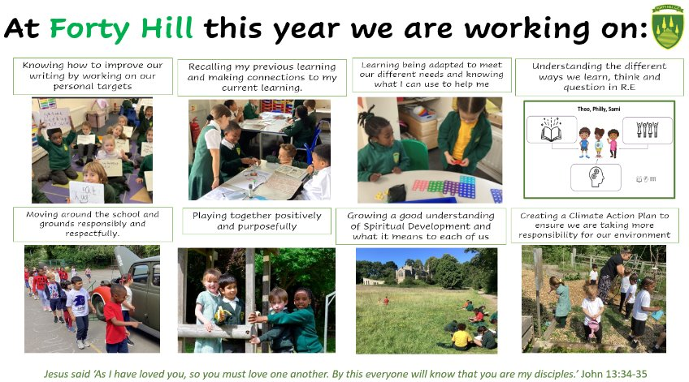
Our School Priorities 2025-2026

Slide 4
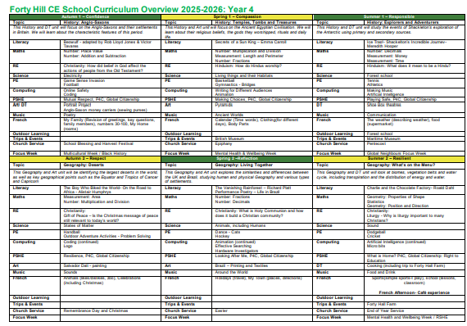
Our Curriculum

Slide 5
Whole Curriculum
History
English
Geography
Maths
Music
Art
DT
Science
PSHE
R.E
P.E
Please see your class overview in the class section of the school website for more information on what is being covered in each area throughout the year.
Please do remember we always publish a half termly curriculum booklet too which will be coming home soon. This will give you even more details about what your child is doing in school so that you know what we are learning each half term.

Slide 6

Reading Expectations
Your child will develop their reading skills during their reading sessions at school. Your child may bring a book band book home if the school feels it would be helpful.
We want children to enjoy reading and share books with you at home. We will be continuing our successful reading challenge again this year to support this.
Please read with your child every day, talking about what you have read and then complete your child’s reading records.

Slide 7
Reading Challenge
We are re-launching our Reading Challenge this year. Each class will have a list of books that we feel children should be reading at their age and your child can tick these off throughout the year to complete the challenge.
These lists, along with more information, will be sent home to you.

Slide 8

Reading records
This year, we are moving on from Boom Reader and returning to recording daily reading in a reading journal. Each child will have a journal, which must be signed every day that they have read. The journal should be shown to the teacher each day as part of their reading routine.
This new approach will help keep track of reading progress in a more traditional way, and we appreciate your support in ensuring it’s completed daily!

Slide 9

Homework
Due to feedback from surveys completed by the Forty Hill community, we have decided to no longer release the Homework Grid. As a result, we now have the following expectations for homework:
Purple Mash: Weekly tasks will be set every Friday and should be completed by the following Friday.
Emile Learn: Children will focus on their spelling words, which will be tested on the following week.
Daily Reading: Children are expected to read every day and ensure their reading is recorded in their reading journals.

Slide 10
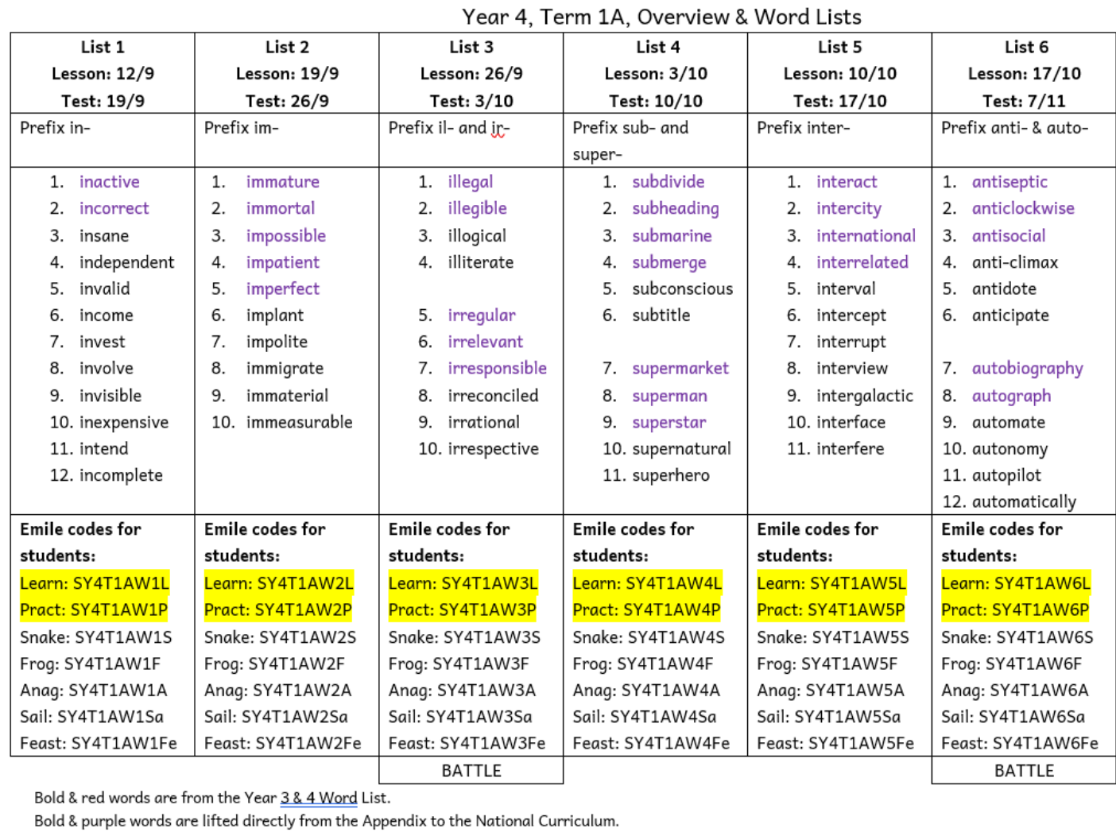
Homework- Spellings with Emile app

Slide 11
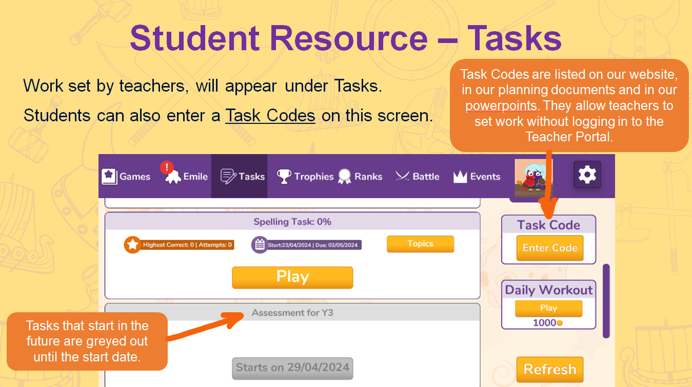

Slide 12



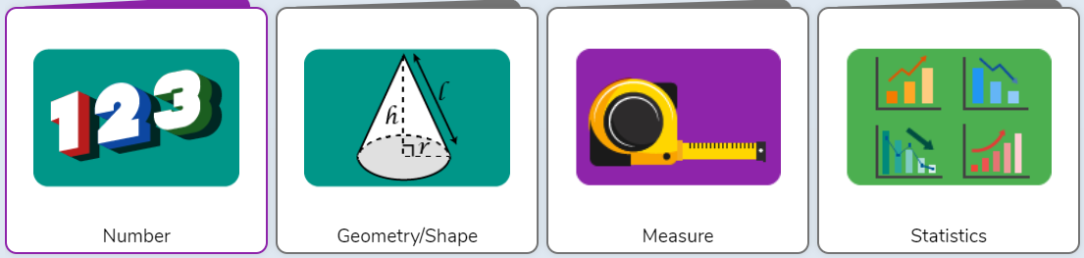
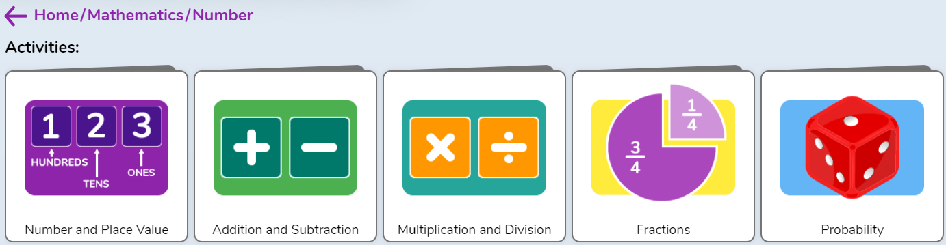
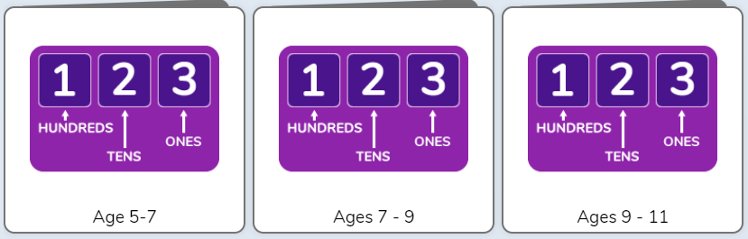
Maths Homework
In KS2, Maths homework will now be set weekly on Purple Mash.
The tasks directly link to the White Rose scheme used in class.
Homework will be set on Friday to be due in the following Friday

Slide 13

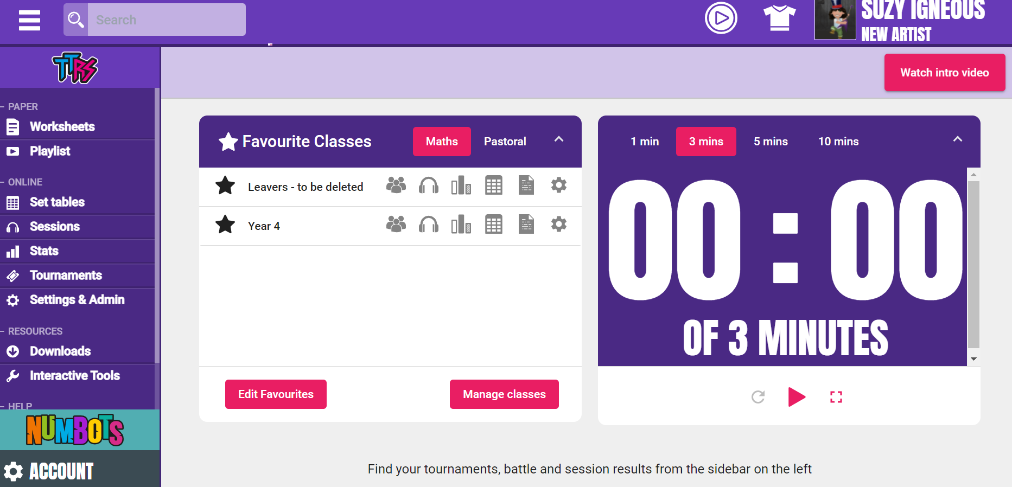

Times Tables Rockstars
Statutory Year 4 Multiplication Tables Check – June 2026

Slide 14
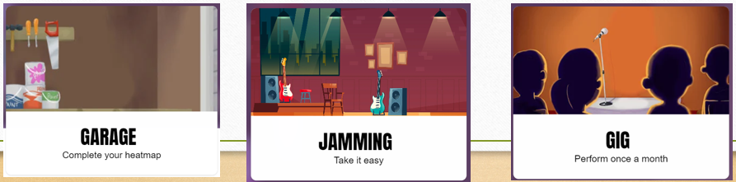
Times Tables Rockstars
Garage: Most children will spend most time here. Questions are tailored to individuals and children earn coins by answering them.
Jamming: No clock or timer. Children can tailor their own questions and choose between multiplication/ division or both.
Gig: Children have a monthly challenge to complete 100 multiplication questions in 5 minutes.

Slide 15
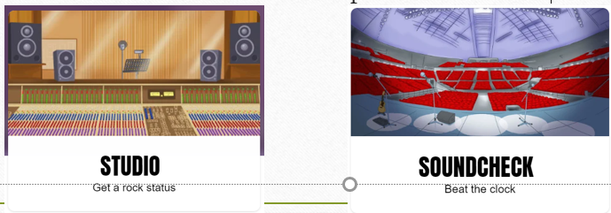
Times Tables Rockstars
Studio: More challenging. Includes multiplication and division. Results affect their rock status which is based on an average of their last 10 games.
Soundcheck: Simulates the MTC. Good practice for Year 4!

Slide 16

Times Tables Rockstars
Festival: Children play against people from around the world.
Arena: Similar to festival but they only play against classmates. Teachers can join as well!
Rockslam: Children can go head to head. Players don’t have to online at the same time.

Slide 17
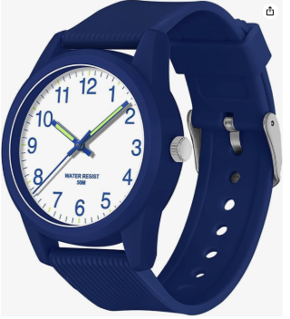
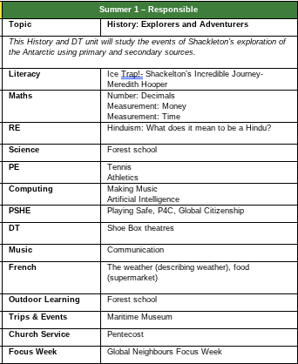
Watch monitors
In Year 4, we will be learning about time in greater detail. To help prepare the children for this topic, I would like to suggest that, if possible, you consider purchasing an analog watch for your child. Having access to a watch will allow them to become more familiar with reading the time.
In class, I will be encouraging the children to look out for specific times throughout the day and practice telling the time. I believe that this extra exposure will greatly support their success when we focus on time in our lessons.

Slide 18

Relationships Policy
From last year, we are continuing to use our developed Relationships and Conduct policy, as it has proven beneficial in supporting positive behaviour and relationships among our children. This approach focuses on restoration when behaviour does not meet our expectations.
Children will be guided through restorative conversations to help them understand the impact of their behaviour on others. Where appropriate, they may have the opportunity to repair any damage through acts of service, in line with our vision for positive community relationships.

Slide 19
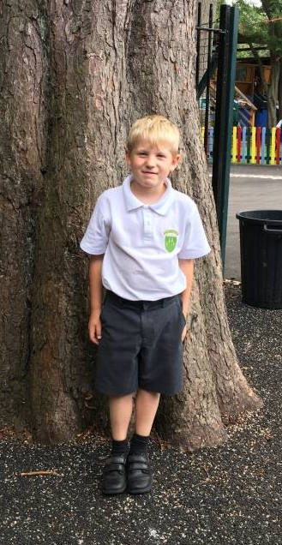
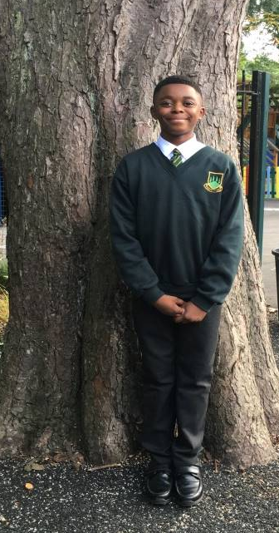
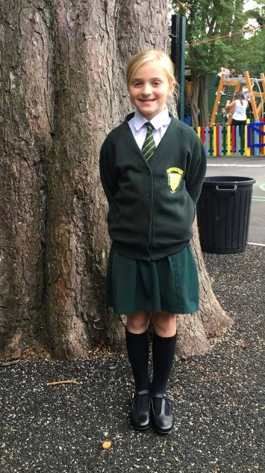
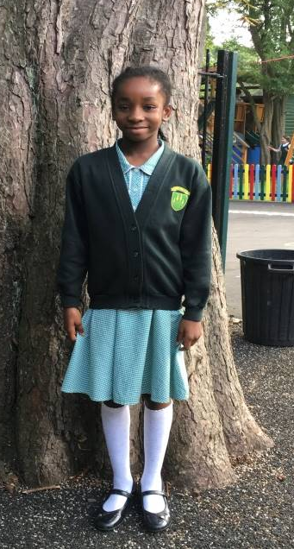
School Uniform
Full details can be found here:
https://www.fortyhill.com/page/?title=Uniform&pid=54
Children should always be smart and should now be using our new school backpack or book bag
Hair should be tied back if long
Black trainers can be worn to school
No nail varnish and stud earrings only – no other jewellery.
Ties to be worn if wearing a shirt
All shirts to be tucked in and appropriate black school shoes (NO boots please)
Full PE kit to be worn on PE days. Our PE days are Tuesday and Thursday.
Forest school clothes should be worn for the whole day when our class have their Forest School sessions. Our sessions will be during Summer 1. A reminder will be sent.

Slide 20

Attendance and Punctuality
Class | Drop Off | Collection
Nursery (when all in) | 8.45am | 11.45am
Reception (when all in full-time) | 8:40-8:50am | 3.20pm
Year 1 | 8.40-8.50am (Glass doors by hall) | Just before 3.20pm from gate by the office
Year 2 | 8.40-8.50am (Glass doors by hall) | Just after 3.20pm from gate by the office
Year 3 | 8.40-8.50am (Top of slope) | 3.20pm (Top of slope)
Year 4 | 8.40-8.50am (Year 4 Classroom steps) | 3.20pm (Year 4 Classroom steps)
Year 5 | 8.40-8.50am (Year 5 Classroom steps) | 3.20pm (Year 5 Classroom steps)
Year 6 | 8.40-8.50am (Bottom of slope) | 3.20pm (Bottom of slope)
It is really important to ensure that you are on time for drop off and collection. Attendance and punctuality are a big focus for the school this year and help children to have the best possible days. Holidays should NOT be taken during term time.

Slide 21

Staying Safe and Medicines
The most effective preventative measure is hand washing. Please make sure that this happens regularly for children AND yourselves.
Inhalers and epi-pens should be labelled and sent into school to be kept in our welfare room. These must be up to date.
Parents are asked to give clearly labelled medication to Mrs Vial in the school office in the morning.

Slide 22

Sickness
If your child has sickness or diarrhoea they must not attend school for a full 48 hours after the last episode to help stop the spread of the bug. This is crucial to keep everyone well.
Please notify the office on the morning of the absence if your child will not be in school.
Please also notify the office of any appointments that your child needs to attend but, where possible, try to make these out of school hours. We know this can be tricky.

Slide 23
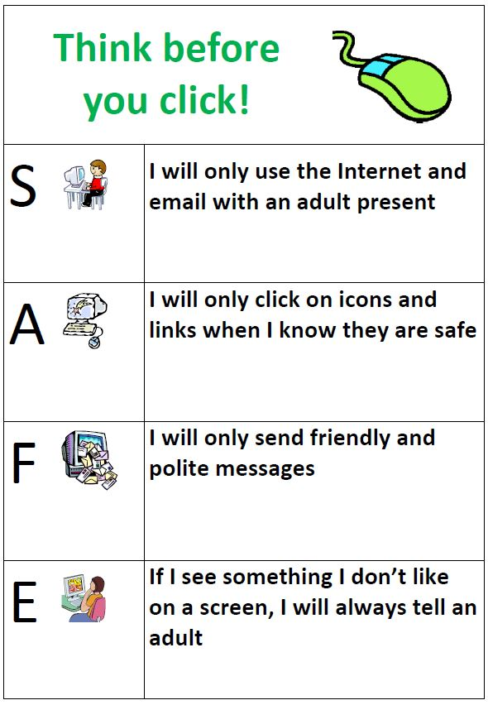

Online Safety KS2
https://www.youtube.com/watch?v=HAZU49hHMLE
For more information on Online Safety, click here:
https://www.fortyhill.com/page/?title=Online+Safety&pid=51
We will be showing these videos to the class. We will now watch this together…

Slide 24
The Maintenance Payment
This is a contribution that we request each new school year. Currently we ask for a yearly contribution of £36.00 for each child that attends the school (discounts are made for siblings). We are asked by the LDBS as a school to contribute over £5000 each year towards a maintenance fund held at the diocese. Schools can then bid for a share of the money to pay for larger costly projects. At Forty Hill we have successfully bid several times over the last few years.
Works have included:
Extensive hot and cold water pipework
Refurbishment of the children’s toilets and disabled toilet
Replacing the school roof
Resurfacing the playground
Improvement to site security and a new gate and fob system
General upkeep e.g. repainting walls and windows, upgrading fire doors
If parents do not make this contribution, then the school has to make up the shortfall. Last year we had to make up a shortfall of 40% - this money therefore comes out of the budget for resources for the children. As a Church of England school, the Local Authority does not contribute at all to the upkeep or repairs of our building, so being part of this fund is a necessity.
For ease, it will be listed on your oldest child’s Parent Pay account as ‘School Maintenance Fund’. If you are a brand new family to our school, this will be set up once your child officially starts.

Slide 25

http://www.fortyhill.com
Our website…
Please make sure you have given your up to date email addresses to the office as well as any changes of address and phone numbers.

Slide 26


