Slide 1

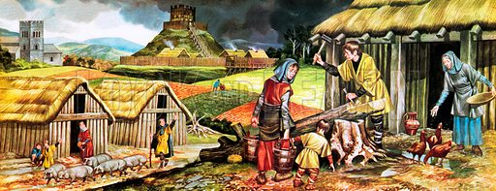
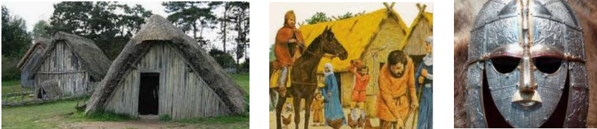
Year 4 Curriculum Plan
Autumn 1 2025/26
Key Curriculum Areas
As Readers we will be exploring a range of texts each week differing from fiction to non-fiction to poetry. We will be using these texts to really try and improve our fluency in reading by making sure to read with expression whilst using all the punctuation to help us understand our tone and delivery. This will allow us to take a deeper dive into our Class book Beowulf and help us to really understand all the vocabulary used in the book.
As Writers we will begin the year by looking at an adaptation of the story of Beowulf, inspired by the poem written in the 6th century. We will use a ‘Talk 4 Writing’ approach to help us produce some pieces of narrative writing, with a special emphasis on creating characters and settings. During this unit we will also focus on several aspects of Spelling, Punctuation and Grammar. We will consider appropriate choices of nouns and pronouns in order to avoid repetition as well as develop our use of expanded noun phrases including prepositional phrases. We will also learn how to use fronted adverbials in our writing, punctuating these correctly.
As Mathematicians we will be revising place value and recognising the value of each digit in a four digit number. We will be learning to partition 4 digit numbers in a variety of ways, including using number lines. We will find 1, 10, 100 and 1000 more and less than a given number as well as estimating, comparing and ordering different numbers. After revising Roman Numerals, we will look at rounding numbers to the nearest 10, 100 and 1000. We will then move on to the key written methods of addition and subtraction. We will be adding and subtracting up to 4 digit numbers with no exchange and one or more exchanges. We will end the unit looking at efficient estimations and strategies for checking our answers.
As Religiously Literate students we will be considering the key question: How did belief in God affect the actions of people from the Old Testament? In this Christianity unit, we will explore a number of religious stories from the Old Testament which show how key individuals enacted their faith in God and demonstrated their faith in extremely testing times. We will consider what Christians can learn from these stories and how they may show use these stories to impact their own choices in daily life.
Anglo-Saxons
Overview of Topic
This History and DT unit will focus on the Anglo-Saxons and their settlements in Britain. We will learn about the characteristic features of this period, which spans both Ancient and Medieval history.
Key Vocabulary
Helmets, jewellery, mead, Long Boat, longhouse, runes, shield, Beowulf, Offa’s Dyke, Sutton Hoo and Wattle-and-Daub.
Value of the half term: Confidence

Slide 2
Other Curriculum Areas
Reminders
P.E Days Tuesday and Thursday - children are to come to school in full PE kit on these days.
Reading: Children are expected to read every day at home. They will be recording their reading in their reading records. with them everyday.
Spellings: Children will be expected to go onto the Emile Spelling app and do the learn task that has been set for that week. The words will be based of the rule we had just learnt in the Friday's lesson.
Maths – Weekly Maths homework will be set on ‘Purple Mash’. This is set on a Friday and due in every Friday.
Learning Experiences
Tuesday 16th September – Arts Trophy Launch
Thursday 25th September – Individual and Sibling Photographs.
Thursday 1st October – Harvest Service
Friday 3rd October - Colour run after school
Friday 10th October – Deadline for Arts Trophy.
Friday 18th October – Arts Trophy Final
w/c Monday 13th October – Multicultural Week
Tuesday 14th / Wednesday 15th October – Parent Consultations
Friday 17th October - Fundraising for Polio & Multicultural food festival
Tuesday 21st October - Yr 4, 5, 6 YSC Macbeth
As Scientists we will explore electricity. We will identify appliances that run using electricity as well as creating our own simple circuits including wires, bulbs, batteries and switches. We will learn how to ask scientific questions and draw scientific diagrams, before carrying out our own class investigation into what makes a successful electrical circuit.
As Historians we will be learning all about the Anglo-Saxons. We will be able to place the Anglo-Saxon era on a timeline of British history and understand how and why the Anglo-Saxon people invaded Britain. We will learn all about village life in this period and the beliefs and culture of Anglo-Saxon people. We will look at the end of the Anglo-Saxon era and how this happened. Throughout the unit, we will carry out our own research, becoming familiar with key dates and historical figures and be able to explain reasons for changes throughout this historical era.
As Design and technology students we will be creating money carriers inspired by those found at Anglo-Saxon archaeological sites. We will be designing, making and evaluating our products and using a variety of practical skills.
As Athletes we will be taking part in developing our skills in football where we will develop pupils’ ability to apply the principles of attack vs defence, with a particular focus on creating simple attacking tactics to move the ball up the pitch, creating an attack that results in a shooting opportunity. In addition, we will be looking into game sense where the unit of work will develop pupils’ ability to apply the principles of attack vs defence, with a focus on effectively using their passing, moving and dribbling skills to create an attack that results in a shooting opportunity. Pupils will be introduced to defensive principles including marking
As Musicians we will be looking at music linked with poetry. We will be focussing on developing our performances of contrasting poems. We will learn to use our voices to speak rhythmically and expressively and how to create accompaniments to enhance our performances.
As Emotionally Literate students we will be examining the importance of respecting other’s thoughts and feelings and how to disagree respectfully with others. We will continue to explore the value of Confidence and use a variety of stimuli in our class P4C sessions, as well as Global Citizenship.
As Linguists we will be having weekly French lessons. We will be looking into the topics of 'My Family', numbers from 30-100 and looking at what can be found in our homes.
As Computer Literate students we will begin by focusing on online safety and coding. We will review coding vocabulary before introducing the ‘if/else’ statement into our programmes. We will also use the ‘Repeat Until’ command and use timers and counting machines.

