Slide 1

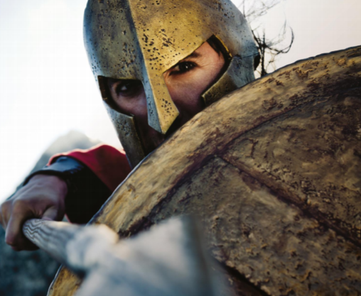
Year 3 Curriculum Plan
Autumn 2025/2026
Key Curriculum Areas
As Readers we will be continuing to improve our fluency and ability to read unfamiliar words including those with prefixes and suffixes. In each week’s whole class Guided Reading sessions we will be exploring a variety of different texts; including fiction and non-fiction and its features. During these sessions we will focus on a specific skill from our VIPERS, which are the 6 reading domains. These may include asking questions about the text, making predictions about what might happen in a story or making inferences. It is essential that the children continue to read at home each day and spend time talking about what they have read with an adult. We encourage the children to read a wide range of texts.
As Writers we will start our learning by using the book ‘We Are All Born Free’ to learn about the Universal Declaration of Human Rights, and we will be using the illustration as a stimulus for a narrative which explores the given article. We will then look at our class text The Firemaker’s Daughter by Phillip Pullman where we will develop our understanding of a number of writing genres. The children will write letters, instructions and character descriptions linked to the text. We will also be predicting Roman myths and writing alternative endings. Within this unit, the children will be retelling some of the myths. We will continue to correctly use conjunctions, learn how to successfully use adverbs and figurative language in our writing. It is important that we continue to use the punctuation we have learned so far (full stops, exclamation marks, question marks and commas) in our writing. Our spelling practice will continue daily with learning word families and the words from the year 3 list. In handwriting, the children will continue to develop their cursive writing which will allow them to work towards earning their pen licence. Practising handwriting and spellings at home is crucial to developing your child’s understanding towards the Year 3 curriculum.
As Mathematicians we will continue to be challenged on our 2s, 5s and 10s times in order to consolidate previous learning. The children will need to continue to practise their number bonds and place value as this supports and maximises their learning. We will continue to develop our understanding of Place Value, specifically focussing on 3-digit numbers. In number, we will be developing our written methods for addition and subtraction, which will then lead to exploring and investigating a variety of problems.
As Religiously Literate students we will be focusing on our big question ‘What is the Bible’s Big Story?’ We will be focus each week on understanding the concepts of the bible and what each of these teach us. By the end of the unit, children should confidently recite the big story of the Bible.
Roman Britain
Overview of Topic
This History and DT unit focusses on the Roman invasion of Britain. We will be learning about the events that took place and representing such events on a timeline. We will also learn about the features of the Roman Empire and the people of that time and their lasting impact.
Value of the half term: Confidence

Slide 2
Other Curriculum Areas
Reminders
P.E Days: We will be having PE twice a week on Mondays and Thursdays. Children will be expected to come to school in their PE kits on those days.
Homework
Reading: Children are expected to read everyday at home and use home reading journals on a daily basis. The children will be given their journals and new books on Wednesdays and will need to return them the following Wednesday morning for a new book.
Spellings: These could be accessed on the school’s website, and will be tested weekly on a Friday. Spelling homework will be set each Friday and due the following Friday.
Maths homework: this will be set each week on Purple Mash each Friday and should be completed by the following Friday.
Fruit: If you wish, you may provide your child with a piece of fruit to eat at morning break.
Learning Experiences
Tuesday 16th September – Arts Trophy Launch
Thursday 25th September – Individual and Sibling Photographs.
Thursday 1st October – Harvest Service
Friday 3rd October - Colour run after school
Friday 10th October – Deadline for Arts Trophy.
Friday 18th October – Arts Trophy Final
w/c Monday 13th October – Multicultural Week
Tuesday 14th / Wednesday 15th October – Parent Consultations
Friday 17th October - Fundraising for Polio & Multicultural food festival
As Scientists we will become rock detectives establishing core knowledge and understanding of rocks, their relationship to soils and how fossils have formed over time.
As Historians we will be learning about and writing about features, events, people and themes from the past and describing similarities and differences between aspects of life at different times in the past. This will include looking at the similarities and differences between the people of Rome (rich and poor). We will learn about people of this time who are historically important.
As Athletes, we will explore how to apply the principles of attack vs defence, with a particular focus on passing, moving and dribbling. In Game Sense, We will learn how to keep possession and eventually score in order to win a modified game.
As Musicians we will learn to play the recorder and read simple musical notation.
As Emotionally Literate students we will be learning about strengths and challenges. Pupils will learn about celebrating achievements and setting personal goals; about dealing with put-downs, as well as about positive ways to deal with set-backs.
As Designers we will be looking at a variety of Roman games to inspire our own board game. We will research the project, then develop our skills before we make our own version.
As Computer Literate students we will continue to look at E-safety and touch typing. We will be working on developing the skill to type with both hands.

