Slide 1
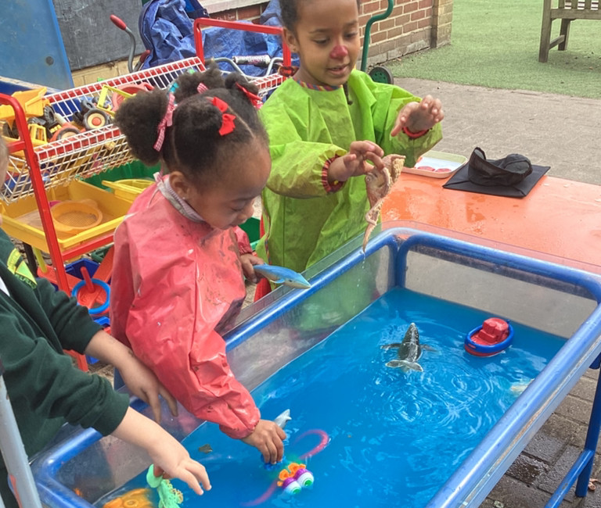
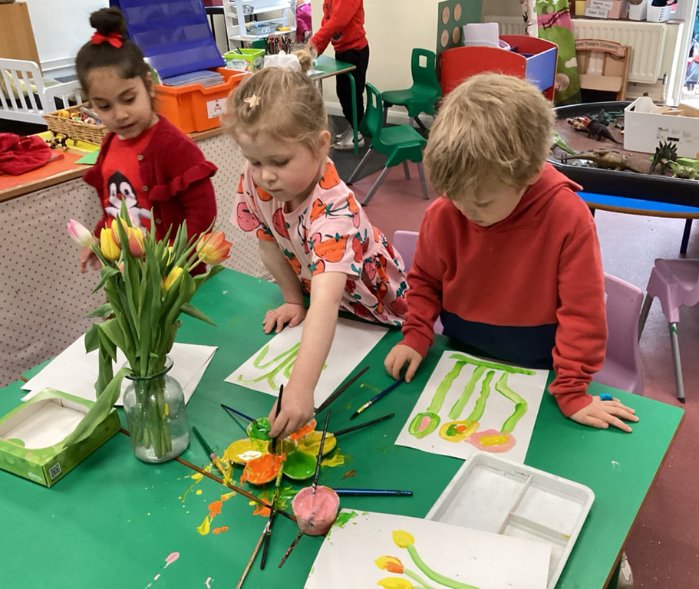
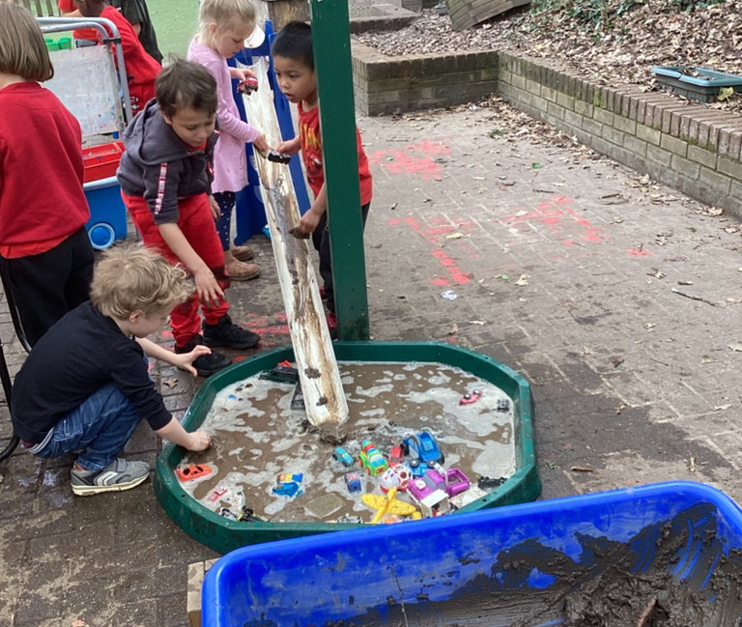


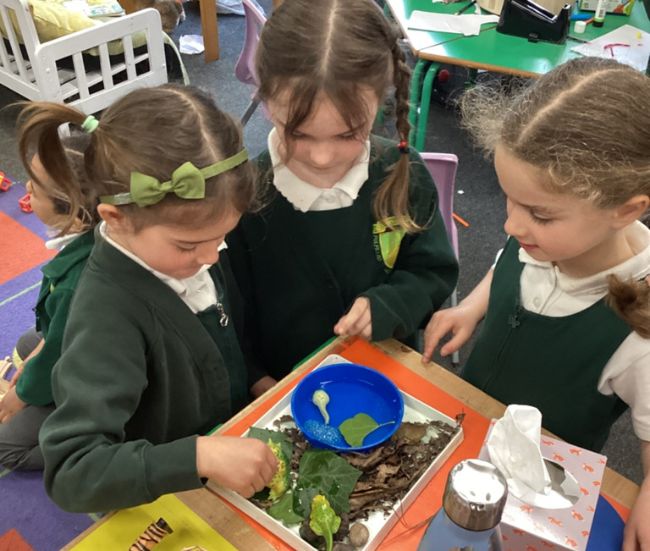
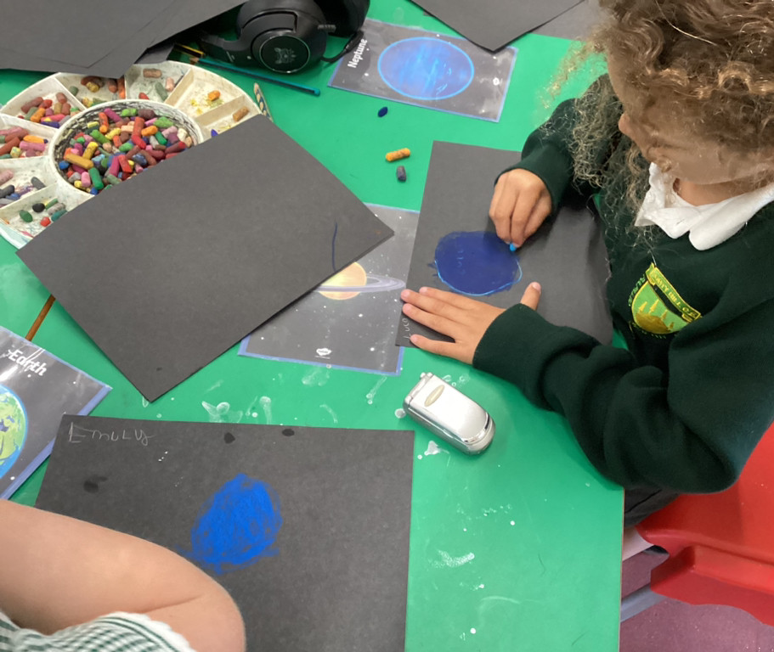
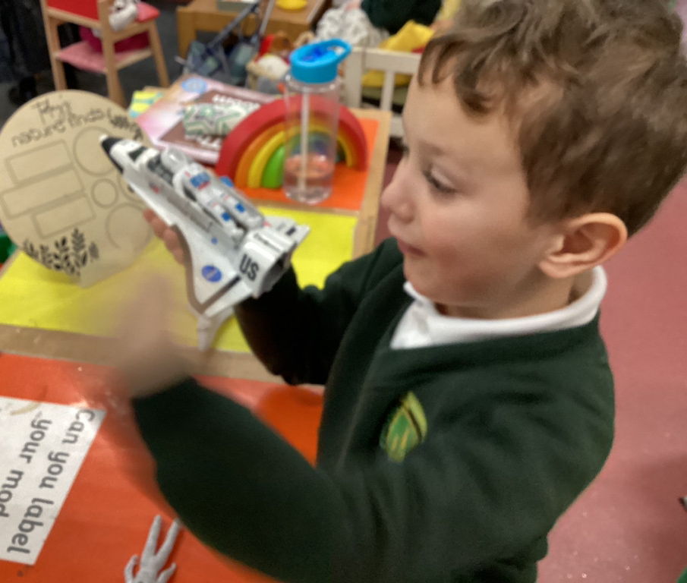
Welcome

Slide 2
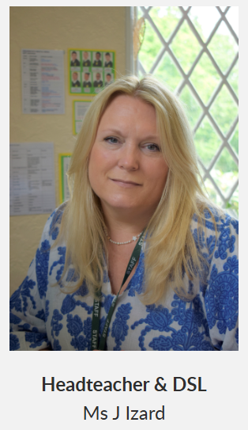
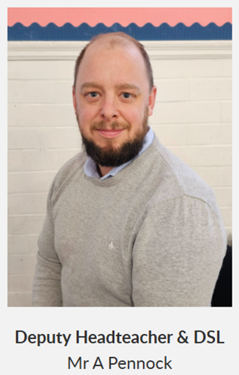

Welcome

Slide 3


Our School Vision and Values

Slide 4
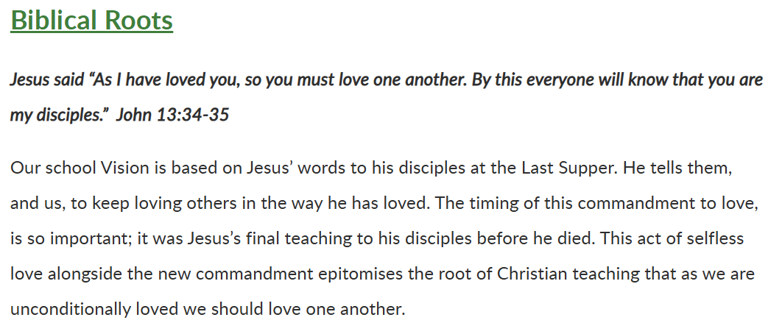
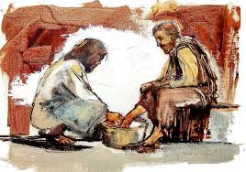

Slide 5
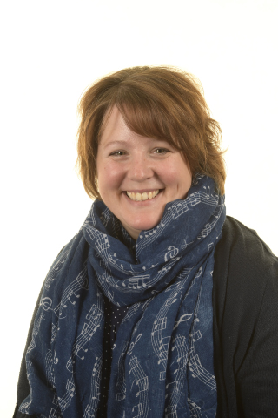
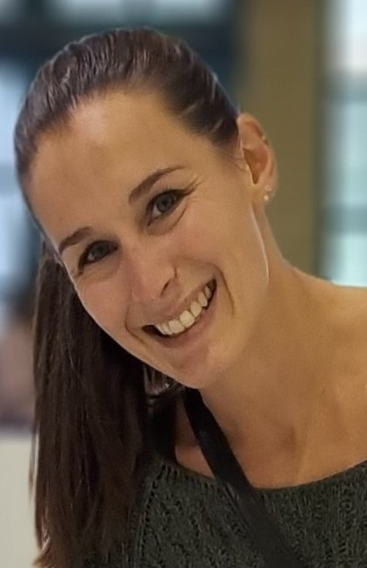
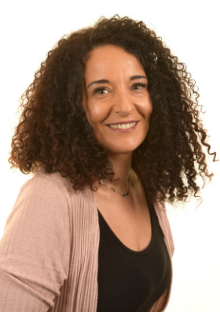
The Reception Team
Mrs Munt
Reception Class Teacher
EYFS & Phase 1 Leader
Ms Toumazou
Higher Level Teaching Assistant
Mrs Sofroniou
Afternoons only

Slide 6

Starting Reception
Transitioning from Nursery to Reception is a huge step for both children and parents/carers, and we will support you to ensure that this is positive transition.
We have a workshop for new parents on 11th July in the School Hall.
Following a Home Visit, the children will attend a one hour Stay and Play session on Monday 8th September at either 9.30am or 11am
Tuesday, Wednesday and Thursday will be transitional days with everyone being in full time by Friday 13th September.
You will receive your starter packs tonight, which will include all key dates – Home Visit, Stay and Play date and your child’s start dates.

Slide 7

Afternoon Workshop
Forty Hill School
Friday 11th July @ 2pm
Please come along and find out what you can do to help your child be 'ready' to start school.

Slide 8
EYFS Curriculum
The Early Years Foundation Stage (EYFS) sets the standards that all early years providers must meet to ensure that children learn and develop well and are kept healthy and safe. It promotes teaching and learning to ensure children’s ‘school readiness’ and gives children the broad range of knowledge and skills that provide the right foundation for good future progress through school and life.
At the beginning of the year the children will have opportunities to initiate their own learning. This will help us plan through their interests and stages of development. These observations will also help assist with our assessments.
As the year progresses the amount of time children spend in child initiated play will reduce to allow for a more structured learning style to ensure they are developing skills needed to embrace the Key Stage One curriculum.

Slide 9
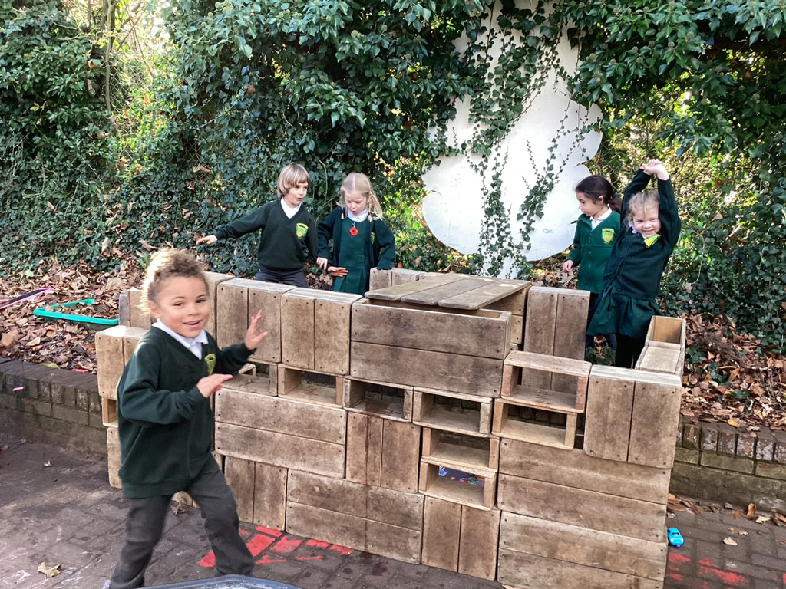
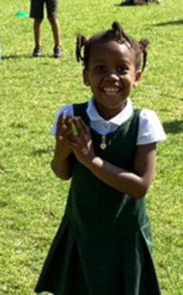
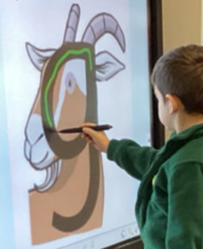
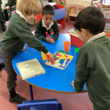
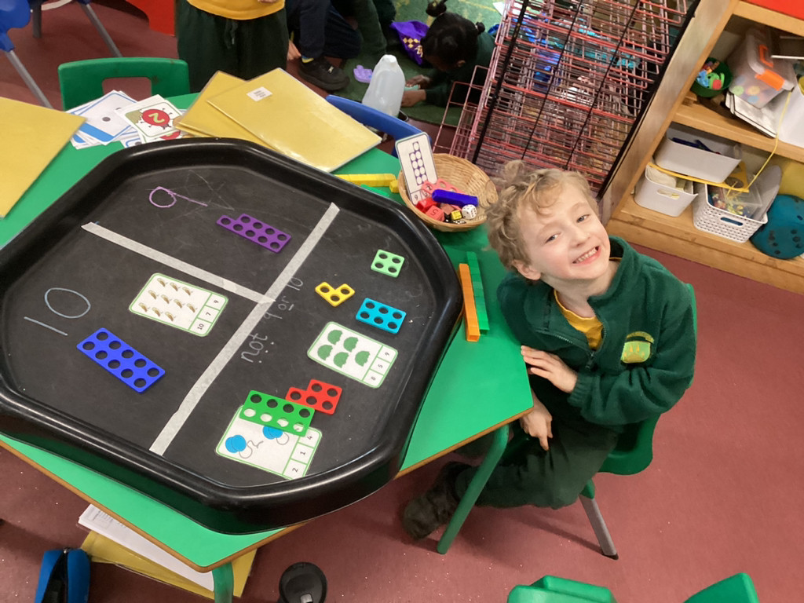
Areas of Learning
The areas of learning and development are important and interconnected.
There are seven areas of learning:
Prime areas –
Personal, Social and Emotional Development
Communication and Language
Physical Development
Specific areas –
Mathematics
Literacy
Understanding the World
Expressive Arts and Design

Slide 10
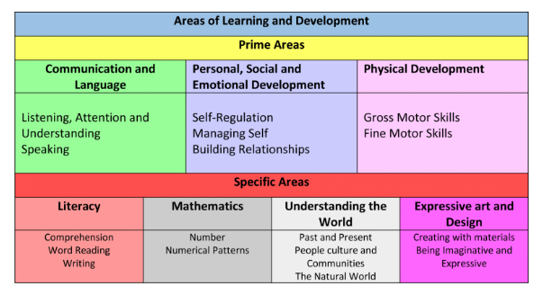
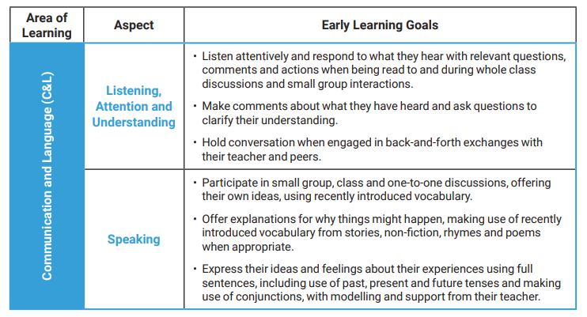
Areas of Development
The Early Learning Goals (ELGs) are the goals or targets children are expected to achieve at the end of their reception year. They are not the curriculum, but an end point measure of what a child should be demonstrating at the end of the Early Years Foundation Stage. There are 17 ELGs across all the areas of learning as shown below.

Slide 11
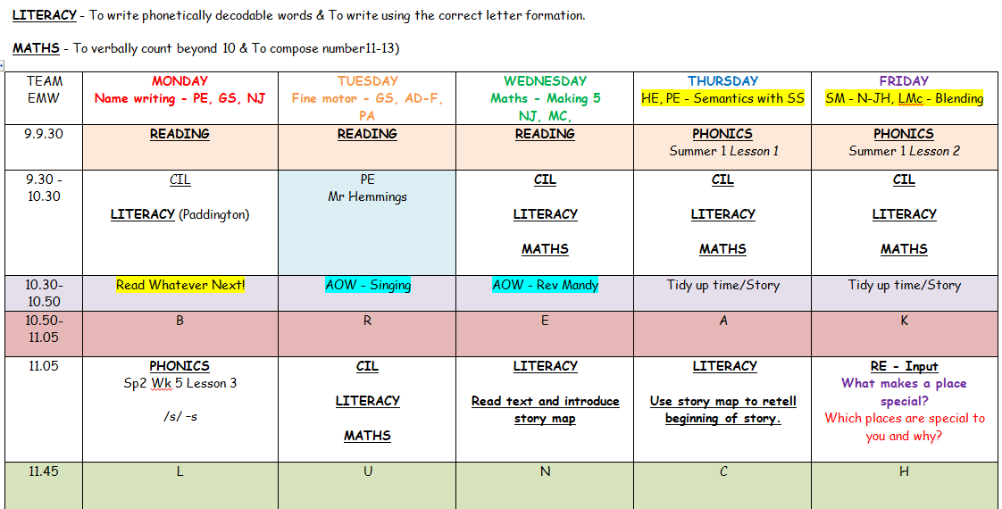
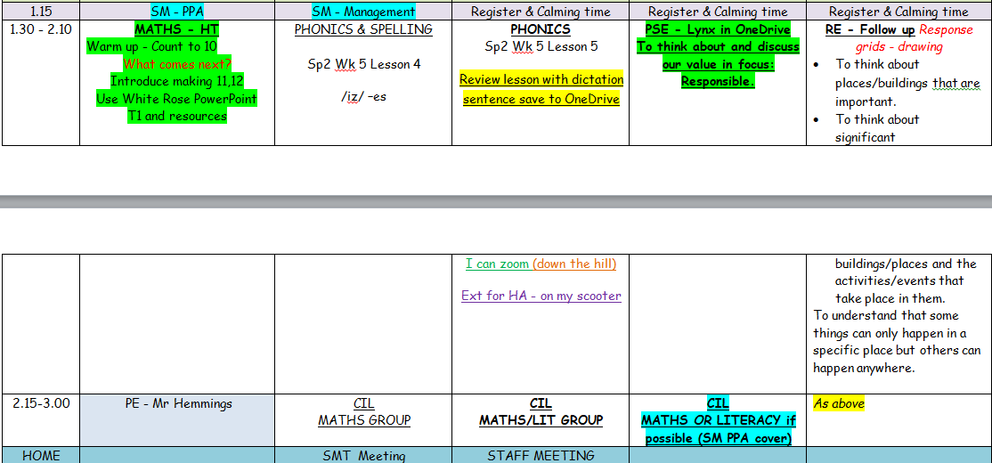
A Day in the life of Reception
Mornings
Reading
Child initiated play and directed tasks
Phonics
Maths
Afternoons
Phonics
Understanding the World
PSHE
RE
Child initiated play and directed tasks

Slide 12


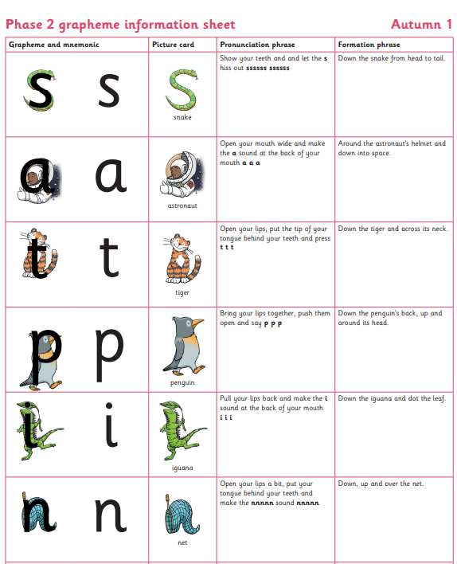
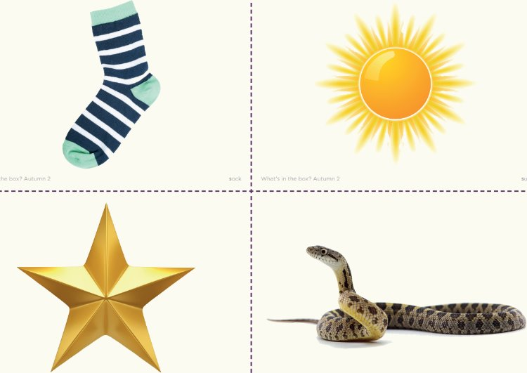

Slide 13


Being Global Neighbours
Being a ‘Steward of the World’ has NEVER been so important.
Global and Climate education should be as important as Literacy and Maths if we are to prepare the next generation to understand what needs to change, have voices for change and have the skills and knowledge to make change.
It is our duty to create global neighbours who are confident, responsible and compassionate. Courageous advocates who will look after our world.
Our Global Neighbours Curriculum consists of a year-long project for every year group that focused on a key area of global awareness. As a child makes their journey through our school, they will build an in-depth and current set of skills and knowledge about our world that will enable them to be courageous advocates, stewards of the Earth, make change and challenge injustice.
But this goes beyond our classrooms; we expect our whole school community to be environmentally responsible and this includes walking to school where possible, if you do drive- park responsibly and safely, recycling uniform by using our pre-loved programme, supporting our school garden with plant donations and physical help, encouraging your child to recycle, care for nature and show respect and kindness to all members of the school and global community whatever their faith, gender, culture, race or beliefs.

Slide 14
It is extremely important that standards of expectations are met from the beginning.
Please make sure your children are on time for school. Our door opens at 8.40am and registers are taken at 8.50am
Please send your child’s backpack in everyday with their reading book as they will be read with at school at least once a week
Read to or listen to your child read (this will look different for each child) at least once every day and practise the sounds learnt
Ensure that your child is wearing the correct uniform (labelled) every day
Ensure your Maintenance Fee is paid every year to help the school building remain safe and well-presented.

Slide 15
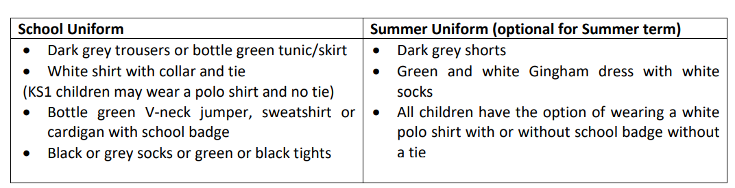
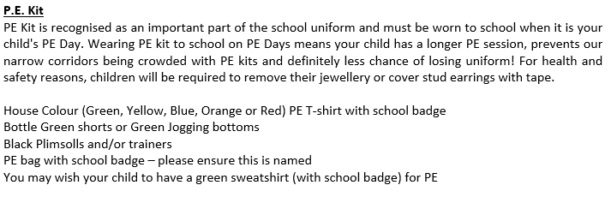
Uniform
https://www.smithsschoolwear.co.uk/
Shoes- black shoes or plain black trainers (no boots)
Bags- Forty Hill Book Bag or Ruck Sack from Smiths Schoolwear.
Please ensure that all clothing is labelled with your child’s name.

Slide 16
Black trainers – Your child will need a pair of black velcro trainers for PE.
Bag - We expect all our children to have a Forty Hill back-pack purchased from the School Uniform Shope Smiths on Baker Street.
We strongly recommend that all children have a Forty Hill backpack (Smiths- Baker Street). These can be used for their reading books, story books, artwork and any letters that are sent out.
Spare Clothes – Your child will need to a spare set of clothes; these will need to be placed in a bag (not plastic) on your child’s peg.
Wellies – So that children can continue their learning outdoors, all year round, they will need a pair of wellies. These can be brought in daily, or you can leave them on our boot rack.
Water bottles – Your child will need a filled water bottle – this will need to be brought into reception, everyday.
Jewellery - Only stud earrings are allowed to be worn to school. Bracelets, necklaces or rings are not to be worn at any time.
Hair - For safety reasons, long hair must be tied back with an appropriate fastening at all times (this applies to girls and boys). All fastenings need to be grey, black or green and should be small and discreet.
Toys and Sweets – Please do not allow your child to bring sweets, toys or money etc. into school.

Slide 17
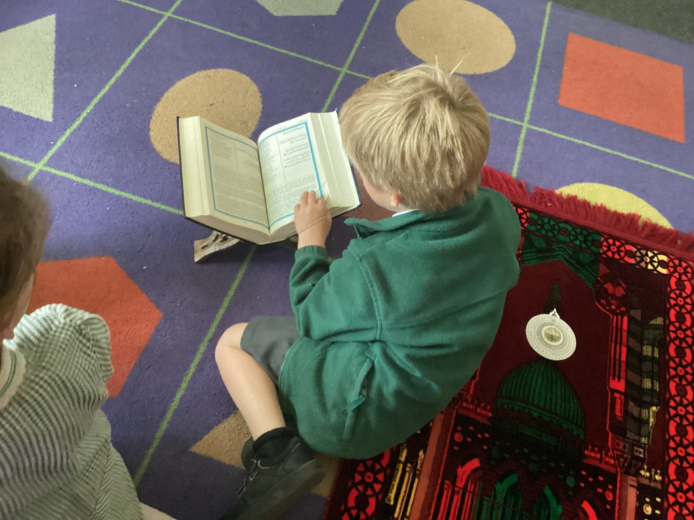
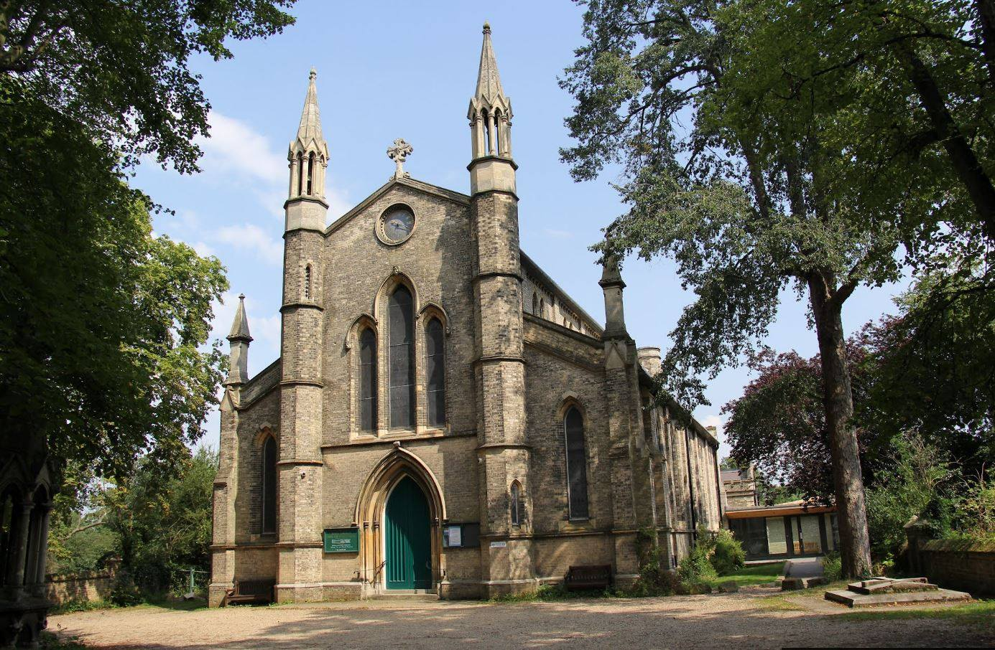
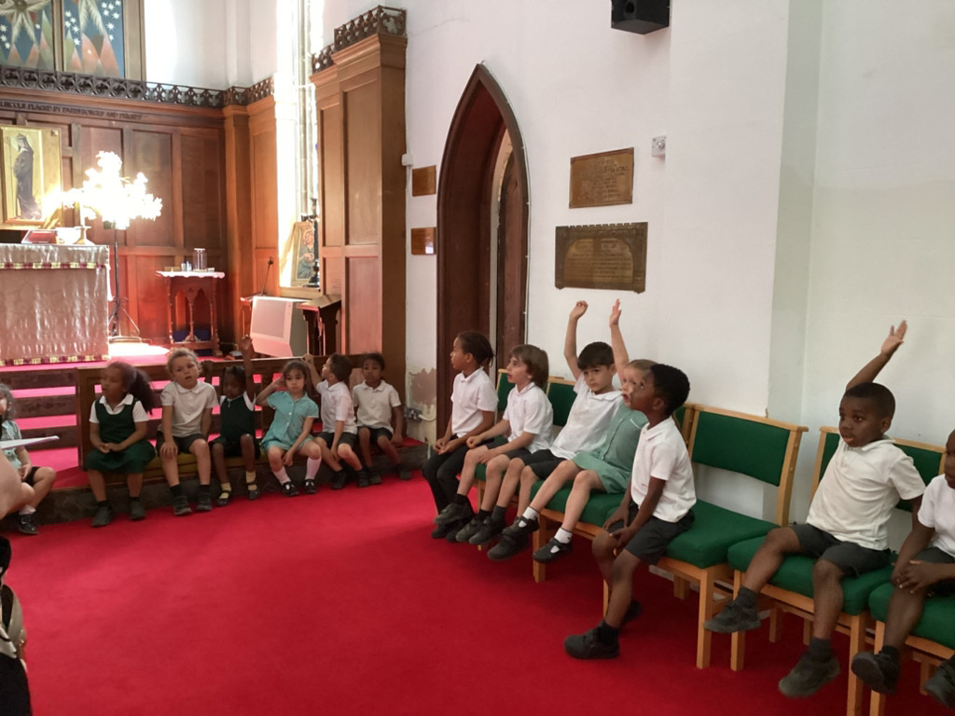
Jesus Church
We are proud to be linked to Jesus Church. Throughout our school year, we visit the church regularly to worship and to enrich RE learning.
Rev’d Bolster and Rev Mandy lead us in an act of worship each week, focussing on our vision and values and a relevant bible story. We are also fortunate enough to have them to support RE learning too when needed.
As part of our Collective Worship Programme, the
school attends Jesus Church throughout the year
to participate in, and lead, festival services.

Slide 18

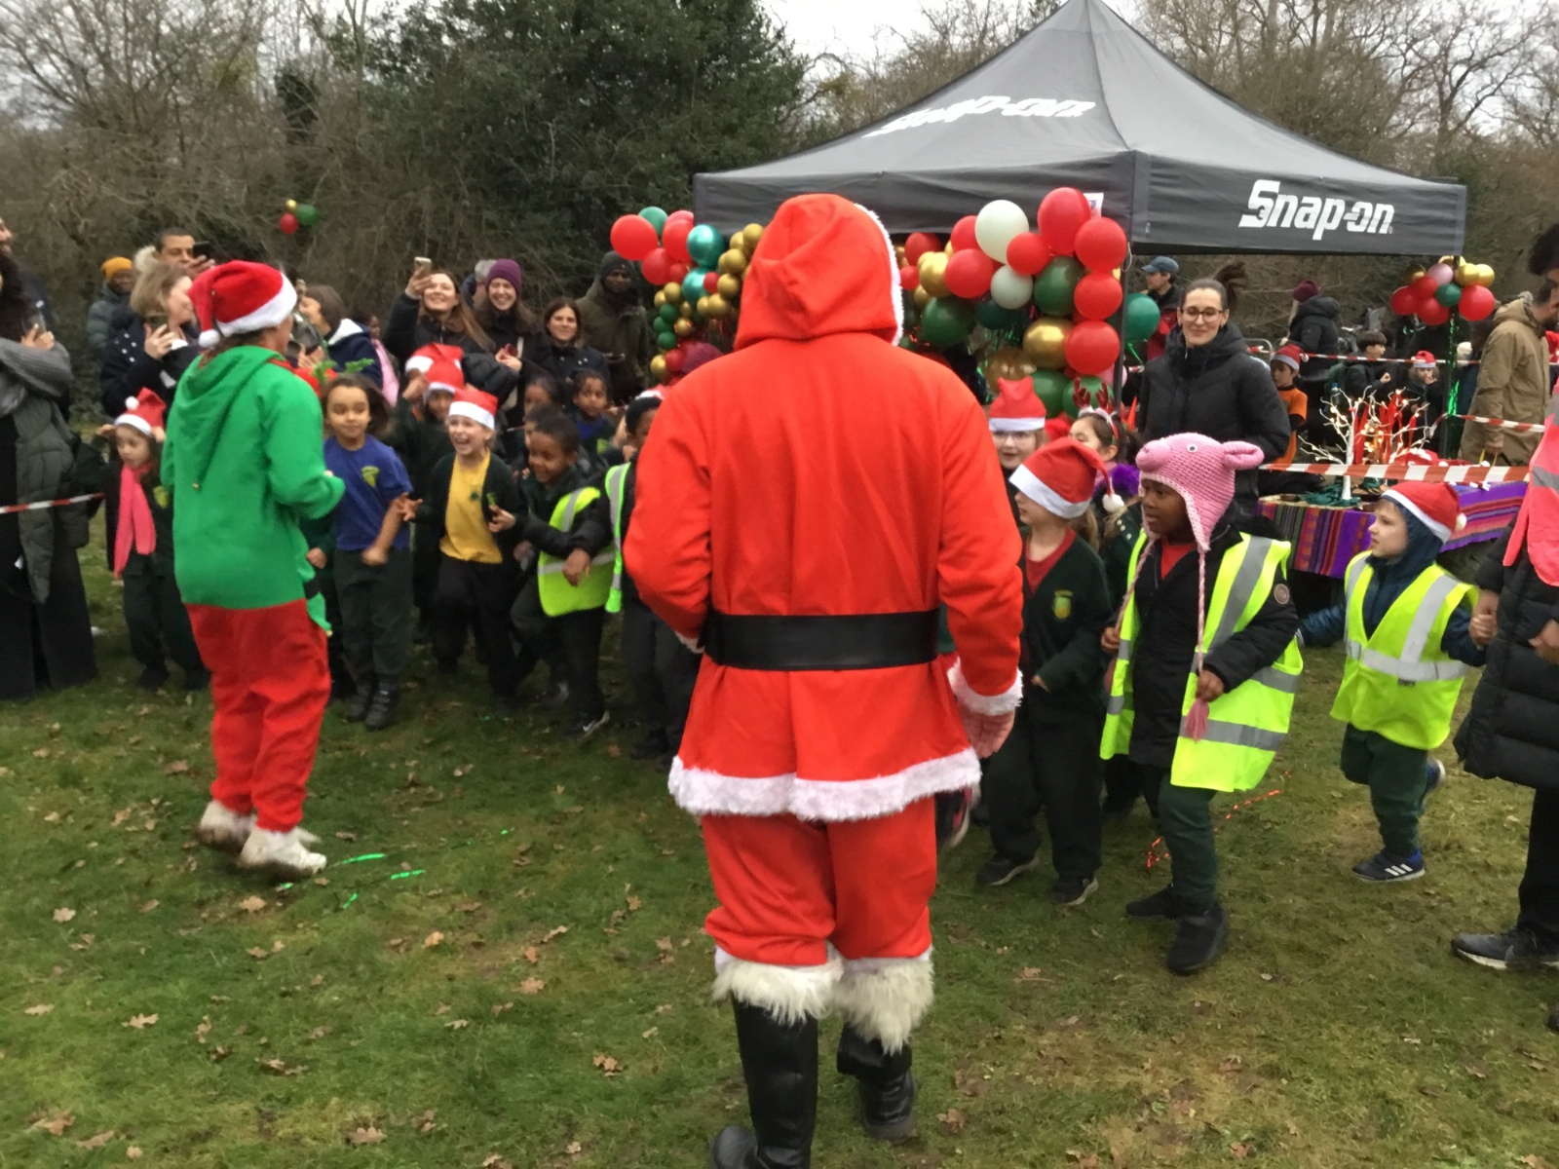
The Friends of Forty Hill
We are The Friends of Forty Hill – and we run the majority of fundraising and community events for the school. We have been an integral part of the school life for many years (formally known as APF) and have raised thousands of pounds, which has been spent on improving equipment and resources to enhance our children’s education.
Some of the items we have managed to raise funds for and buy are:
A new reflection area; mirrors for our Dance Studio; School Reading Challenge books and storage hampers; new carpets for classrooms; Bibles for our school leavers.
Past fundraising events have included the Santa Dash and Disco/Mini movers Sessions
Our Forty Hill Summer Fete will be held after School on Friday 11th July- so please come and join us!
Our reward is to see the children having fun at the events and enjoy seeing the money we raise used in the school.
You are automatically a member of the Friends of Forty Hill – but we are always looking for volunteers and helpers to support our different fundraising projects in different ways so please don’t be shy and help us to help our children!

Slide 19
Home School Communication
Please do let us know if there is anything we can do to help you and your child settle at Forty Hill.
The best way to do this is to catch us at the end of the school day or email the school office who will arrange an appointment if it is not you who collects your child.
Whilst we encourage open communication, please avoid talking at length in the mornings as this is a very busy time for us and we need to be there for the children, in the class.

Slide 20

Tapestry
Tapestry is an online educational package that records children’s learning in the early years. It is a secure system where filenames are encoded for uploaded images and videos that make it a safe online learning journal tool.
Tapestry allows parents to access their child’s journal, so parents can see their child’s learning and progression. Parents are also able to upload pictures and videos of their child at home.
The latest guidance regarding observations in the EYFS is not to capture teaching and learning on the i-pad but to be present, exchange in back and forth conversation and to be IN the MOMENT!
You will receive regular updates but they may be less frequent than you are used to with Nursery children. There is not less happening, it’s just a different timetable and some outcomes are recorded in books which you will see during Parent Consultations.

Slide 21

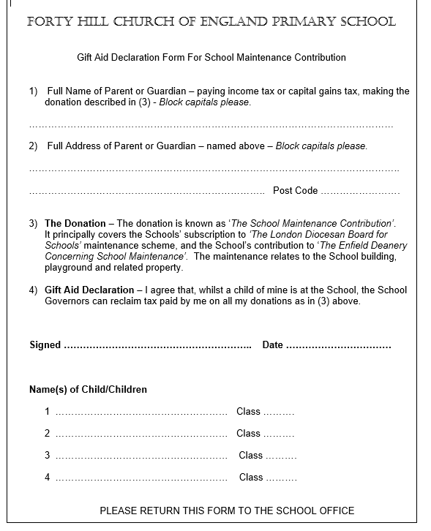

Maintenance Fund
This is a contribution that we request each new school year. Currently we ask for a yearly contribution of £36.00 for each child that attends the school (discounts are made for siblings).
We are asked as a school to contribute over £5000 each year towards a maintenance fund held at the diocese. Schools can then bid for a share of the money to pay for larger costly projects. At Forty Hill we have successfully bid several times over the last few years.
Works have included:
Extensive hot and cold-water pipework
Refurbishment of the children’s toilets and disabled toilet
Replacing the school roof
Resurfacing the playground
Improvement to site security and a new gate and fob system
General upkeep e.g. repainting walls and windows, upgrading fire doors
If parents do not make this contribution, then the school has to make up the shortfall. As a Church of England school, the Local Authority does not contribute at all to the upkeep or repairs of our building, so being part of this fund is a necessity.
In this time of funding cuts and increased pressure on school budgets, we would urge every family to support the school by making this contribution every year. For ease, it will be listed on your oldest child’s Parent Pay account as ‘School Maintenance Fund’. If you are a brand new family to our school, this will be set up once your child officially starts.

Slide 22

Donations
It is customary for Early Years providers to ask parents for contributions throughout the year. Here at Forty Hill, we ask for a £10 donation every term so approximately every 12-15 weeks.
This money goes mainly towards the purchase of sensory materials such as ingredients to make playdough, rice, popcorn kernels, foam, shaving gel/cream, bubble mixture, key texts to support our topics, seeds and anything that we feel will support the children and enhance their learning around a topic.
We thank you in advance for your support and if you’d like to pledge more this will be greatly appreciated.

Slide 23
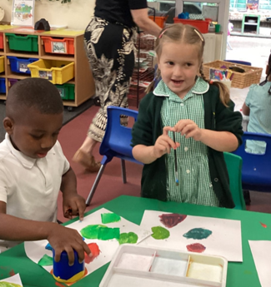
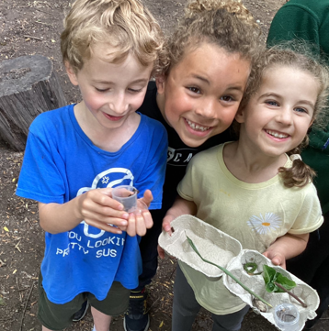
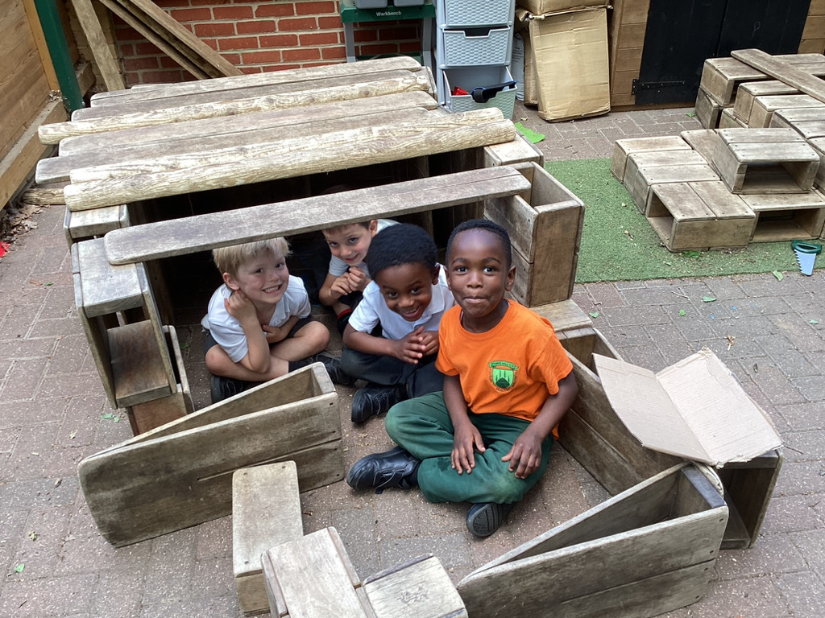
Any Questions?
If you have any additional questions following this meeting please email office@fortyhill.enfield.sch.uk and we will respond as soon as we can.

