Slide 1
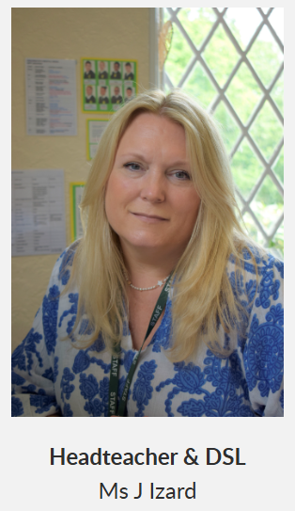
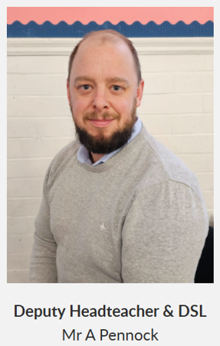


Welcome

Slide 2


Our School Vision and Values

Slide 3
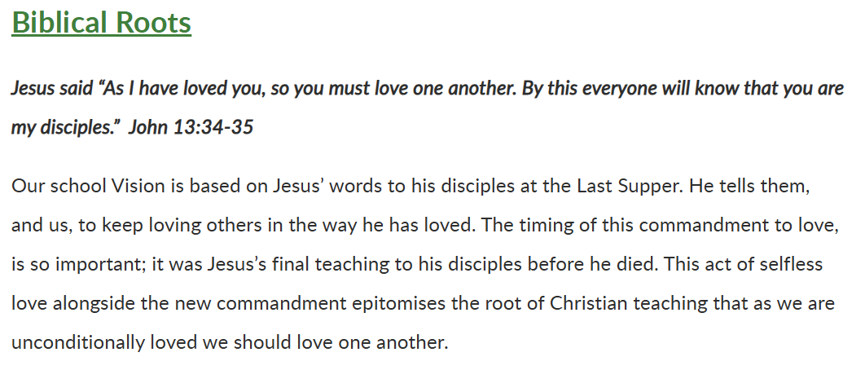
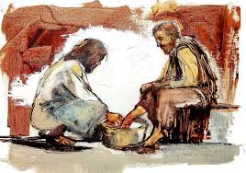

Slide 4
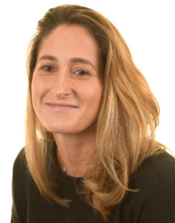
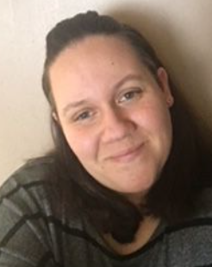
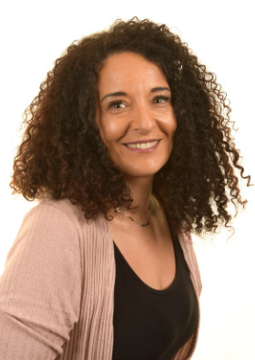
The Nursery Team
Miss Bissett
Nursery Class Teacher
Ms Golebiowska
Mrs Sofroniou (Mornings)

Slide 5

Starting School
Starting Nursery is a huge step for both children and parent/carers, so in the early days we welcome you to stay for as long as it is felt necessary for your child to settle.
We have a workshop for new parents on 11th July in the School Hall.
Tonight you will receive your key dates letter and the details of your Home Visit.
The children will have a staggered start to Nursery to support their needs, with one-hour sessions with parents leading up to a full morning without parents on Thursday, the 11th September.
Your child will spend the whole session with us. However, if we feel this is too long for them and they will benefit from a shorter day to begin with, we will speak to you. We make these decisions really based on the individual needs of the child.

Slide 6

Afternoon Workshop
Forty Hill School
Friday 11th July
Please come along and find out what you can do to help your child be 'ready' to start school.

Slide 7
Nursery Curriculum
The Early Years Foundation Stage (EYFS) sets the standards that all early years providers must meet to ensure that children learn and develop well and are kept healthy and safe. It promotes teaching and learning to ensure children’s ‘school readiness’ and gives children the broad range of knowledge and skills that provide the right foundation for good future progress through school and life.
There are four principles which underpin the work of
all early years’ practitioners:
A unique child – every child is unique, is constantly learning with the potential to become resilient, capable, confident and self-assured.
Positive relationships –children learn to be strong and independent through positive relationships.
Enabling environments with teaching and support from adults –
children learn best in environments which respond to their
individual needs and where there is a strong partnership between
practitioners, parents and carers.
Learning and development – we recognise that all children develop and learn at different rates and in different ways. Our practice aims to be inclusive no matter the individual needs of the child.

Slide 8
Areas of Learning and Development
Practitioners teach children by ensuring there are challenging and playful opportunities to learn within the areas of learning and development. There are seven areas of learning:
Prime areas -
Communication and Language,
Physical Development,
Personal, Social & Emotional Development
Specific areas –
Mathematics,
Literacy,
Understanding the World,
Expressive Arts and Design
These areas of learning and development are integral to a child’s learning and development
and interconnected. We deliver
a cross curricular approach to learning geared by
the children’s interests.

Slide 9
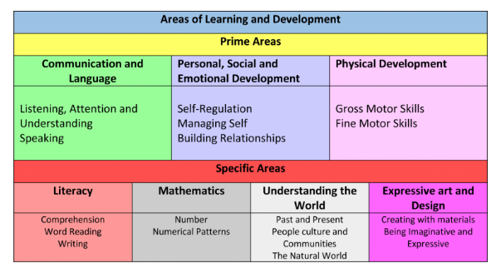
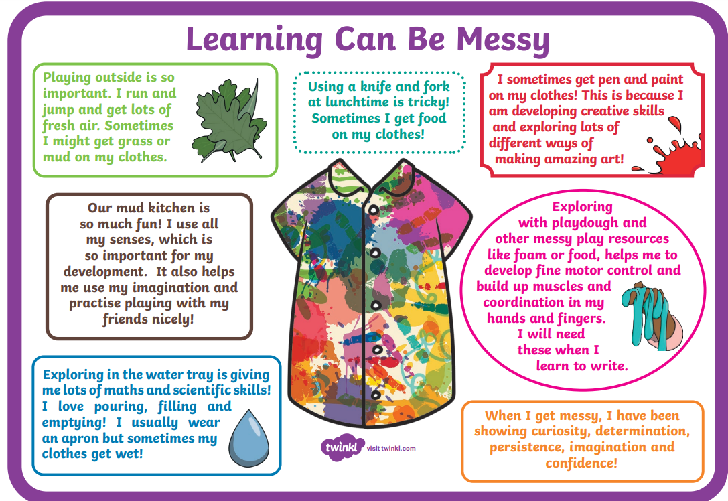
EYFS Curriculum

Slide 10
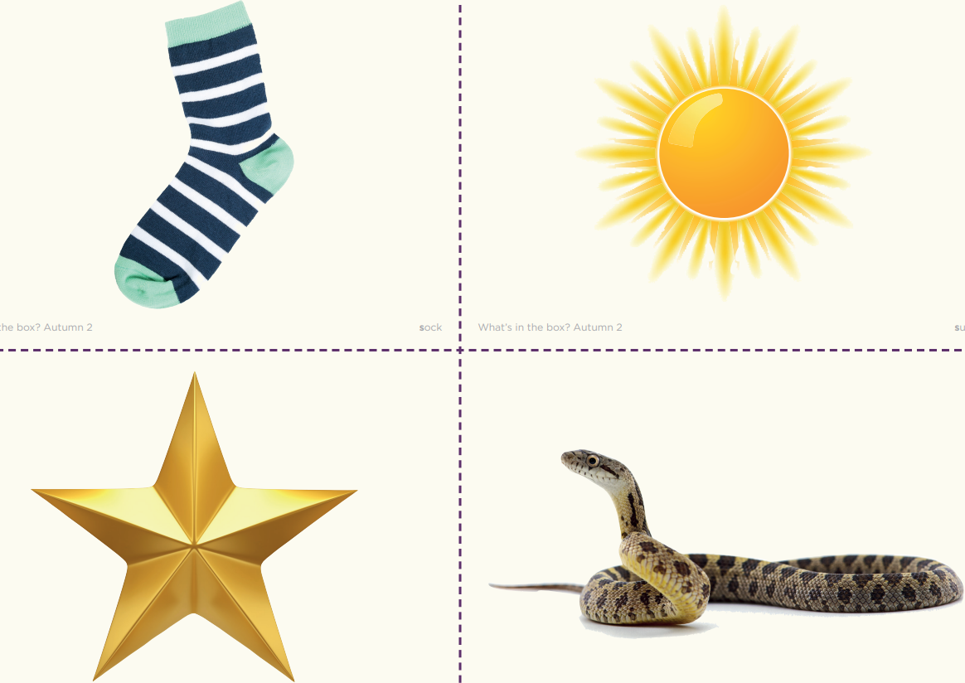


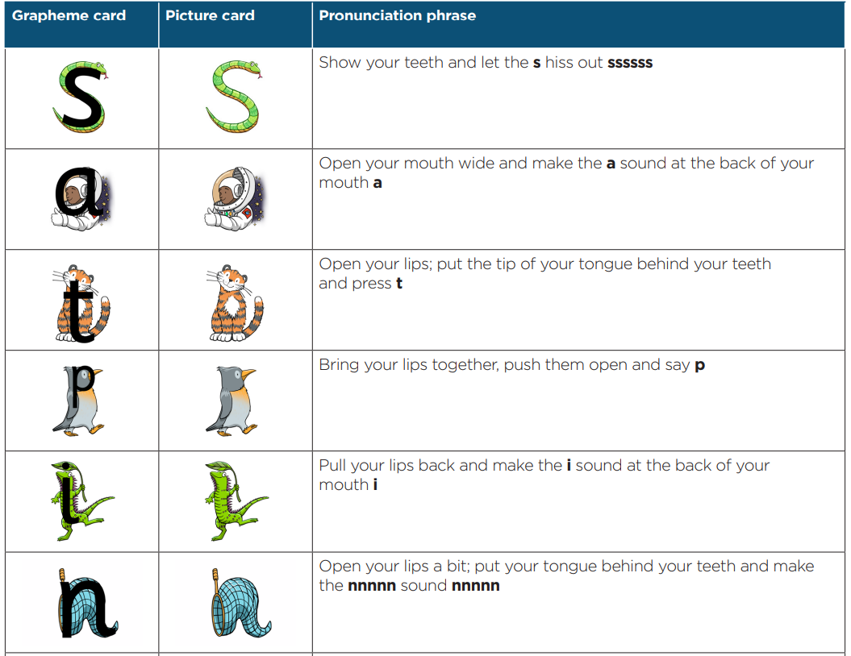


Slide 11

Tapestry
Tapestry is an online educational package that records children’s learning and development within the Early Years. It is a secure system where filenames are encoded for uploaded images and videos that make it is a safe online learning journal tool.
Tapestry allows parents to access their child’s journal, so they can see their child’s learning and progression. Parents are also able to upload pictures and videos of their child at home, and we encourage this interaction so we can enhance your child’s learning experience based on their interests at home.
The latest guidance regarding observations in the EYFS is not to capture teaching and learning on the i-pad but to be present, exchange in back-and-forth conversation and to be IN the MOMENT! We aim to observe every child at least once a week.
As well as teaching, observing children’s play is an important part of Early Years development. It allows us to gain insight into pupil’s understanding and helps us to extend and move pupils on. Observations are also used to inform planning and assess individual children.
Observations will be conducted by staff working with the children. Staff will make comments based on what your child is doing and saying.

Slide 12
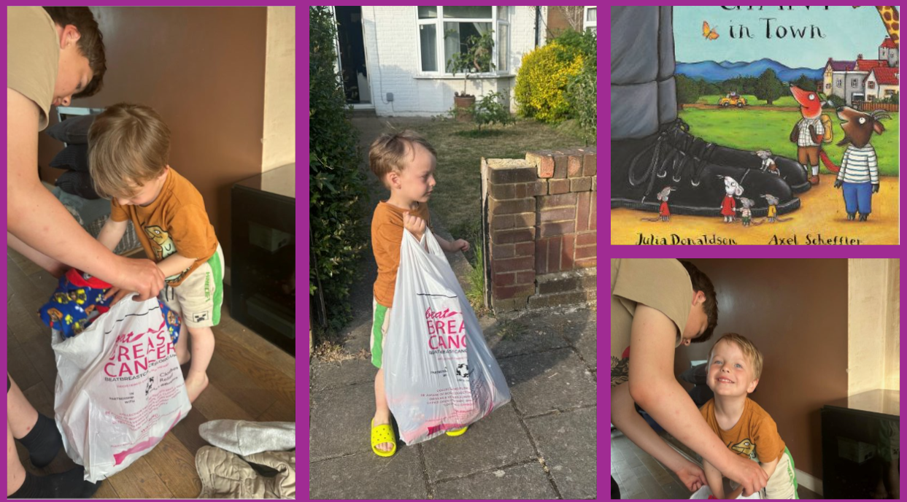

Being Global Neighbours
Being a ‘Steward of the World’ has NEVER been so important.
Global and Climate education should be as important as Literacy and Maths if we are to prepare the next generation to understand what needs to change, have voices for change and have the skills and knowledge to make change.
It is our duty to create global neighbours who are confident, responsible and compassionate. Courageous advocates who will look after our world.
Our Global Neighbours Curriculum consists of a year-long project for every year group that focused on a key area of global awareness. As a child makes their journey through our school, they will build an in-depth and current set of skills and knowledge about our world that will enable them to be courageous advocates, stewards of the Earth, make change and challenge injustice.
But this goes beyond our classrooms; we expect our whole school community to be environmentally responsible and this includes walking to school where possible, if you do drive- park responsibly and safely, recycling uniform by using our pre-loved programme, supporting our school garden with plant donations and physical help, encouraging your child to recycle, care for nature and show respect and kindness to all members of the school and global community whatever their faith, gender, culture, race or beliefs.

Slide 13
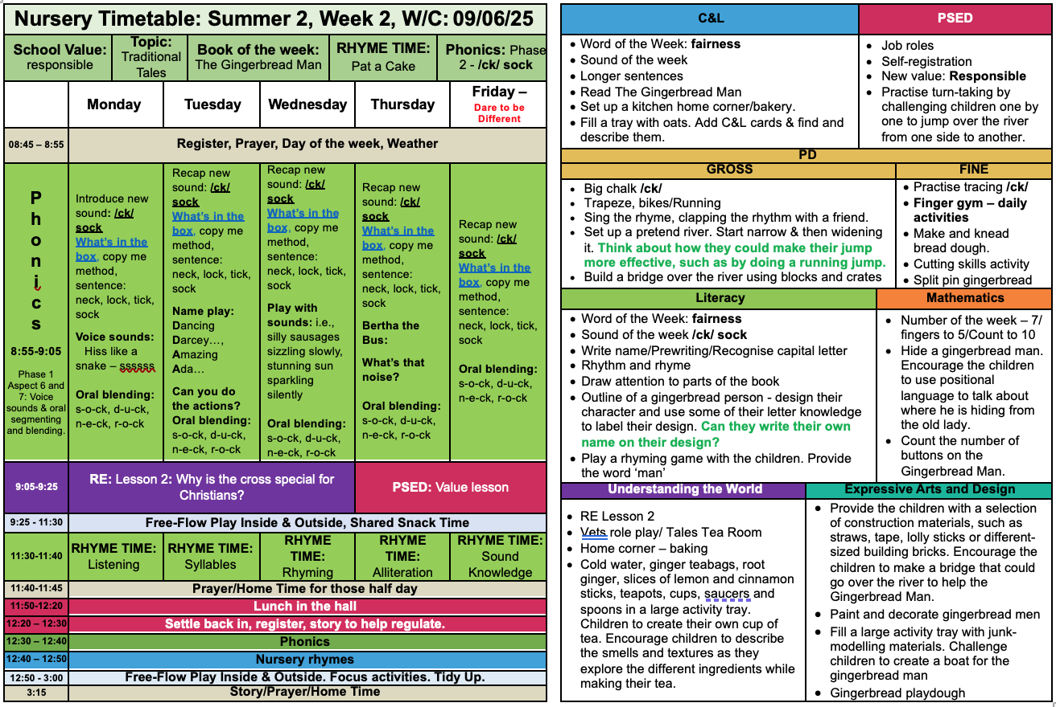

Slide 14
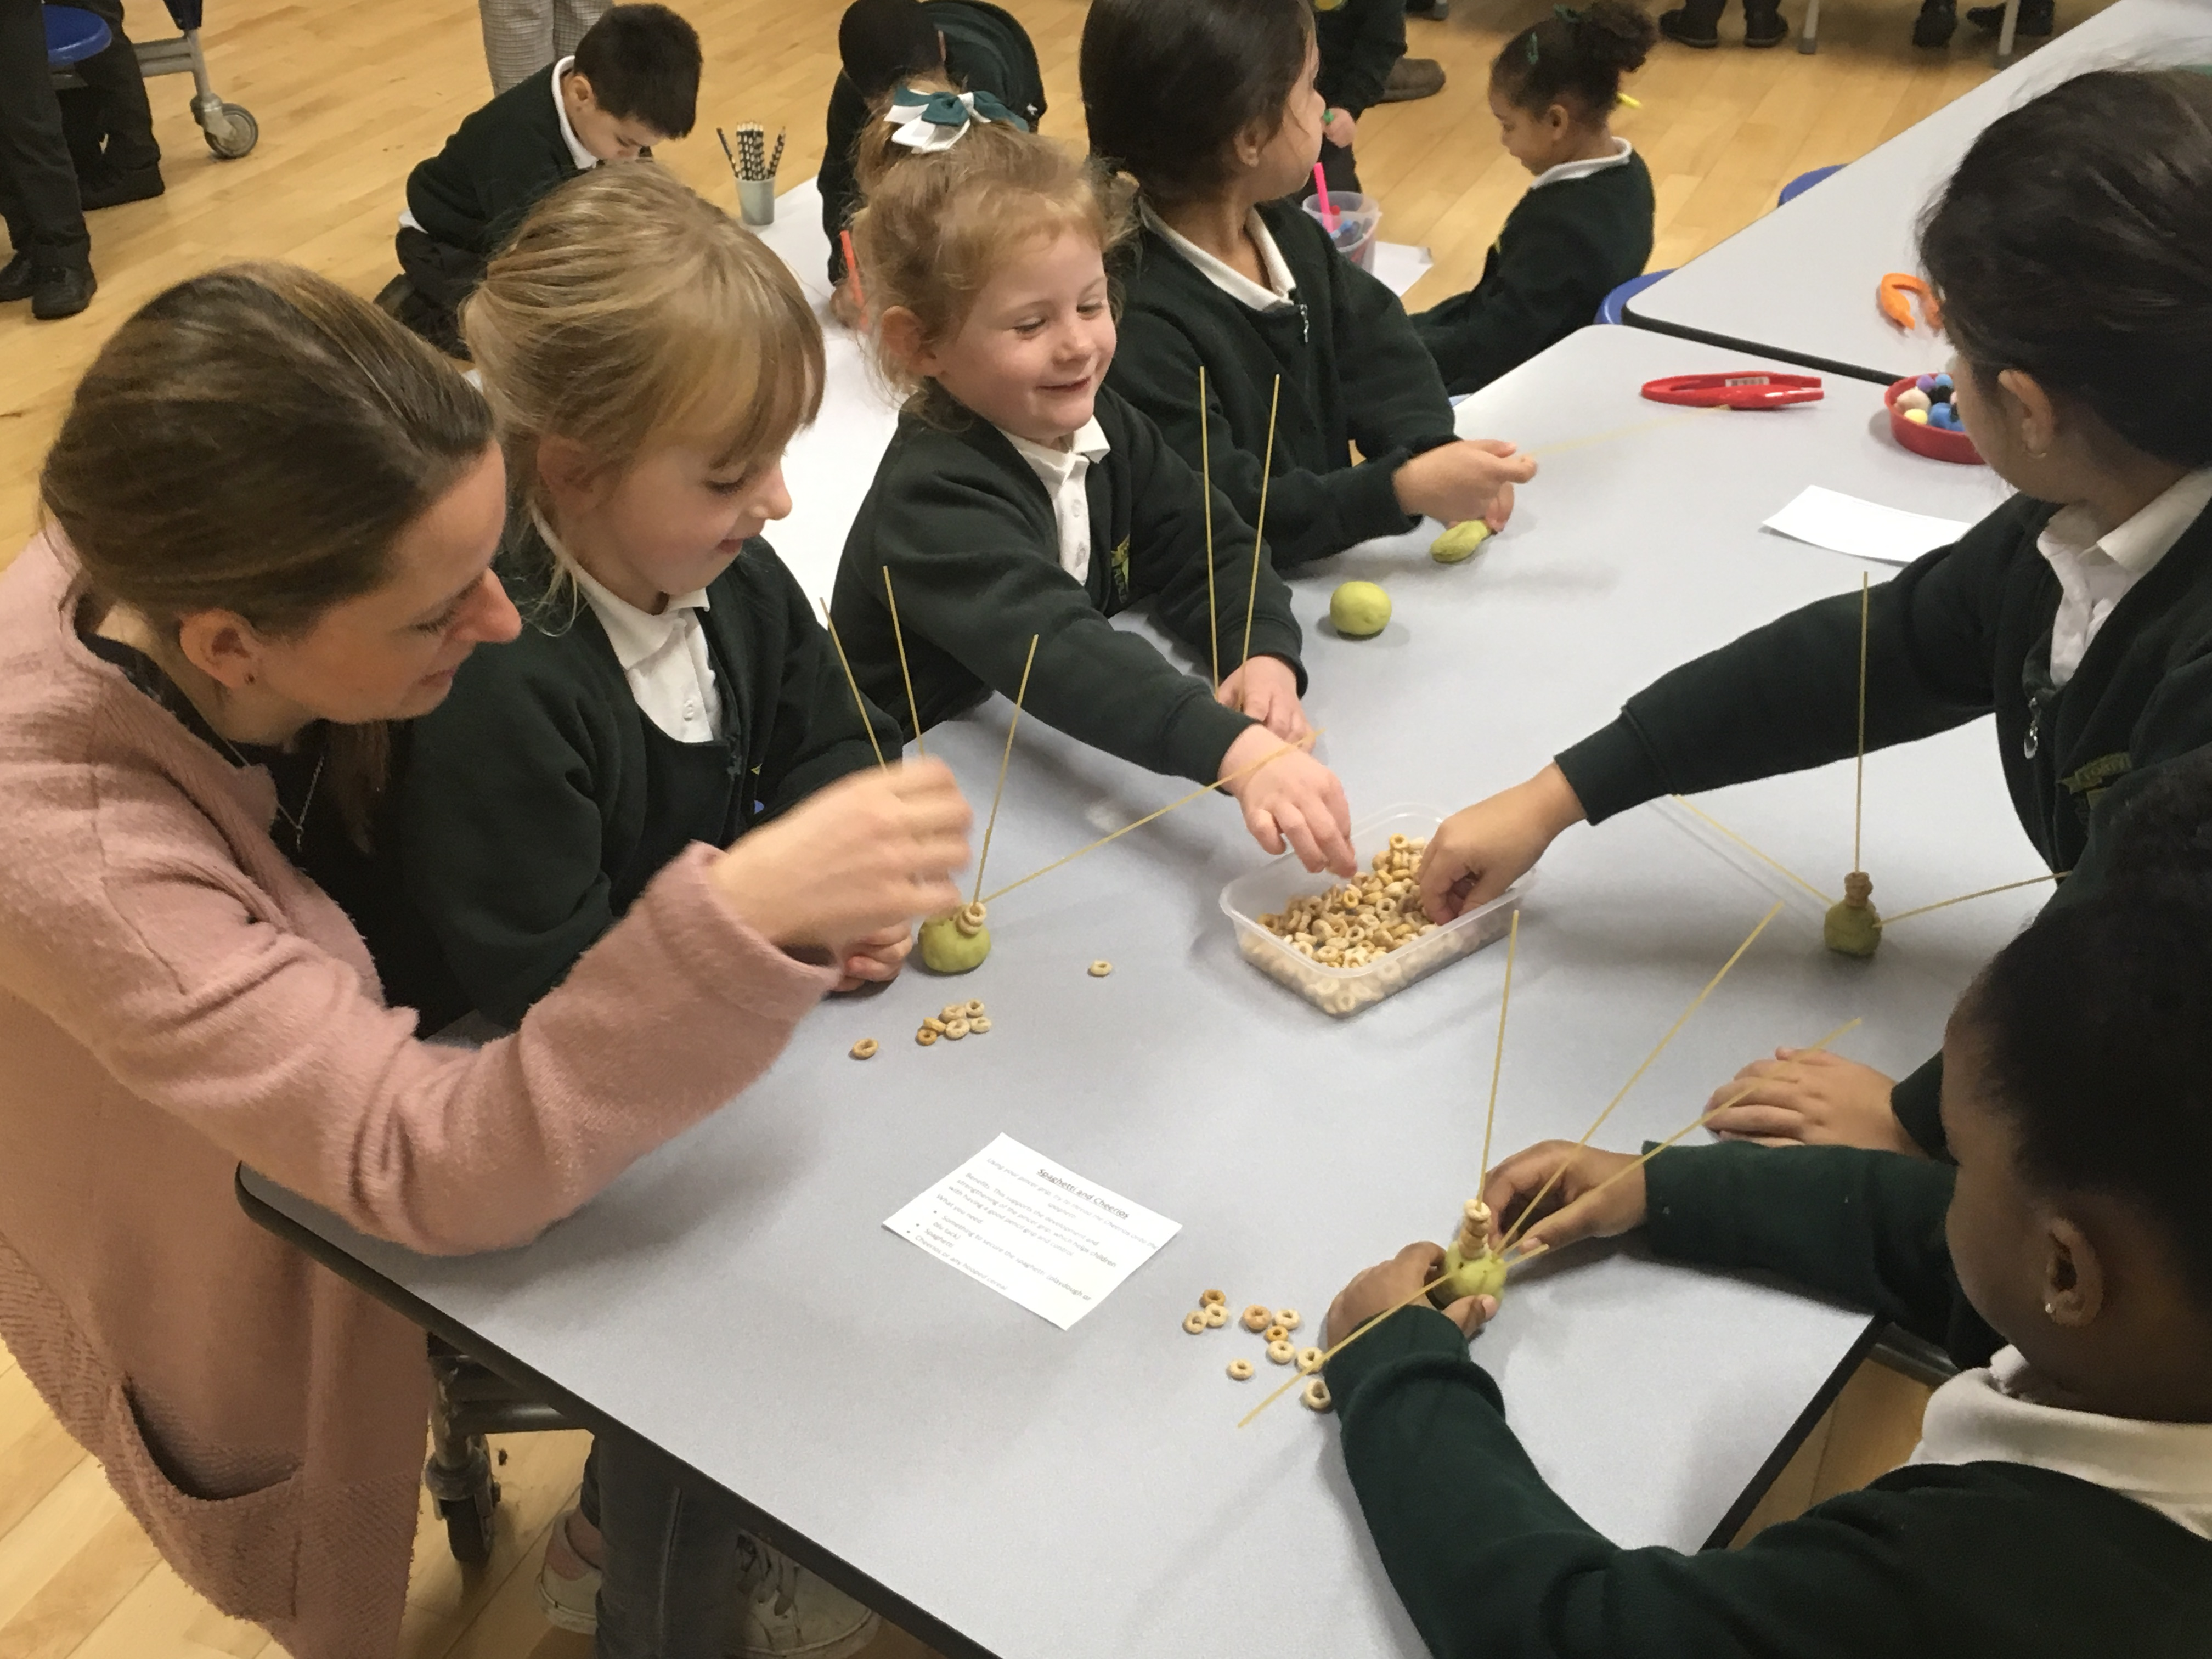
Home School Communication
Please do let us know if there is anything we can do to help you and your child settle in at Forty Hill.
The best way to do this is to catch us at the end of the nursery session or email the school office who will arrange an appointment if it is not you who collects your child.
Whilst open communication is welcome we ask you to please avoid talking at length in the mornings as this is a very busy time for us and we need to be there for the children.
All communication from the school will come via the school's information system Arbor.

Slide 15
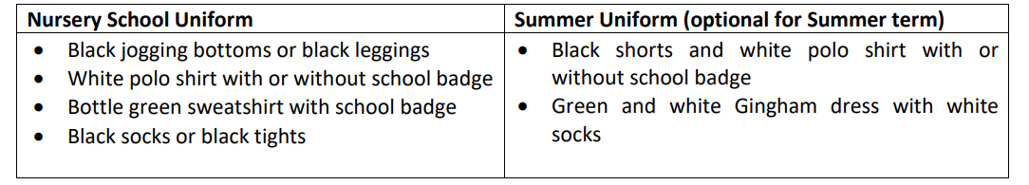
Uniform
Footwear
Black school shoes or smart plain black trainers (NO boots or sandals).
PE Top – Once your child knows which tree group they are in please purchase a plain t-shirt in that colour or purchase a School one from Smiths.
Ordering and Purchasing Uniform
Our uniform can be purchased at J Smith & Sons (Baker Street) or online by logging into https://www.smithsschoolwear.co.uk/
Enter “Forty Hill” in the search section and the uniform will appear.
You can also purchase general uniform items (those without our logo) from other suppliers e.g. Marks & Spencer and major supermarkets.
Please ensure that all clothing is labelled with your child’s name.

Slide 16
Bag - We expect all our children to have a Forty Hill back-pack purchased from the School Uniform Shope Smiths on Baker Street.
Spare Clothes – Your child will need a spare set of clothes; these will need to be placed in a bag (not plastic) on your child’s peg.
Wellies – So that children can continue their learning outdoors, all year round, they will need a pair of wellies. These can be brought in daily, or you can leave them on our boot rack.
Water bottles – Your child will need a filled water bottle – this will need to be brought into nursery, everyday.
Jewellery - Only stud earrings are allowed to be worn to school. Bracelets, necklaces or rings are not to be worn at any time.
Hair - For safety reasons, long hair must be tied back with an appropriate fastening at all times (this applies to girls and boys). All fastenings need to be grey, black or green and should be small and discreet.
Toys and Sweets – Please do not allow your children to bring sweets, toys or money etc. into nursery.

Slide 17
It is extremely important that standards of expectations are met from the beginning.
Please make sure your children are on time for Nursery. Our door opens at 8.45am and registers are taken at 8.55am.
Please send your child’s book bag / backpack in everyday with their reading book and reading journal as they will be read with at school at least once a week.
Read to your child at least once every day.
Ensure that your child is wearing the correct uniform that is labelled with their name every day.
Ensure you pay your yearly Maintenance Fee so we can make sure our school building is kept safe and well presented.

Slide 18
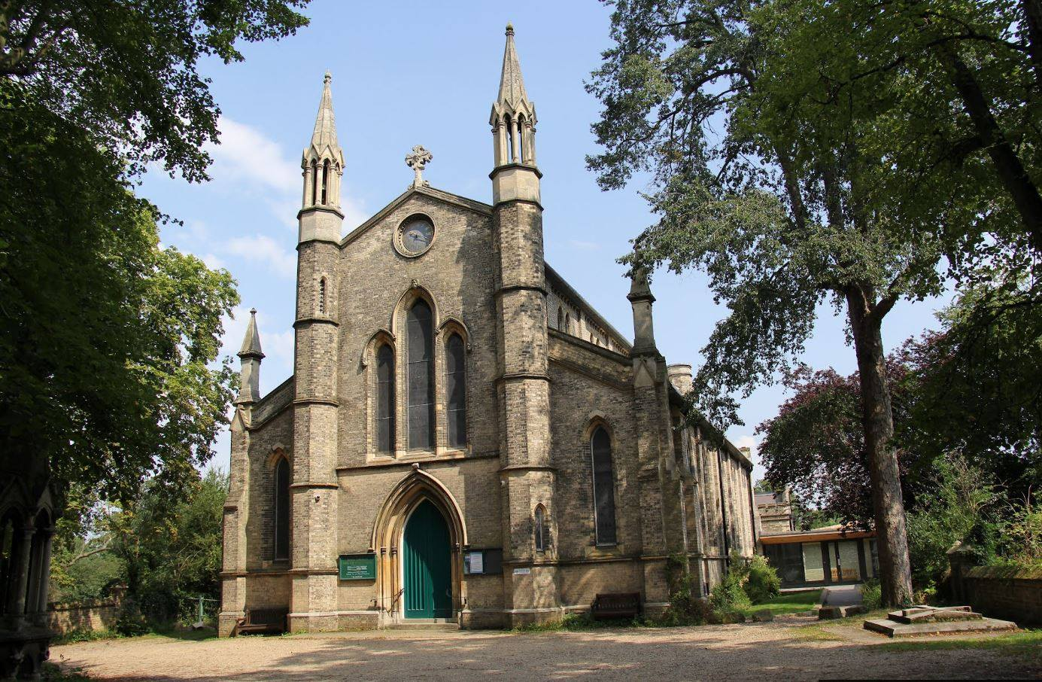
Jesus Church
We are proud to be linked to Jesus Church. Throughout our school year, we visit the church regularly to worship and to enrich our RE learning.
Rev’d Bolster and Rev Mandy lead us in an act of worship each week, focussing on our vision and values and a relevant bible story. We are also fortunate enough to have them to support RE learning too when needed.
As part of our Collective Worship Programme, the
school attends Jesus Church throughout the year
to participate in, and lead, festival services.

Slide 19

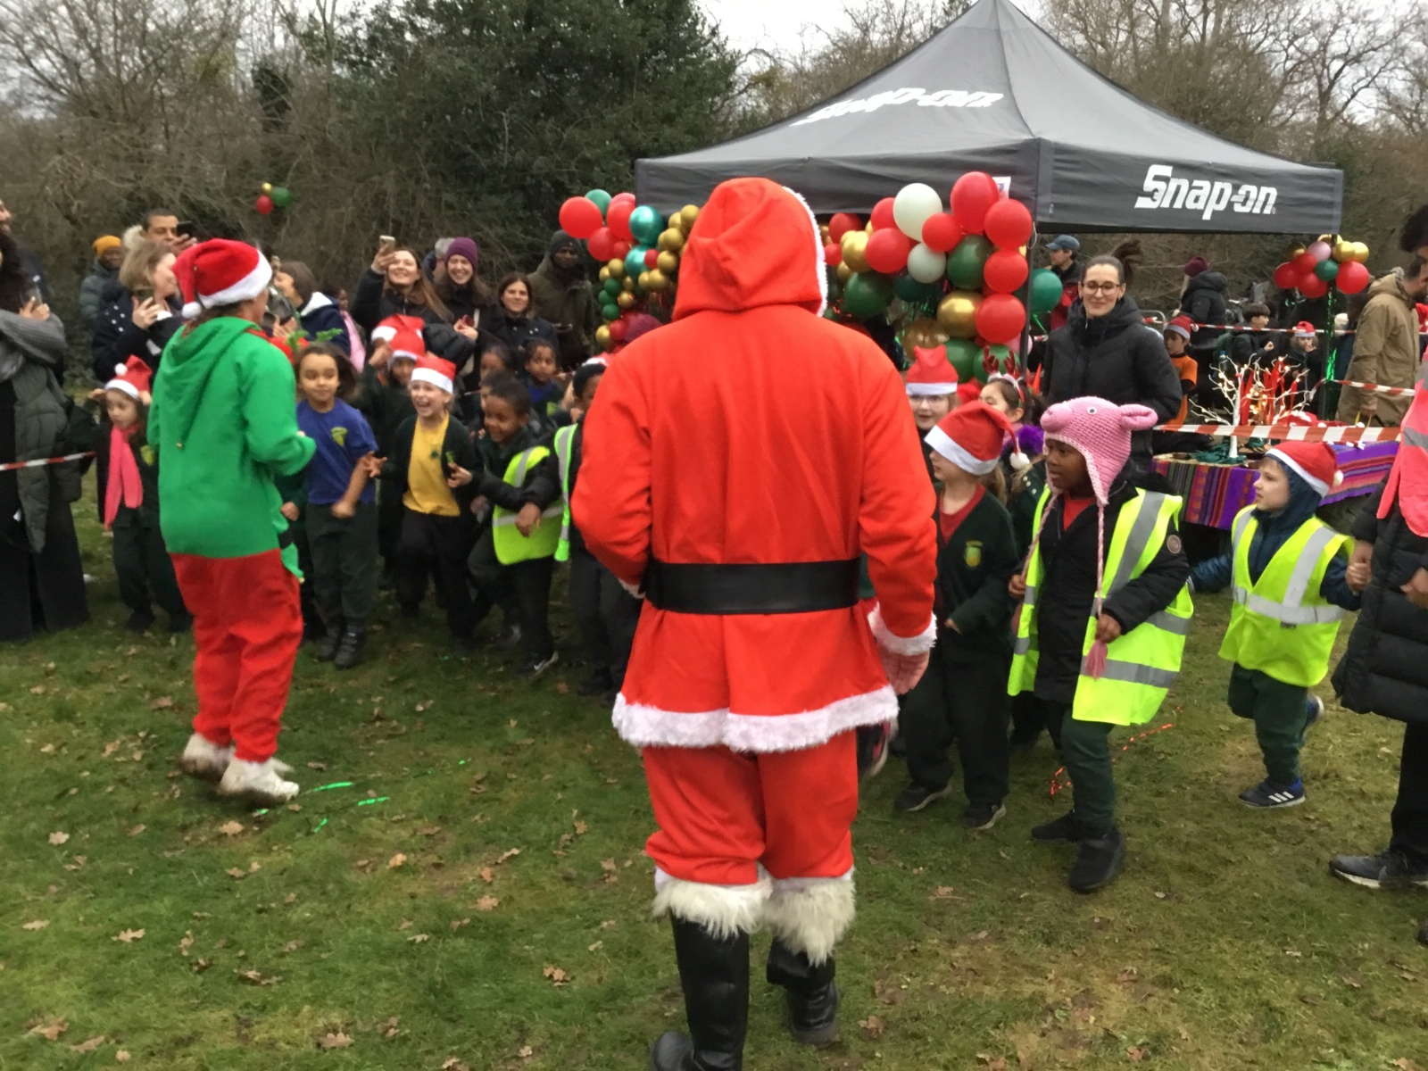
The Friends of Forty Hill
We are The Friends of Forty Hill – and we run the majority of fundraising and community events for the school. We have been an integral part of the school life for many years (formally known as APF) and have raised thousands of pounds, which has been spent on improving equipment and resources to enhance our children’s education.
Some of the items we have managed to raise funds for and buy are:
A new reflection area; mirrors for our Dance Studio; School Reading Challenge books and storage hampers; new carpets for classrooms; Bibles for our school leavers.
Past fundraising events have included the Santa Dash and Disco/Mini movers Sessions
Our Forty Hill Summer Fete will be held after School on Friday 11th July- so please come and join us!
Our reward is to see the children having fun at the events and enjoy seeing the money we raise used in the school.
You are automatically a member of the Friends of Forty Hill – but we are always looking for volunteers and helpers to support our different fundraising projects in different ways so please don’t be shy and help us to help our children!

Slide 20

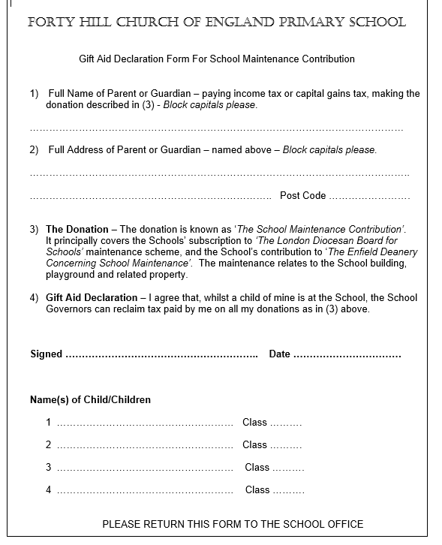

Maintenance Fund
This is a contribution that we request each new school year. Currently we ask for a yearly contribution of £36.00 for each child that attends the school (discounts are made for siblings).
We are asked as a school to contribute over £5000 each year towards a maintenance fund held at the diocese. Schools can then bid for a share of the money to pay for larger costly projects. At Forty Hill we have successfully bid several times over the last few years.
Works have included:
Extensive hot and cold-water pipework
Refurbishment of the children’s toilets and disabled toilet
Replacing the school roof
Resurfacing the playground
Improvement to site security and a new gate and fob system
General upkeep e.g. repainting walls and windows, upgrading fire doors
If parents do not make this contribution, then the school has to make up the shortfall. As a Church of England school, the Local Authority does not contribute at all to the upkeep or repairs of our building, so being part of this fund is a necessity.
In this time of funding cuts and increased pressure on school budgets, we would urge every family to support the school by making this contribution every year. For ease, it will be listed on your oldest child’s Parent Pay account as ‘School Maintenance Fund’. If you are a brand new family to our school, this will be set up once your child officially starts.

Slide 21


Donations
It is customary for Early Years providers to ask parents for contributions throughout the year. Here at Forty Hill, we ask for a £10 donation every term.
This money goes mainly towards the purchase of sensory materials such as ingredients to make playdough, rice, popcorn kernels, foam, shaving gel/cream, bubble mixture, key texts to support our topics, seeds and anything that we feel will support the children and enhance their learning around a topic.
We thank you in advance for your support and if you’d like to pledge more this will be greatly appreciated.

