Slide 1
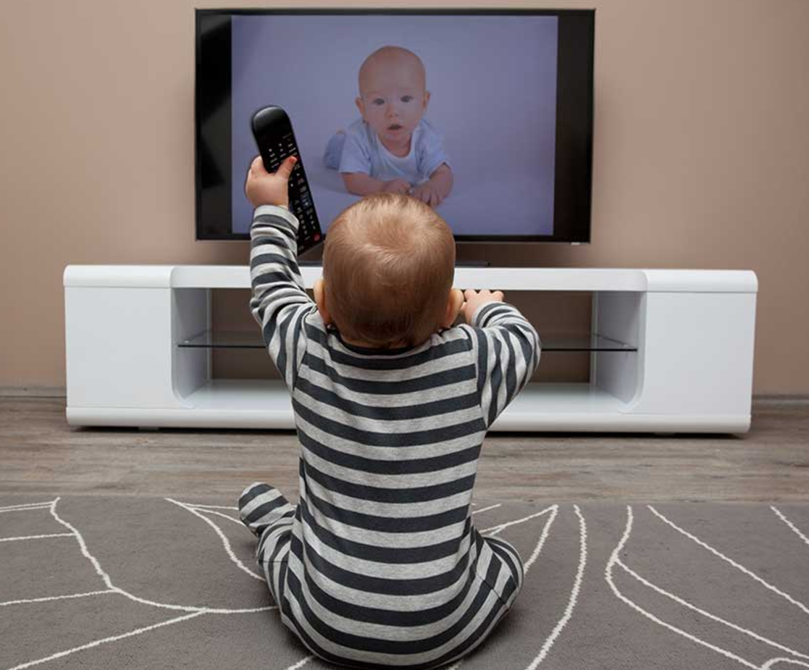
Screen Exposure and Potential Impact
The impact from infant screen time use affect the trajectory of subsequent cognitive development beyond infancy into later childhood and even potentially adulthood.
Children are hardwired to seek out meaningful connections – they won’t get them from TV screens, devices or from adults busy on their devices!
Infants that consistently watch TV
Score lower on cognitive tests
May have motor delays
As they get older have lower in-class participation and lower academic proficiency
May have poorer language processing skills

Slide 2

Infants that have high screen time may;
Have lower scores on cognitive tests
Have lower communication scores
Have lower levels of problem-solving skills
Have delayed social development
Have negative impacts on executive functioning skills

Slide 3
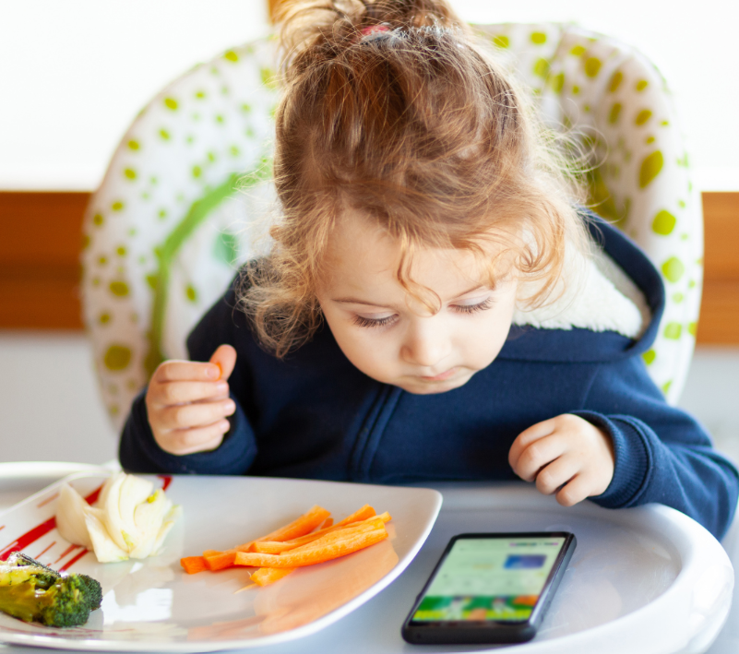
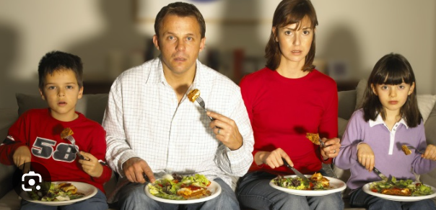
TV during family meals and background TV contribute to children;
Having lower verbal scores
Having poorer language processing skills

Slide 4
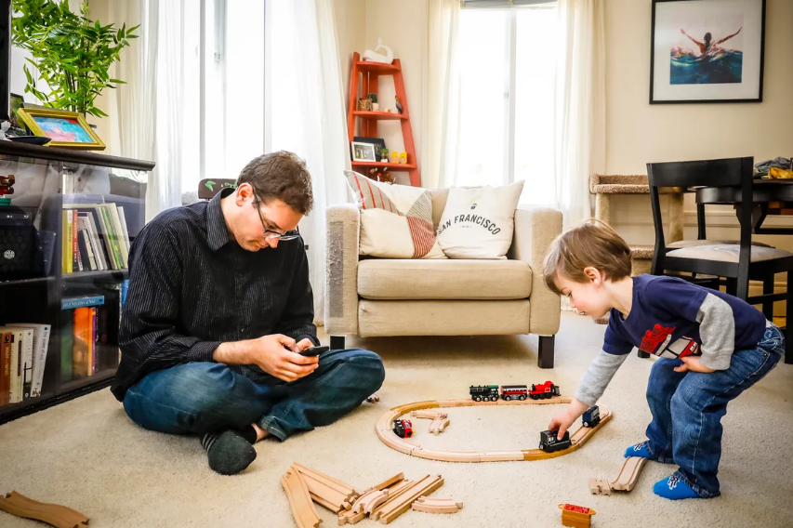

Parental/Carer media use;
The more time an adult spends on their device whilst in the room with a child, the fewer adult-child interactions there are, which are critical for cognitive and social development and for exposing children to language. Children are hardwired to seek out meaningful connections!

Slide 5
The truth about Early Years children and the use of screens and devices (based on the most recent research)
4 out of 10 toddlers have their own Ipad or tablet
6 out of 10 children under 4 have their own Ipad or tablet
1 in 5 children under the age of 8 use screens to support their emotional regulation
Of those children that use screens to support their emotional regulation - 23% use them whilst eating – 20% watch or play on a device every night or most nights in order to fall asleep
1 in 4 children under the age of 8 have their own phone – 79% of them have a smartphone which they use to go online, use apps, play and watch videos
48% of those children have watched short videos on platforms such as Tik Tok, Instagram or youtube with 16% engaging in that daily!
Of those watching videos – on average they are watching short videos for 14 minutes per day that are NOT designed for children
Children that are spending 2 or more hours on screens have a 42% greater risk of being over weight
32% of 3 – 17 year olds regularly upload their own videos to online platforms with Tik Tok remaining the most popular
15% pf 3 – 4 year olds have uploaded videos to sharing platforms

Slide 6
In a world where everyone is on devices and ‘interacting’ is potentially something that doesn’t happen as often as it should…………
Every Child Can Thrive By Five
https://www.youtube.com/watch?v=aISXCw0Pi94

