Slide 1







Slide 2

What's all the fuss about?
Phonics
Reading
Writing
Vocabulary

Slide 3
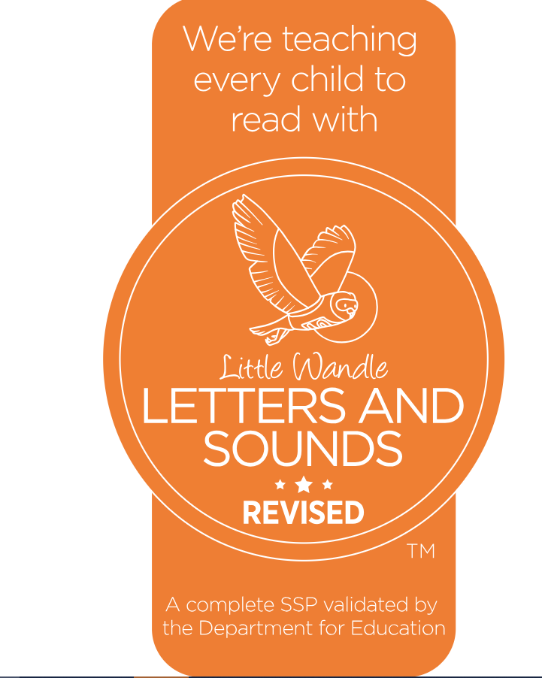




Slide 4
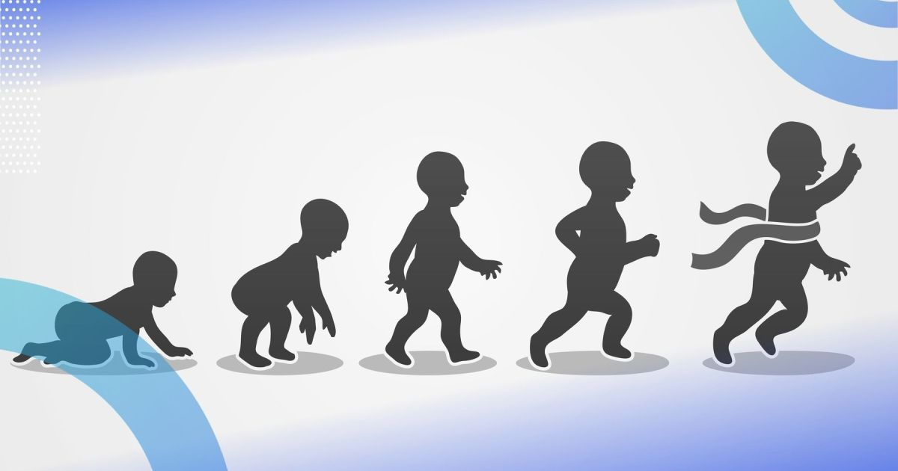

Slide 5
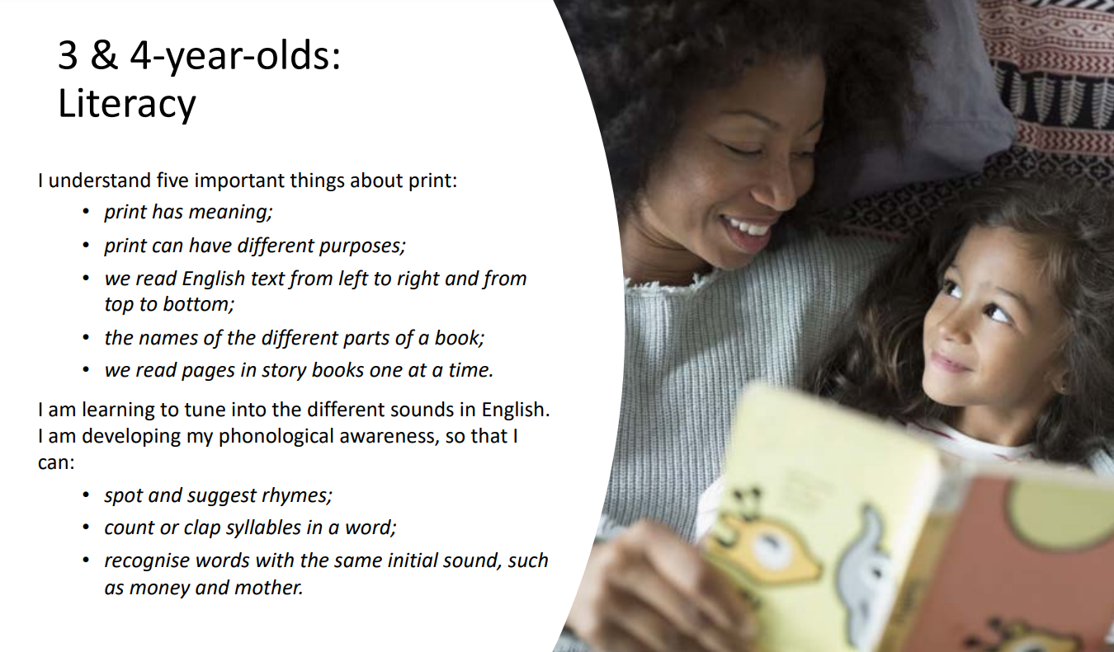

Slide 6
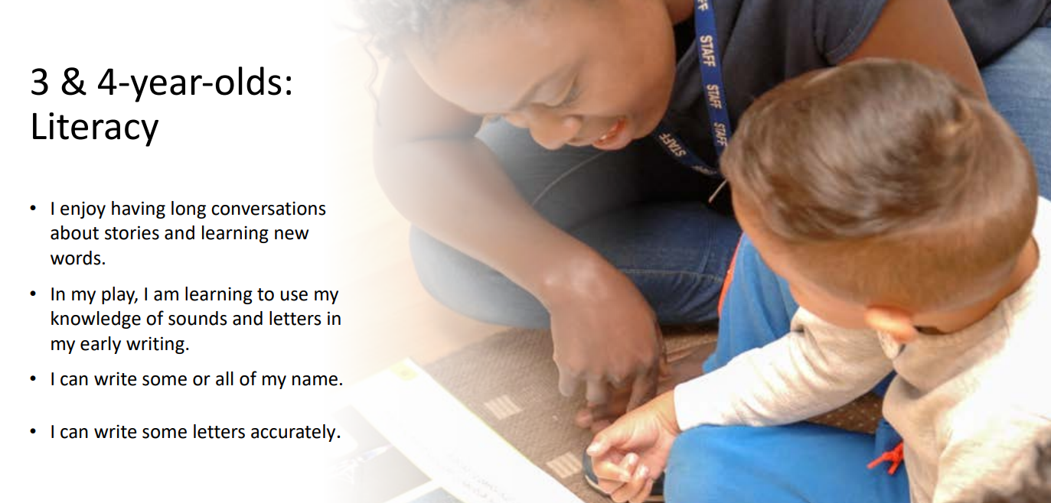

Slide 7
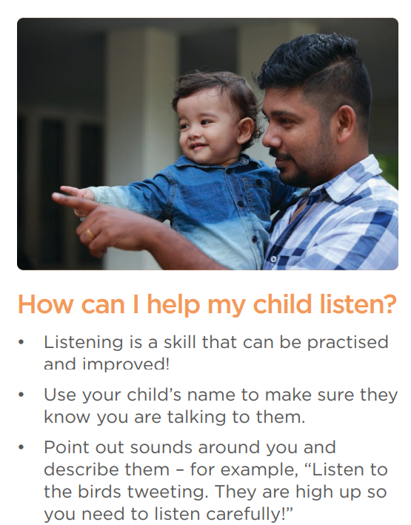
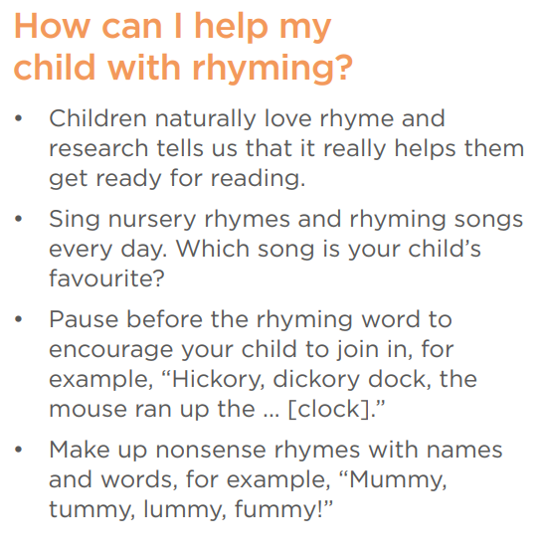

Slide 8

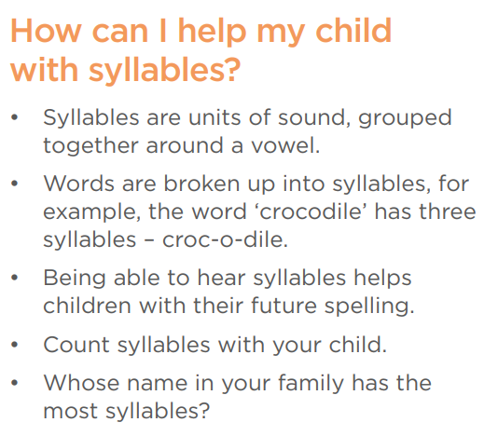
Mumm-y
Dadd-y
Tho-mas
Will-i-am
O-liv-er
Josh-u-a

Slide 9
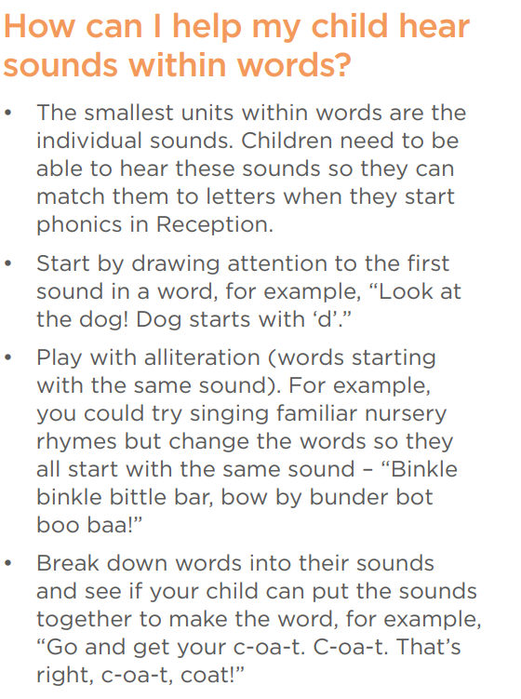
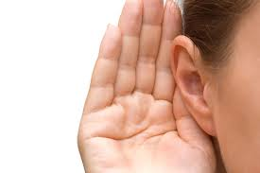

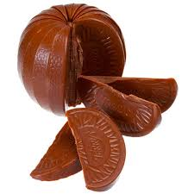

Slide 10
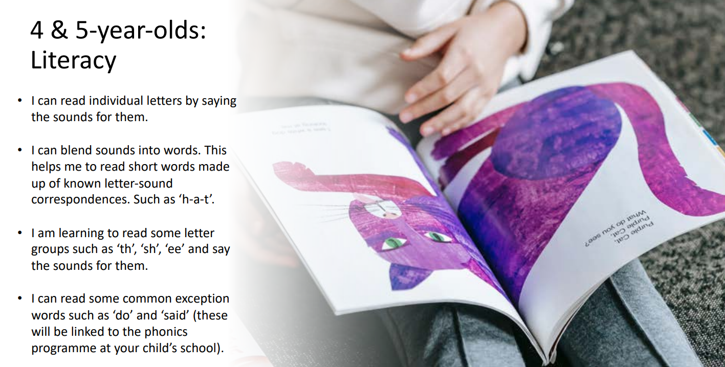

Slide 11
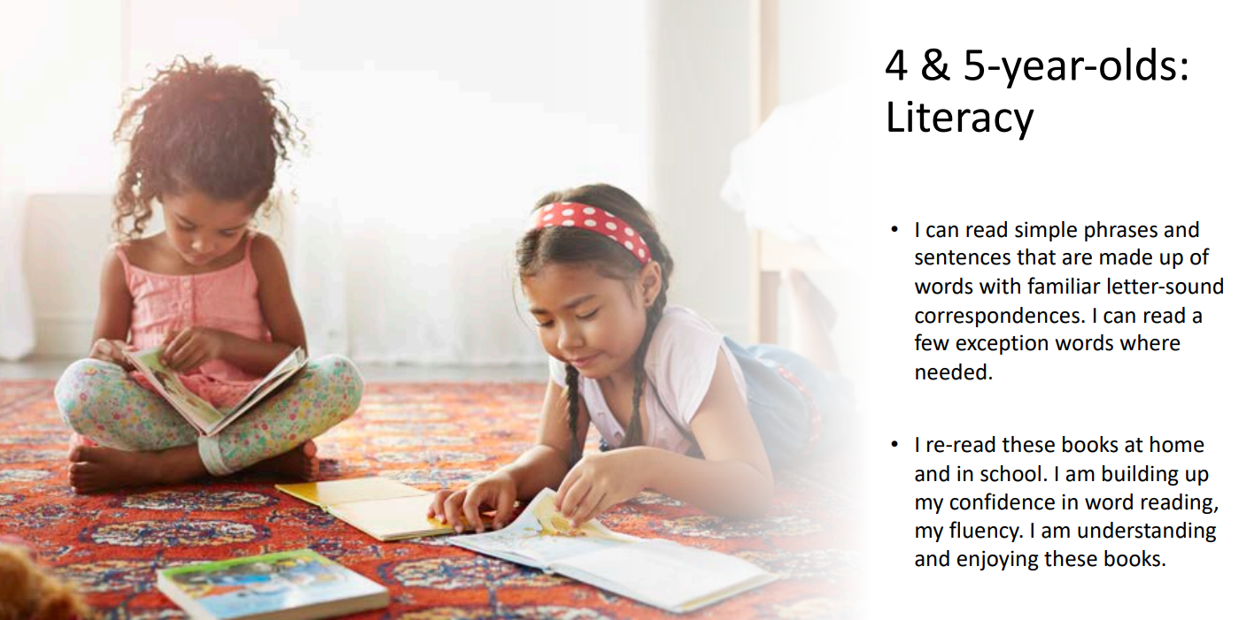

Slide 12
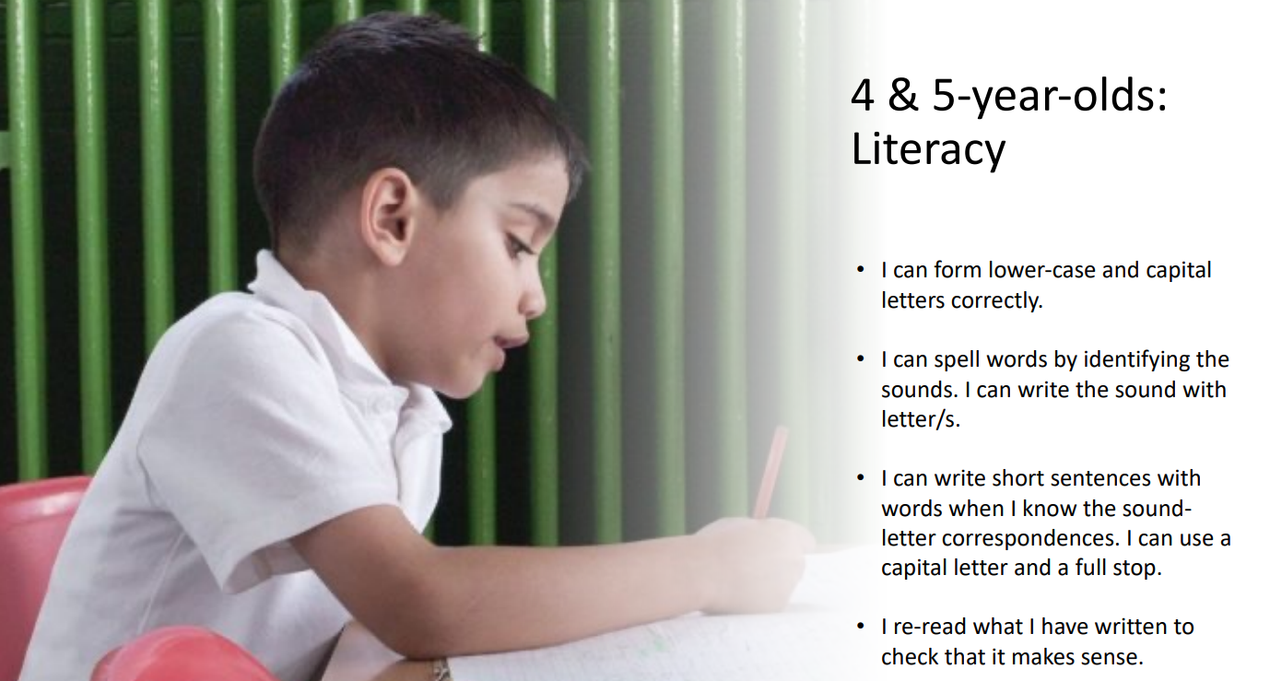

Slide 13






Systematic Synthetic Phonics ~ SSP

Slide 14

What makes a Phonics Scheme a scheme?

Slide 15
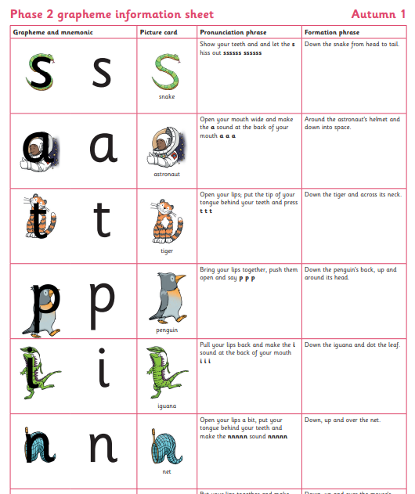
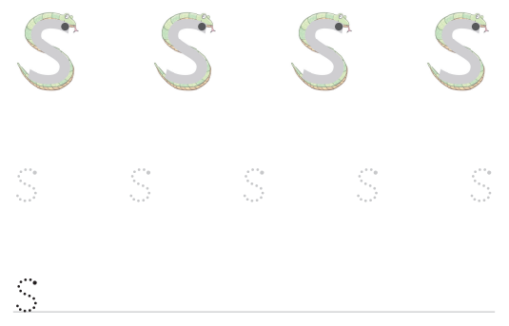
Consistency

Slide 16
Terminology
Phoneme: The smallest unit of sound that can be identified in words. We also use the term ‘sound’ but your child may use the word ‘phoneme’. There are 44 phonemes or sounds in the English language.
Grapheme: A letter or group of letters used to represent a phoneme in writing. The way graphemes are used to represent phonemes in our written language is known as the alphabetic code.

Slide 17
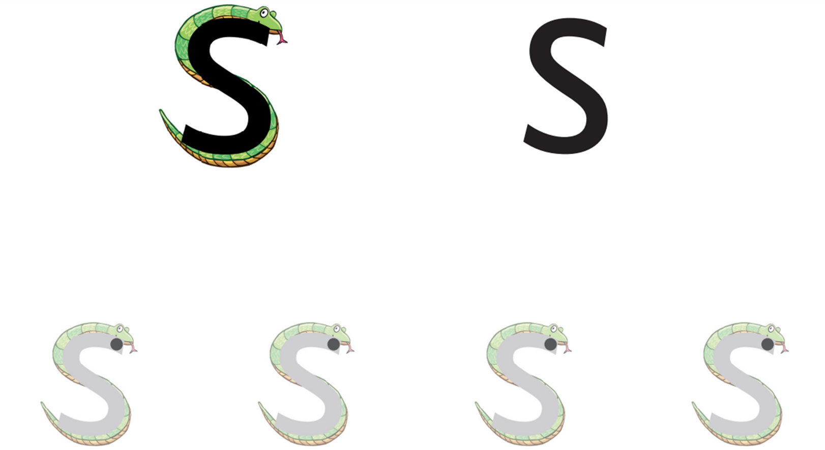
Phoneme and Grapheme - initial sounds

Slide 18
Decode: To break down (‘sound out’) a written word into sounds then blend the sounds together to read the word.
Digraph: A grapheme made of two letters that represent one sound. An example is the ‘sh’ in ‘shop’.
Schwa: This is the name for the most common sound in English. It is the unstressed sound that we find in many words and can be spelled in many ways. It makes an ‘uh’ sound, which varies according to accent. Examples include: the, better, carrot, balloon.

Slide 19



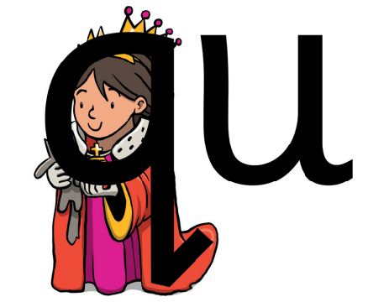


Decode

Slide 20
Digraph

Slide 21
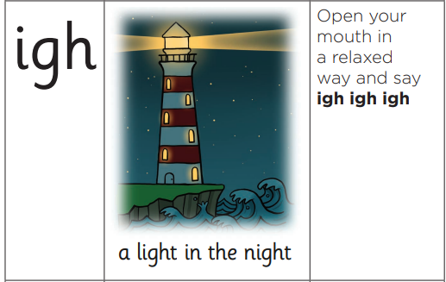
Trigraph - A grapheme made of three letters that represent one sound. An example is the ‘igh’ in ‘light’ and 'night'.

Slide 22
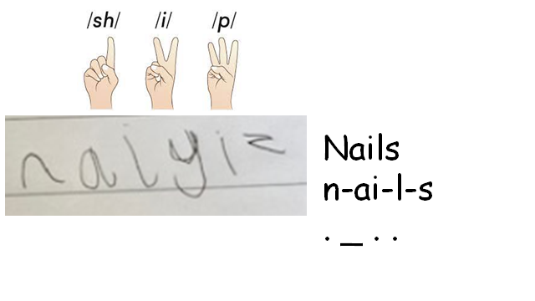
Pronunciation (pure sounds)

Slide 23
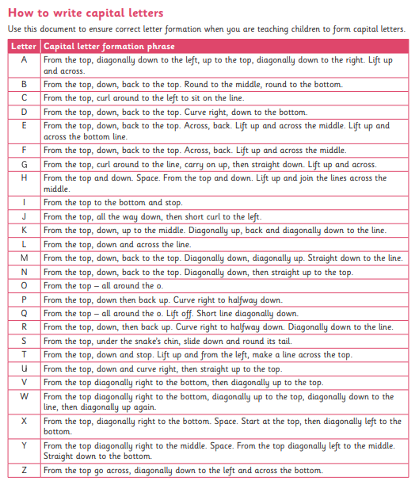
Captial letters

Slide 24
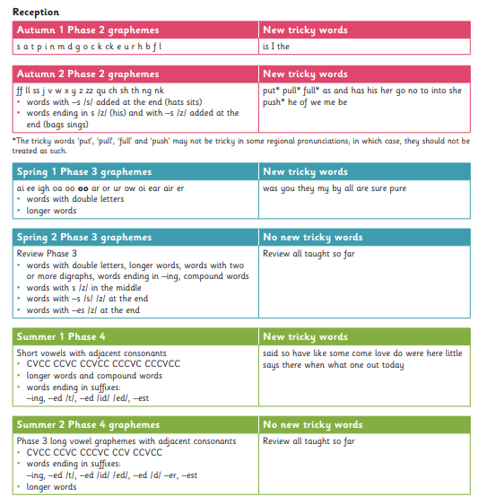
Progression

Slide 25
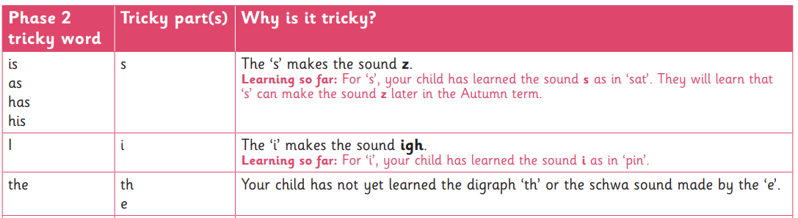
Tricky Words

Slide 26

Reading @ Forty Hill
1. Love of reading
2.Wordless picture books
3.School reading sessions x3
GPC's (Grapheme phoneme correspondence)
Prosody
Comprehension

Slide 27
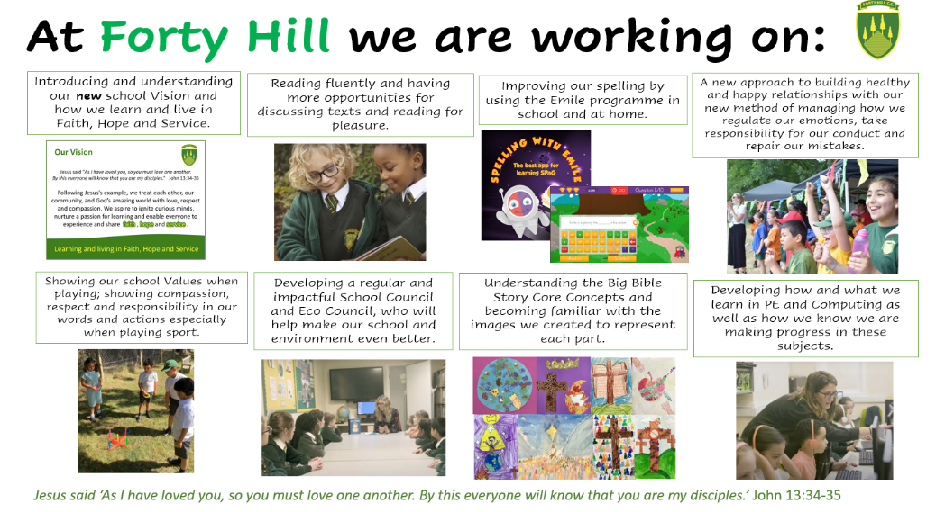
Fluency

Slide 28

Read for pleasure

Slide 29
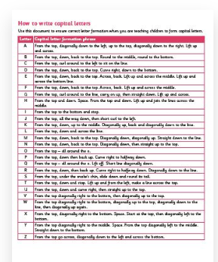
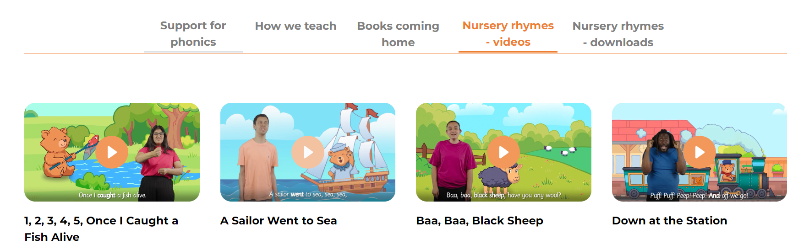
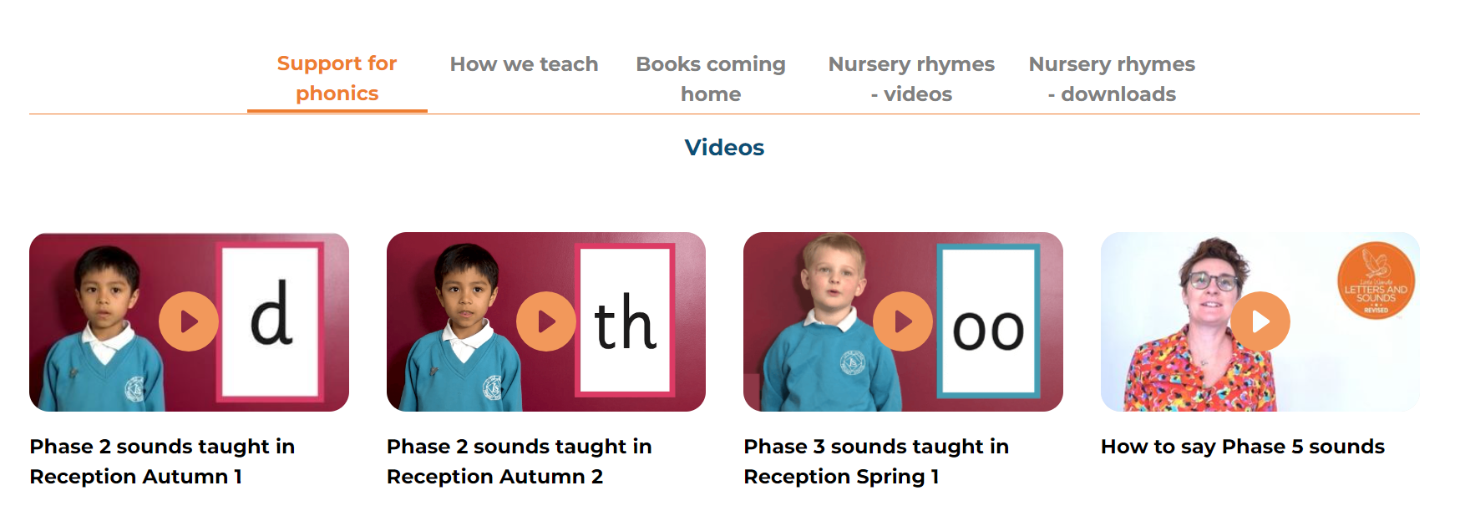
Little Wandle – For parents tab!
https://www.littlewandlelettersandsounds.org.uk/resources/for-parents/

Slide 30

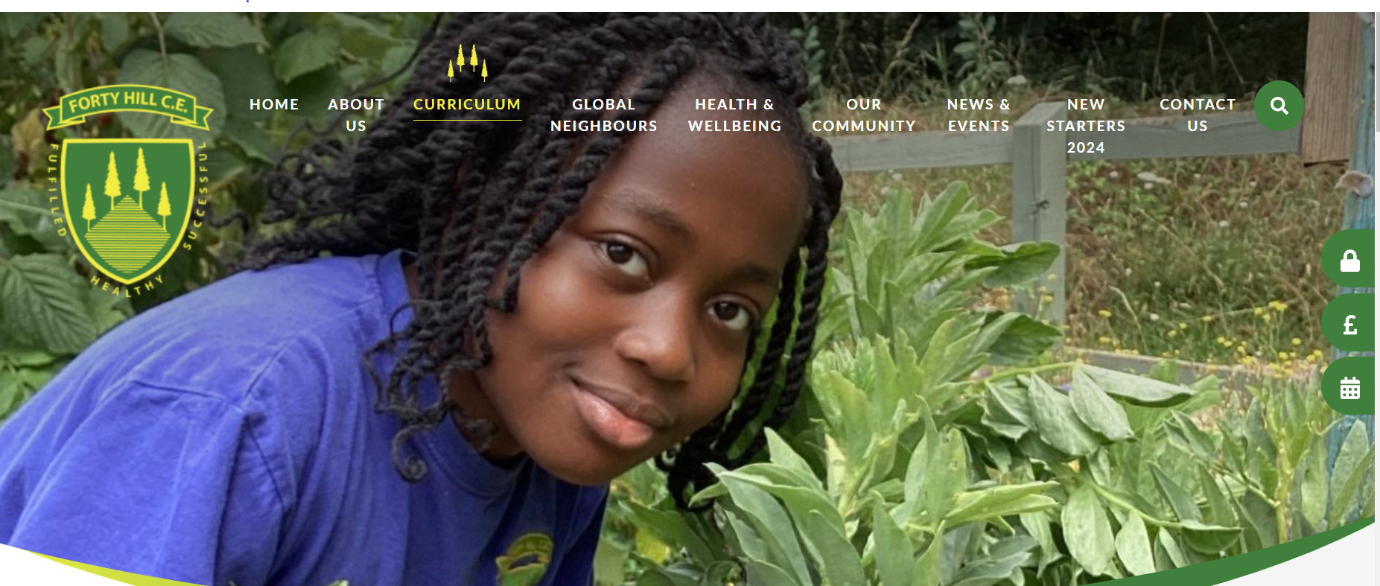
What's next?
We are teaching Phase 2
s, a, t, p, i, n, m, d, g, o, c, k, ck, e, u, r, h, b, f, l

Slide 31
At home!

Slide 32
Assessment
Children are assessed individually after each half term and daily interventions are then provided, as necessary.
Reading books will be allocated in relation to this data.

Slide 33

Any questions?

