Slide 1

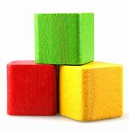
Personal, social and emotional development
Workshop
Self-Regulation
Managing Self
Building relationships

Slide 2
Personal, social and emotional development (PSED)
What is it?
Why is it a Prime Area?
What does PSED look like in EYFS?
What does PSED look like across the School?
What can you do to help your child be ready
for Nursery or Reception?

Slide 3
Personal, social and emotional development (PSED) is one of three prime areas within the early years foundation stage (EYFS), but it connects the whole curriculum.
Through positive relationships with adults, children learn
what their emotions are
how to regulate them
how relationships with their peers work

Slide 4

Greater separation anxiety and issues in forming relationships with staff
Children becoming more emotional, and a difficulty with managing their emotions
Children exhibiting more disruptive and challenging behaviour
Children experiencing greater issues socialising
Children developing an obsession with cleaning hands, a fear of germs and the virus
Children being upset over lost connections to family and friends, including 12% becoming bereaved
Children experiencing various developmental delays and/or regressions

Slide 5
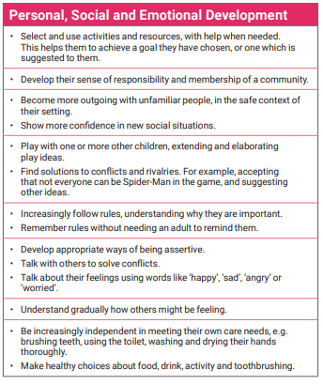
3- and 4-year-old development statements.

Slide 6
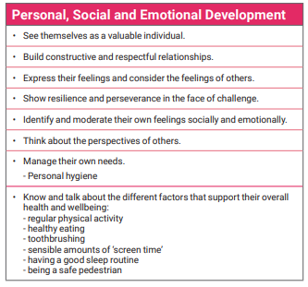
Reception development statements.

Slide 7

STATUTORY - Good Level of Development (GLD)
Self-Regulation
Show an understanding of their own feelings and those of others, and begin to regulate their behaviour accordingly
Set and work towards simple goals, being able to wait for what they want and control their immediate impulses when appropriate
Give focused attention to what the teacher says, responding appropriately even when engaged in activity, and show an ability to follow instructions involving several ideas or actions.
Managing Self
Be confident to try new activities and show independence, resilience and perseverance in the face of challenge
Explain the reasons for rules, know right from wrong and try to behave accordingly
Manage their own basic hygiene and personal needs, including dressing, going to the toilet and understanding the importance of healthy food choices.
Building Relationships - Work and play cooperatively and take turns with others; Form positive attachments to adults and friendships with peers; Show sensitivity to their own and to others' needs.

Slide 8


Whole School Approaches to
PSED, Mental Health and Well-being

Slide 9
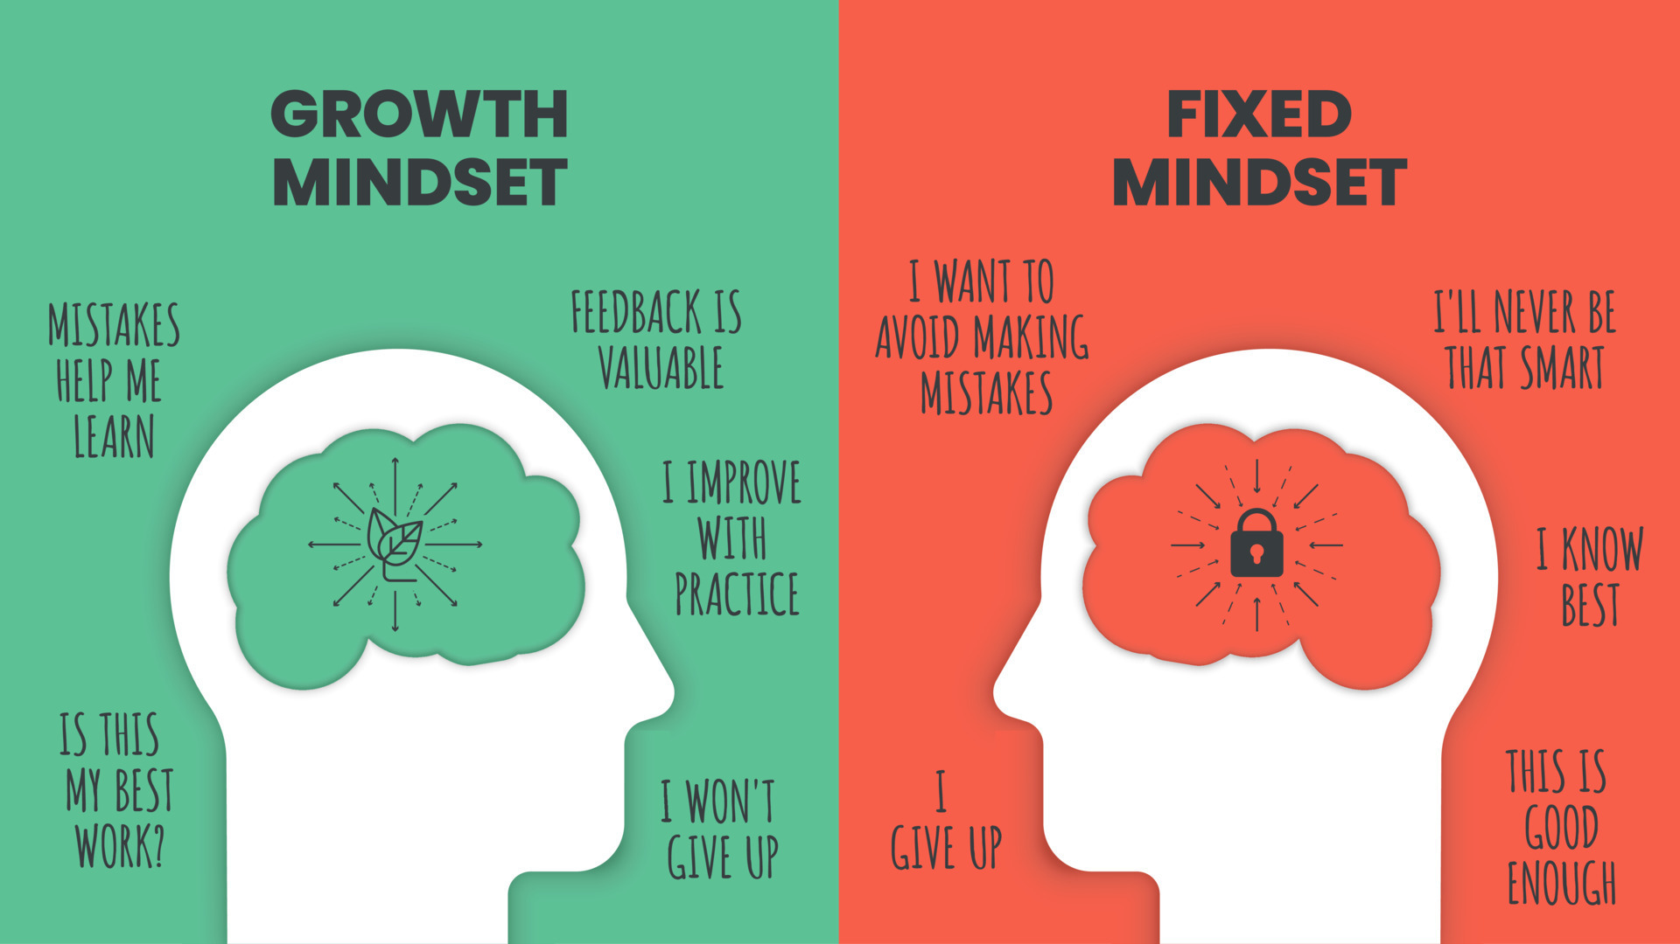

Slide 10


Slide 11

10th December 2024 @ 9am

Slide 12
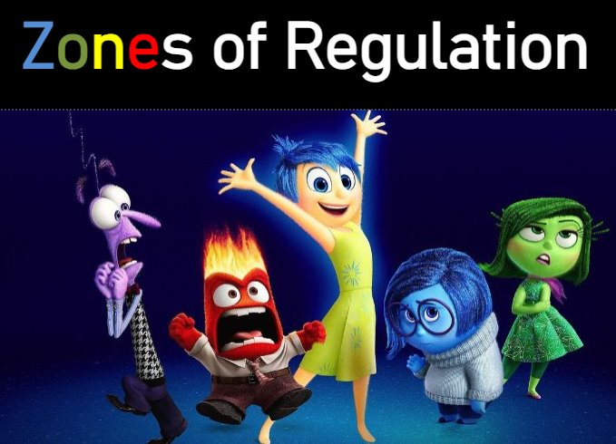

Slide 13
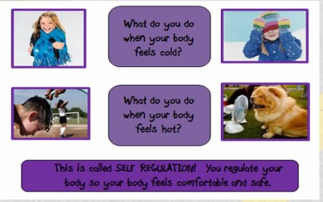
What is self-regulation?
The ability to focus your attention, control your emotions and manage your thinking, behaviour and feelings. ​

Slide 14
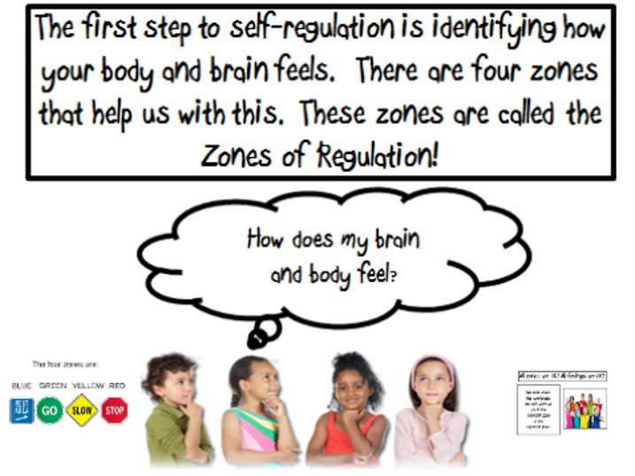

Slide 15

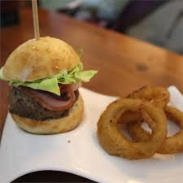
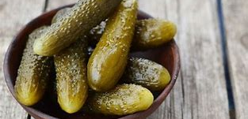
Love them or hate them.......

Slide 16
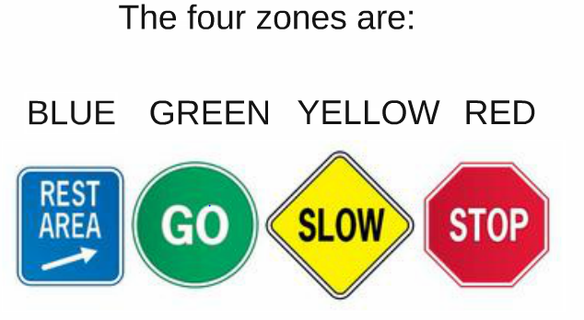
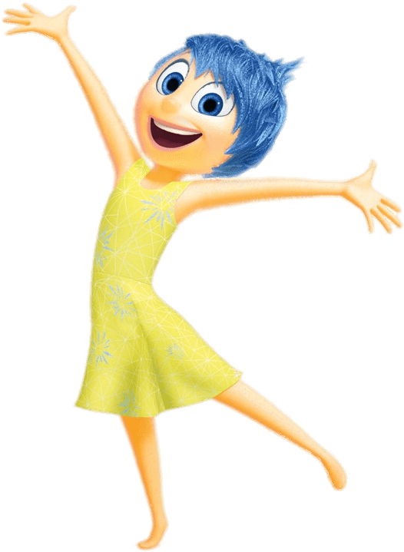

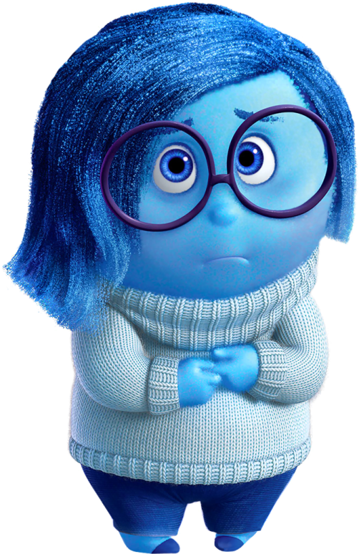
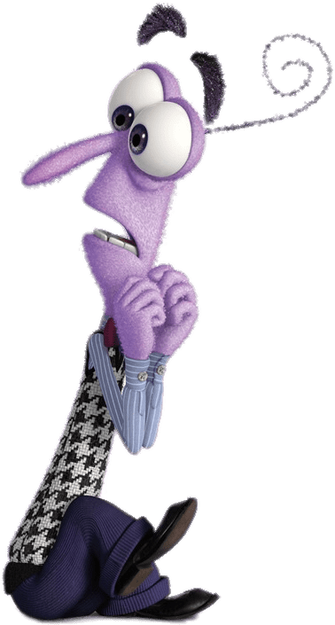

Slide 17
What zone?
Firstly, the children needed to develop an understanding of which zone they were in to enable them to talk about it.​
​
angry frustrated scared​
​
worried overwhelmed tired ​
​
sad excited calm happy ​
​
​

Slide 18
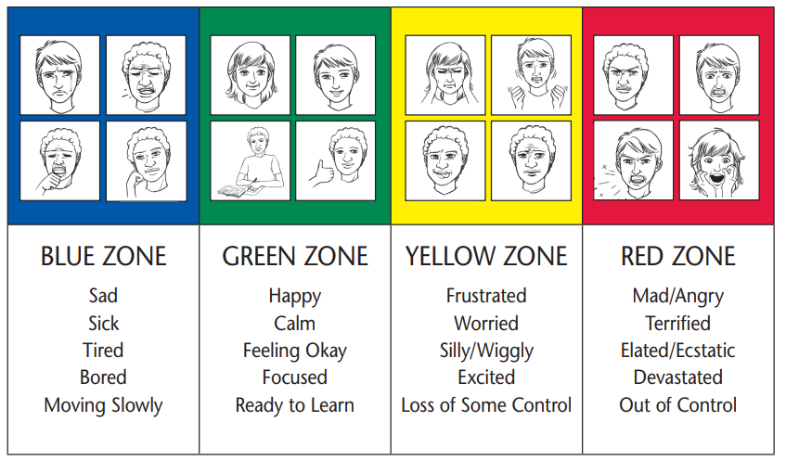

Slide 19
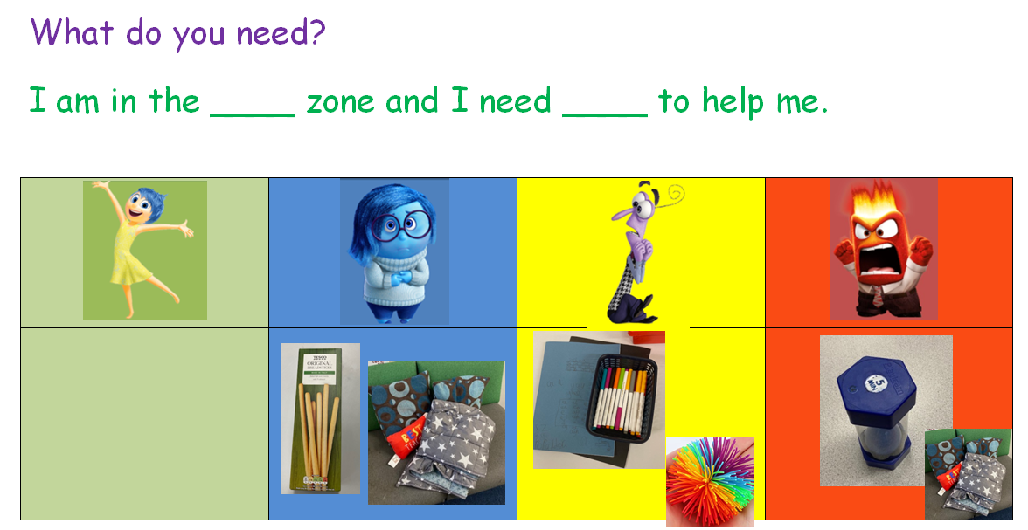
What do you need? (Personalised plan)

Slide 20

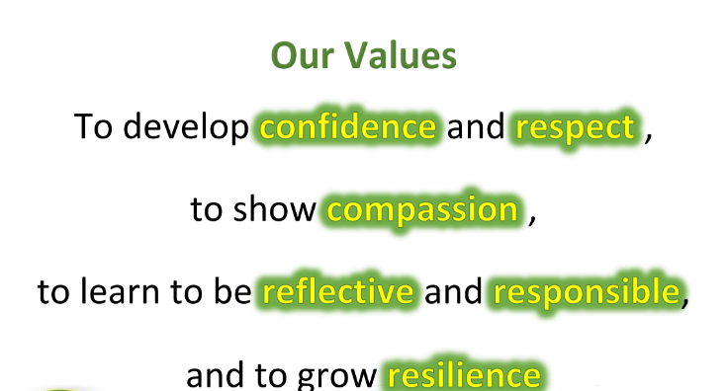

Slide 21

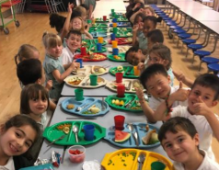



Lunch
Lunchtime can be quite a busy environment with lots of children eating at the same time. There are of course adults to support children but having these skills will enable your child to be able to eat independently and not have to wait.
Practice using knives and forks at home during mealtimes, drinking from an open cup, clearing their own plate when they are finished and peeling fruit. If they are going to have packed lunch then have a practice opening and closing the lunchbox, opening packaging and cartons.

Slide 22
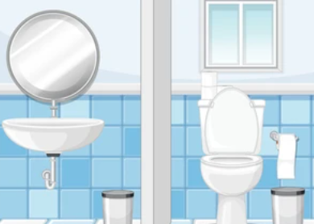
Toileting
Encourage your child to use the toilet independently, wipe themselves and wash their hands afterwards.

Slide 23

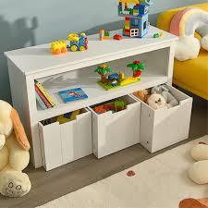
Resources
Discuss with your child how they can take care of their toys and resources and encourage them to tidy up when they have finished playing.
Discuss with your child the importance of looking after their own belongings, for example their water bottle, jumpers/cardigans and book bags. Please make sure that all uniform is fully labelled.

Slide 24
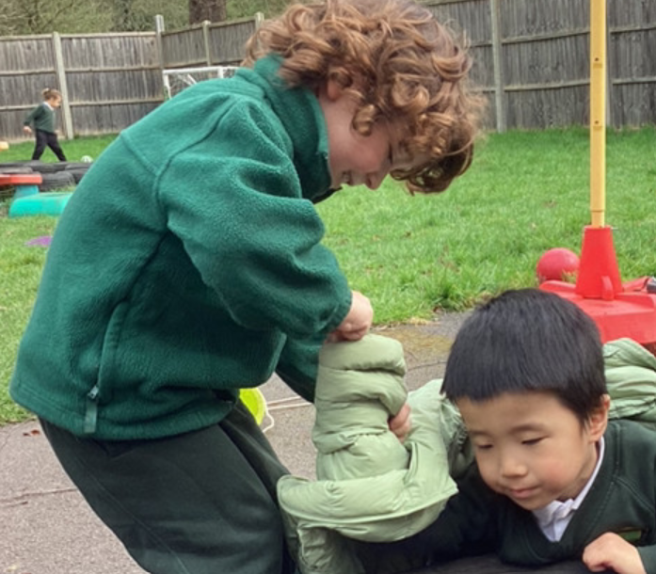
Getting dressed
Uniform - Please make sure that your child has the correct uniform when they begin school.
Give your child opportunities to practice getting themselves dressed and undressed independently. Practice with buttons, zips and poppers.
Encourage children to put their shoes on themselves. We do recommend that children should only have laces on their shoes if they are able to tie them independently. You can write their name on a piece of masking tape and cut it in half placing one in each shoe so that they know which is the left and the right

Slide 25

Name Recognition
Provide your child with lots of exposure to their name so that they will begin to recognise it.
This will support them with identifying their peg, which will support them to independently hang up their coats and bags throughout the day.
Additionally, children self-register in the morning, this is where children have to find their name and move it when they arrive at school. Therefore, having the ability to recognise their name will support them to do this. It also supports children in identifying their names on their uniform so that they can look after their belongings.
It is not an expectation for children starting Nursery to be able to write their name when they start school. However, we do encourage children to have a practice at this if they are ready to do so. It will also support children with labelling their work at school. If you are going to practice this at home, we strongly encourage that children use only a capital letter at the start of their name and lower-case letters for the rest of their name.

