Slide 1


Physical Development in the EYFS
Gross & Fine Motor Skills

Slide 2
Today's aims:
Why are gross and fine motor skills important?
Why are they identified separately?
How is development supported in the EYFS?
What can you do to support your child?

Slide 3
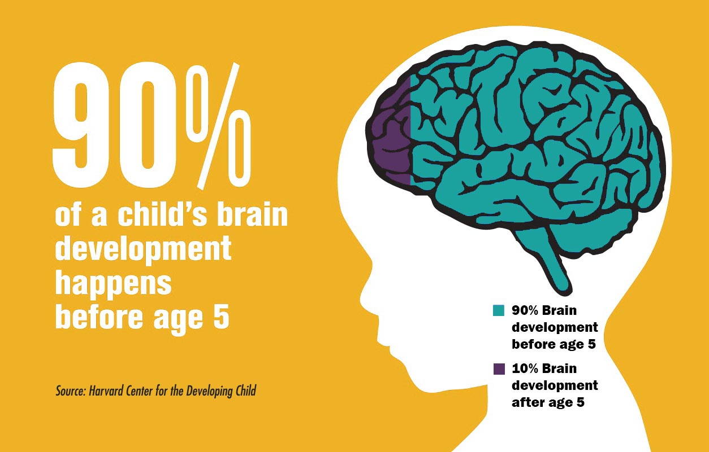
The Early Years
“No job is more important than working with children in the early years.”(2021, Development Matters)
Children develop the most between birth to five. This is where all the foundations are laid for their future development.
When children are given the best start in their early years, we not only give them what they need today but set them up to succeed in future.

Slide 4
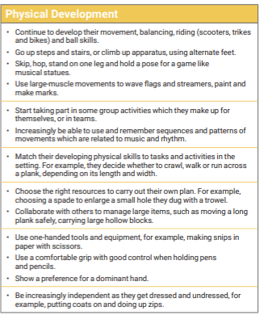
Three and Four-Year-Olds

Slide 5
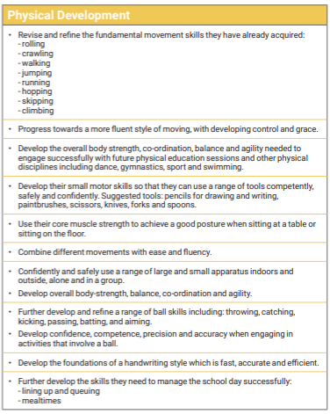
Children in Reception

Slide 6
What physical development skills will your child have developed in readiness for the National Curriculum in KS1?
Gross Motor Skills ELG
Children at the expected level of development will: • Negotiate space and obstacles safely, with consideration for themselves and others
Demonstrate strength, balance and coordination when playing
Move energetically, such as running, jumping, dancing, hopping, skipping and climbing.
Fine Motor Skills ELG
Children at the expected level of development will:
Hold a pencil effectively in preparation for fluent writing – using the tripod grip in almost all cases
Use a range of small tools, including scissors, paint brushes and cutlery
Begin to show accuracy and care when drawing.

Slide 7
Why fine motor skills are important?
Fine motor skills involve small muscles working with the brain and nervous system to control movements in areas such as the hands, fingers, lips, tongue and eyes. Developing fine motor skills helps children do things like eating, writing, manipulating objects and getting dressed.

Slide 8
Fine motor skills help children to navigate and explore the world with confidence and independence.
Fine motor skills depend on gross motor skills. You need a joined-up approach for developing whole body physicality and strength.
Rich outdoor and indoor environments will provide opportunities for developing fine motor skills.

Slide 9

https://youtu.be/uR2tmJ60vNg
Motor skills – Seeing the whole picture!

Slide 10

The increasing prominence of tablets and iPads has indeed been valuable for children, offering games, apps, and learning at their fingertips. However, there’s a catch: spending too much time on these devices can impact fine motor skills. Traditional activities like modeling with playdough or using scissors and glue help develop crucial muscles for skills such as writing, using cutlery, and tying shoelaces. Sedentary screen time, especially on iPads, may hinder physical development.

Slide 11
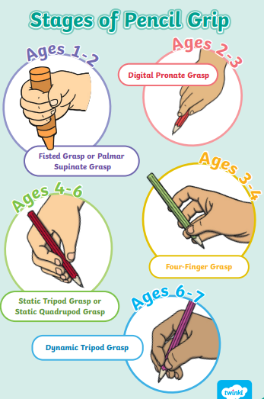
Types of pencil grip
These images show the different stages of pencil grip you would expect to see in the early years.
It is important that we are aware what is expected so that we can ensure we are giving children support where needed.
Pencil grips that can be purchased can sometimes help, however it is crucial that we address why a child is not holding their pencil correctly.

Slide 12
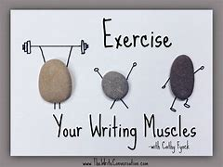
Muscular movement during handwriting involves a combination of actions:
Shoulder muscles: These move the hand and arm to the correct position above the paper.
Upper arm muscles: They raise the elbow and control the direction of writing
Forearm muscles: Responsible for twisting the wrist as letters are formed.
Hand muscles: These move and control the hand, hold the pencil and maintain grip.

Slide 13
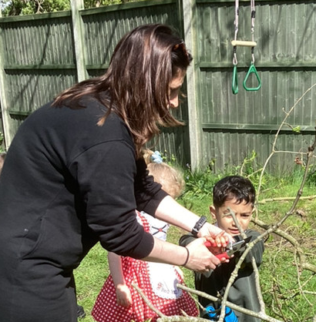
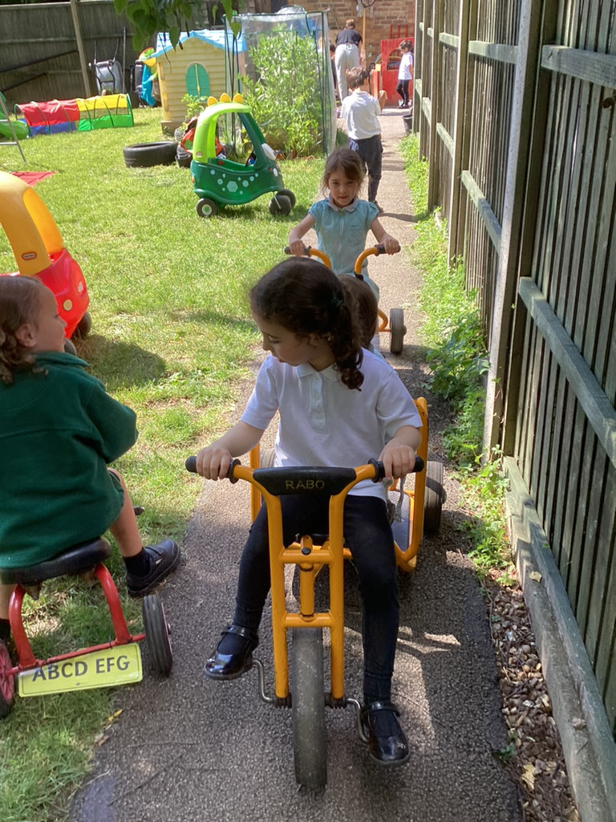

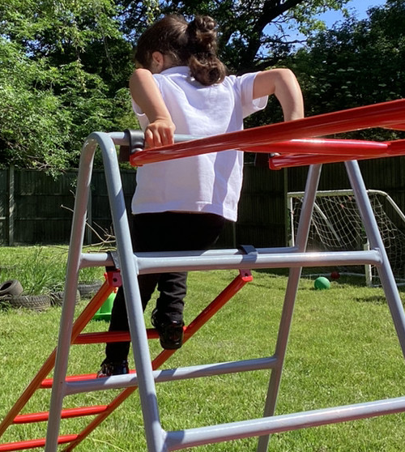
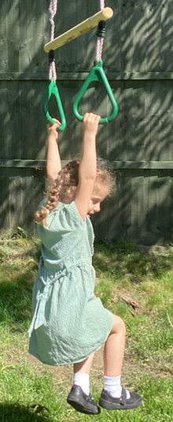
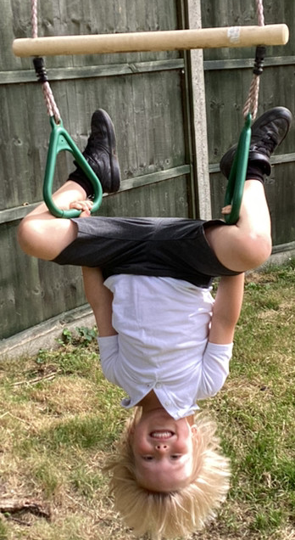
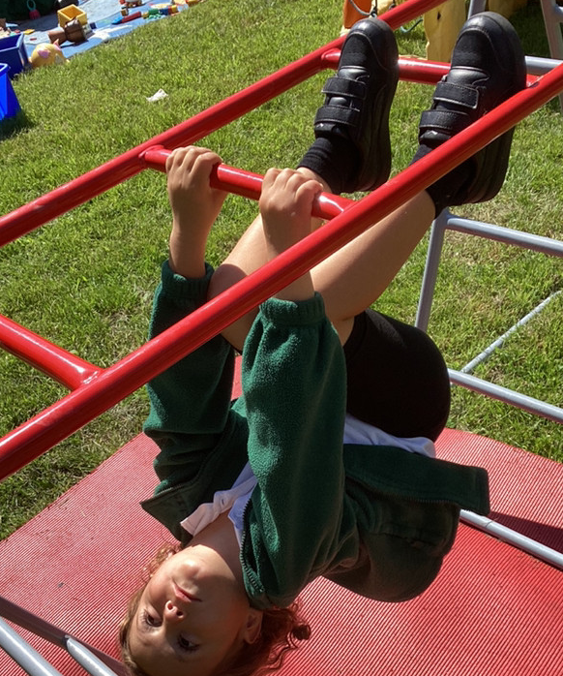
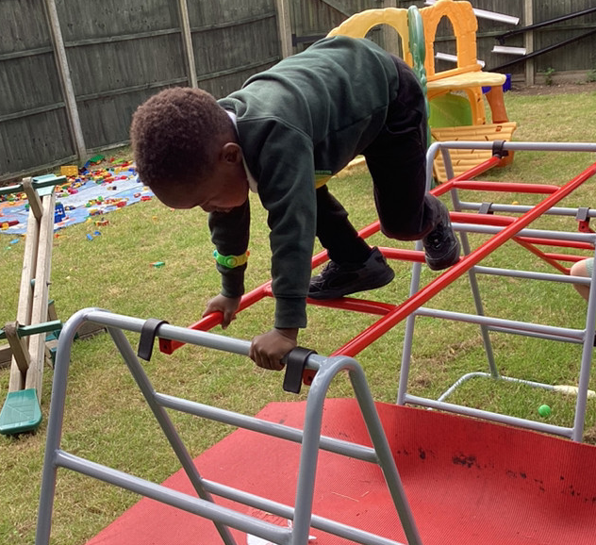
How to support your child at home.

Slide 14
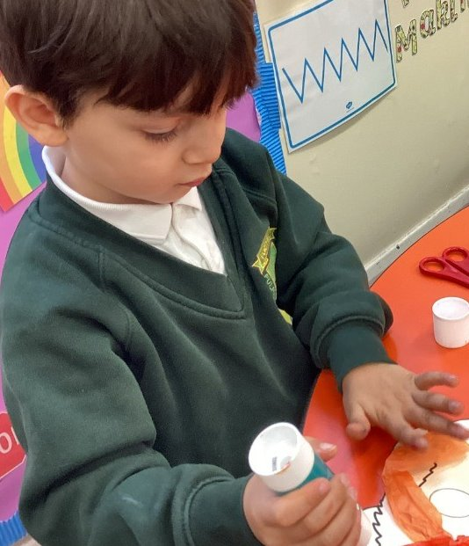
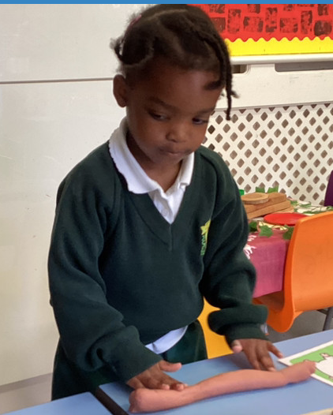
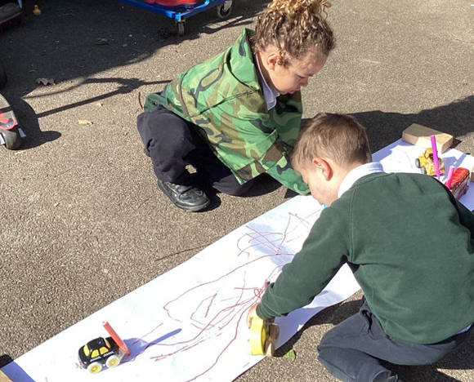
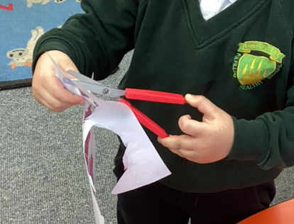
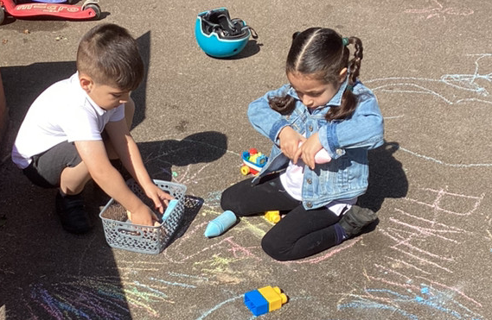
Physical Development - Fine Motor Skills
Physical Development is vital to children’s all-round development.
Fine Motor Skills help support control and precision found in hand-eye coordination which is later linked to early writing.
These skills are important for having the ability to do up buttons, zips and use various utensils such as scissors and cutlery. They are also crucial for early writing.
Fine motor skills involve the small muscles in the body, specifically those that control the wrist, hands and fingers. It is important that we give children the best start when acquiring this skill and have the skills they need before they start.

Slide 15
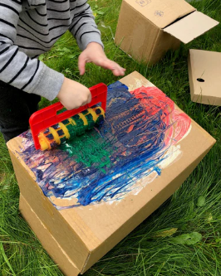
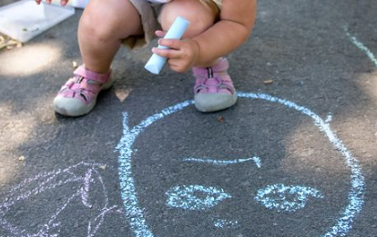
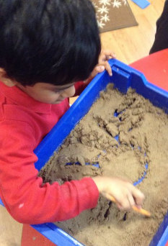
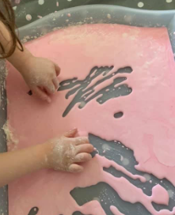
How to support your child at home
Provide your child with mark-making opportunities. This does not always have to be in the traditional pencil and paper format. It is actually good to provide different surfaces such as chalk on the ground and chunky crayons. The resistance supports the strengthening of muscles.
Large scale mark-making – this can be on large roll of paper, or opened boxes.
Using paintbrushes, rollers and other home utensils such as forks, whisks etc.
Mark-making can be in sand, flour, or gloop. This is especially good for reluctant writers as there is less pressure. This is also great for nursery children.
Give children opportunities to be independent when dressing themselves (buttons and zips).

Slide 16
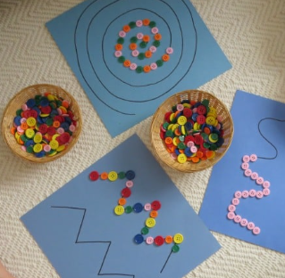
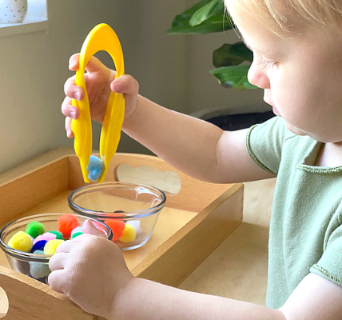
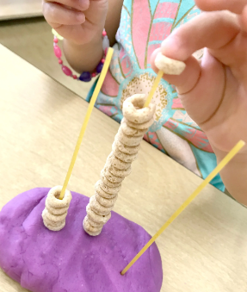
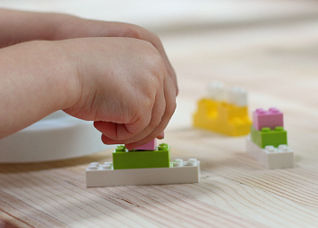
How to support your child at home
Provide your child with activities that support the strengthening of wrists, hands and fingers.
Lego is really good for this, as it helps to develop dexterity and strengthen fingers.
Large tweezers help to develop hand-eye coordination and strengthen fingers.
Playdough is a great way to support children with developing fine motor skills. It is something that you can cheaply make at home and can last for months.
Threading – you can use spaghetti and Cheerios if you don’t have a threading set at home.
Using scissors to snip paper, cut through wavy lines and cut around shapes.
Placing buttons or beads on patterns.
Using pegs to pick things up, these can ones that you use at home.

