Slide 1


Slide 2


Slide 3
What do we mean by communication and language?
Why is it so important?
What does communication and language look like in the EYFS?
What can you do to support your child?

Slide 4

https://www.ted.com/talks/molly_wright_how_every_child_can_thrive_by_five?language=en

Slide 5
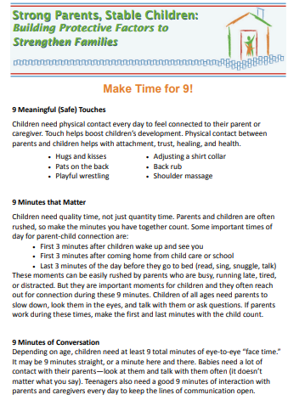
Pdf is saved in the One Drive.

Slide 6

Communication and language is a prime area of learning and development in the Statutory Framework for the Early Years Foundation Stage.

Slide 7
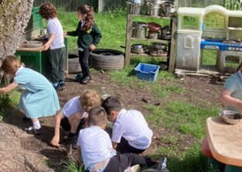
We know there are positive outcomes when children have well-developed speech, language and communication skills.
They achieve better in school, develop friendships, show improved self-esteem and confidence and quite simply, they have more fun!

Slide 8
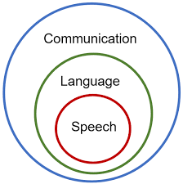
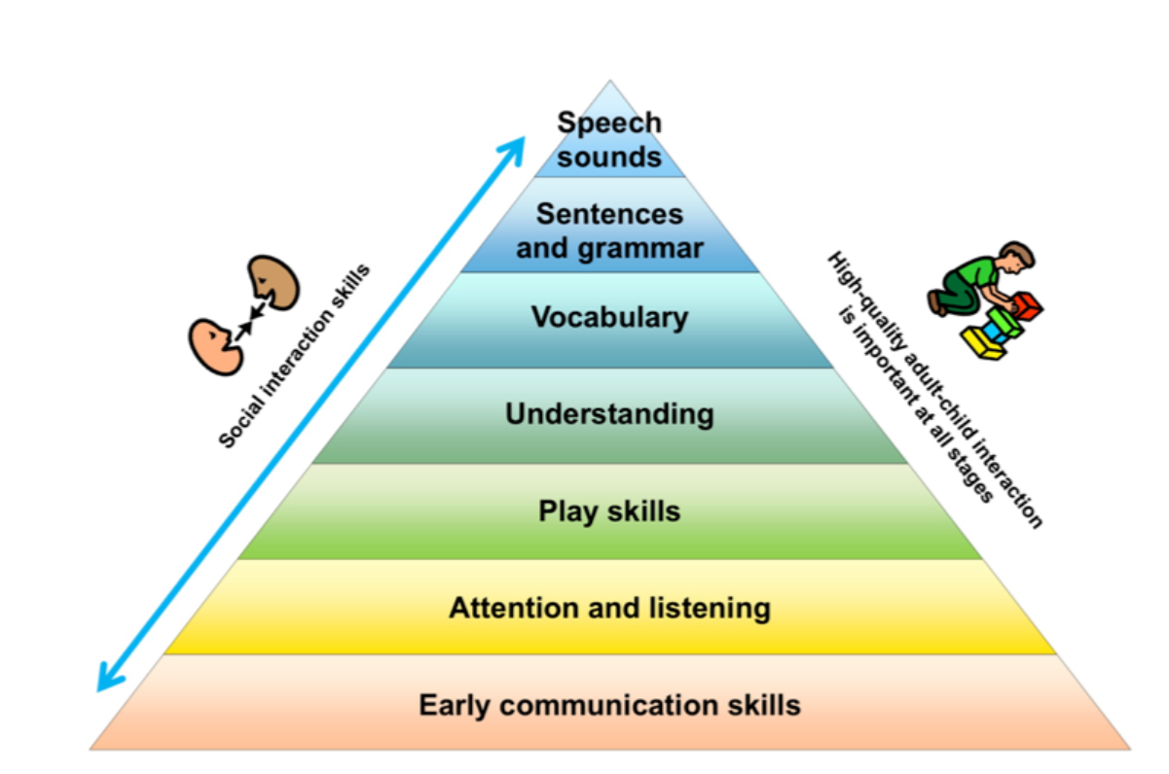

Slide 10
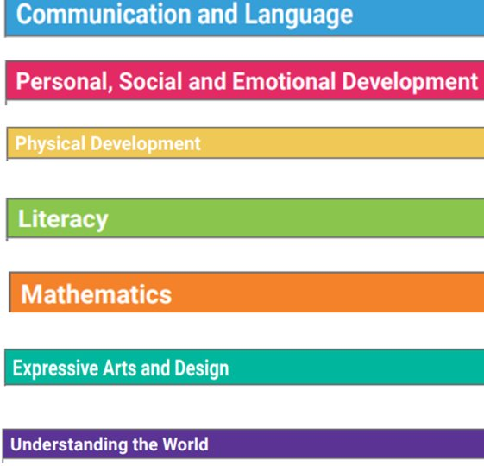
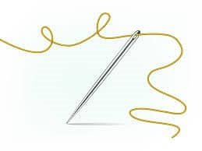

Slide 11
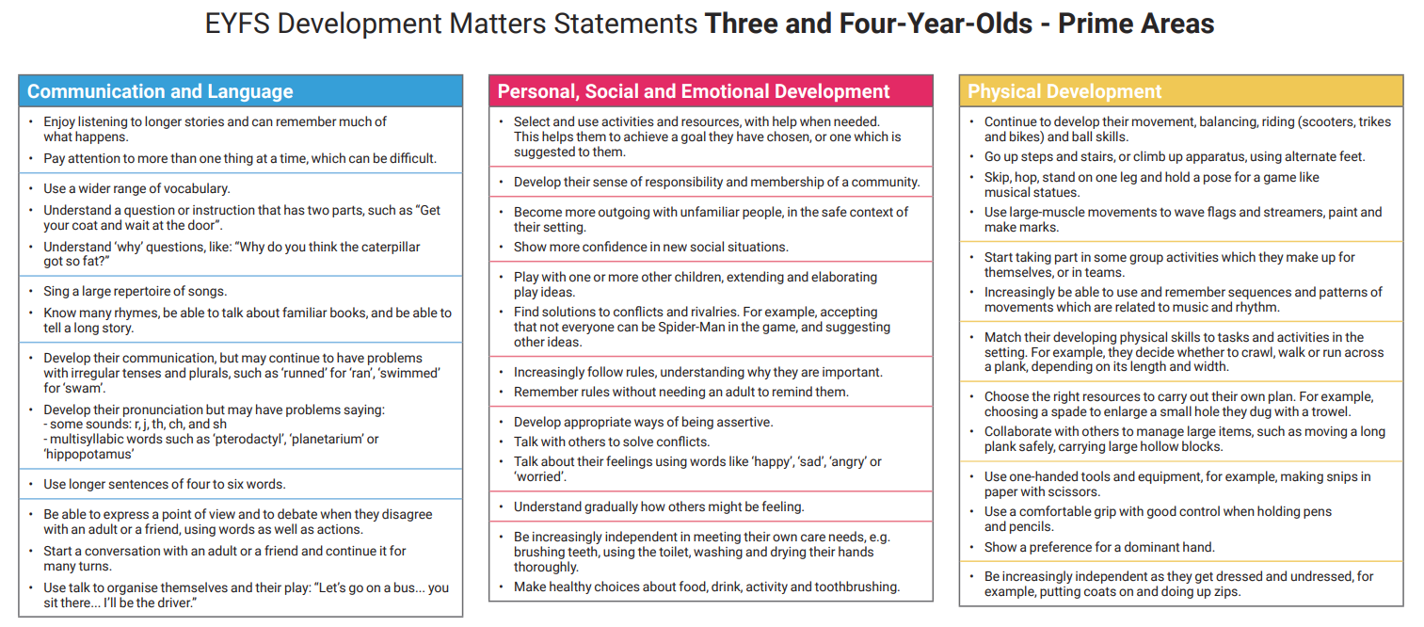
Non-Statutory /Link to Statutory Good Level of Development

Slide 12
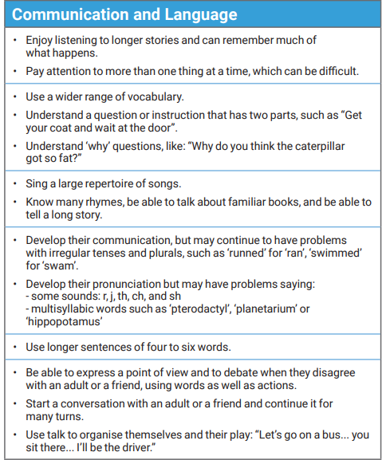

Slide 13
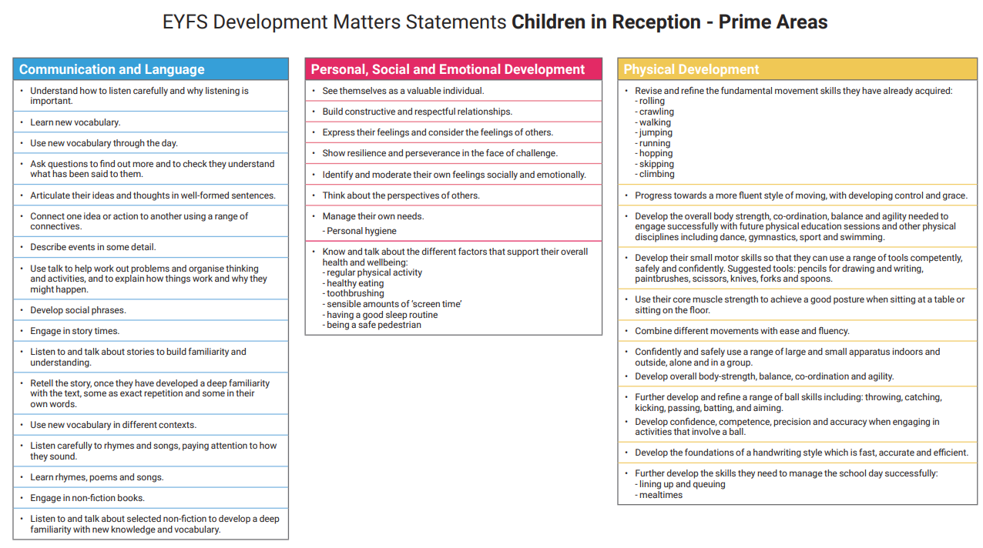

Slide 14
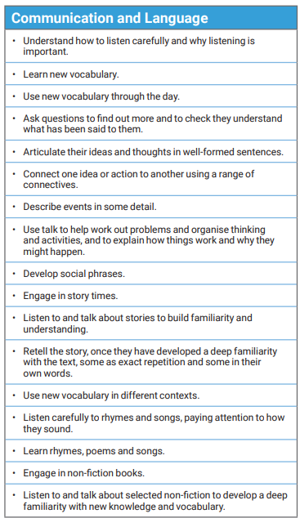

Slide 15
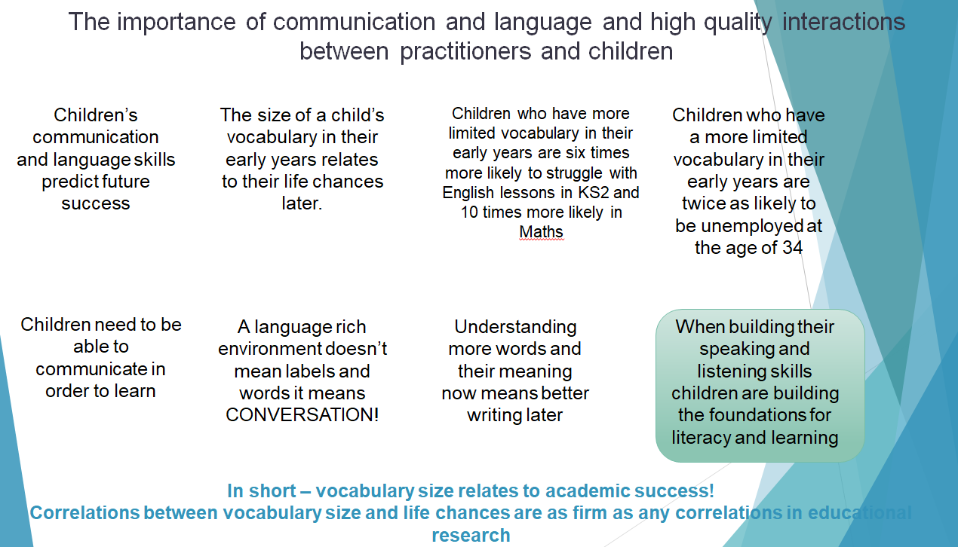


Slide 16


Slide 17
Communication and language approaches involve intentionally acting to develop young children’s understanding of language and their ability and confidence to use language, and other strategies, to communicate effectively.

Slide 18
We teach and model vocabulary and language.
Interactive reading and/or collaborative talk.
Approaches that support the physical aspects of communication such as teaching and modelling social communication skills.

Slide 19
Speech, vocabulary, and discussion

Slide 20
Speech, vocabulary, and discussion
Most commonly, activities designed to develop interaction with peers and adults fall into this category. Encompassing all games where discussion is encouraged, these are excellent short burst games at any point in the day.

Slide 21
Nursery rhymes
Nursery rhymes and repetitive songs with actions are an excellent vehicle for changes of intonation in voice and encouraging simple actions.

Slide 22
Tea Party
Include all the favourite toys and teddies in their own tea party. This can be including measuring and pouring different levels and liquids for some practical life skills as well as having discussion topics and taking turns when joining in with the conversation.

Slide 23

Would you rather?
Needing no resources, just an imagination, these questions can be as serious or silly as you like. You can begin to see preferences and interests shine through with these questions and they are perfect for any new starters that may be a little nervous.

Slide 24
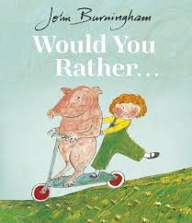
Here are a few to get you going: Would you rather be a monster-sized ant or an ant-sized monster?
Would you rather have hands for feet or feet for hands?
Extend their vocabulary skills with explanations.

Slide 25
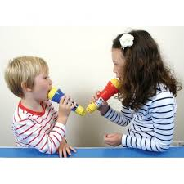
Microphones
These can be attached to a sound system, a plastic microphone or just a prop. Regardless of the resource you decide on, they have a stage to fill!

Slide 26

Surprise Box
This activity is an excellent discussion starter, it can be the hook into an organised phonics or literacy activity. Inside a box, place a mystery object, it can be linked to your story. Give the children clues about what may be inside. They can talk as a group or together with a partner.

Slide 27
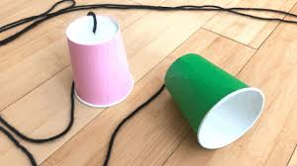
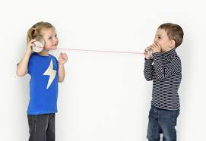
Makeshift phone
An age-old activity, using the middle of a toilet roll or a plastic cup, attach some strong string to the end of the cup/roll. Repeat this at the end of the string to have a 2-way telephone. You can extend this by giving partner one a simple set of instructions to deliver to partner two down their new telephone.

Slide 28
Pompom avalanche
Requiring patience and fine motor skills, this activity includes pompoms (or any small item), chopsticks and a colander. Place the sticks in through the holes of the upturned colander and pour the pompoms on top. The children will carefully pull the chopsticks out watching the pompoms fall.

Slide 29
Roleplay
There are many different types of play, roleplay can include an end goal (catching the baddie), use of imaginary weapons or having a real-life purpose (shopping for food). Ensure your fancy dress box is fully stocked, using different textures of material for open-ended play.

Slide 30

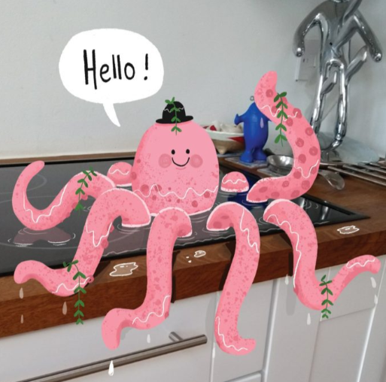
Picture stimulus
Online free websites such as Once upon a picture are excellent starting points for discussions and vocabulary acquisition missions!

Slide 31
Comprehension and vocabulary

Slide 32
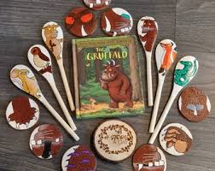
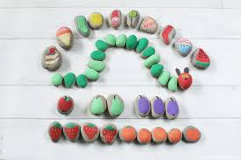
Story stones
These can be made by the children themselves, you or can be purchased. They can be dotted around your setting for the children to find and create a story as they go.

Slide 33
Draw me a…
Truly testing their comprehension of vocabulary, instructional drawing is an activity to develop fine motor skills and listening ability. This works well in small groups, an adult (or child) will choose an object, you can add additional adjectives for extension. They will call out the object and the children will try to draw what they think that object looks like.

Slide 34

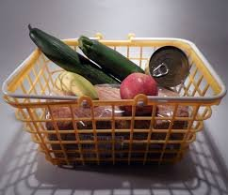
Find me the…
Increase back and forth conversation by engaging the children in the process. Naming the objects you will need in a list and extending the length of the list each time can also increase their working memory capacity.

Slide 35
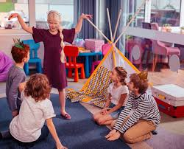
Charades
A timeless game, where vocabulary understanding is key to being able to describe it well. Remind them they can use their senses by linking to rhyming sounds.
10 clues

Slide 36

10 clues
This activity works well when the children can physically see the item you are describing. The aim of the game is to guess the object in the least about of clues- the clues will get progressively easier. For example, the first 3 clues for a pencil may be: You can hold me in your hand, I can be sharp, and artists use me

Slide 37
Senses and concrete experiences.

Slide 38

Musical statues
Why not link in different cultural music to link with your focus topics? You can play the music very quietly to require quiet feet and careful listening, also working on core strength and balance for the statue pause.

Slide 39

I-spy
Using your surroundings, find some objects that they are familiar with (you can link this game of I-spy to their current alphabet and phonics learning). You can give clues whether the object may be up high or down low

Slide 40
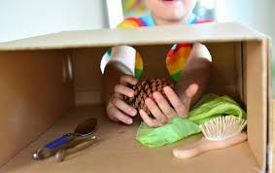
Feely boxes
Linking to their senses and concrete experience, place an object with texture (spikey ball, jelly, water snake) in a box that is covered with only a slot for their hands to feel. Cue the squeaks and squeals as they find the jelly texture.

Slide 41
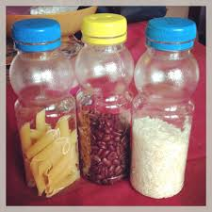
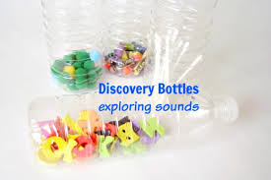
Listening bottles
This is an ideal use for those recycled plastic bottles. Fill the bottles with dried rice, pasta or beans. Listen to the sounds they make; can they begin to make connections with what the sounds remind them of?

Slide 42

Guess the sound
Allow the children to play with a number of noisy objects (foil, recycled plastic wrapper, pasta in a bottle, wooden blocks). If they are comfortable, they can wear a blindfold and guess which item you make a noise with. This is linking their concrete experience with their senses helping the information to move into long term memory

