Slide 1
Early Reading Workshop
Supporting your child with reading at home.
EYFS – Year 2

Slide 2

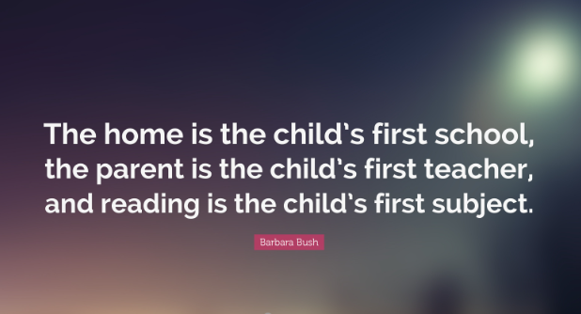
Learning at home

Slide 3
Agenda
What Early Reading looks like at Forty Hill
Overview of Early Reading
The Foundations of Fluency
Why is Communication and Language Development important in early reading?
Phonics at Forty Hill – Little Wandle Scheme
How can I support my child at home?

Slide 4
Early Reading At Forty Hill
Reception
Daily Phonics lesson
Little Wandle Reading sessions 3x a week (Jan start)
Literacy 3-4 x a week based on class (Talk for Writing – once a term)
Nursery
Daily Phonics focus/session/activities
Daily singing session
Daily story
C&L activities, eg, traditional nursery rhymes
Class text – 2 per half term
Warming up/preparing for Talk for Writing

Slide 5
Early Reading At Forty Hill
Year Two
Guided Reading 4x a week
Daily Phonics lessons (Aut 1 only)
Literacy 4x a week based on class text (Talk for Writing – once a term)
Small group reading once a week
Year One
Daily Phonics lessons
Little Wandle Reading sessions 3x a week
Poem 3x a week
Daily Story
Literacy 3-4 times a week linked to class text.

Slide 6

Spoken and written language
It’s important to note that The EYFS framework, KS1 & KS2 all recognise the importance of spoken and written word – they go hand it hand. In particular the exploration, and acquisition of, language and comprehension.

Slide 7
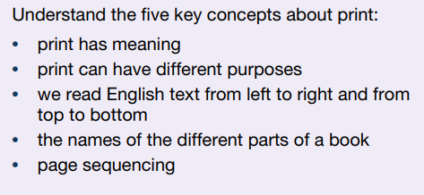
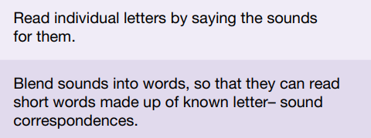

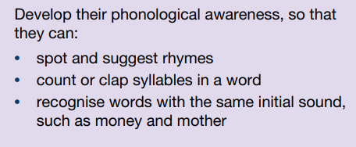
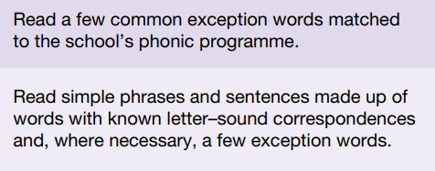


Early Years Foundation Stage Framework
Nursery
Reception

Slide 8
Key Stage 1: Year 1&2 (Reading Words)
Year One
Year Two
To apply phonic knowledge and skills as the route to decode words.
To respond speedily with the correct sound to graphemes (letters or groups of letters) for all 40+ phonemes, including where applicable, alternative sounds for graphemes.
To read accurately by blending sounds in unfamiliar words containing GPCs that have been taught.
To read common exception words, noting unusual correspondences between spelling and sound and where these occur in the word.
To read words containing taught GPCs and -s, -es, -ing, -ed, -er and -est endings.
To read other words of more than one syllable that contain taught GPCs.
To read words with contractions (for example, I`m, I`ll, we`ll), and understand that the apostrophe represents the omitted letter(s).
To read aloud accurately books that are consistent with developing phonic knowledge and that do not require the use of other strategies to work out words.
To re-read books to build up fluency and confidence in word reading.
To continue to apply phonic knowledge and skills as the route to decode words until automatic decoding has become embedded and reading is fluent.
To read accurately by blending the sounds in words that contain the graphemes taught so far, especially recognising alternative sounds for graphemes.
To read accurately words of two or more syllables that contain the same graphemes.
To read words containing common suffixes.
To read further common exception words, noting unusual correspondences between spelling and sound and where these occur in the word.
To read most words quickly and accurately, without overt sounding and blending, when they have been frequently encountered.
To read aloud books closely matched to improving phonic knowledge, sounding out unfamiliar words accurately, automatically and without undue hesitation.
To re-read books to build up fluency and confidence in word reading.

Slide 9
Key Stage 1: Year 1
Reading Comprehension
To develop pleasure in reading, motivation to read, vocabulary and understanding by
listening to and discussing a wide range of poems, stories and non-fiction at a level beyond that at which can be read independently.
being encouraged to link what is read or heard read to own experiences.
becoming very familiar with key stories, fairy stories and traditional tales, retelling them and considering their particular characteristics.
recognising and joining in with predictable phrases.
learning to appreciate rhymes and poem, and to recite some by heart.
discussing word meanings and linking new meanings to those already known.
To understand both the books they can already read accurately and fluently and those they listen to by:
drawing on what is already known or on background information and vocabulary provided by the teacher.
checking that the text makes sense as it is read and self-correct inaccurate reading.
discussing the significance of the title and the events of books.
making inferences on the basis of what is being said and done.
predicting what might happen on the basis of what has been read so far.
participating in discussion about what is read, taking turns and listening to what others say.
explaining the understanding of what is read.

Slide 10
Key Stage 1: Year 2
Reading Comprehension
To develop pleasure in reading, motivation to read, vocabulary and understanding by
listening to, discussing and expressing views about a wide range of contemporary and classic poetry, stories and non-fiction at a level beyond that can be read independently.
by discussing the sequence of events in books and how items of information are related.
becoming increasingly familiar with and retelling a wide range of stories, fairy stories and traditional tales.
being introduced to non-fiction books that are structured in different ways.
recognising simple recurring literary language in stories and poetry.
discussing and clarifying the meanings of words and linking new meanings to known vocabulary.
discussing favourite words and phrases.
continuing to build up a repertoire of poems learnt by heart, including appreciating poems and reciting some, with appropriate intonation to make the meaning clear.
To understand both the books that can already be read accurately and fluently and those that are listened to by:
drawing on what is already know or on background information and vocabulary provided by the teacher.
checking that the text makes sense and self-correcting inaccurate reading.
making inferences on the basis of what is being said and done.
answering and asking questions.
predicting what might happen on the basis of what has been read so far.
To participate in discussion about books, poems and other works that are read by taking turns and listening to what others say.
To explain and discuss understanding of books, poems and other material both those that they listen to and those that they read for themselves.

Slide 11

Phonics Overview
Nursery
Little Wandle Foundation
To be used as part of the wider curriculum for C&L and Literacy
Separated into the following three areas:
Foundation for a Love of Reading – Books, books, books!
Foundation for Phonics – Phase One (hearing sound)
Foundations for Language – Acquisition and comprehension
Short regular bursts
Daily sessions
Small groups

Slide 12
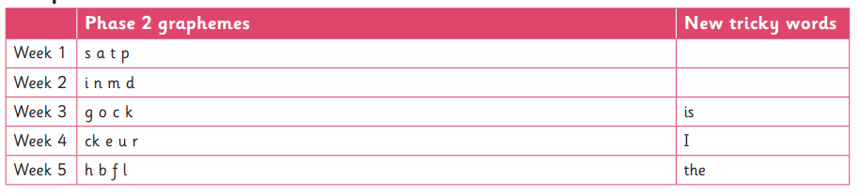
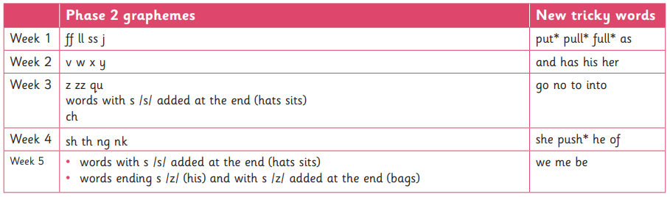
Phonics Overview – Reception
Autumn term

Slide 13
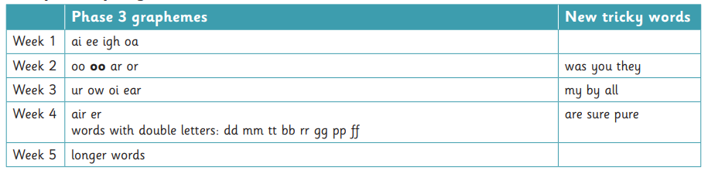
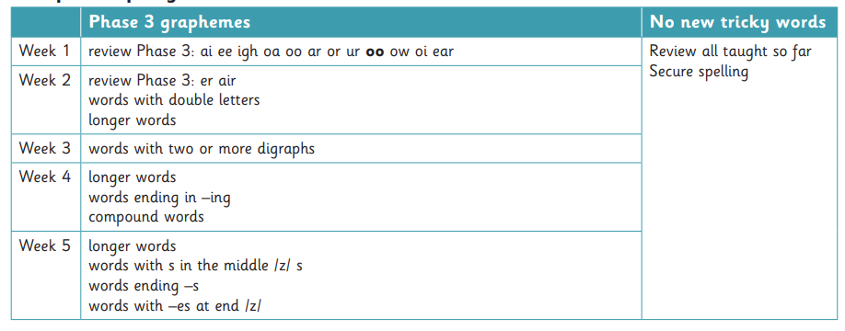
Phonics Overview – Reception
Spring term

Slide 14
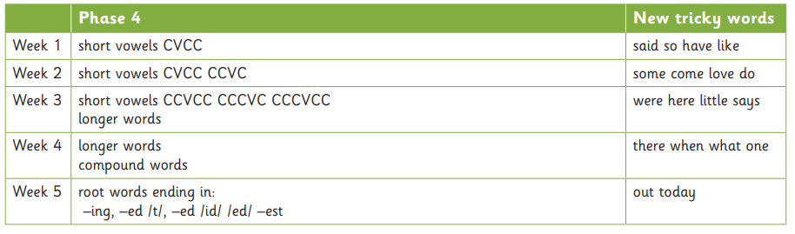
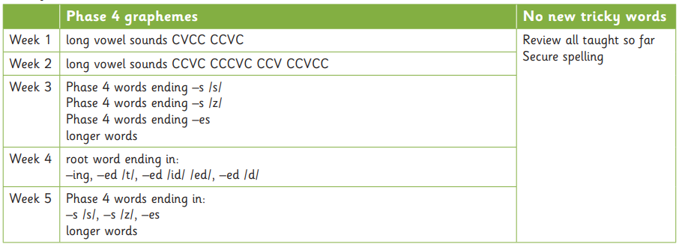
Phonics Overview – Reception
Summer term

Slide 15
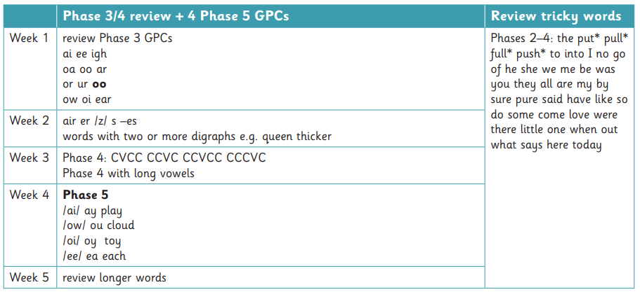
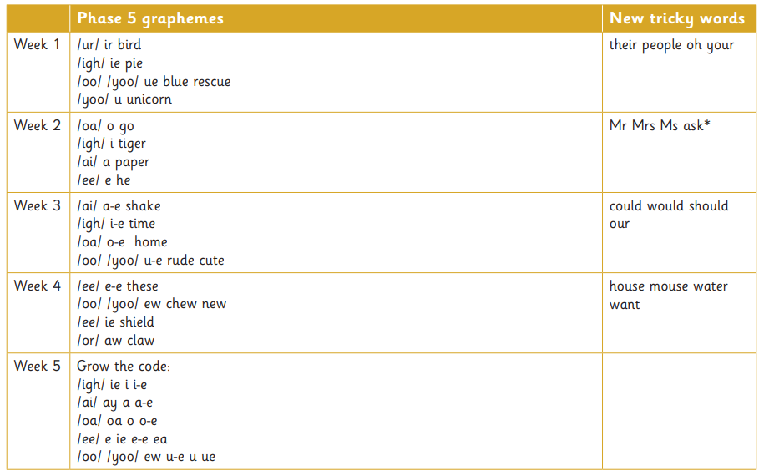
Phonics Overview – Year One
Autumn term

Slide 16
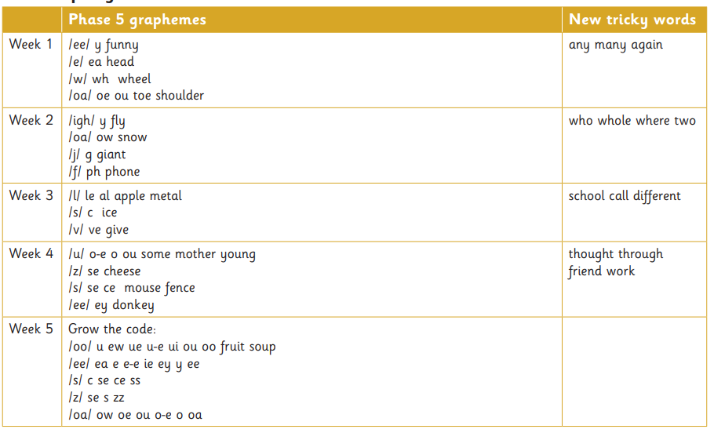
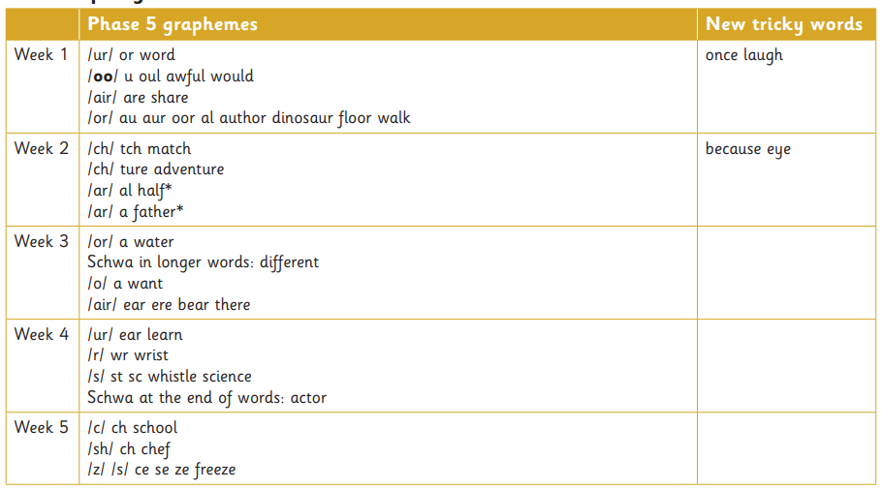
Phonics Overview – Year One
Spring term

Slide 17
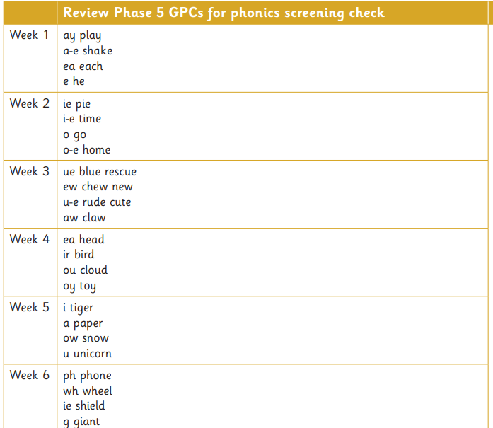
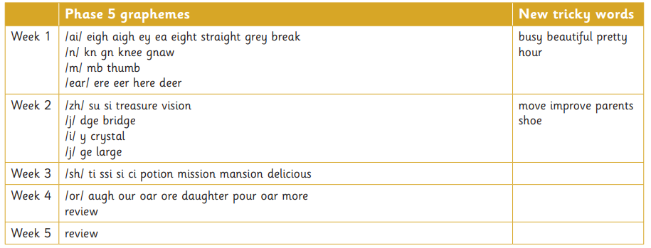
Phonics Overview – Year One
Summer term

Slide 18
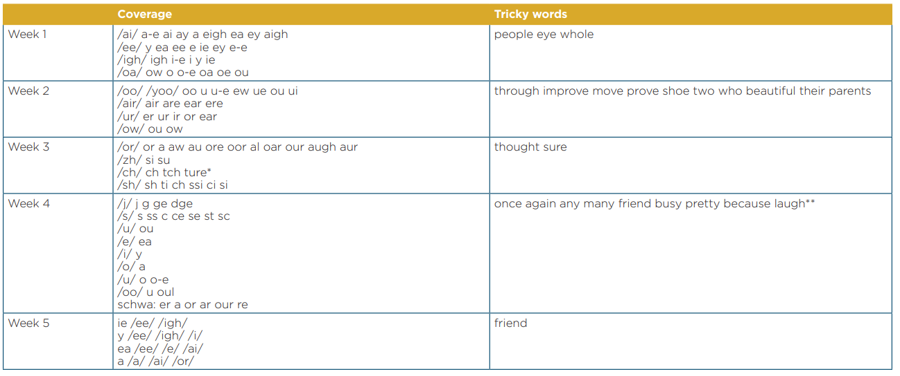
Phonics Overview – Year Two
Autumn term

Slide 19
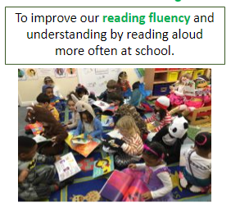
Foundations of fluency
Before children can become fluent readers, they need to develop foundational skills such as phonetic awareness, GPC recognition, vocabulary and comprehension skills.
These skills lay the groundwork for them to become proficient readers as they progress through early literacy stages.

Slide 20
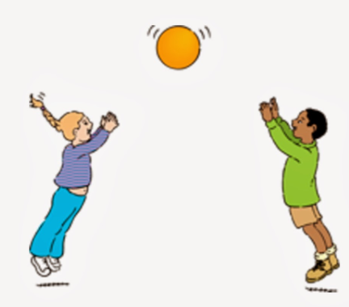
Communication and language development
Communication and language development is imperative to children’s literacy skills. You need to be able to listen, understand and speak if you are going to be able read or write.
Having a good range of vocabulary helps children to learn, this is because words allow children to make sense of the world around them. It is important to develop a language rich environment. A language-rich environment is one in which adults talk with children throughout the day. The more children take part in conversations and discussion, the more they will understand once they can read and the more vocabulary and ideas they will have to draw on when they can write.

Slide 21
Phonological awareness
Phonics is fundamental for reading as it teaches the relationship between sounds and letters, enabling individuals to decode words and understand meanings. It is a crucial skill in the early stages of learning to read.
Supporting at home:
From Reception practice GPCs at home as much as possible
Prior to recognising GPCs there should be a focus on hearing and recognising initial sounds, orally segmenting and blending. For example, can you get your c-u-p?
Practice 'tricky words' at home, children need to be able to read these by sight. Knowing why they are tricky, for example is, supports understanding sight recognition over decoding.
Read your child’s school reading book with them.

Slide 22

Something to take away…
A recent study underscored the importance of parents talking and singing to their babies, using rhythmic speech patterns such as those found in nursery rhymes. This could significantly influence language outcomes, as rhythmic information serves as a framework for adding phonetic information.
https://www.psypost.org/2023/12/new-neuroscience-research-upends-traditional-theories-of-early-language-learning-in-babies-214800

Slide 23
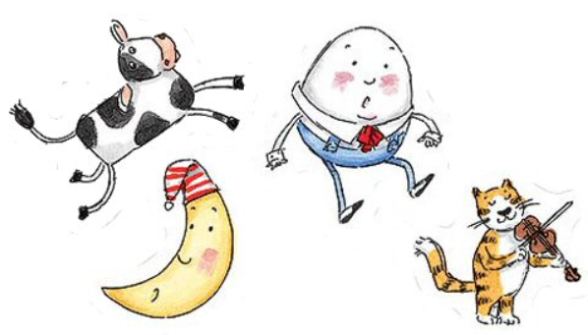
Supporting your child at home with reading: Nursery Rhymes!
Nursery rhymes support children in learning and retention of new vocabulary.
They give children the opportunity to hear sounds in words. They will begin to recognise rhyme, alliteration and this will in turn help children to develop phonological awareness.
They teach sequencing – nursery rhymes usually tell a story, and this will teach children that there is a beginning, a middle and an end.

Slide 24

Develop communication and language
Young children typically learn new words at an astonishing rate. The number of words a child has by the time they are 3 will have an impact on their language development.
Build on background knowledge – research new topics that children are interested in and introduce new vocabulary.
Give children experiences – these do not have to be expensive days out they can be going to the local woodland area, watching construction vehicles etc.
Talk about new words and what they mean.
If you speak another language at home, continue to do this as it will build on children’s vocabulary and help them to make links at school.
Share stories and books together
Sing songs and nursery rhymes
Act out stories and engage in imaginative play with children
Back and forth conversations

Slide 25

Develop a love of books
Research has demonstrated that children’s attitude towards reading is one of the strongest predictors of their later academic and life success.
Model a love of reading
Share a range of books
Talk about books and stories
Make up your own stories
Visit the local library
Read a range of books
Read and listen to poems

Slide 26
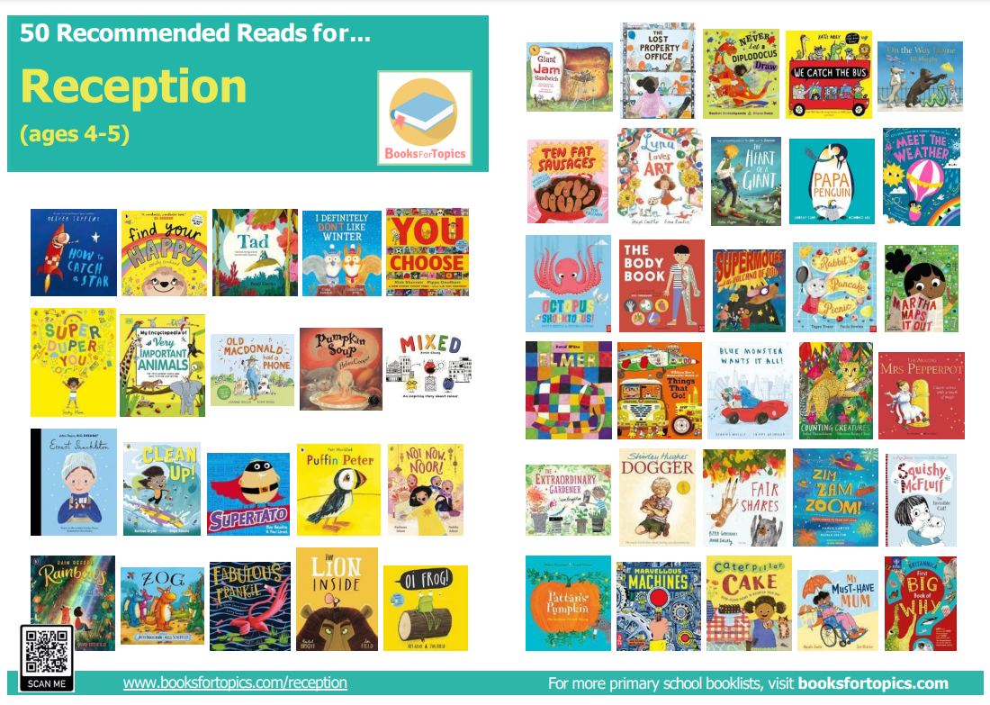
Recommended books https://www.fortyhill.com/page/?title=Literacy&pid=55

Slide 27



Helpful websites
Little Wandle – Support for Parents
https://www.littlewandlelettersandsounds.org.uk/resources/for-parents/
National Literacy Trust
https://literacytrust.org.uk/parents-and-families/
Book Trust
https://www.booktrust.org.uk/books-and-reading/tips-and-advice/reading-tips/

Slide 28

Thank you for listening!
Any questions?

