Slide 1
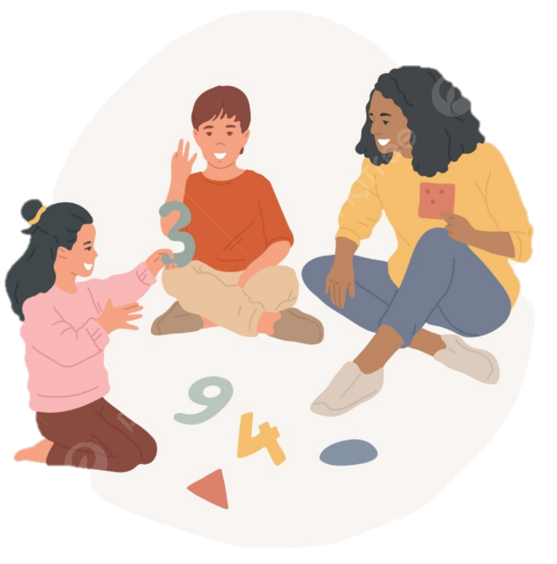
Helping your child with early Maths
EYFS – Year 2

Slide 2
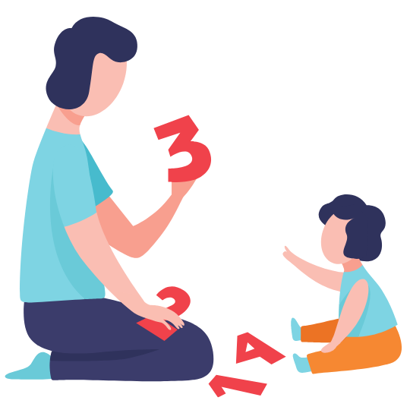
Why are we here?
“Parental engagement is a powerful lever for raising achievement in schools.
Where parents and teachers work together to improve learning, the gains in achievement are significant.”
“ ENGAGING PARENTS IN RAISING ACHIEVEMENT. DFE HARRIS & GOODALL 2007

Slide 3
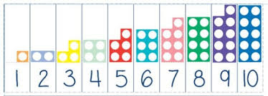
Our agenda:
Growth mind-set
Maths at Forty Hill
Curriculum Overviews
Understanding number
Make it, Draw it, Write it, Solve it
Manipulatives
Practical examples at home
Books
Websites

Slide 4

Growth Mindset
“I can’t do it!”
“I can’t do it, yet!”
Students who believe that intelligence or maths and science ability is simply a fixed trait (a fixed mindset) are at a significant disadvantage compared to students who believe that their abilities can be developed (a growth mindset)’
(Dweck 2008)
“I give up!”
“I can always improve. I will keep trying!”
“I’ve got everything wrong!”
“Mistakes are how I learn!”

Slide 5



Maths at Forty Hill
Nursery
Reception
Nursery does not follow the White Rose scheme. Instead they learn according to the ‘Development Matters’ statements which set out the necessary skills they will need.
Maths is incorporated in all areas of learning through play and within the classroom context e.g. How many children are on the carpet?
Children’s work is recorded through teacher assessment, most of which is recorded on Tapestry.
Follow White Rose scheme completing between 3 and 5 maths lessons a week.
Usually the class may focus on one concept, exploring this in different ways and in either small group or individual tasks.
Children’s work is recorded in their Maths books however this is mainly through photographic evidence of hands on maths.

Slide 6
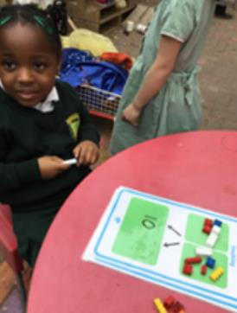
Maths at Forty Hill
KS1
4 Maths lessons a week.
In Year 2, the children will also have a weekly Arithmetic lesson.
Children follow the White Rose scheme and record their maths in their own maths books.
Children begin to understand presentation expectations and use a mixture of work sheets and writing out number sentences on the squared paper.

Slide 7
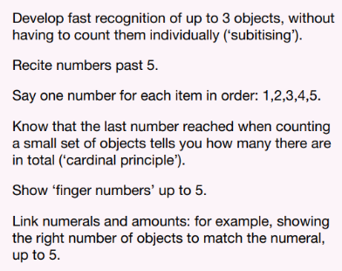
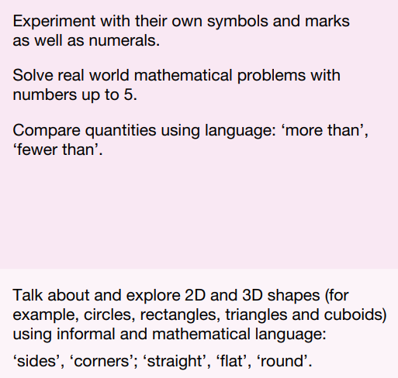
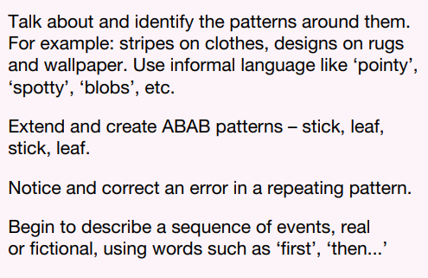

EYFS Curriculum:
Example statements taken from ‘Development Matters’:

Slide 8
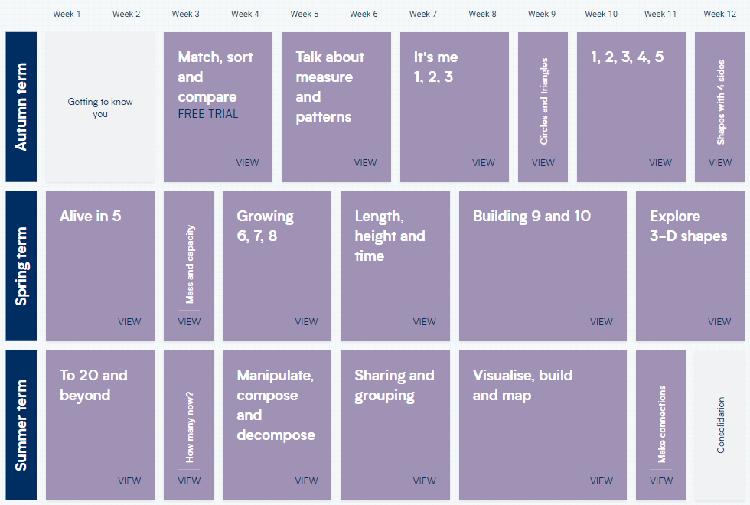
Reception Curriculum Overview

Slide 9
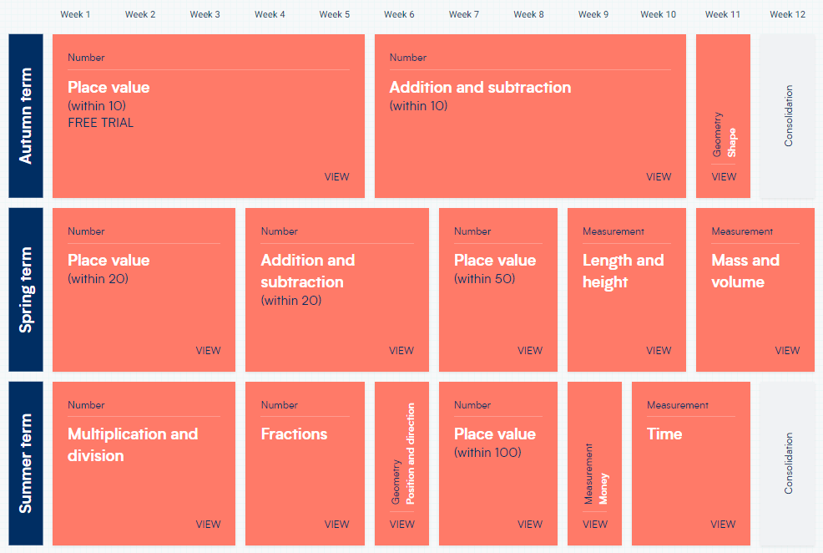
Year 1 Curriculum Overview

Slide 10
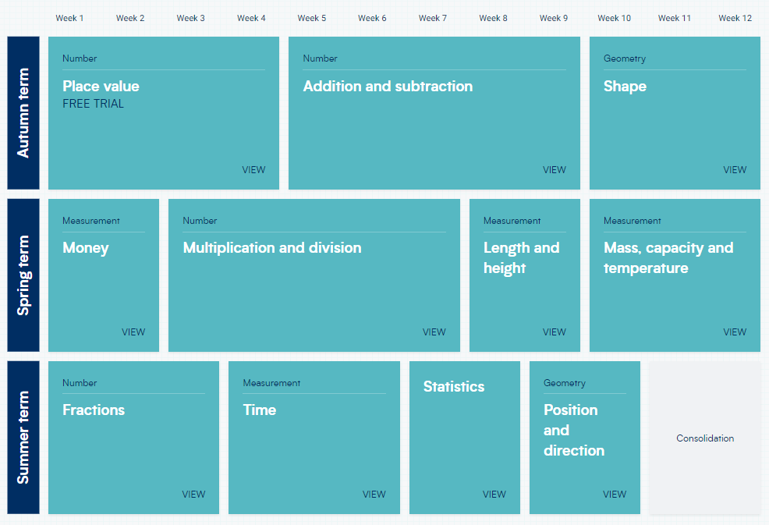
Year 2 Curriculum Overview

Slide 11
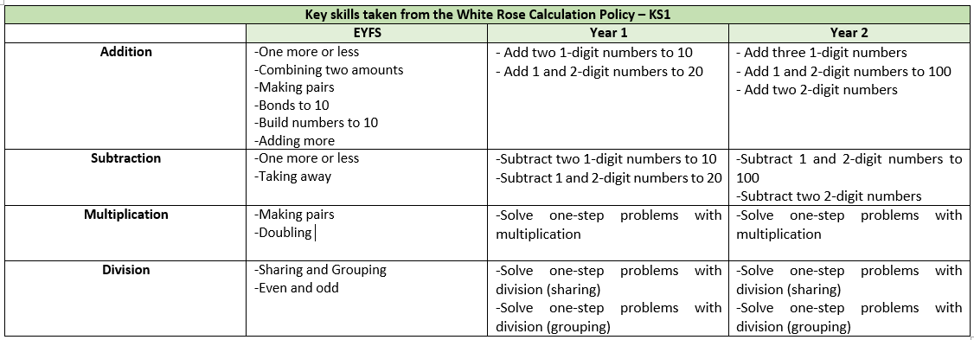
Skills progression – EYFS to Year 2
Skills are sequential and build over time. Children do not learn formal methods for multiplication or division at this stage.

Slide 12
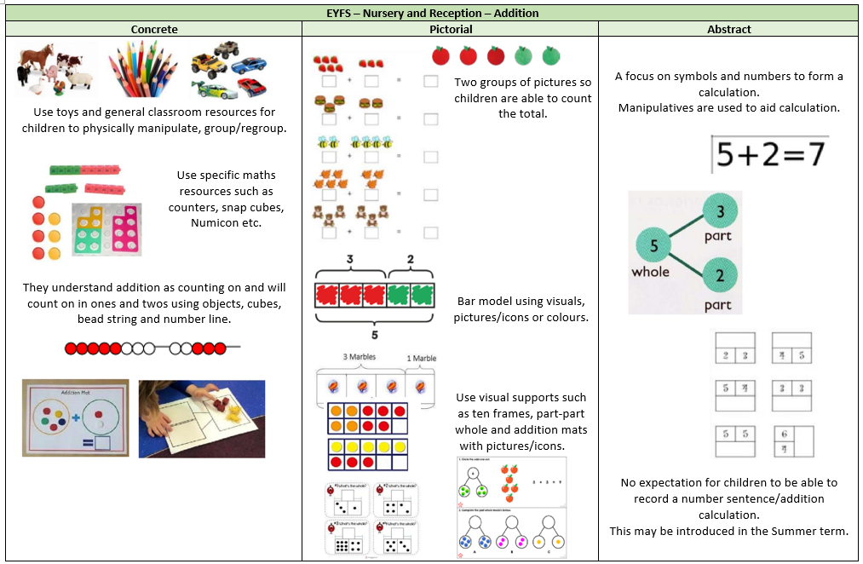

Slide 13
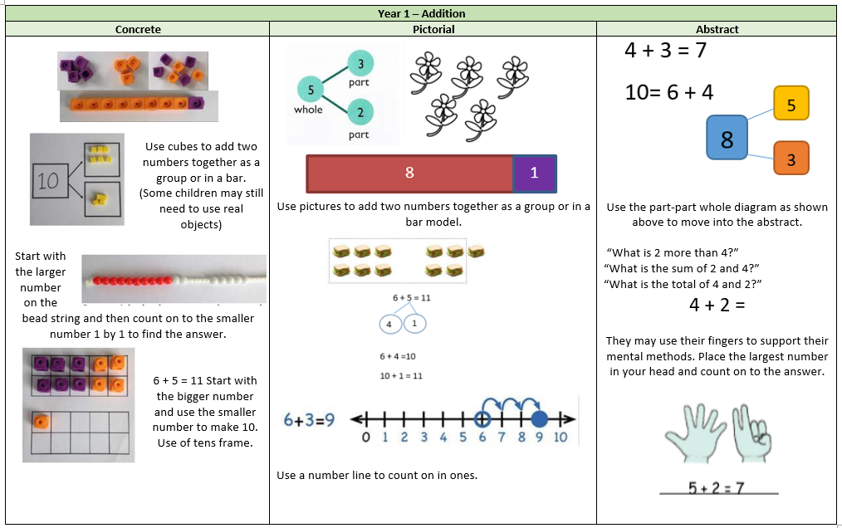

Slide 14
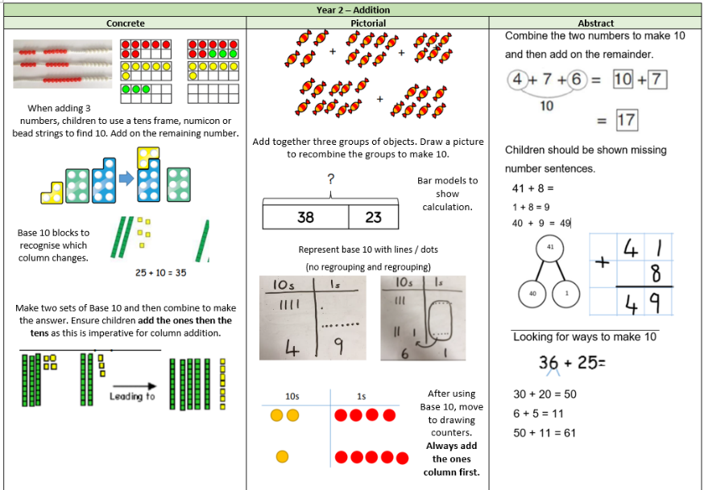

Slide 15

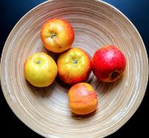

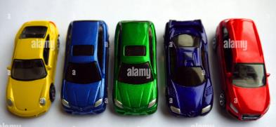
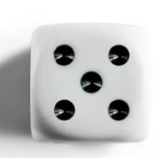
What is 5?
Subitising: The ability to instantly recall the number of objects or images without needing to count them individually.
Notes:
Understanding number is a key part of any child’s early mathematical understanding. In EYFS, this begins with subitising. The ability to instantly recall the number of objects or images without needing to count them individually. Children will not be able to understand mathematical concepts with ease if they do not understand what a number represents!

Slide 16
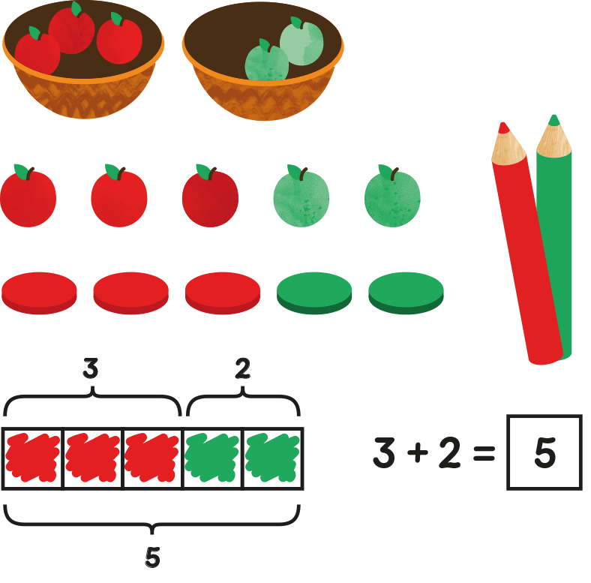
What is 5?
We first teach children to recognise number in concrete forms.
They will make a number using objects or represent a number sentence.
Then, they should see the number or problem in pictorial representations. This could be drawing objects or counters. Children may also use other representations such as bar models or part-whole models.
Finally, children then come to use write out number sentences or problems using numerals. This is in its most ‘abstract’ form.

Slide 17
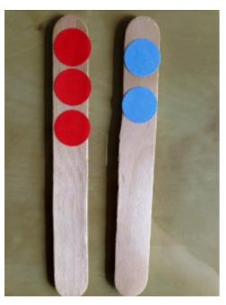
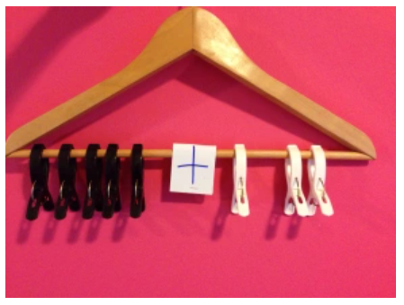
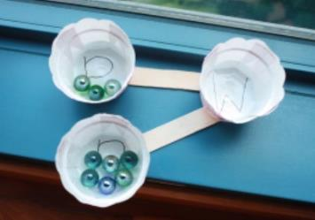
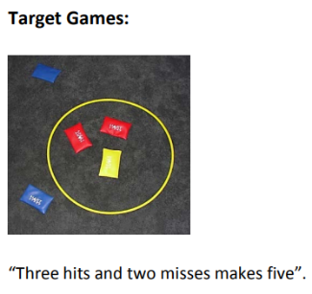
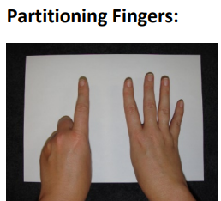
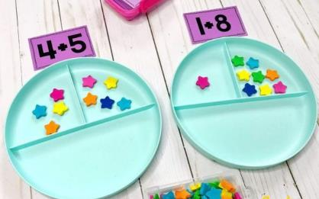

Slide 18
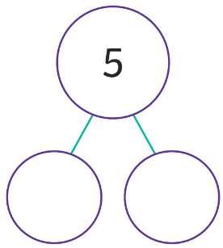

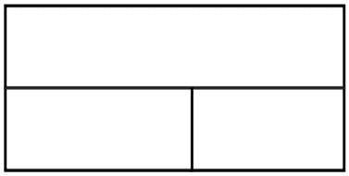
What is 5?
5
2 + 3 = 5
2
3
3
2
Part-whole models
Bar models

Slide 19
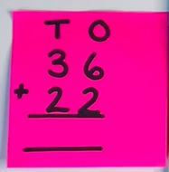
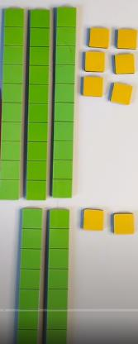
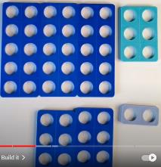
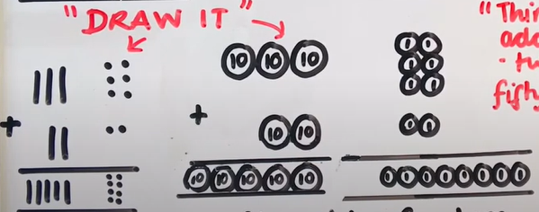
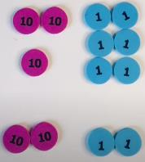
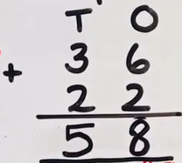
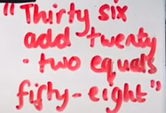
“Make it, Draw it, Write it, Solve it”

Slide 20
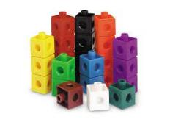
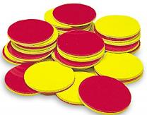
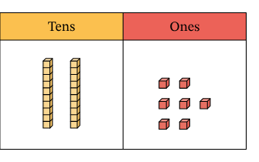
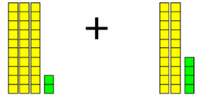
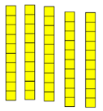

Manipulatives
Manipulatives are essential in helping to support children’s concrete understanding of number.
These are also used to help support children’s understanding of place value. This refers to what each numeral in a number represents.
Manipulative are not just used to support those children who find maths more tricky. If children are to achieve ‘greater depth’ they must be able to use manipulatives to explain or prove their answer.
2 | 7
=

Slide 21
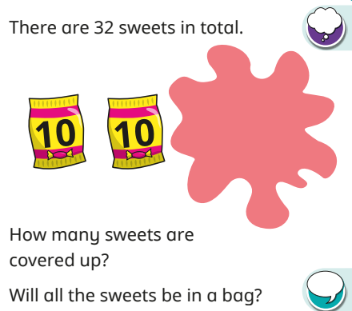


Manipulatives to show Greater Depth
Year 2 – Mastery question
“I have made 32.
I can see two groups of 10.
So, I know I need one more group of 10 and 2 ones.
There are 12 sweets covered up.”
The two ones will not be in a bag as they are less than 10.”

Slide 22



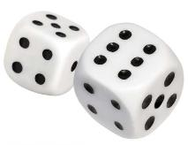
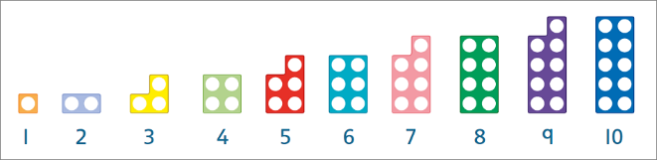
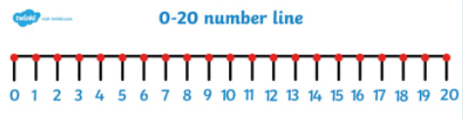

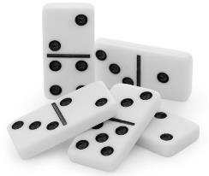
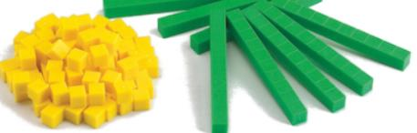

Slide 23
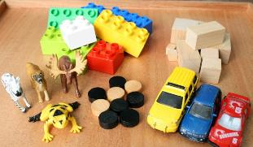

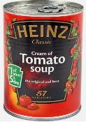
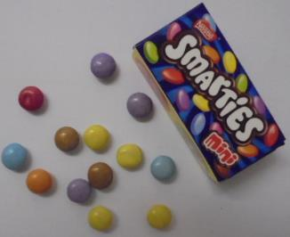
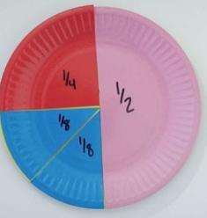

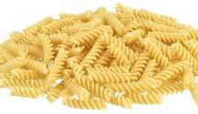
Manipulatives
Which ever manipulatives your child chooses to use is fine!
As long as they understand what they are representing, allowing them to choose may help to spark their interest!
Notes:
Pasta shapes instead of base 10
Real life objects for shape
Fractions – paper plates
Sweets for addition and subtraction/ number bonds

Slide 24

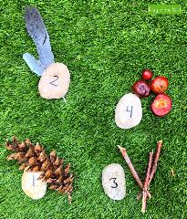



Practical Maths at home
“How many people are eating dinner?”
“How many plates do we need?”
“How many forks do we need?”
“Every one has two sausages. Let’s count in 2s”.
“How many dogs can you see?”
“How many ducks are there? How many would there be if two ducks flew away?”

Slide 25




Maths in books!

Slide 26





Helpful websites:
There are lots of songs available on YouTube!
BBC: Number Blocks
BBC: Super Movers

