Slide 1
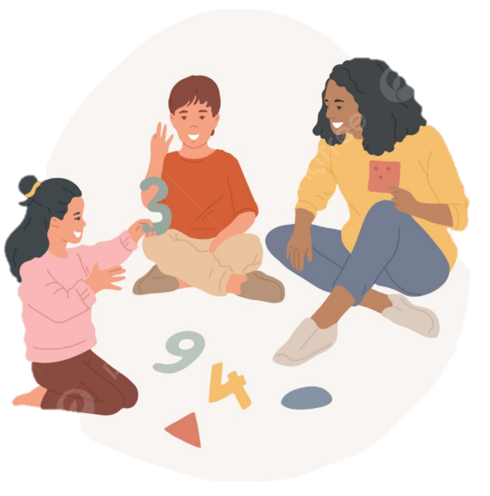
Helping your child with Maths
Years 3 - 6
Notes:
Thank you for coming. We are not going to be able to cover everything we need to – just a brief summary. There should be time for questions at the end.

Slide 2
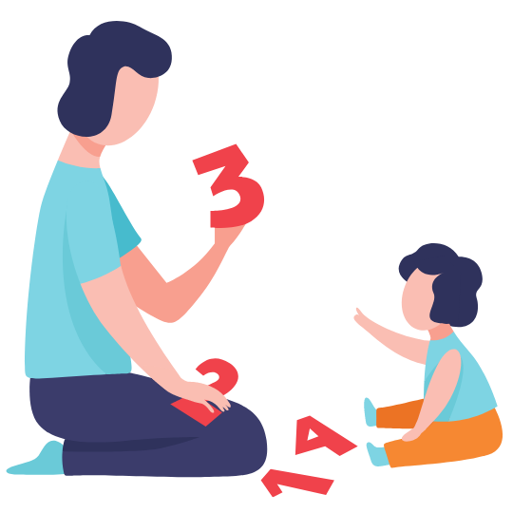
Why are we here?
“Parental engagement is a powerful lever for raising achievement in schools.
Where parents and teachers work together to improve learning, the gains in achievement are significant.”
“ ENGAGING PARENTS IN RAISING ACHIEVEMENT. DFE HARRIS & GOODALL 2007
Notes:
Please have a read of this quote.
By attending today’s workshop you have made a fantastic step and hopefully you will come away with some practical ideas for how to support your child at home!

Slide 3
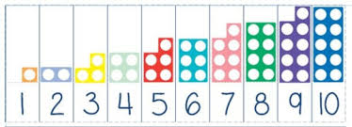
Our agenda:
Growth Mindset
Maths at Forty Hill
Curriculum Overviews
Calculation Policy
Arithmetic lessons
Manipulatives
Choosing the most efficient method
Maths at Home
Multiplication Tables Check
Helpful websites

Slide 4

Growth Mindset
“I can’t do it!”
“I can’t do it, yet!”
Students who believe that intelligence or maths and science ability is simply a fixed trait (a fixed mindset) are at a significant disadvantage compared to students who believe that their abilities can be developed (a growth mindset)’
(Dweck 2008)
“I give up!”
“I can always improve. I will keep trying!”
“I’ve got everything wrong!”
“Mistakes are how I learn!”
Notes:
Studies have shown that children’s mindset particularly for maths is greatly influenced by their parents. Lots of adults say they do not like/ are not comfortable with maths – even if this is the case, just show them a growth mindset and work together!

Slide 5


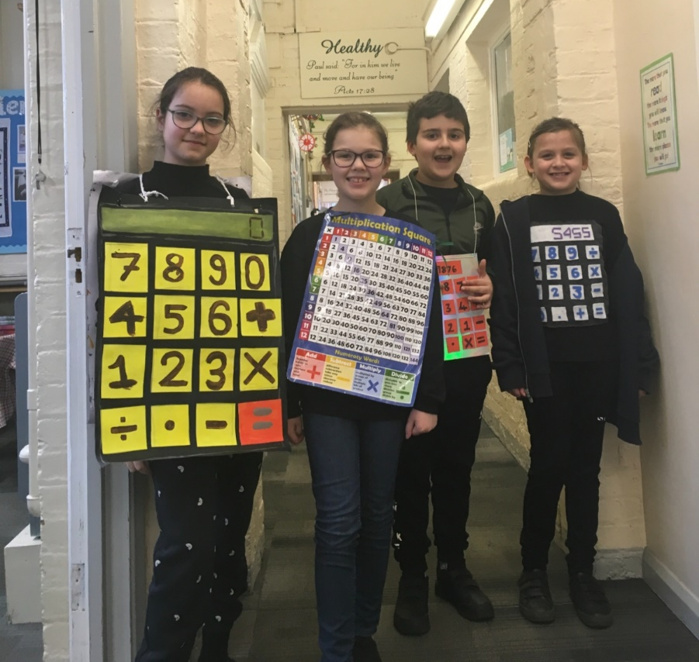
Maths at Forty Hill
KS2
4 Maths lessons a week.
1 weekly Arithmetic lesson.
Children follow the White Rose scheme
Notes:
Follow a White Rose scheme – this allows for clear progression and coverage of all units. Units build sequentially and ideas are revisited each year to build on children’s knowledge. Opportunities for mastery are throughout – if children are secure, they are not moved on to a new concept but instead go deeper and develop both their conceptual and procedural fluency as well as reasoning and problem solving. Children will also be given opportunities to explore non-routine problems.
Non –routine problems = problems that replicate real-life situations and do not provide keywords to solve using known procedures or standard methods – trial and error approach/ systematic working

Slide 6
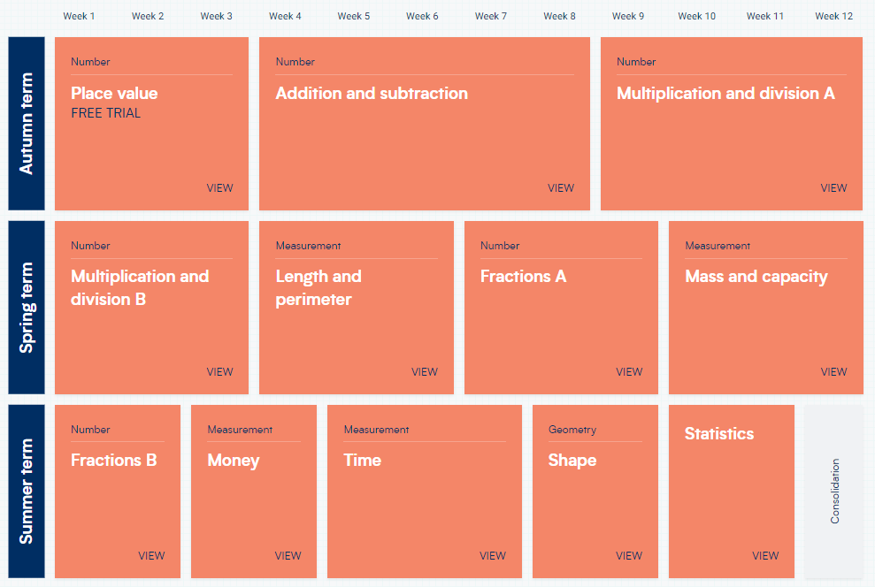
Year 3 Curriculum Overview

Slide 7
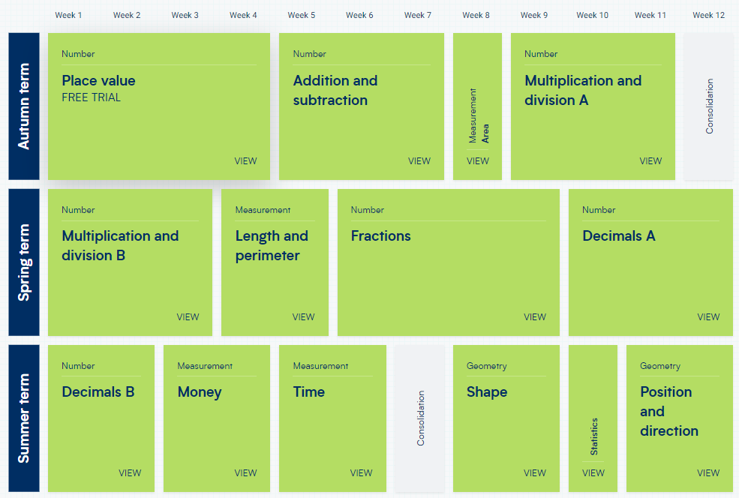
Year 4 Curriculum Overview

Slide 8
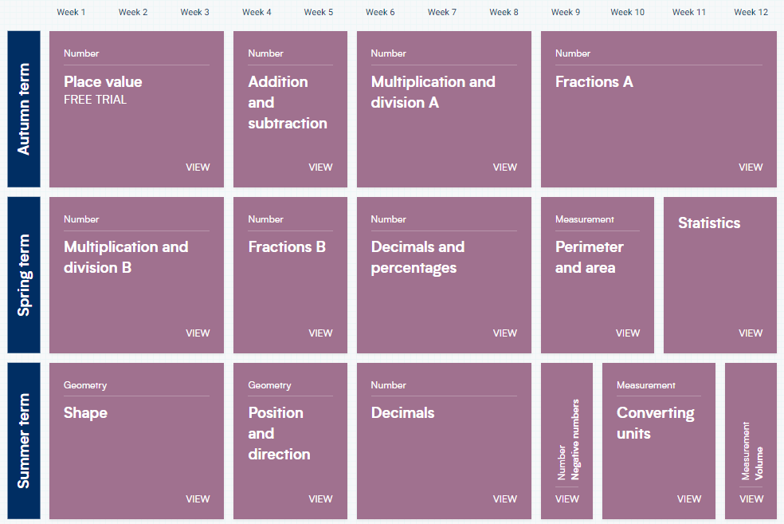
Year 5 Curriculum Overview

Slide 9
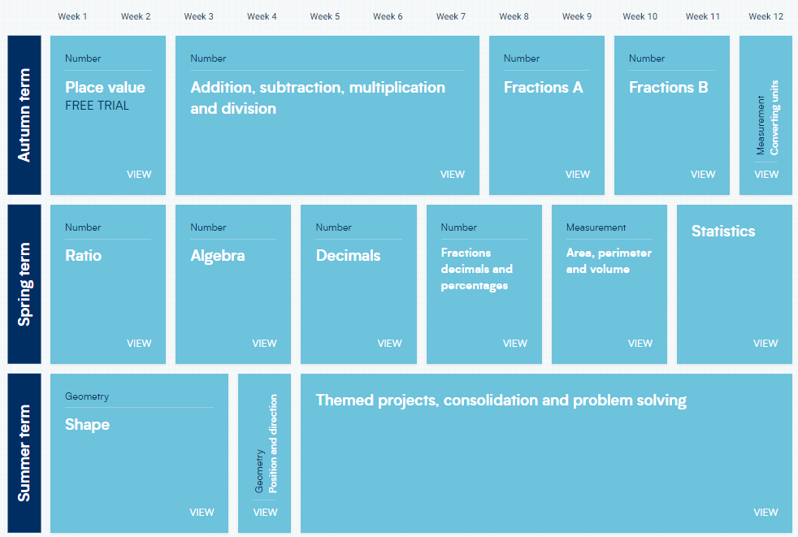
Year 6 Curriculum Overview

Slide 10
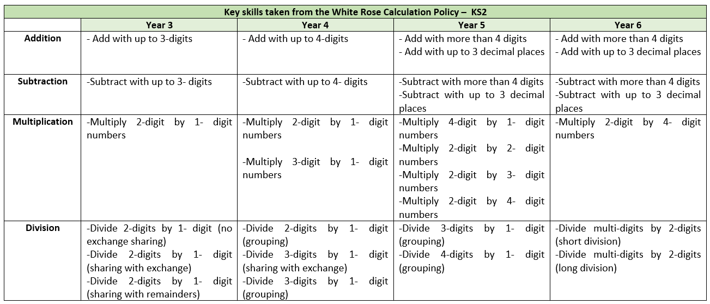
Skills progression from White Rose –Year 3 - 6
Skills are sequential and build over time.

Slide 11
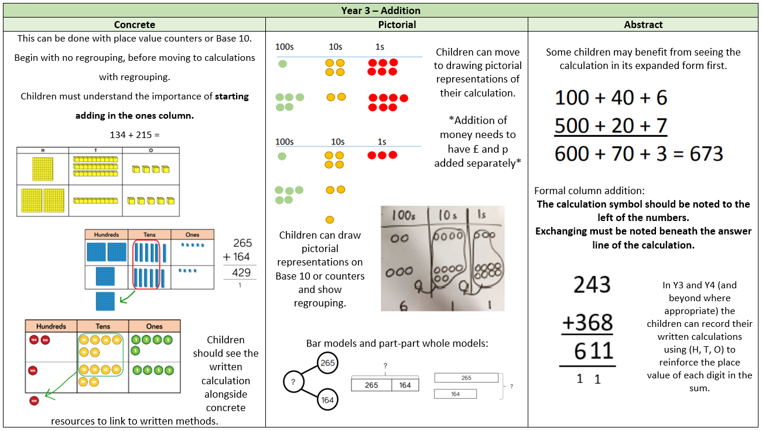

Slide 12
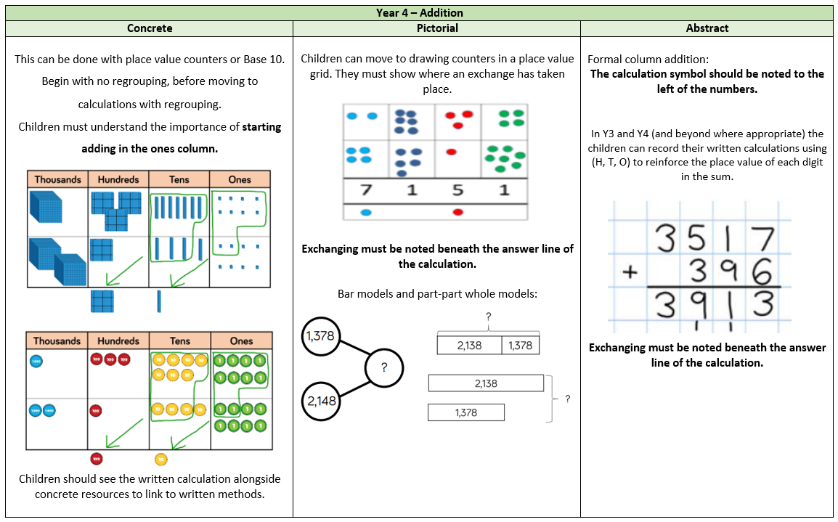

Slide 13
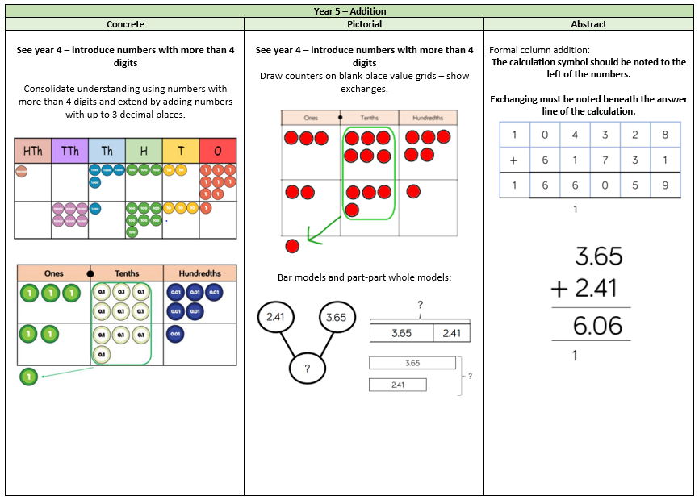

Slide 14
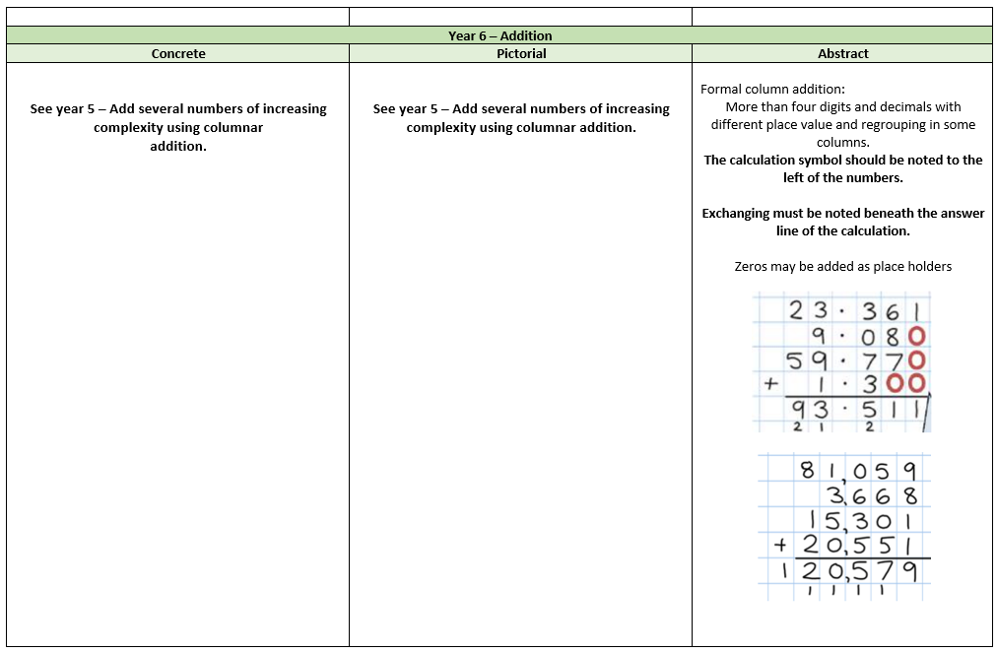

Slide 15
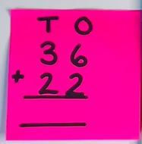
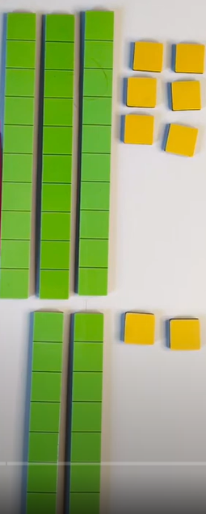
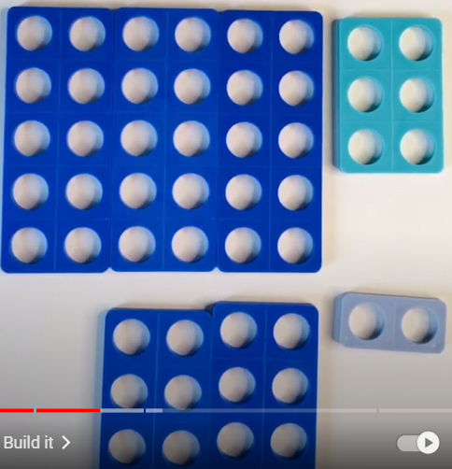
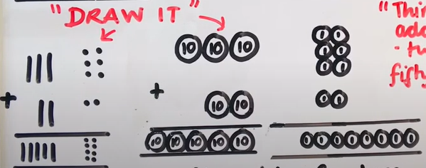
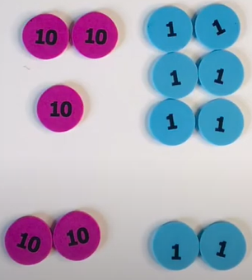
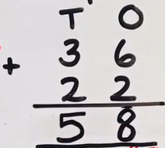
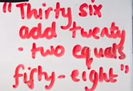
“Make it, Draw it, Write it, Solve it”

Slide 16
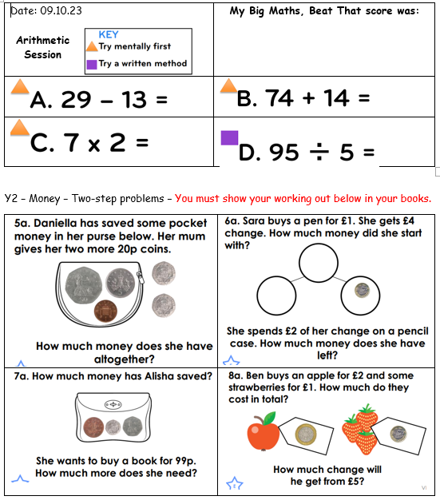
Arithmetic Lessons
Arithmetic lessons consist of:
Big Maths, Beat That
Questions aimed to consolidate children’s conceptual and procedural fluency in a variety of arithmetic skills
Questions to consolidate key learning from the previous year group on areas often given less coverage e.g. shape, measurement, time, money

Slide 17
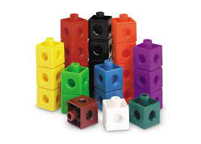
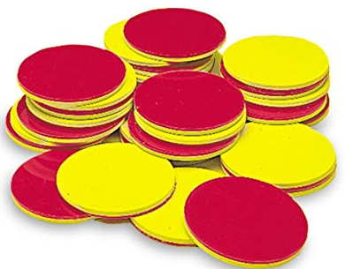
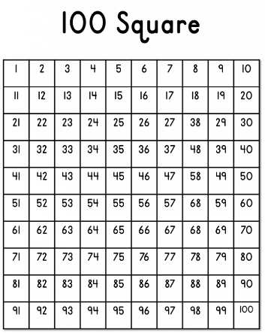
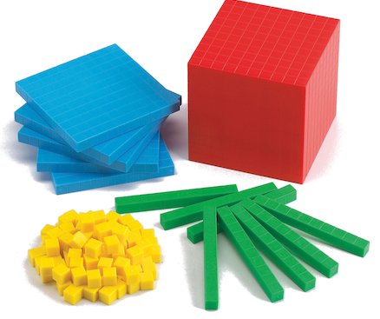

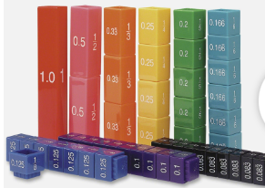
Manipulatives
With mathematics itself being abstract, concrete maths manipulatives provide the learner a ‘window’ in, to make sense of the problem at hand by touching them, exploring patterns and relationships which make a huge difference between understanding for depth or just for procedure.
These should not just be in KS1!

Slide 18
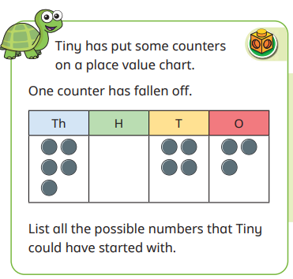
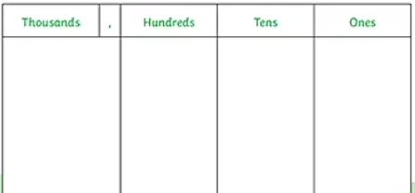
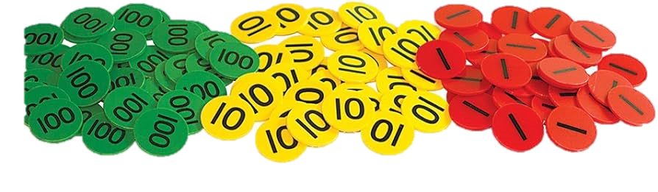
Manipulatives in action
Year 4 – Mastery question
Systematic working out is a key skill that children should develop.
Children must find all possibilities to problem solving questions.

Slide 19

Choosing the most efficient method
As children reach UKS2, they will have learnt several ways to calculate answers to given questions.
They must now be able to select the most appropriate and efficient method. This is also a highly valuable test skill for KS2 SATS.
Is a calculation necessary?
Can I calculate this mentally?
Which written method/s should I use?
Notes:
Arithmetic SATS paper = 30 minutes, 40 marks – less than a minute/ question
Tests speed and accuracy – if children can calculate mentally, this saves time!

Slide 20
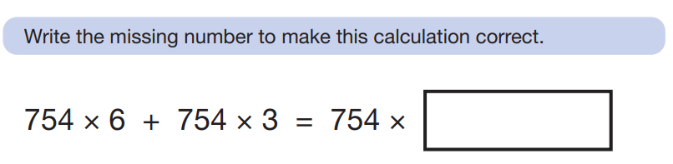

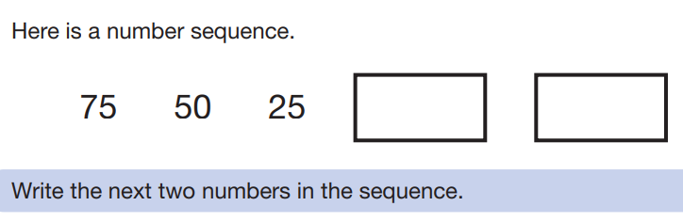
Choosing the most efficient method
Is a calculation necessary?

Slide 21



Choosing the most efficient method
Can I calculate this mentally?
Notes:
Methods that can be done mentally -

Slide 22
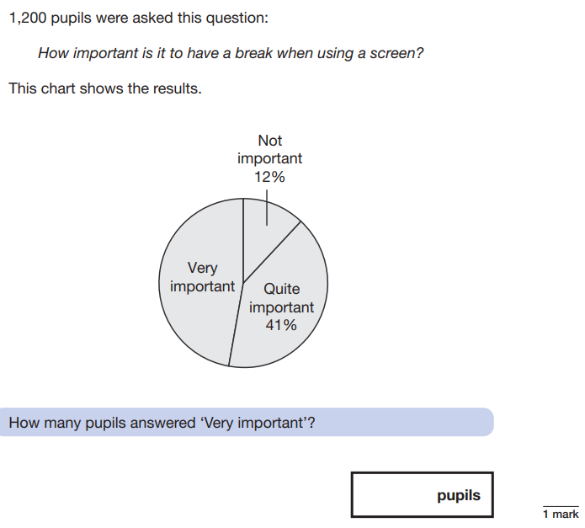
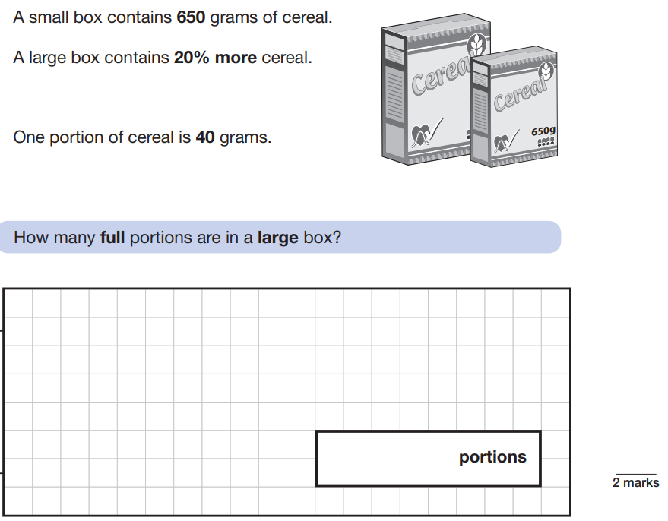
Choosing the most efficient method
Which written method/s should I use?

Slide 23
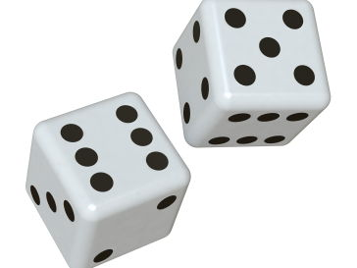
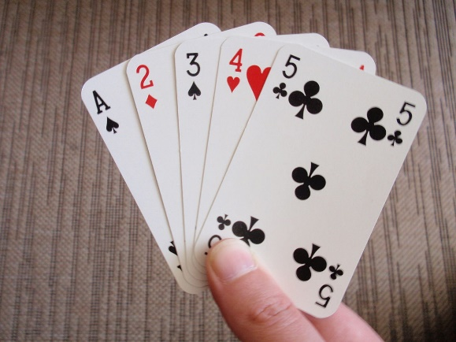
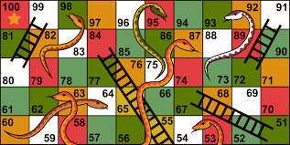
Maths at Home
If children in KS2 still struggle with subitising, recognising number bonds, using doubles or near doubles, it will hamper their maths in other areas.
Simple games can be used to help them practice this.
subitising: being able to look at a group of objects and realise how many there are without counting
Notes:
Dice games and card games. Use the images on the cards to help subitise. Ask children to add the numbers on the cards. If they are a near double, get children to cover over one shape, add the double and then add on the remaining shape. Snakes and Ladders can help with mental addition and subtractions and going across tens boundaries.

Slide 24

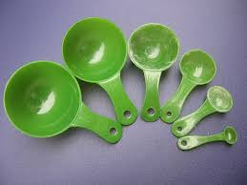


Maths at Home
Practice spotting and recognising numbers in the environment. Add/multiply/subtract/divide door numbers, numbers on car registration plates, road signs and at the shop.
Flicking through the TV guide? Ask your child to calculate the length of their favourite programmes. How long is it until the next programme?
Use food packaging to discuss 2D and 3D shapes. What are the properties of these shapes e.g. how many faces, sides, vertices? Flatten the packaging out to find the net of the 3D shape too.
Notes:
Maths is all around – we must help children to understand the value of what they learn in the classroom with real word applications! Give purpose

Slide 25
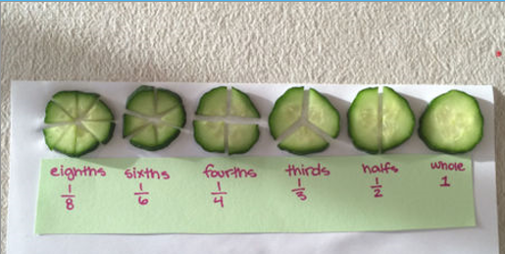
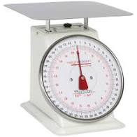
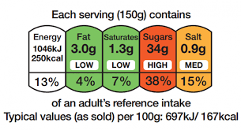
Maths at Home
Measuring up for new furniture? Want to make sure the Christmas tree will fit in your living room? These are really good opportunities to encourage your child to see the value of careful measuring skills in everyday life.
Practice telling the time with your child. Can they read both the digital and analogue clock? Can they readily convert between the two and use the 24 hour clock? Can they also recognise Roman Numeral representations of the time too?
Board Games supply endless opportunities for Maths –Monopoly, Bingo, Connect Four, Battle Ships etc

Slide 26

‘MTC’ – Multiplication Times Tables Check – Year 4
The purpose of the check is to determine whether children can fluently recall their times tables up to 12.
Consists of an-screen check consisting of 25 times table questions.
Children have 6 seconds to answer each question. On average, the check should take no longer than 5 minutes to complete.
This is completed at school.
Notes:
Lots of information available on the Government website – you will be given info nearer the time, however please speak to Miss Campion or myself with concerns.

Slide 27


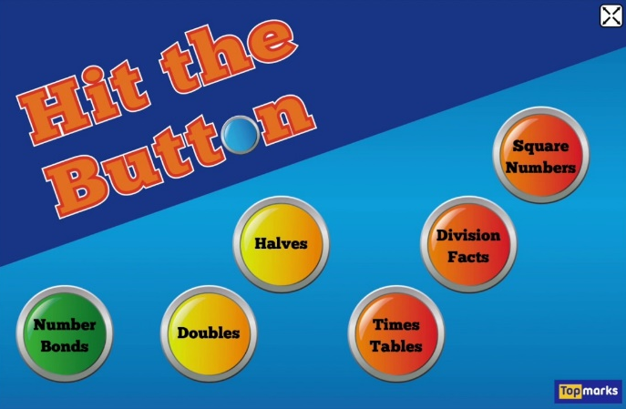


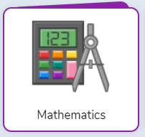
Helpful websites:
There are lots of Times Tables songs available on YouTube!

Slide 28
Any questions?
Thank you very much for coming!

