Slide 1


Fine Motor Skills Workshop
Wednesday 16th November 2022

Slide 2

Our focus for today
What are fine motor skills and why they are important.
How can you support your child at home
Activities to try

Slide 3
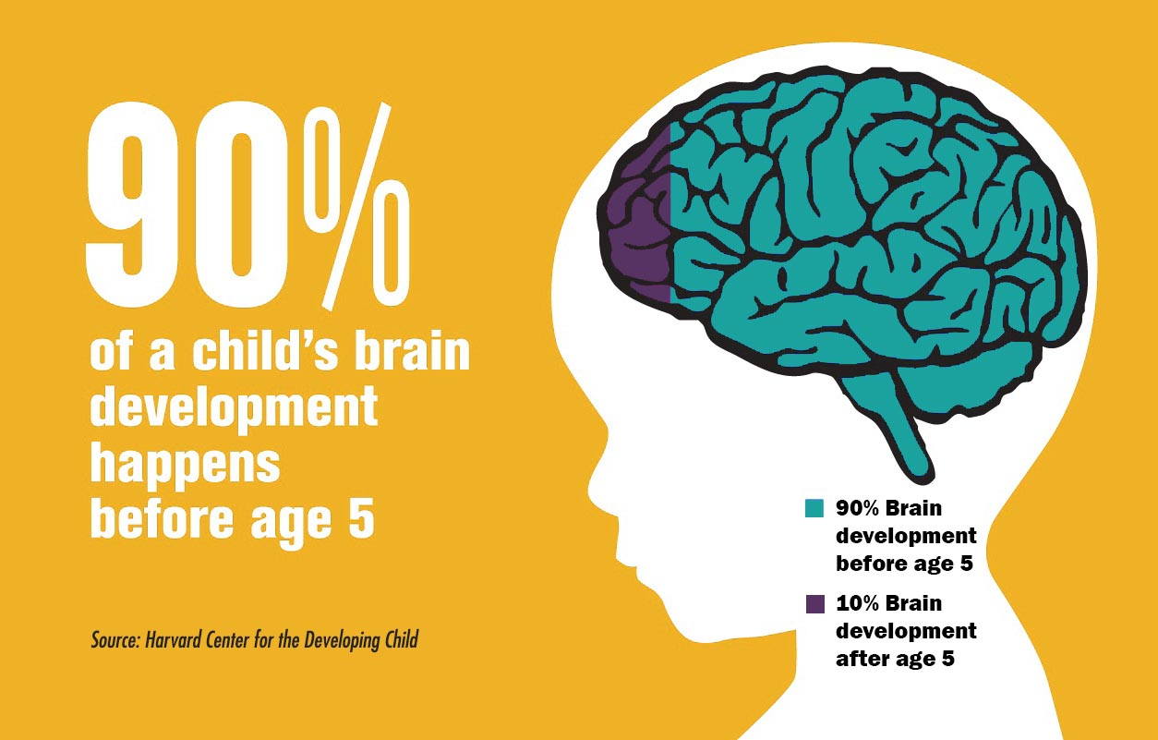
The Early Years
“No job is more important than working with children in the early years.”(2021, Development Matters)
Children develop the most between birth to five. This is where all the foundations are laid for their future development.
When children are given the best start in their early years, we not only give them what they need today but set them up to succeed in future.

Slide 4

The Early Years Foundation Frame
Prime Areas | Specific Areas
Communication and Language | Literacy
Personal, Social and Emotional | Mathematics
Physical | Understanding the World
 | Expressive Arts and Design
The Prime Areas are considered fundamental to a broad and balanced base for children’s learning.
They are crucial in igniting children’s curiosity and enthusiasm for learning, their capacity to learn, form relationships and thrive.

Slide 5
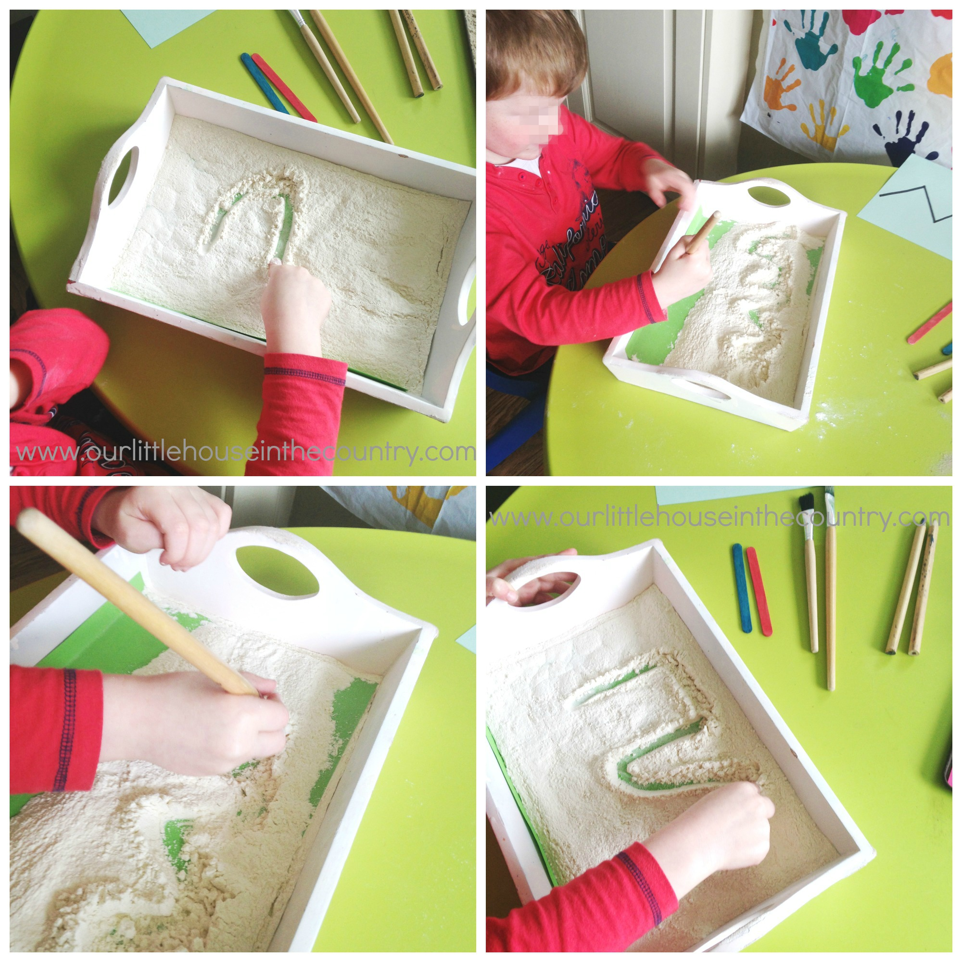
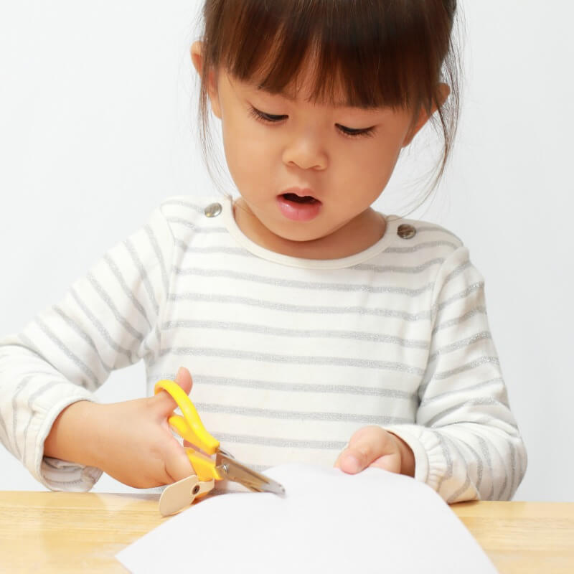
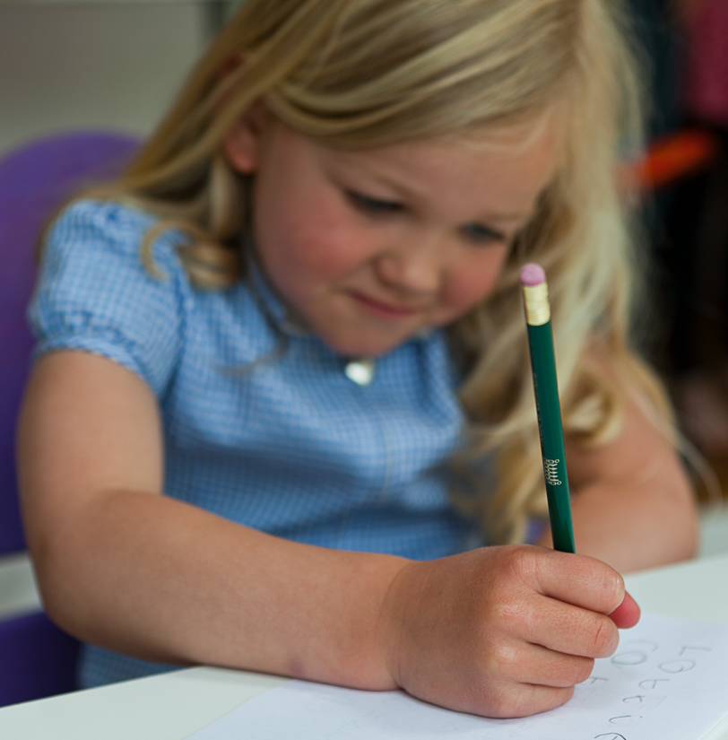
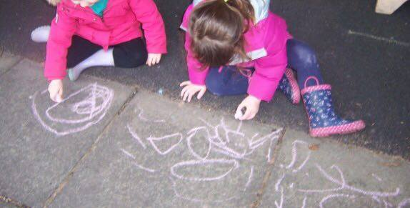
Physical Development - Fine Motor Skills
Physical Development is vital to children’s all round development.
Fine Motor Skills help support control and precision found in hand-eye coordination which is later linked to early writing.
These skills are important for having the ability to do up buttons, zips and use various utensils such as scissors and cutlery. They are also crucial for early writing.
Fine motor skills involve the small muscles in the body, specifically those that control the wrist, hands and fingers. It is important that we give children the best start when acquiring this skill and have the skills they need before they start.

Slide 6
What skills will your child develop during early years?
Birth to three | 3&4 year olds | Reception Children
Beginning to manage zips and buttons independently. | Making snips in paper with scissors. | Using a range of tools safely and confidently.
Dressing themselves with increasing control. | Use a comfortable grip when mark-making. | Develop the foundations of handwriting style which is fast, accurate and efficient.
Feeding themselves with cutlery. | Show a preference for a dominant hand. | Forming recognisable letters that can be read by themselves and others.
Mark-making using a range of media - | Increasing independence when dressing and using zips.

Slide 7
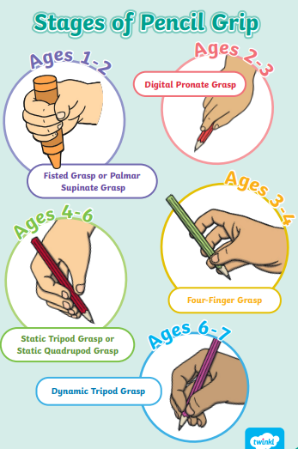
Types of pencil grip
These show the different stages of pencil grip you would expect to see in the early years.
It is important that we are aware what is expected so that we can ensure we are giving children support where needed.
Pencil grips that can be purchased can sometimes help, however it is crucial that we address why a child is not holding their pencil correctly.

Slide 8
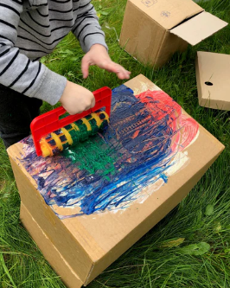

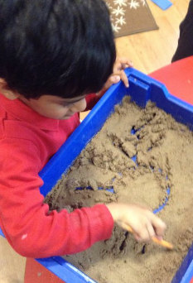
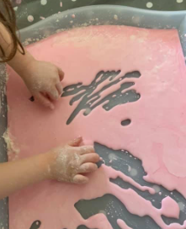
How to support your child at home
Provide your child with mark-making opportunities. This does not always have to be in the traditional pencil and paper format. It is actually good to provide different surfaces such as chalk on the ground and chunky crayons. The resistance supports the strengthening of muscles.
Large scale mark-making – this can be on large roll of paper, or opened boxes.
Using paintbrushes, rollers and other home utensils such as forks, whisks etc.
Mark-making can be in sand, flour, or gloop. This is especially good for reluctant writers as there is less pressure. This is also great for nursery children.
Give children opportunities to be independent when dressing themselves (buttons and zips).

Slide 9
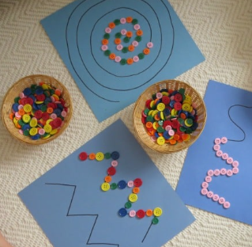
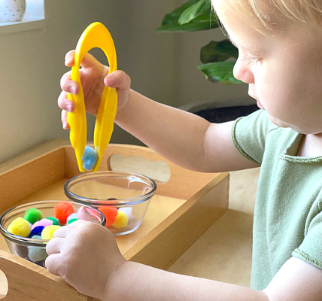
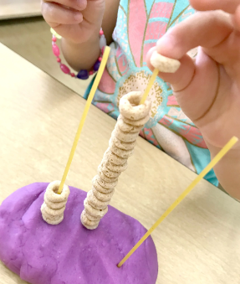
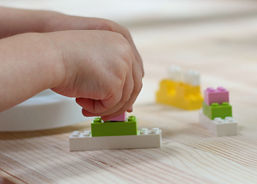
How to support your child at home
Provide your child with activities that support the strengthening of wrists, hands and fingers.
Lego is really good for this, as it helps to develop dexterity and strengthen fingers.
Large tweezers help to develop hand-eye coordination and strengthen fingers.
Playdough is a great way to support children with developing fine motor skills. It is something that you can cheaply make at home and can last for months.
Threading – you can use spaghetti and Cheerios if you don’t have a threading set at home.
Using scissors to snip paper, cut through wavy lines and cut around shapes.
Placing buttons or beads on patterns.
Using pegs to pick things up, these can ones that you use at home.

Slide 10


Slide 11

Activities
We are now going to have a chance to experience the activities.
Next to each activity is a card which explains how the activity supports your child and some ideas on how you can play with it.
There are also some recipes next to the activities that you can take with you to try at home.

