Slide 1

Phonics and Reading
Reception and Year One

Slide 2

Phonics and Reading

Slide 3
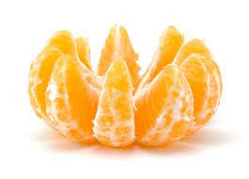
Before we get going
Phonics is a specific body of knowledge and there is lots of vocabulary that comes with it that you might find strange to begin with. Don't panic, we are providing you with a glossary and lots of other information that will assist you in supporting your child's journey.
For now, a phoneme is the smallest unit of sound that can be heard (think phone or headphones). A grapheme is that sound in written form.

Slide 4




Vocabulary for now
A graph is a single grapheme for example: s, a, t, p
A digraph is when two letters work together to make one sound for example: ck in sock. A trigraph is three letters making one sound for example igh in light.
A split digraph is when two letters still work together but don't sit next to each other any more for example: a_e in snake, e_e in delete, i_e in kite, o_e in bone and u_e in cube.

Slide 5
vocabulary
Segment
To break a word down into it’s sounds for example tip, t-i-p or duck, d-u-ck .
Blend
To combine those individual sounds into a word. t-i-p tip or d-u-ck duck

Slide 6
Changes
We previously taught phonics using Letters and Sounds which was a fully Systematic Synthetic Programme approved by the Government.
We are now using Little Wandle – Letters & Sounds revised as it meets the new requirements of being a fully Systematic and Synthetic Scheme.

Slide 7
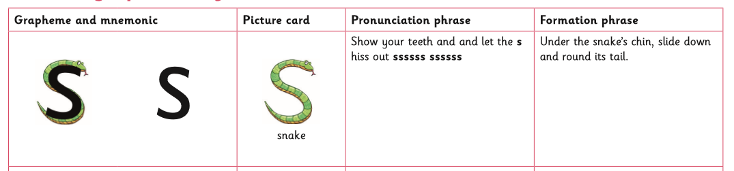
What's the difference?
This scheme still teaches the progression of sounds cumulatively with few changes to the order in which they are taught.
There are mnemonics which support the children to remember the grapheme alongside formation phrases to support letter formation and memory with catchphrases.

Slide 8
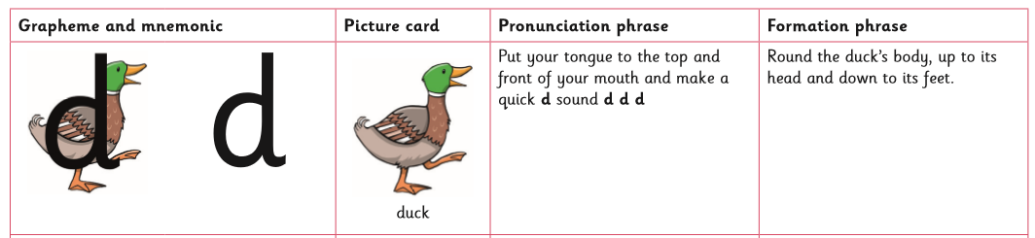
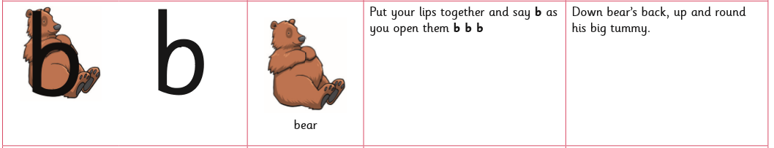

The formation phrases support correct letter formation and particularly those that are commonly reversed. the catchphrases support memory when previously taught graphemes become digraphs or trigraphs and two or three letters now work together to make one sound.

Slide 9
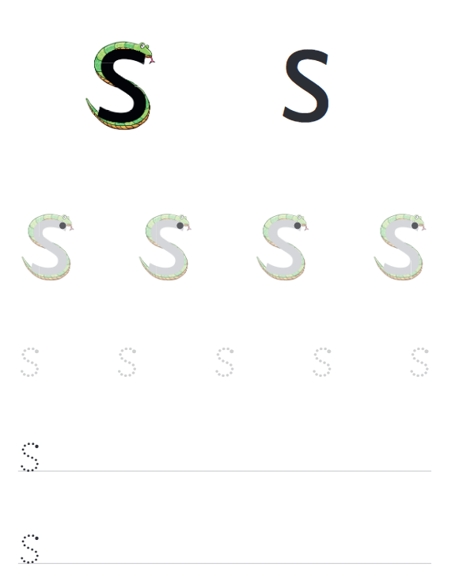
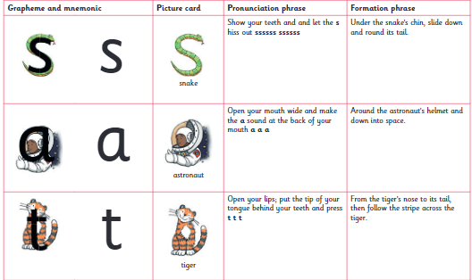
The importance of pronunciation
https://www.littlewandlelettersandsounds.org.uk/resources/for-parents/

Slide 10
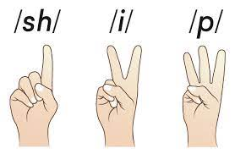

Nails
n-ai-l-s
. _ . .

Slide 11
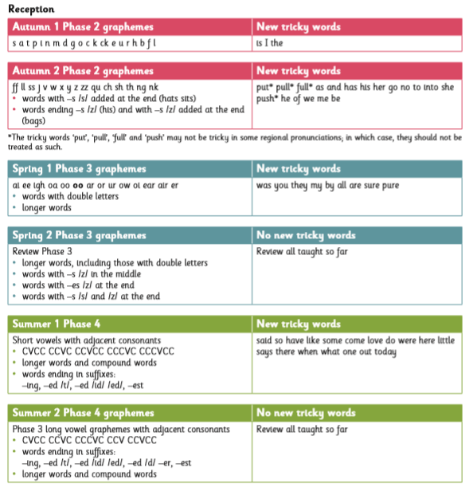
Reception
Phase 2 in Autumn Terms
Phase 3 in Spring Terms
Phase 4 in Summer Terms

Slide 12
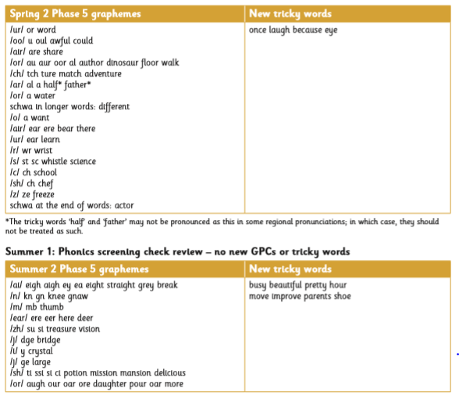
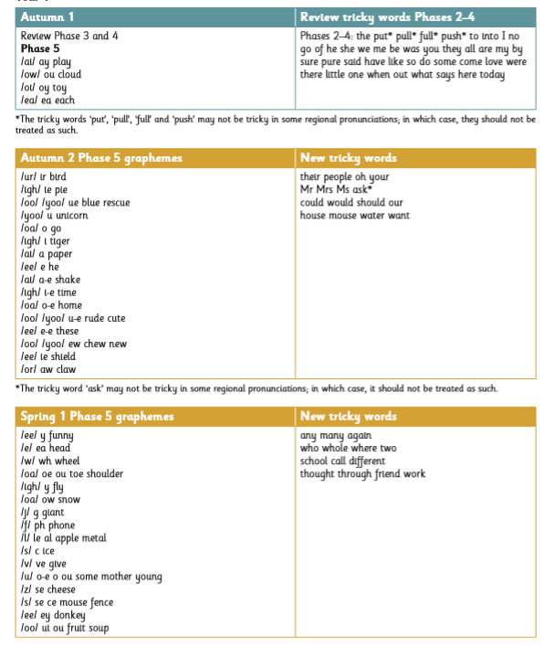
Year one
Revisit and review
Teach new graphemes
Teach alternate sounds
Statutory Phonics Screening Check

Slide 13
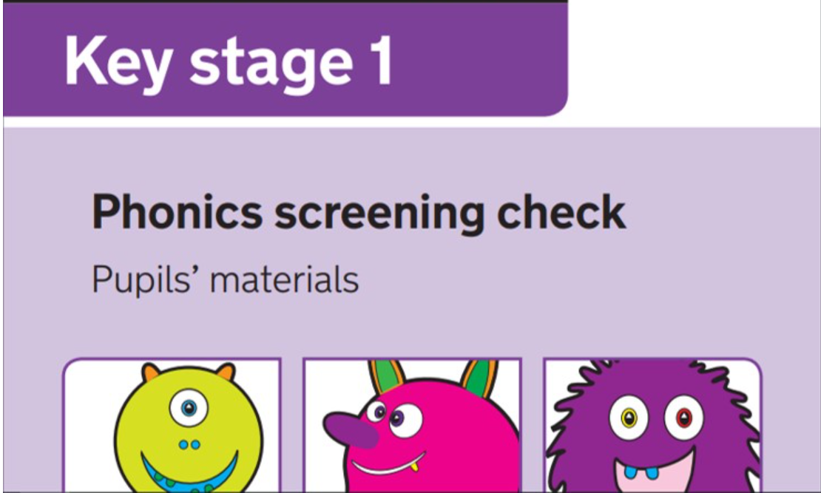
Year TWO
Revisit and review of Phase 5
Past Phonic Screening Paper in Autumn Term 2.
Children who pass at this point will not take the Statutory Phonics Screening Check in Summer Term 2.
Statutory Phonics Screening Check for relevant children who will continue to receive targeted teaching throughout the year in order to prepare.
Previously known Phase 6 is now taught in line with National Curriculum expectations alongside any school programme for spelling.
Real and Pseudo words
For example
Sweeps
Splaits

Slide 14
Reading
Children learn to read using their phonics skills, decoding words to read and not inferring from pictures. Inference is still an important comprehension skill but is NOT a reading strategy.
Children will take home a phonetically decodable book which is meant to be read fluently.

Slide 15
Reading structure
Reception & Year 1
Children will have three guided reading sessions during the week.
Session One – Word reading
Session Two – Prosody (Reading with tone and expression)
Session Three – Comprehension

Slide 16
Reading structure
Year 2
Some children in Year 2 will also have three group reading practice sessions during the week following the same structure.
Session One – Word reading
Session Two – Prosody (Reading with tone and expression)
Session Three – Comprehension
Some children will participate in whole class guided reading sessions where they will work on comprehension skills such as retrieval and inference.

Slide 17
Fluency
After the third reading session your child will bring that book home with them.
It is meant to be read fluently and this is not the same as a book being "too easy".
Please praise your child for being fluent and revisit vocabulary and tricky words with them.

Slide 18
Reading strategies
Owls perch up high.
It is hidden.

Slide 19

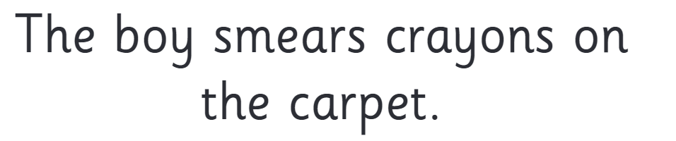
Reading strategies

Slide 20
Writing & spelling strategies
Say it
Sound it (use segmenting fingers)
Model it
Your turn

Slide 21
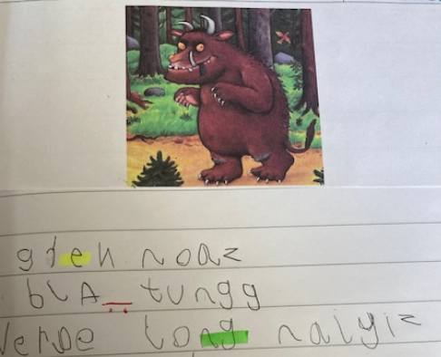
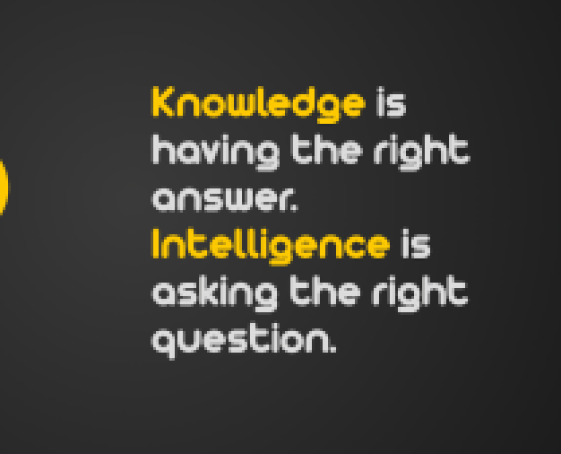

Slide 22
Support strategies
Consistency is so important for children. If your child stops to segment and blend a word, allow them to do so without challenge. They are using the correct strategy and will begin to recognise the word in time.

Slide 23
Support strategies
If your child stops at a word and doesn’t start to segment and blend, ask them “Are you stuck or are you thinking?”
They will tell you if they need help with the grapheme to phoneme correspondence You may need to remind them of the sound the grapheme makes. See if they can blend for themselves or do it with them whichever works best for them and you!

Slide 24
Support strategies
If your child begins to segment a digraph (or trigraph) wait for them to finish. Then gently ask them, can you see two (or three) letters working together to make one sound?
See if they can identify it. See if they can remember it and if not say it to them and then read and blend the word together.

Slide 25
Support strategies
Longer words can be overwhelming to segment and then remember to blend back together. Use the method of chunking up to help. For example, sunken would become
s-u-nk – sunk
e-n – en
Put it together - sunken

Slide 26
Support strategies
Common exception words – referred to as ‘tricky words’ are taught at different stages as outlined in your overview. They do not always remain ‘tricky’ because as the children attain more phonic knowledge they can apply it to decode some of them. However, it’s important to encourage them to be read by sight and to talk about why they are tricky at that stage. This conversation is not only important but a recommended curriculum strategy.

Slide 27
Why is fluency so important?
The evidence for phonics is described in the new reading framework as being indisputable. A similar view is taken with regards to fluency with children adding to their orthographic store (long term memory). This supports a rigorous progression in reading, transcends to writing ( a harder skill to master) and is an area identified in our own School Development Plan.

Slide 28
What next?
Staff are completing training
Children are being assessed
Your child will bring home a phonetically decodable book which should be read fluently AND a book of their choice which should be read to them for sheer pleasure.

Slide 29

Any questions?

