Slide 1
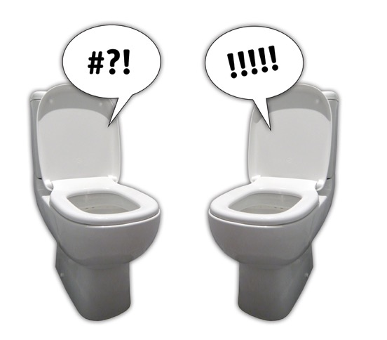
Q. What did one toilet say to another toilet?
A. You’re looking flushed!

Slide 2
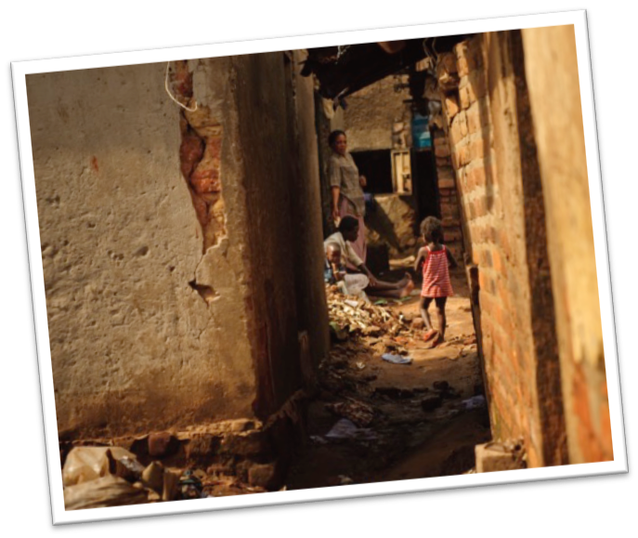
Imagine what life would be like if you didn’t have a toilet at home.
What would you do when you needed the loo?
You might have to go in your garden.
Or in a bucket in your bedroom.
What do you think your house would smell like?
Would your garden be a nice place to play?

Slide 3
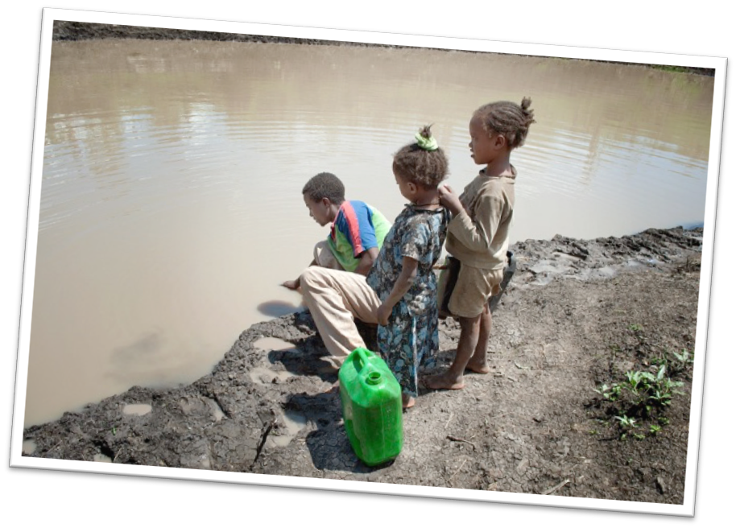
What if we didn’t have any toilets in school?
What would you do when you needed to go to the loo?
What would the school playground look like if every
child here went to the toilet outside on the ground?

Slide 4
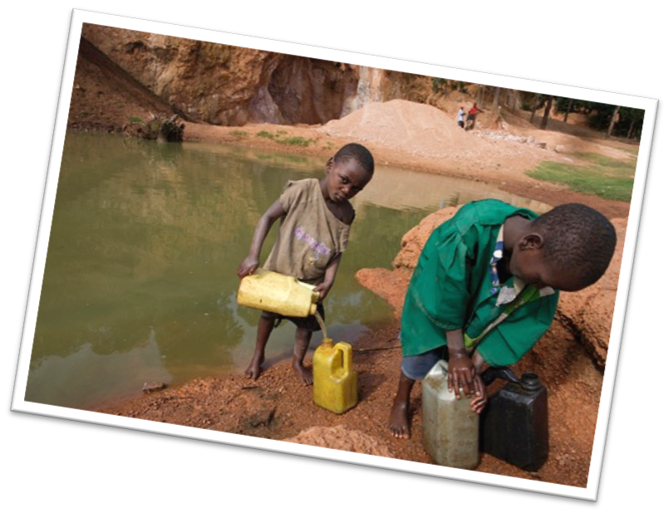
In lots of places around the world, there aren’t any toilets and so children go to the toilet in the open air.
Flies land on the waste and then land on food. This means that children get sick.
In lots of places around the world, the children have to go to the toilet in a bush or in the local river. Then they drink the dirty water and they get very poorly.
No one has ever been to their school and told them that it is really important to wash your hands with soap after using the toilet.

Slide 5
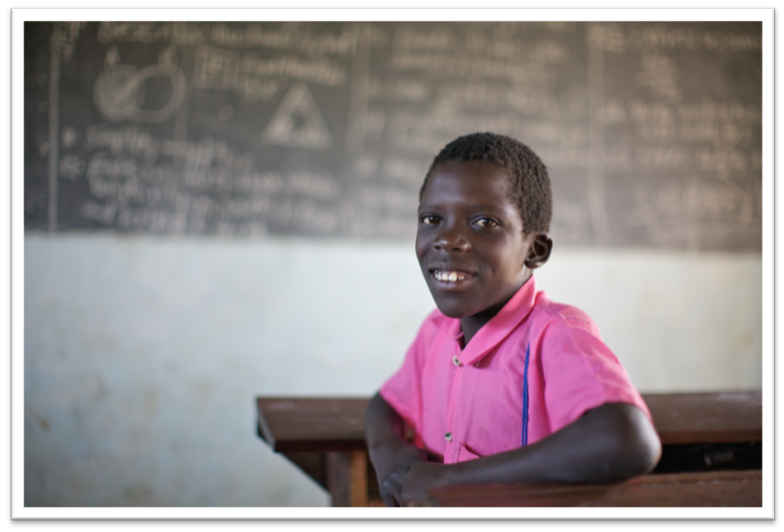
This means that often, children can’t play because they’re too sick.
They also can’t go to school and miss out on lots of learning.

Slide 6


What can we do to help?
https://www.youtube.com/watch?app=desktop&v=F6ad46JPJyQ

Slide 7
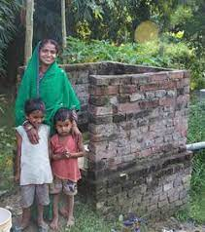
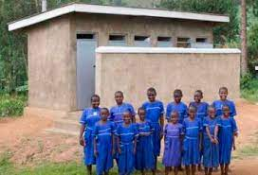
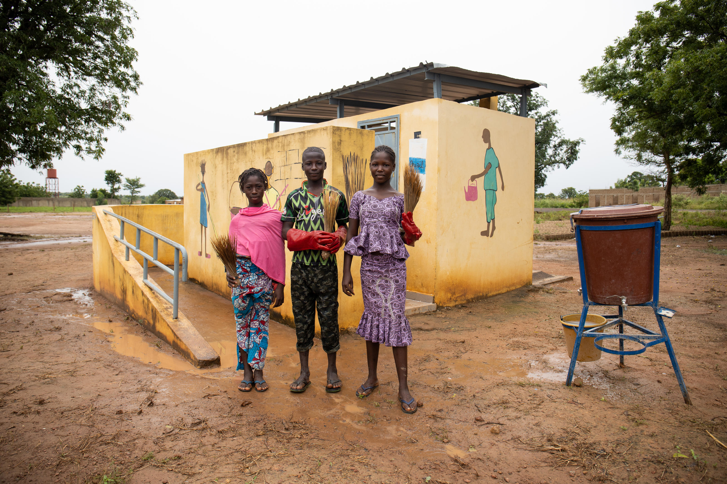
What does ‘toilet twinning’ do?
Toilet twinning will take the money that we raise and use it to help educate communities around the world about the importance of sanitation.
They teach people that they are becoming unwell because they do not have clean toilets.
Afterwards, they help these communities to build their own toilets or latrines (communal toilet).

Slide 8

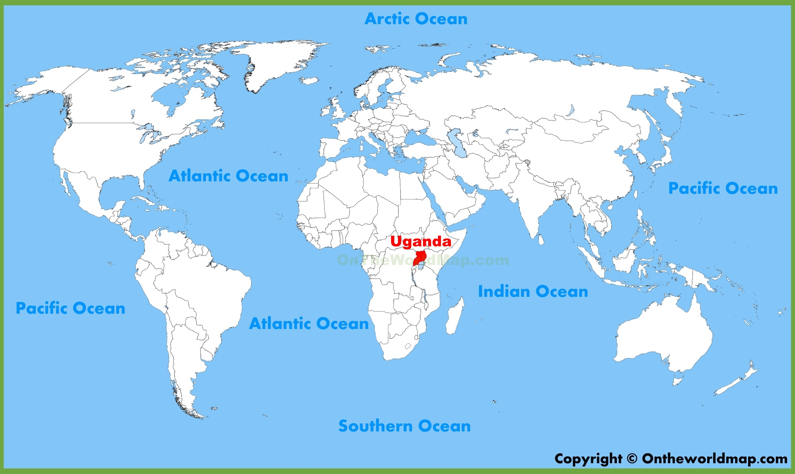
We will be twinning out toilets with a community in Uganda!

Slide 9
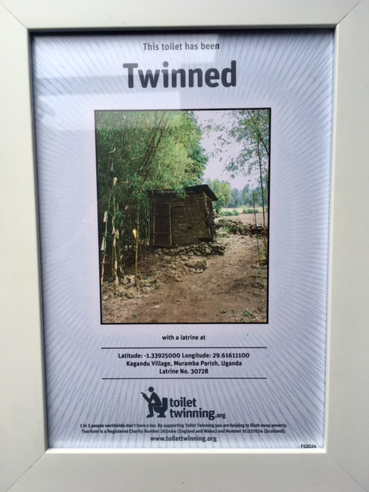
How much does it cost?
It costs £60 to twin one of our toilets with a toilet in Uganda.
We will receive a framed photo of our twinned toilet and GPS coordinates so that we can find the location on Google Maps!
But how will we raise the money?

Slide 10
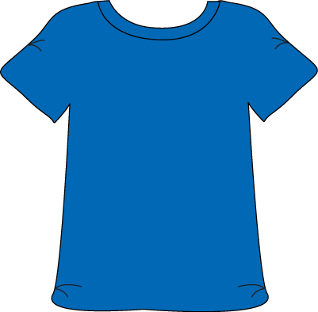


Friday 25th November - Toilet twinning day!
We will be having a non-school uniform day:
Wear blue for a loo!
We would love if everyone could bring in a £2 donation to be paid either via Parent Pay or you can bring cash on the day.
If everyone donated £2, we could raise £466!
This would be enough to fund 7 toilets in Uganda!

Slide 11


New and pre-loved book sale
After school, there will be a book sale in the playground.
Some are new and some are pre-loved and have been donated by the school community.
Come along with your adult, find a wonderful book to take home and read and give a small donation.
All donations will go towards our final total!

Slide 12
Prayer
Heavenly father,
We thank you that we are able to live in a country where people do not become ill due to poor sanitation.
We do not take for granted that some people in our global community do not have access to clean toilets and we pray that through charities like Toilet Twinning, we can ensure that all children and adults can be kept safe and healthy.
Please bless those people that work so hard to make change across the world and please support us as we begin our own fundraising efforts.
Amen.

