Slide 1
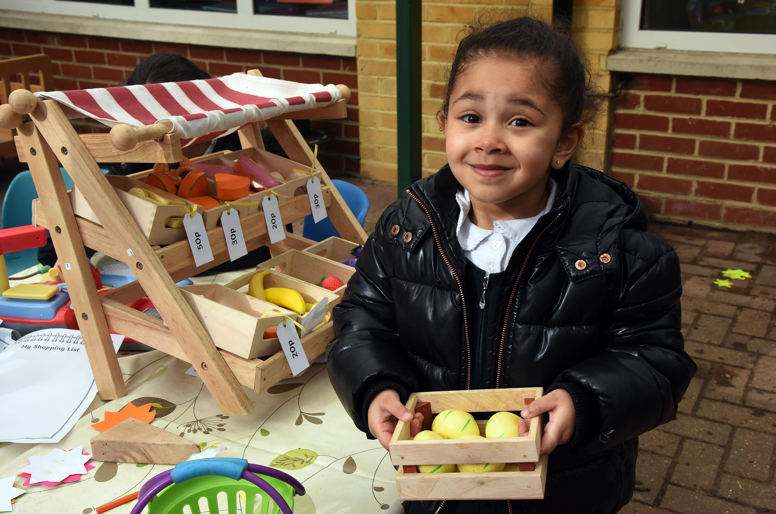
Welcome to Forty Hill C.E Primary School

Slide 2
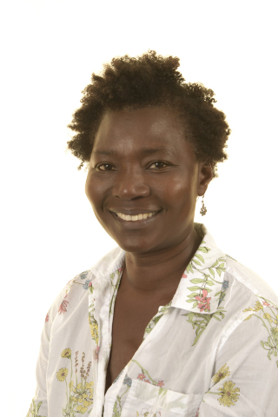
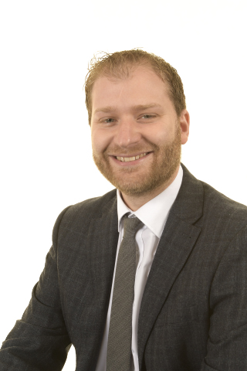
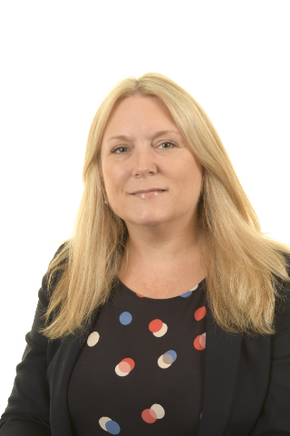
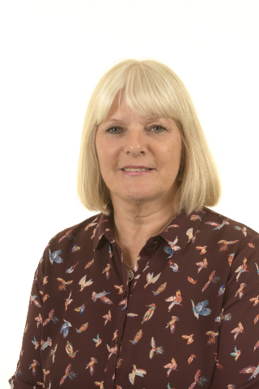
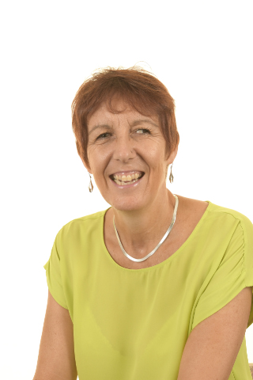
The Team
Miss Keane
Reception Class Teacher and Phase 1 Leader
Mrs Buller
Teaching Assistant
Mr Newham
Headteacher
Ms Izard
Deputy Head
And SENDCo
Mrs Vial
Welfare Officer
Mrs Allen
Office Manager

Slide 3
EYFS Curriculum
The Early Years Foundation Stage (EYFS) sets the standards that all early years providers must meet to ensure that children learn and develop well and are kept healthy and safe. It promotes teaching and learning to ensure children’s ‘school readiness’ and gives children the broad range of knowledge and skills that provide the right foundation for good future progress through school and life.
At the beginning of the year the children will have opportunities to initiate their own learning. This will help us plan through their interests and stages of development. These observations will also help assist with our assessments.
As the year progresses the amount of time children spend in child initiated play will reduce to allow for a more structured learning style to ensure they are developing skills needed to embrace the Key Stage One curriculum.

Slide 4
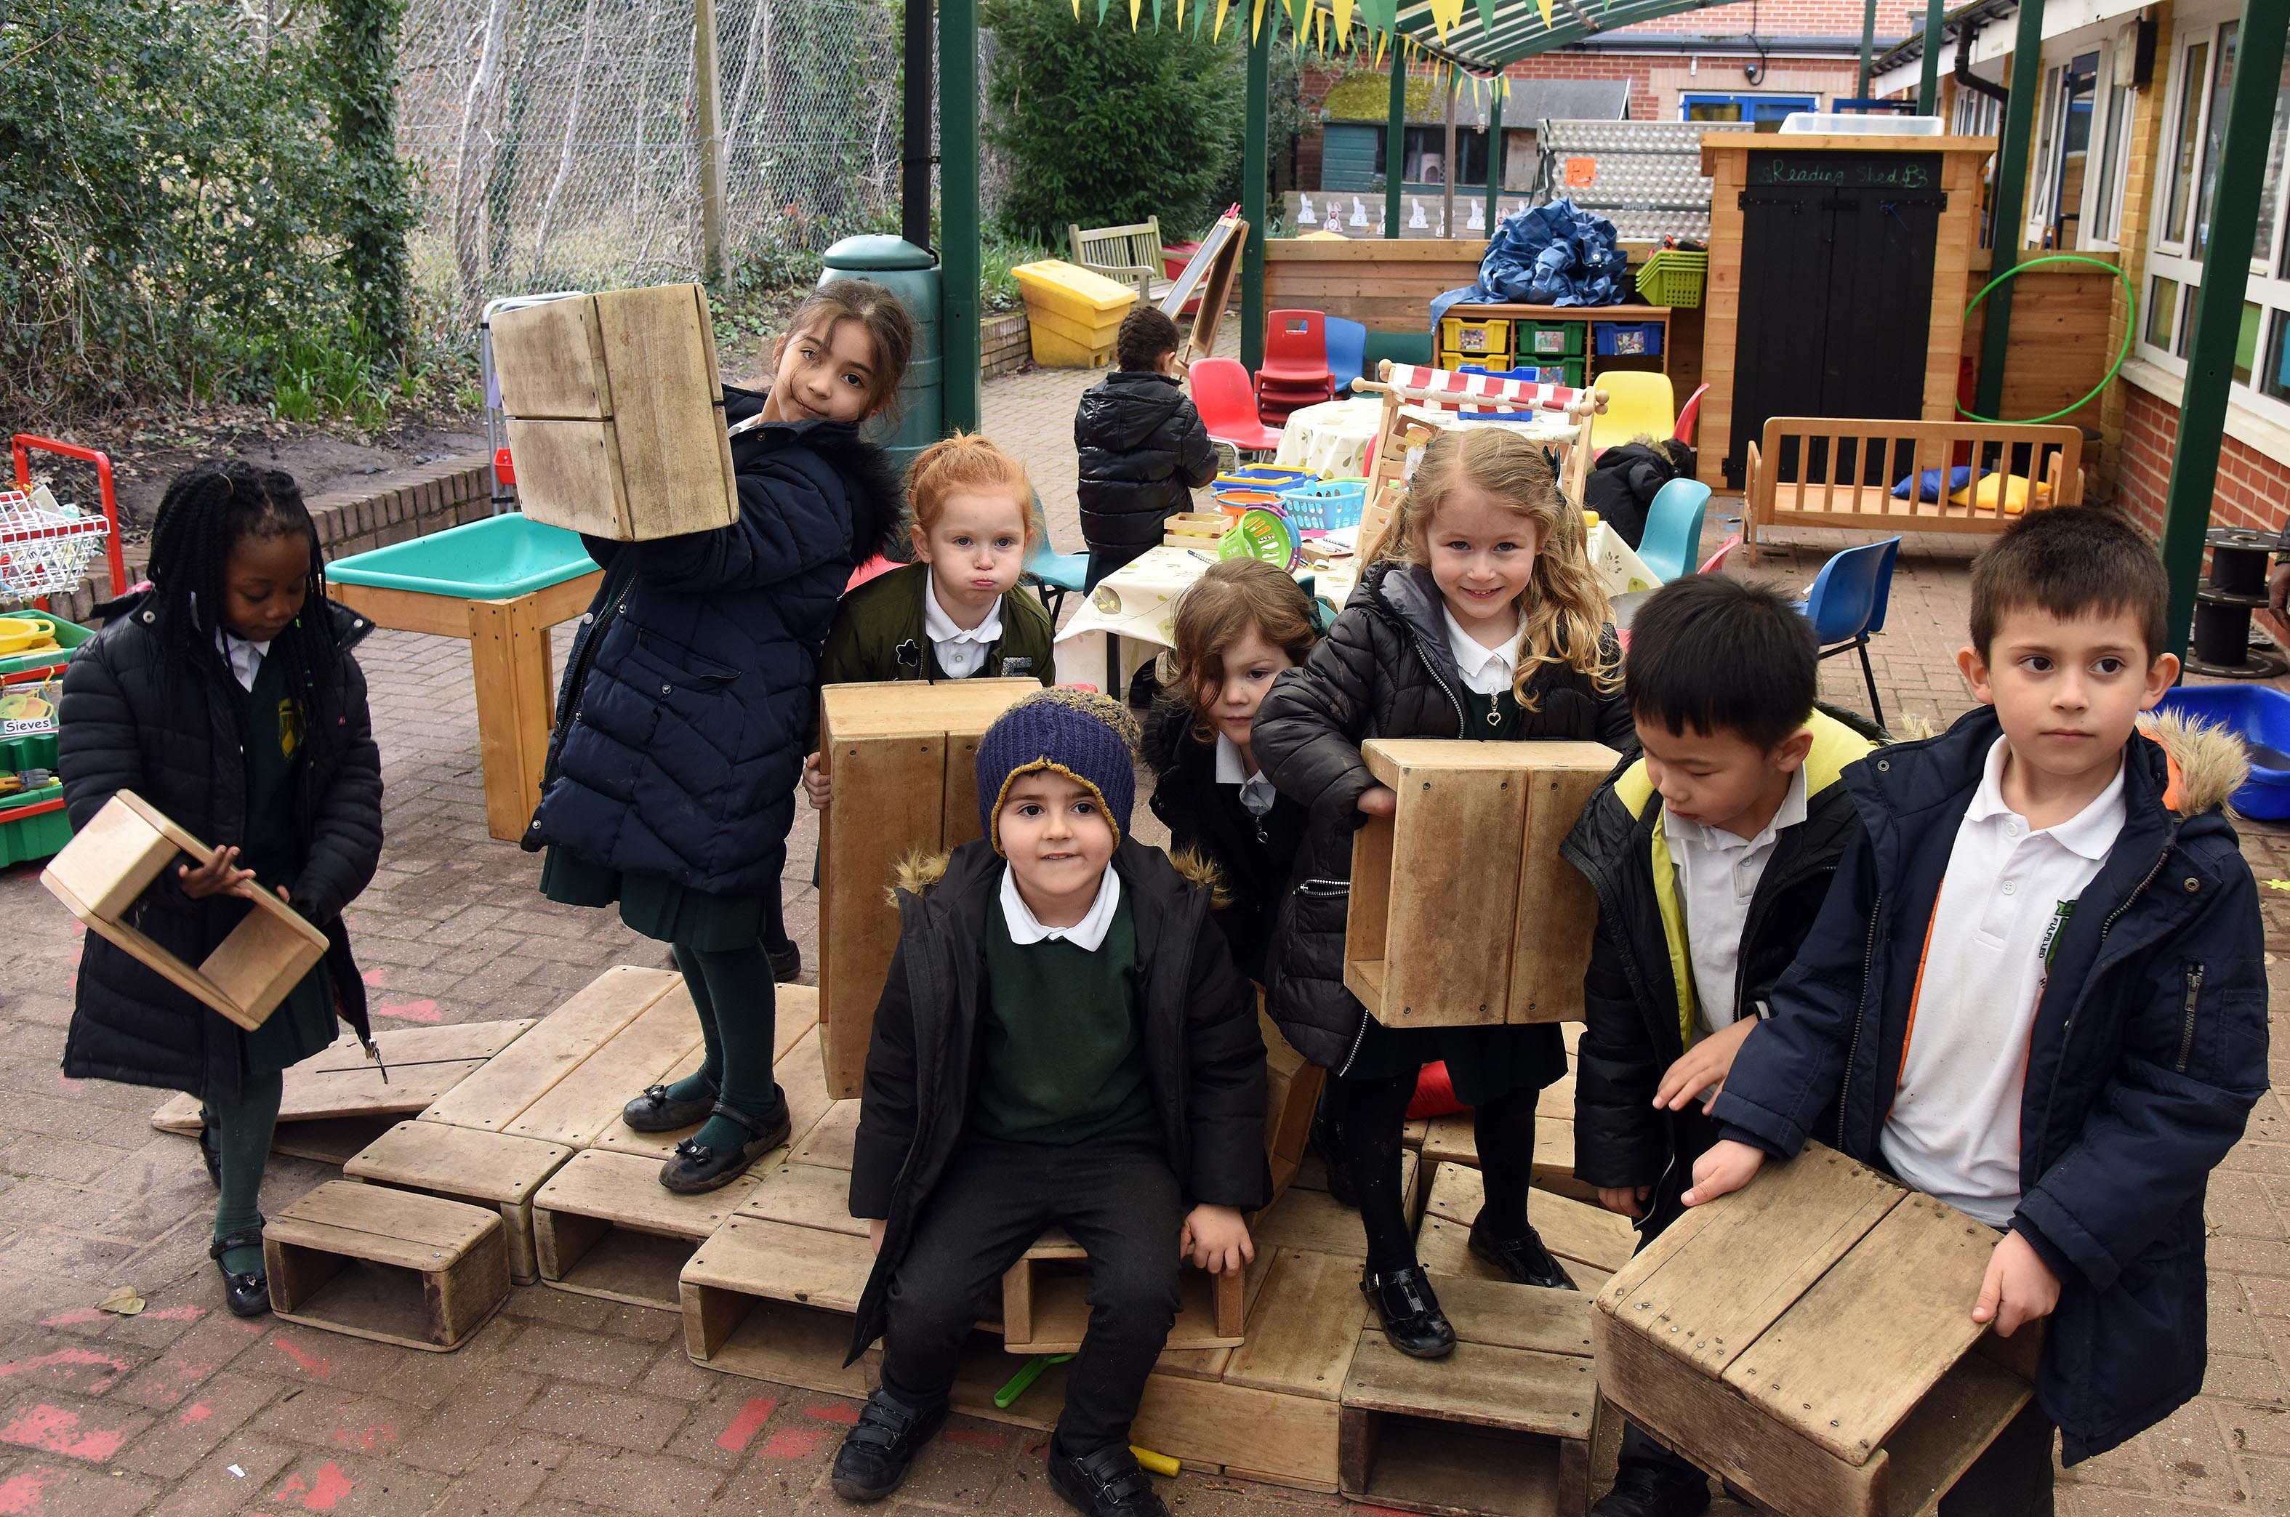
Areas of Learning
The areas of learning and development are important and interconnected.
There are seven areas of learning:
Prime areas –
Personal, Social and Emotional Development
Communication and Language
Physical Development
Specific areas –
Mathematics
Literacy
Understanding the World
Expressive Arts and Design

Slide 5
Reception School Day
*CIL = Child Initiated Learning

Slide 6
It is extremely important that standards of expectations are set from the beginning.
Please make sure your children are on time for school. Our door opens at 8.45am and registers are taken at 8.55am
However, for the first half term, please stay outside with your children until 8.55 am. The class teacher will then bring them inside all together. This gives parents an opportunity to get to know one another.
Please send your child’s book bag in everyday with their reading book and reading journal as they will be read with at school at least once a week
Read to or listen to your child read at least once every day and practise the sounds learnt
Ensure that your child is wearing the correct uniform every day

Slide 7
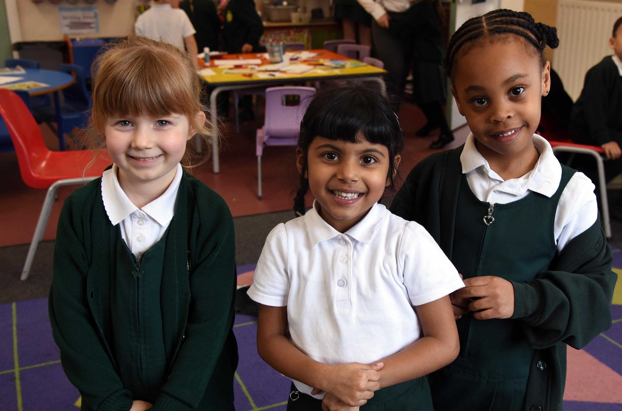
Uniform
https://www.smithsschoolwear.co.uk/
PE Kits
PE t-shirt in the treehouse colour with school’s logo -
Bottle green shorts or green jogging bottoms
Black plimsolls/trainers
PE bag with school logo – please ensure this is named
Optional: Green sweatshirt with school logo
Please ensure that all clothing is labelled with your child’s name.

Slide 8
Black plimsoles – Your child will need a pair of black plimsoles for PE. These will need to be kept in nursery, as we will also use these as a spare pair of shoes.
Book Bags - We strongly recommend that all children have a school book bag. These can be used for their reading records, story books, artwork and any letters that are sent out.
Spare Clothes – Your child will need to a spare set of clothes; these will need to be placed in a bag (not plastic) on your child’s peg.
Wellies – So that children can continue their learning outdoors, all year round, they will need a pair of wellies. These can be brought in daily, or you can leave them on our boot rack.
Water bottles – Your child will need a filled water bottle – this will need to be brought into nursery, everyday.
Jewellery - Only stud earrings are allowed to be worn to school. Bracelets, necklaces or rings are not to be worn at any time.
Hair - For safety reasons, long hair must be tied back with an appropriate fastening at all times (this applies to girls and boys). All fastenings need to be grey, black or green and should be small and indiscreet.
Toys and Sweets – Please do not allow your children to bring sweets, toys or money etc. into school.

Slide 9
The APF
We are the APF – the Association of Parents and Friends – and we are the ones who run the majority of fundraising and community events for the school. We have been an integral part of the school life for many years and managed to raise thousands of pounds which has been spent on improving equipment and resources to enhance our children’s education.
Some of the items we have managed to raise funds for and buy are:
Fully functioning Children’s Kitchen, Contribution to the Prayer Garden, Astro Turf Chairs, Books and Bibles for the school, Reception Climbing Frame and Astro, The Jungle Walk, The Outdoor Stage
Our most popular events are the Forty Hill Festival, Christmas Bazaar, our regular cake sales and school discos as well as quiz nights, pamper evenings and fashion shows!
Our reward is to see the children having fun at the events and enjoying seeing the money we raise used in the school.
You are automatically a member of the APF – so please don’t be shy and help us to help our children!

Slide 10
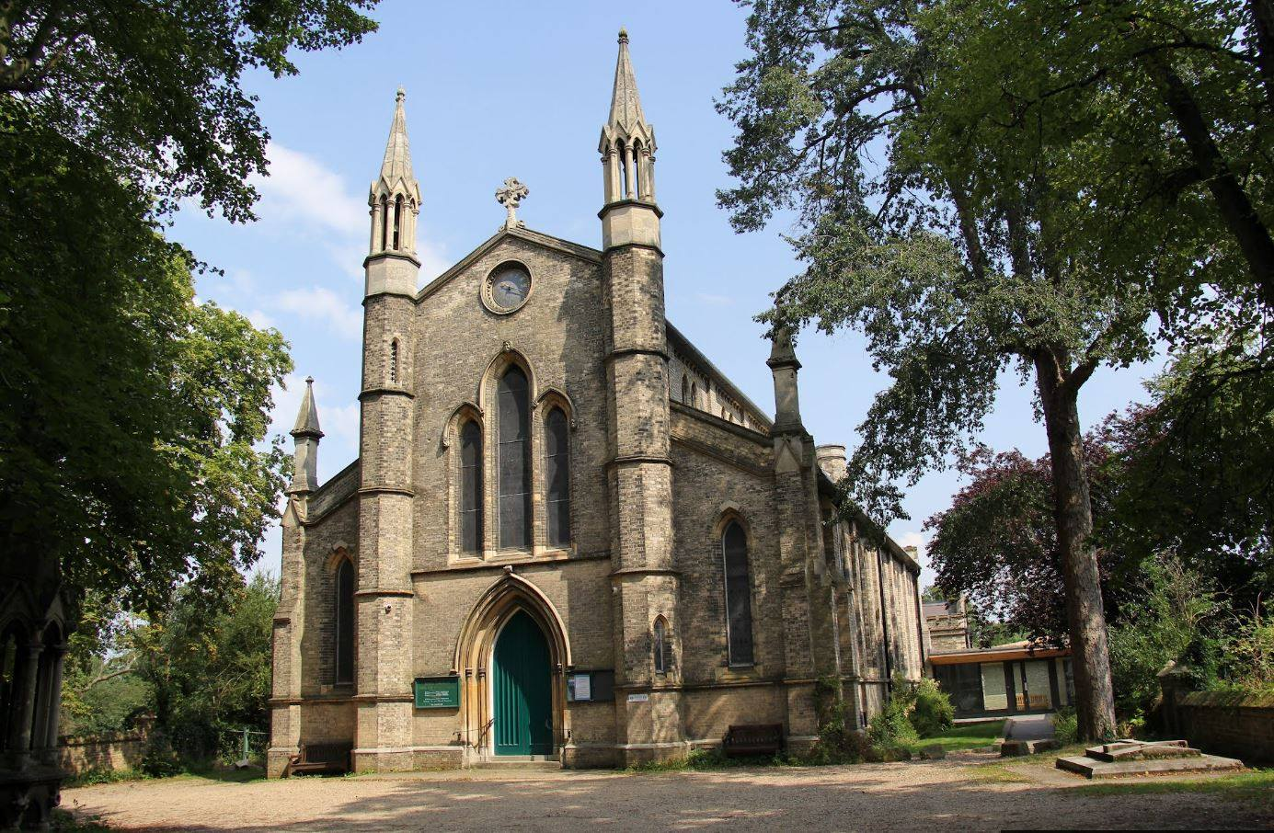
Jesus Church
We are proud to be linked to Jesus Church. Throughout our school year, we visit the church regularly to worship at festivals, as well as part of our RE learning.
Rev’d Ian Crofts leads us in an act of worship each week, focussing on our vision and values and a relevant bible story. We are also lucky enough to have him visit our classes during our Christmas and Easter Focus Weeks.
As part of our Collective Worship Programme, the school attends Jesus Church throughout the year to participate in and lead festival services.

Slide 11
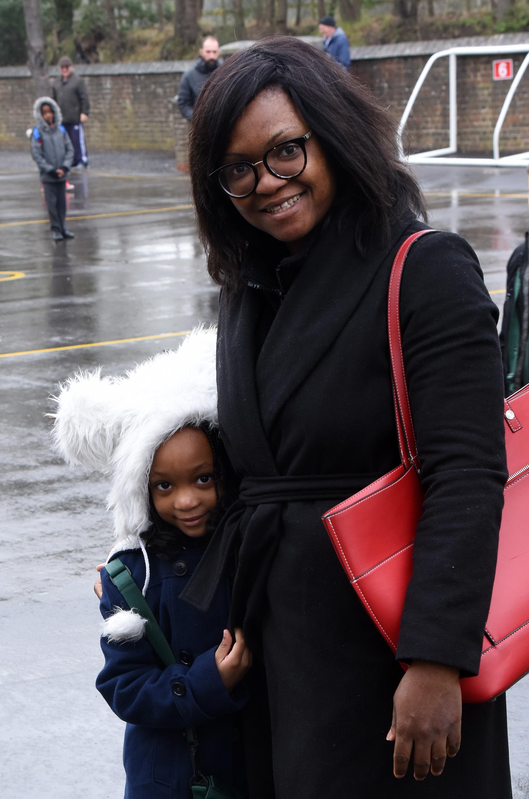
Home School Communication
Please do let us know if there is anything we can do to help you and your child settle at Forty Hill.
The best way to do this is to catch us at the end of the school day or email the school office who will arrange an appointment if it is not you who collects your child.
Whilst we encourage open communication, please avoid talking at length in the mornings as this is a very busy time for us and we need to be there for the children, in the class.

Slide 12
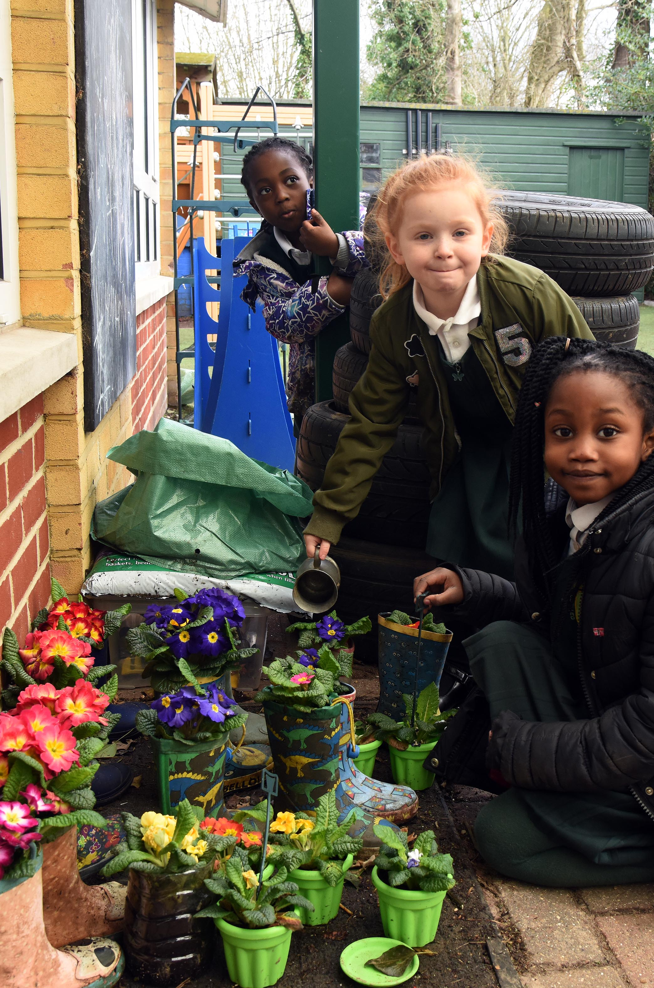
Starting School
Children will start one half day before beginning whole days. This will be from 9am to 12pm, from Monday 14th September. Your child’s individual start date will be in your packs.
The children will be split into groups of 10 and a new group of children will start every 2-3 days.
The rationale behind this is that children will have an opportunity to settle in small groups, which will allow children to get to know one another and become familiar with the school and the staff.

Slide 13
Tapestry
Tapestry is an online educational package that records children’s learning in the early years. It is a secure system where filenames are encoded for uploaded images and videos that make it a safe online learning journal tool.
Tapestry allows parents to access their child’s journal, so parents can see their child’s learning and progression. Parents are also able to upload pictures and videos of their child at home.
As well as teaching, observing children’s play is an important part of early years education. It allows us to gain insight into pupil’s understanding and helps us to extend and move pupils on. Observations are also used to inform planning and assess individual children.
We aim to observe every child at least once a week.
Observations will be conducted by staff working with the children. Staff will make comments based on what your child is doing and saying. They are made in the moment, so please forgive us if there is a typing error!

Slide 14
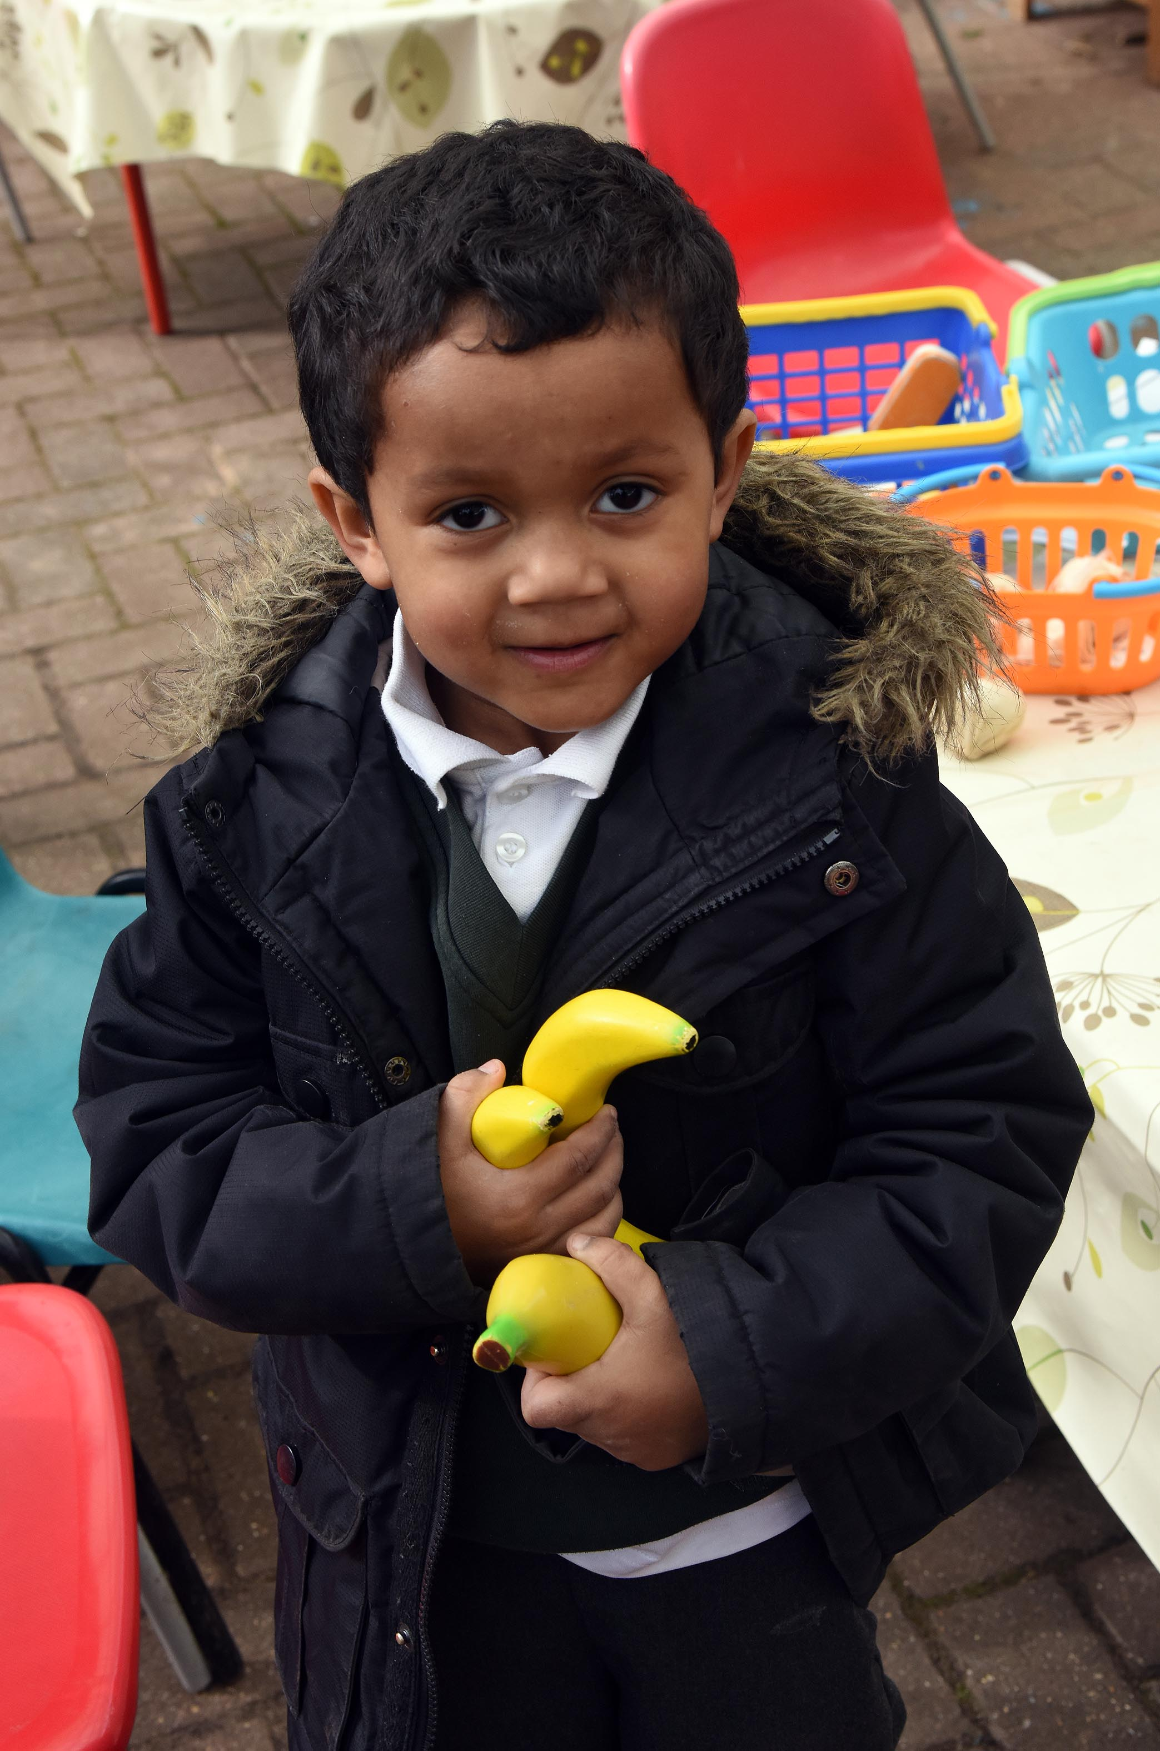
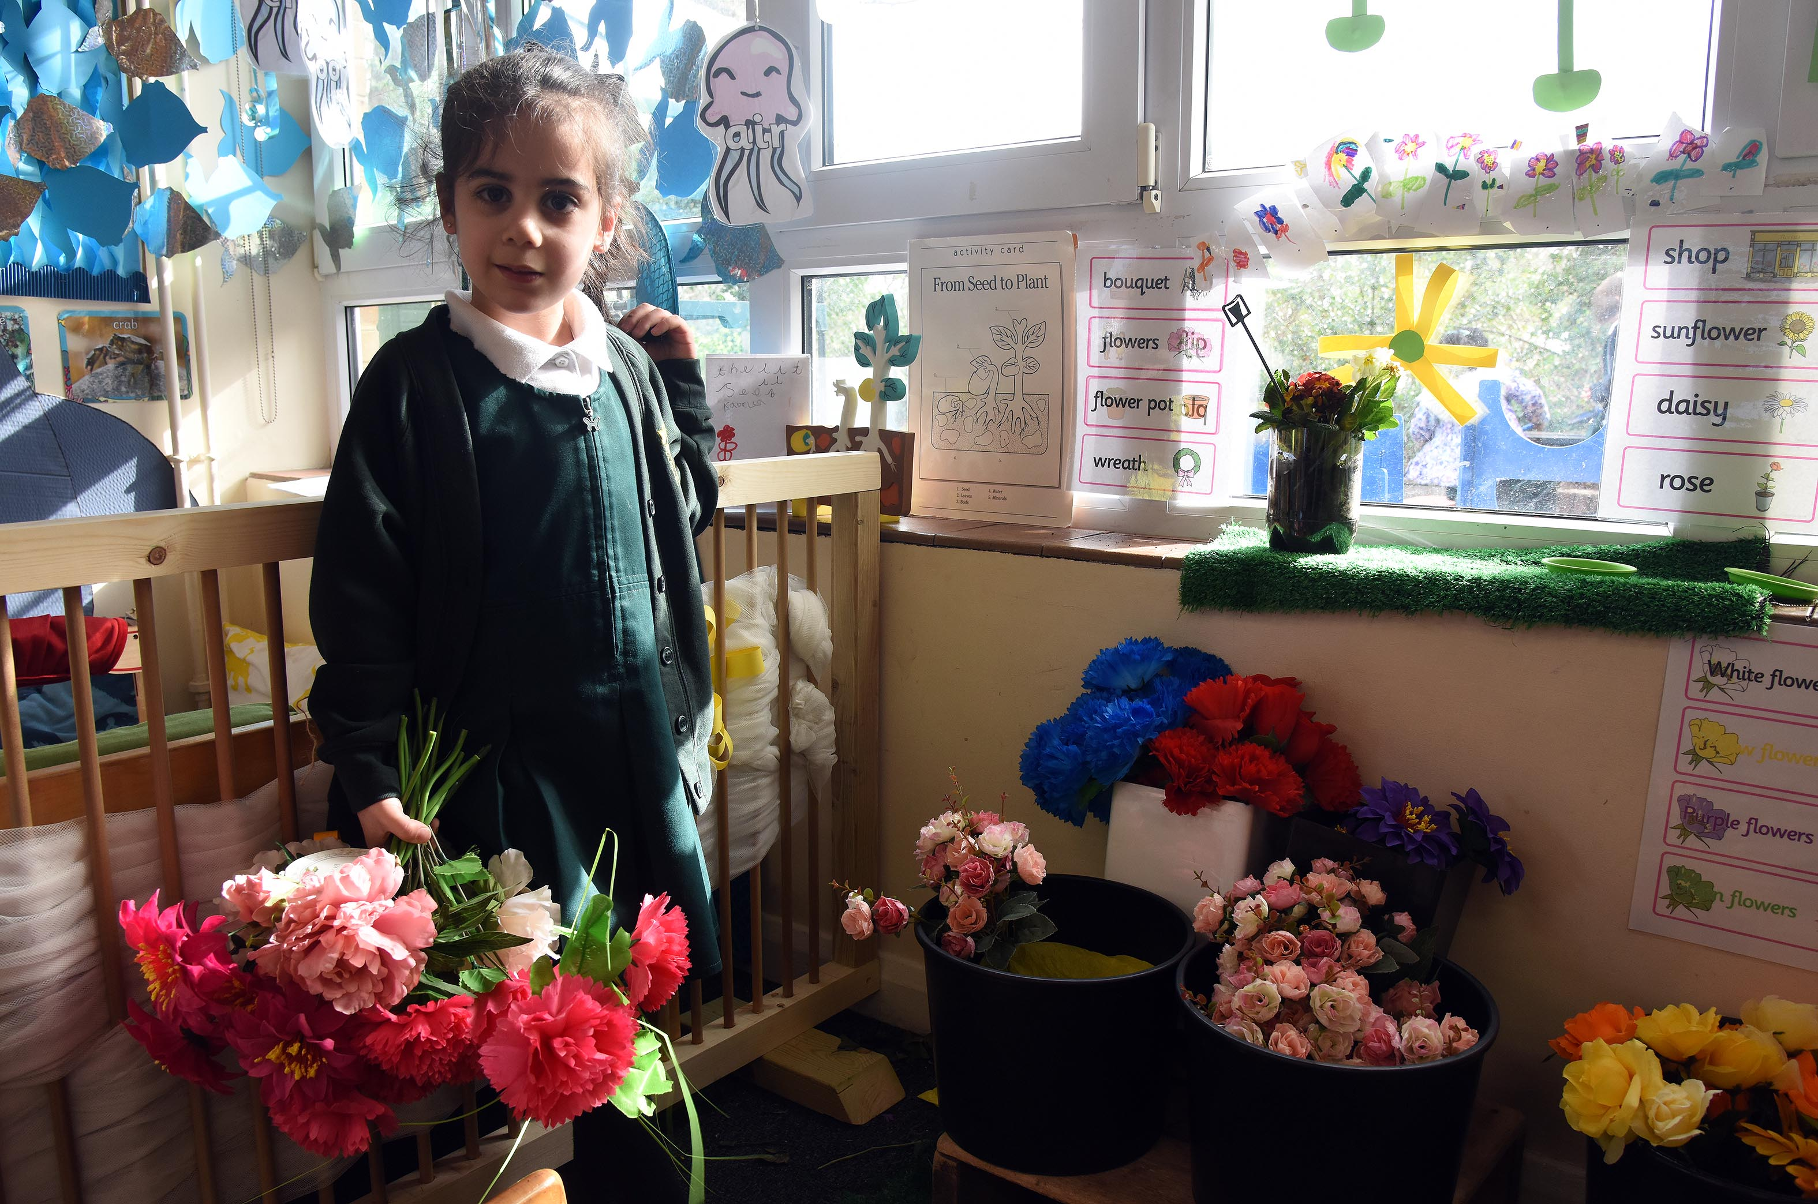
Any Questions?
Please email office@fortyhill.enfield.sch.uk and we will answer your emails, as soon as we can.

